Slide 1


AP BIO
TOPIC 6.6:
Gene Expression and Cell Specialization

Slide 2
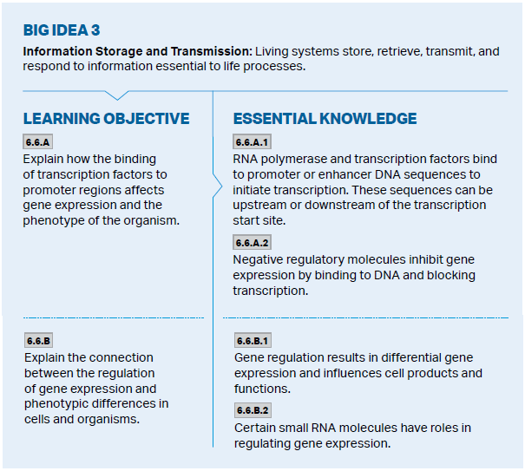
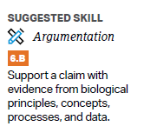
Objectives

Slide 3
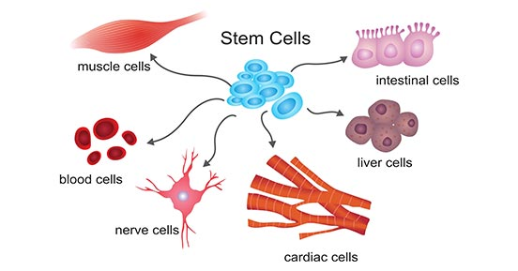
Differential Gene Expression
Differential gene expression – the expression of different genes by cells with the same genome, influencing cell products and function

Slide 4
Transcription Factors and Gene Expression
Transcription binding to enhancer sequences can initiate transcription, while negative regulatory molecules inhibit transcription
Different genes expressed -> different proteins produced -> different structure and function of the cell
Regulatory molecules also exist in prokaryotes, not transcription factors

Slide 5
Small RNAs and Gene Expression
Small RNAs can also regulate gene expression
microRNA -> miRNA and small interfering -> siRNA can bind to mRNA and degrade the mRNA or block its translation
RNA interference – impacts post transcription

Slide 6
Gene Expression and Cell Specialization Review
How gene expression results in cell specialization
Transcription factors, regulatory molecules, and small RNAs all influence gene expression

