Slide 1


AP BIO
TOPIC 6.7:
Mutations

Slide 2
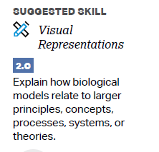
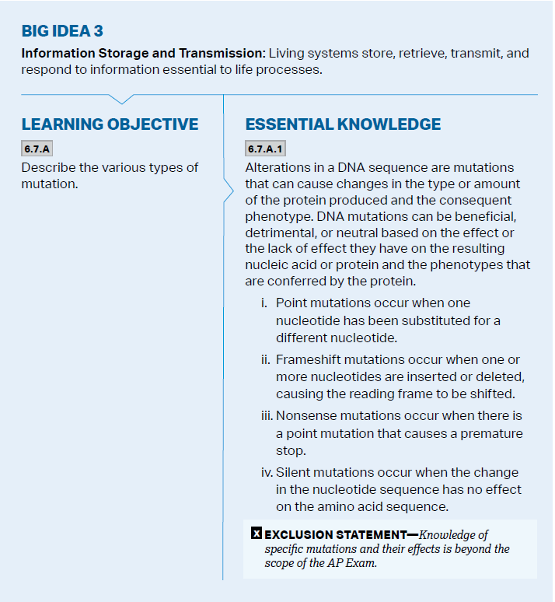
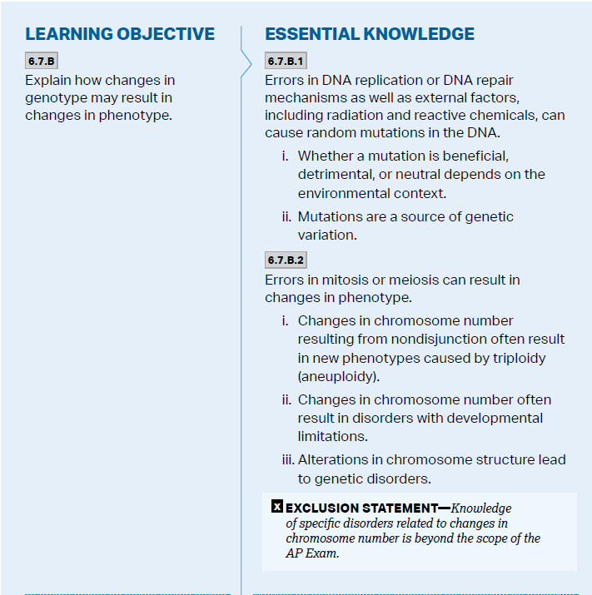
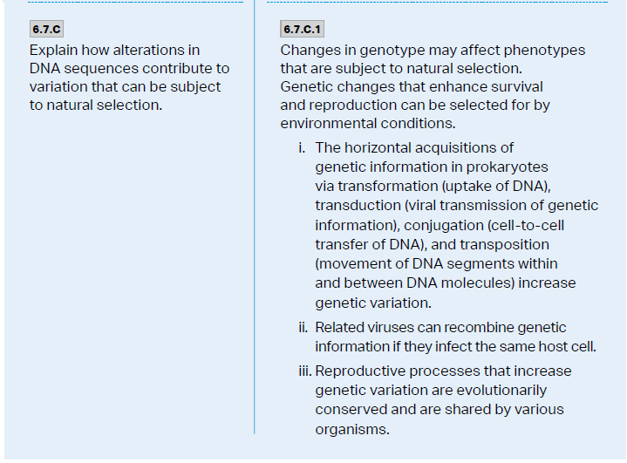
Objectives

Slide 3
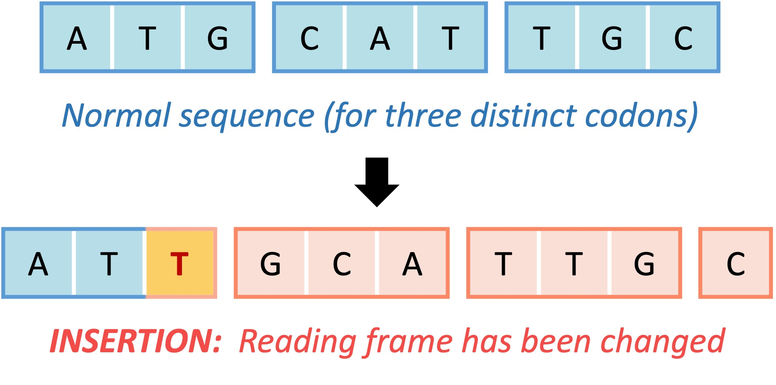
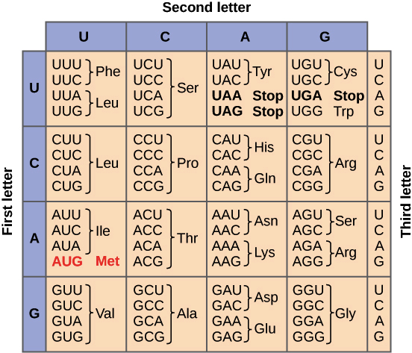
Point Mutations
Mutation – random alterations in a DNA sequence – can affect changes in the amount/type of a protein produced, altering phenotype
Point mutation – alterations of just 1 nucleotide base pair (substitution)
Insertion/deletion – addition or loss of nucleotide pairs -> Frameshift mutation – mutation that interferes with the codon groupings
Nonsense mutation – causes premature stop codon
Silent mutation – no effect on the resulting protein
Notes:
UAC GUA ACG
AUG CAU UGC
Met (start) His Cys
UAA CGU AAC
AUU GCA UUG
Ile Ala Leu

Slide 4
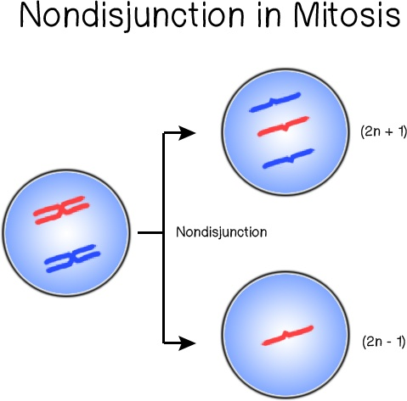
Causes of Mutations
Mutagens – substances that interact with DNA in ways that cause mutations
Radiation
Errors in DNA replication, DNA repair, cell cycle can cause mutations
Alteration in chromosome structure leads to genetic disorders
Changes in chromosome number due to nondisjunction leads to changes in phenotype/genetic disorders (aneuploidy) – Down Syndrome

Slide 5
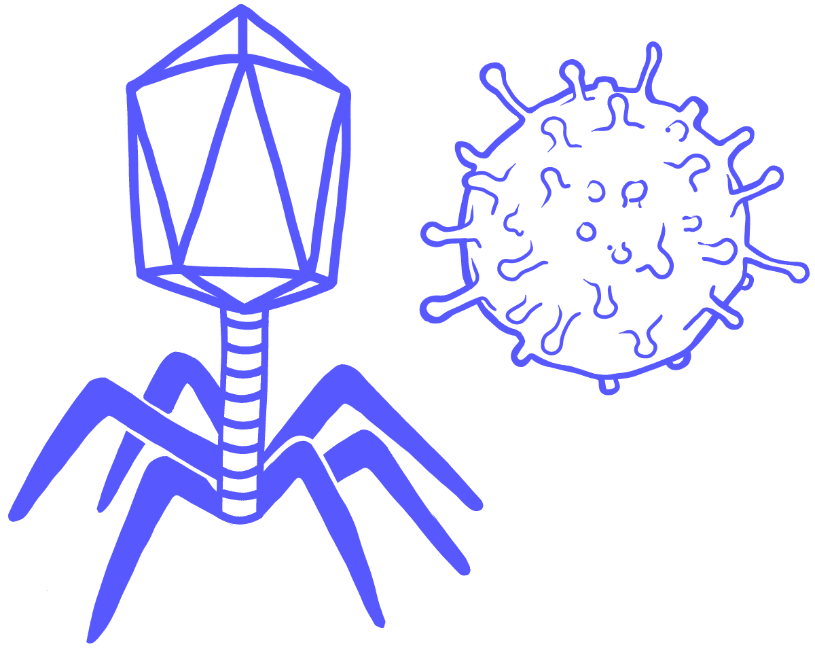
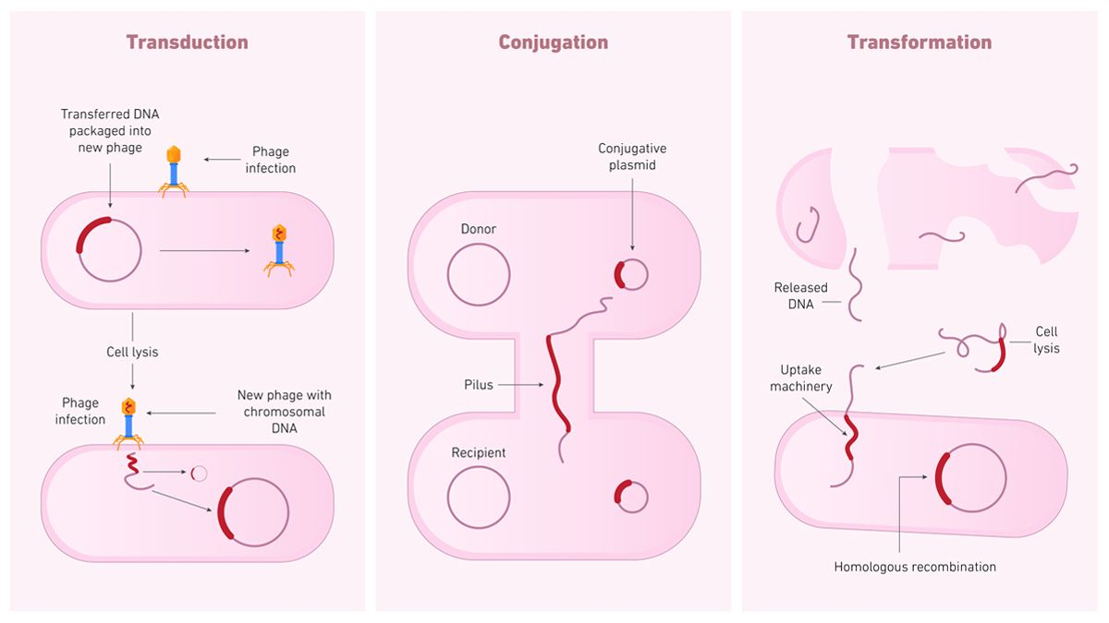
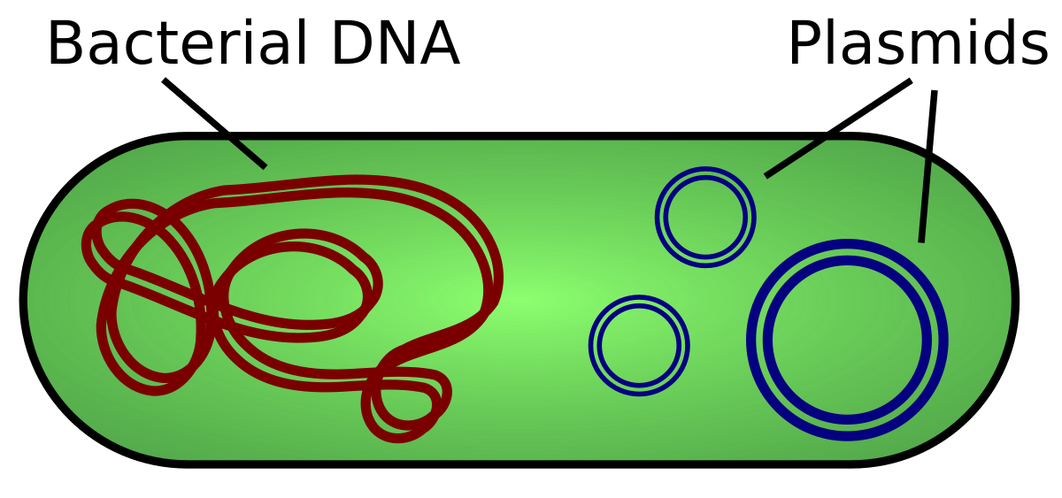
Horizontal Gene Acquisition
Prokaryotic gene acquisition
Transformation – takes in DNA (plasmid) and adds it to genome
Transduction – takes in viral DNA and adds it to genome – related viruses can recombine DNA if they infect the same host cell
Virus - an infectious agent that replicates only inside the living cells of an organism
Conjugation – transfers DNA through cell-cell connection
Transposition – movement of DNA segments between DNA molecules

Slide 6
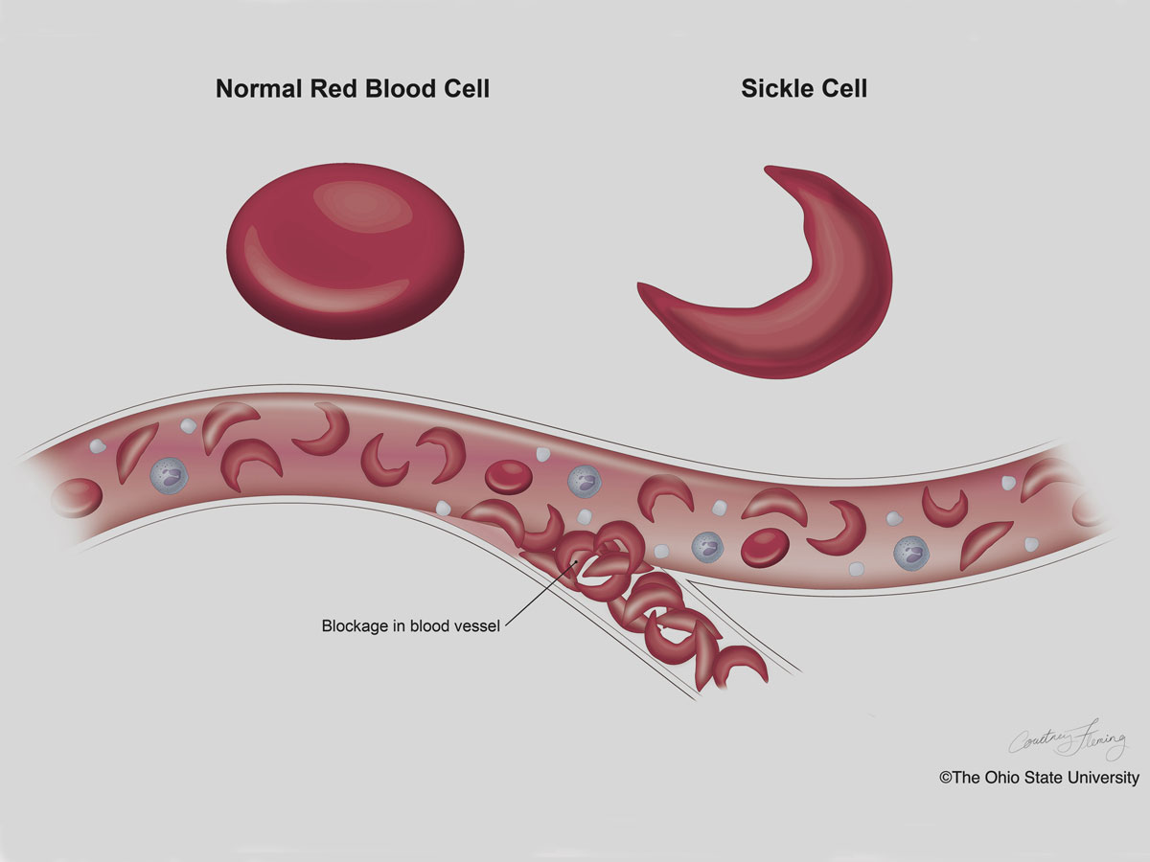
Mutations and Genetic Variation
Mutations can be beneficial, detrimental, or neutral depending on the environment – not all mutations are bad!
Passed down when they are useful to the organism to surviving in the environment – sickle cell anemia
Mutations are the primary source of genetic variation

Slide 7
Mutations Review
Point, frameshift, nonsense, silent mutations
Causes of mutations
Transformation, transduction, conjugation, transposition

