Slide 1


AP BIO
TOPIC 6.8:
Biotechnology

Slide 2
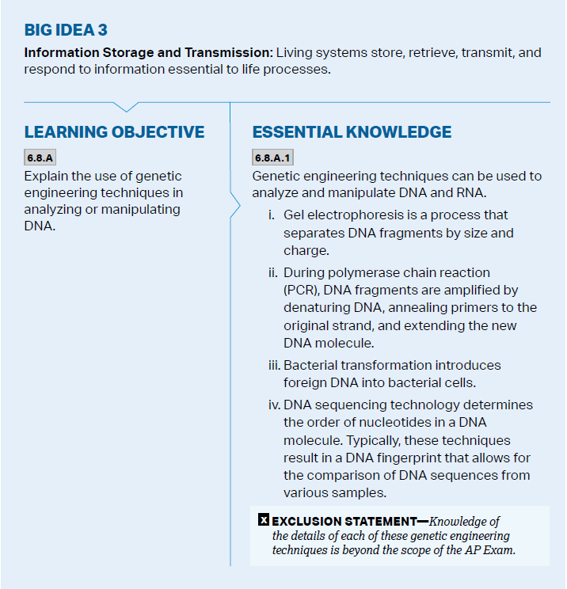
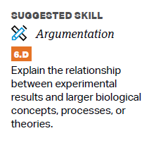
Objectives

Slide 3
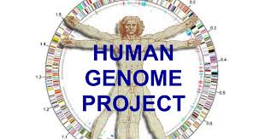
Biotechnology
Biotechnology – the process of manipulating organisms for the purpose of making useful products
DNA sequencing – used to determine the complete nucleotide sequence of a DNA molecule using base pairing
Allows for comparison of DNA between species
Humans and potatoes share 50% of their genomes

Slide 4
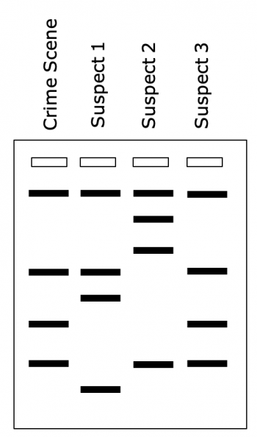
Gel Electrophoresis
Gel electrophoresis – a lab technique used to separate DNA
DNA is placed in small depressions in a gel matrix that allows small molecules to move through it
An electric current is applied to the field – DNA is negatively charged and will migrate to the positive end of the field (smaller fragments move the fastest)
Difference in banding patterns allows for diagnosis of disease, paternity

Slide 5
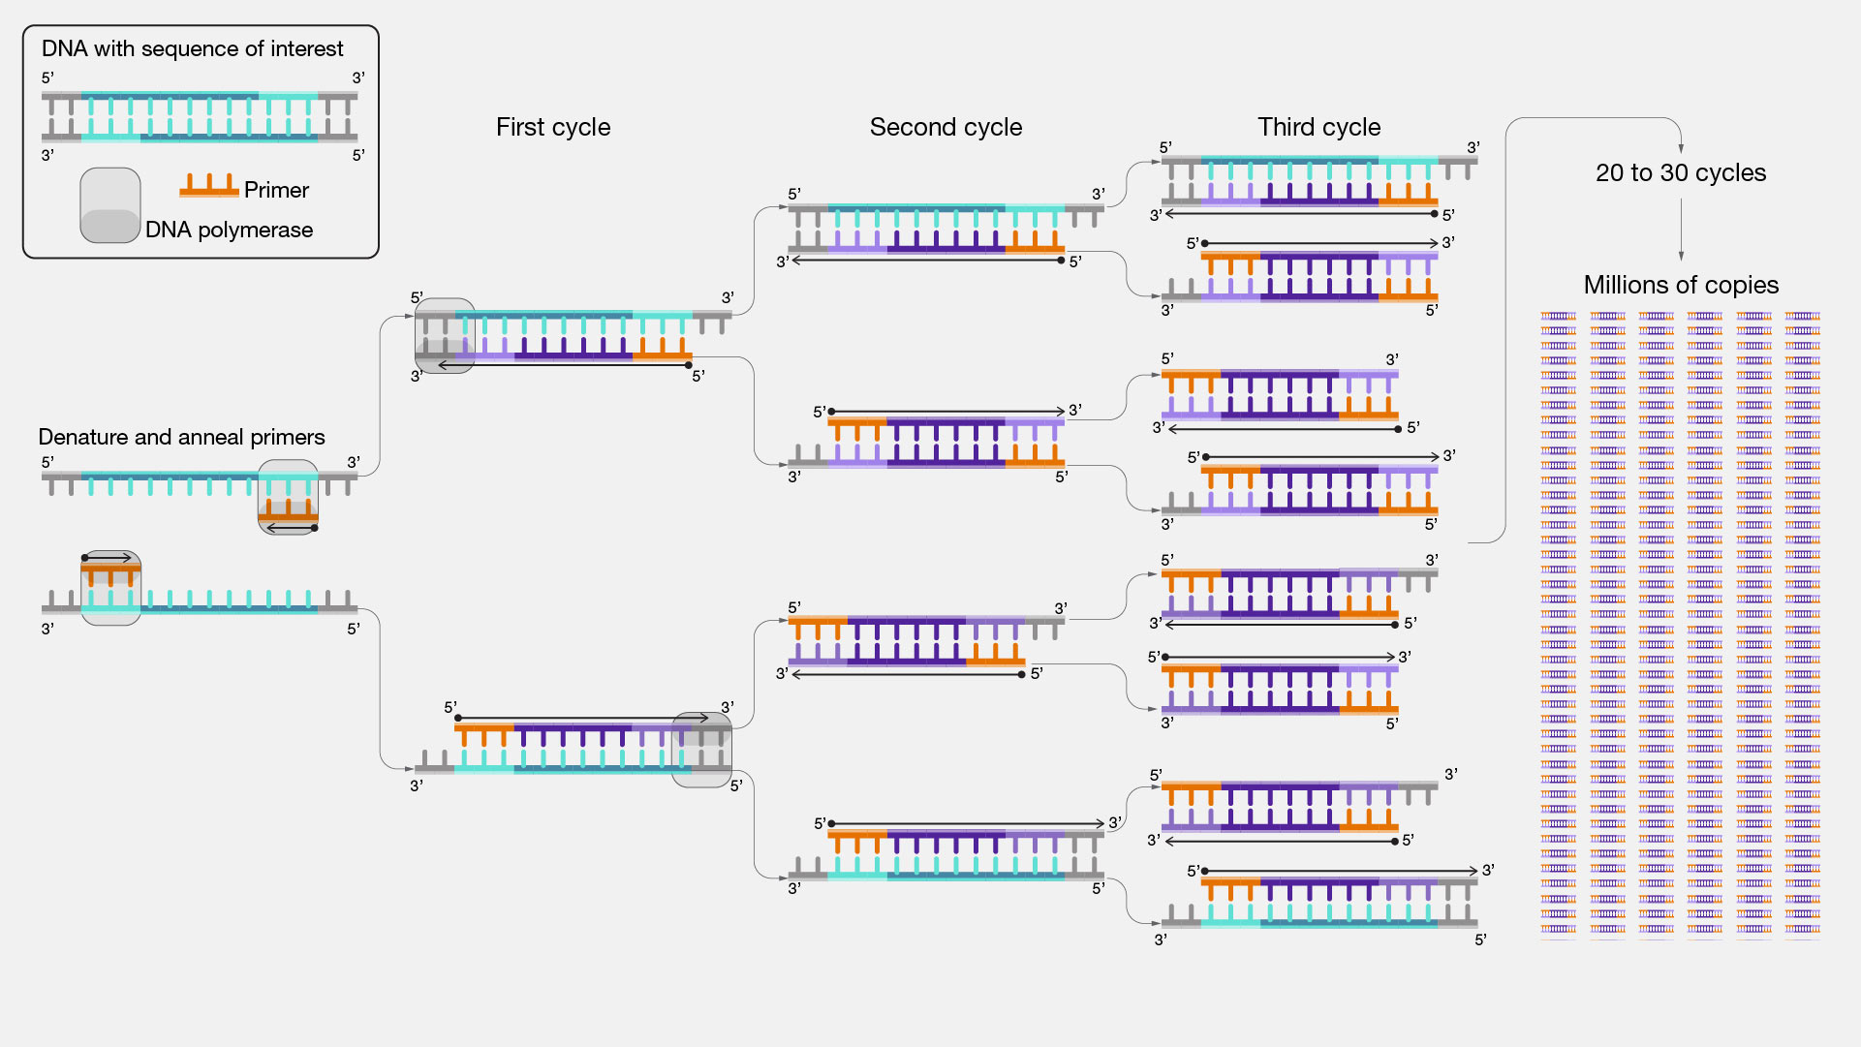
PCR
Polymerase chain reaction – amplifies a piece of DNA without using cells
Quickly heat to denature and separate DNA strands
Allow cooling for primers to attach
DNA polymerase adds nucleotides to the 3’ end of the primer -> a bunch of identical DNA molecules

Slide 6
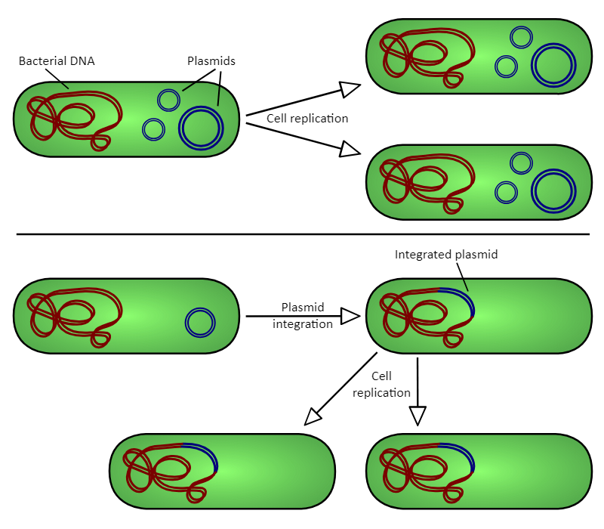
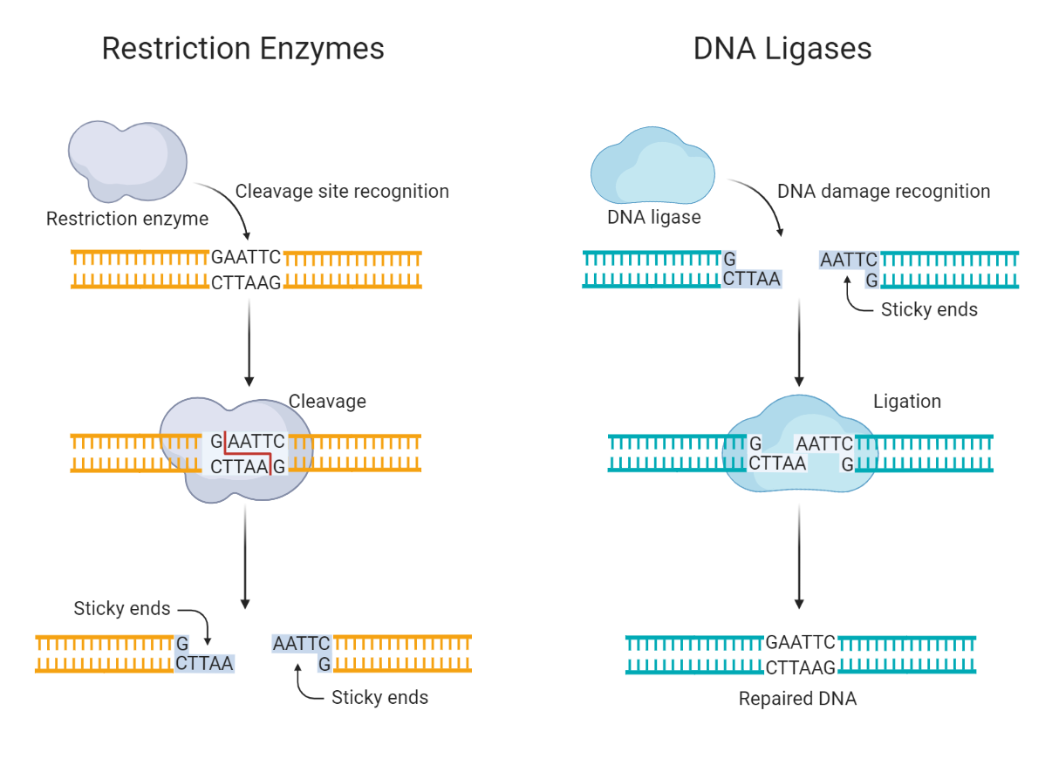
Recombinant DNA and Gene Cloning
Recombinant DNA – artificially made DNA using DNA from different sources
Introducing human genes into bacteria
Gene cloning – process by which scientists can produce multiple copies of specific segments of DNA – turn the gene into a plasmid, enter it into bacteria, bacteria reproduces faster
Restriction enzymes (CRISPR-Cas9) cut DNA at a specific location -> restriction fragments, one single stranded end will be “sticky” – can bond to complementary strands using ligase
Notes:
Plasmid – small, circular, extrachromosomal loop of DNA

Slide 7
Biotechnology Review
1. Methods and benefits of dealing with DNA using biotechnology

