Slide 1


AP BIO
TOPIC 7.10:
Speciation

Slide 2
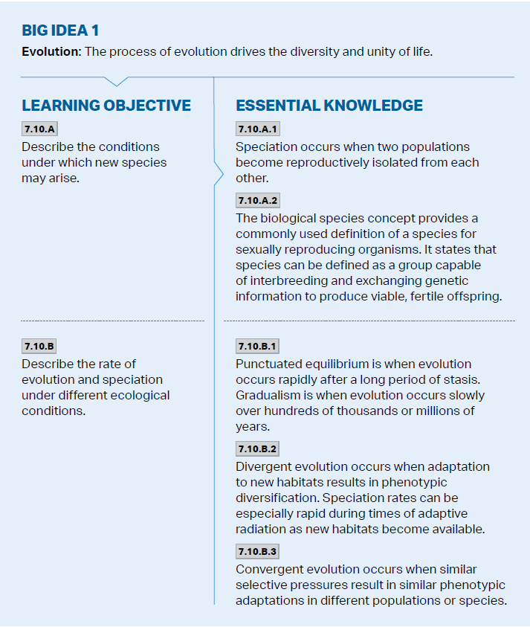
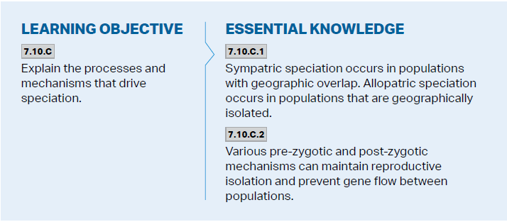
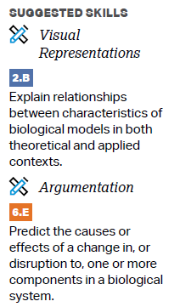
Objectives

Slide 3
Overview of Speciation
Speciation – the process by which one species splits into multiple species
Species – a group of population whose members have the potential to breed and produce viable, fertile offspring
Speciation is focused on reproductive isolation – biological barriers that prevent members of 2 species from producing hybrids

Slide 4

Prezygotic Barriers
Prezygotic barriers prevent mating or hinder fertilization
Habitat isolation (location) -> no reproduction
Behavioral isolation (signals) -> no reproduction
Temporal isolation (time) -> no reproduction
Mechanical isolation (anatomy) -> no reproduction
Gametic isolation (zygote) -> no zygote

Slide 5
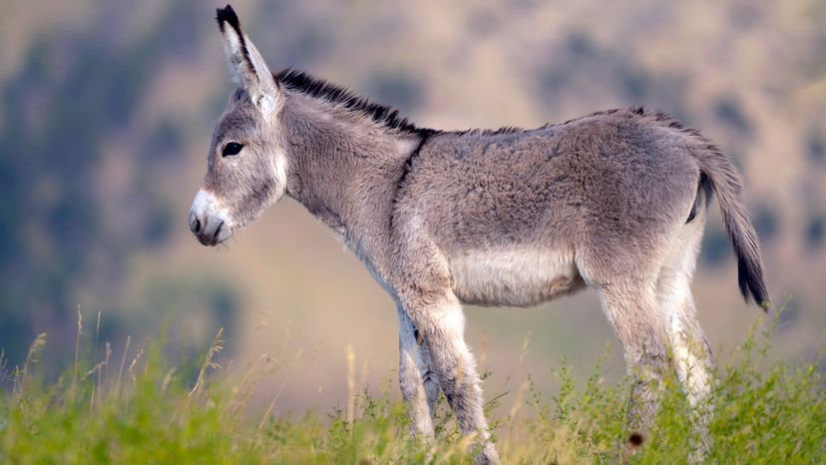
Postzygotic Barriers
Postzygotic barriers prevent the zygote from being viable or fertile
Reduced hybrid viability – development ceases
Reduced hybrid fertility – offspring is sterile
Hybrid breakdown – offspring of hybrids are weak/sterile

Slide 6
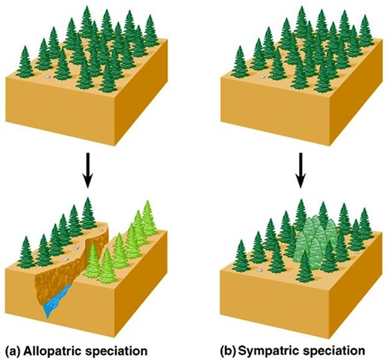
Types of Speciation
Allopatric Speciation | Sympatric Speciation
Geographical Isolation – interrupts gene flow | Behavioral Isolation
Newly isolated populations – more altering of gene pools, geographic occurrences | Sexual selection/ part of pop switching habitat, change in resource
Slow | Fast
Natural selection occurs (selection against hybrids) -> speciation | Polyploidy in plants (nondisjunction of chromosomes) -> cannot breed with diploid members and produce fertile offspring
Hybrid zones – places where species can meet, not complete barrier -> reinforce barrier, species fuse, or stabilize hybrids

Slide 7
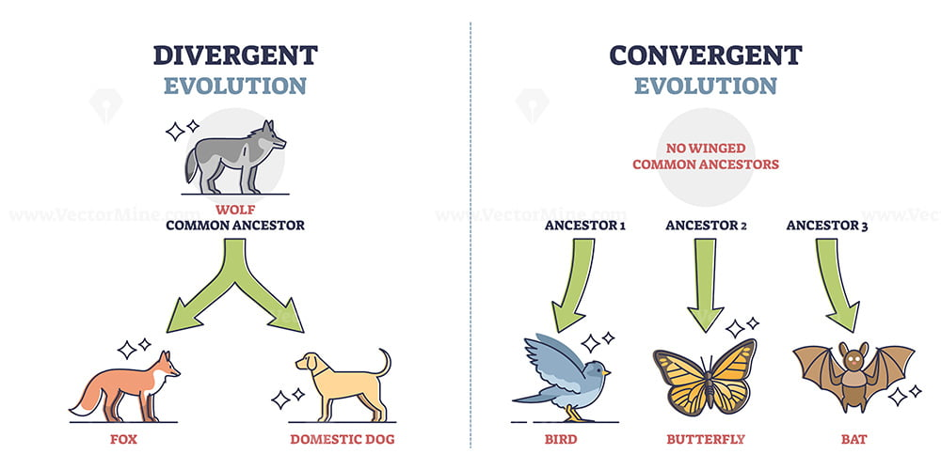
Rates of Evolution and Speciation
Divergent evolution – adaptation to new habitats results in phenotypic diversification -> speciation
Adaptive radiation – many new species arise from a single common ancestor due to many new niches available to be filled (like after an extinction) – speeds up speciation
Punctuated equilibrium – periods of stasis followed by sudden change
Gradualism – gradual evolution over time
Compares to convergent evolution

Slide 8
Speciation Review
Reproductive barriers
Allopatric and sympatric speciation
Rates of speciation

