Slide 1


AP BIO
TOPIC 7.12:
Origins of Life on Earth

Slide 2
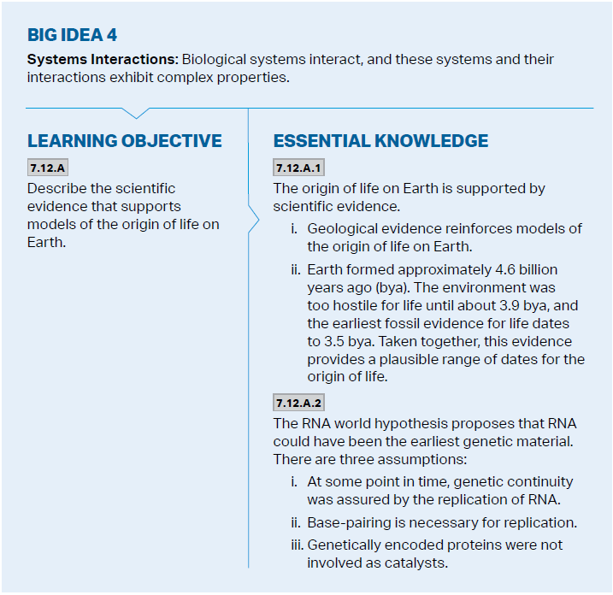
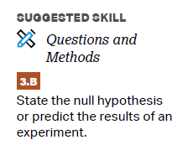
Objectives

Slide 3
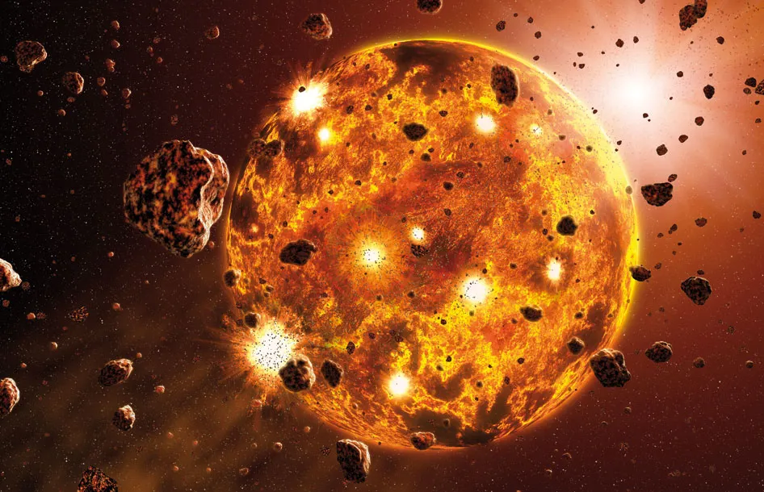
The Origins of Life
Earth formed approximately 4.6 billion years ago, the environment was too hostile for life 3.9 billion years ago, and life first appeared 3.5 billion years ago – appearance of water (prokaryotes)
Evidence using geological data (dating of the fossil record) – radiometric dating – uses the rate of decay of radioactive isotopes to determine age of rocks
Oxygen accumulation 2.7 billion years ago through photosynthesis allowed for respiration, and eukaryotes appeared 2.1 billion years ago

Slide 4
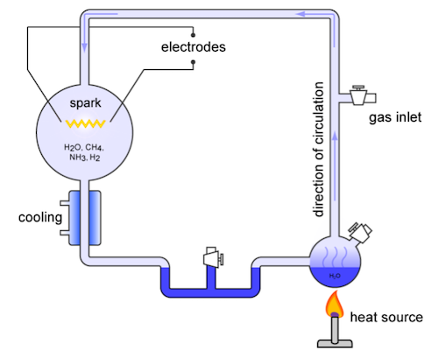
Models for the Origins of Life
Oparin-Haldane Hypothesis – inorganic compounds, energized by lightning or UV radiation, developed organic compounds
Urey-Miller Experiment – showed that macromolecules can be formed from inorganic compounds, but different atmospheric conditions
CHONP rule
Atmosphere had a lot of energy, little oxygen – reducing environment
Meteorites may have transported organic compounds

Slide 5
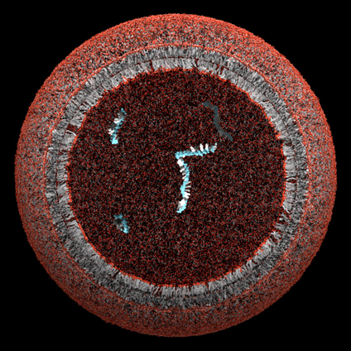
How Life Arose
Experiments suggest spontaneous creation of polymers from monomers
Inorganic molecules -> organic monomers -> organic polymers -> Protocells (membrane – differing internal and external environments) -> self replication

Slide 6
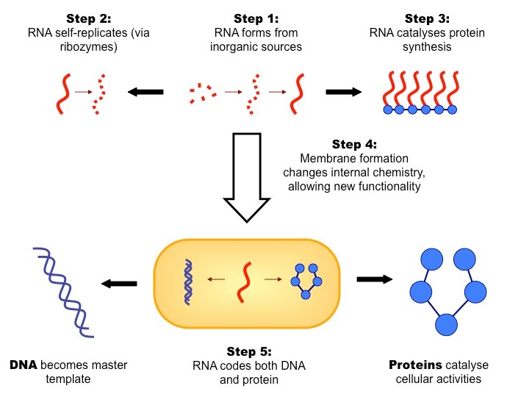
RNA World Hypothesis
RNA World Hypothesis – RNA could have been earliest genetic material – catalyzes protein synthesis
Genetic continuity assured by RNA replication – ribozymes (RNA catalysts) allow for RNA self replication
No protein enzymes used

Slide 7
Origins of Life on Earth Review
Urey-Miller experiment and models for organic compound creation
Protocells and how life arose
RNA World Hypothesis

