Slide 1


AP BIO
TOPIC 7.2:
Natural Selection

Slide 2
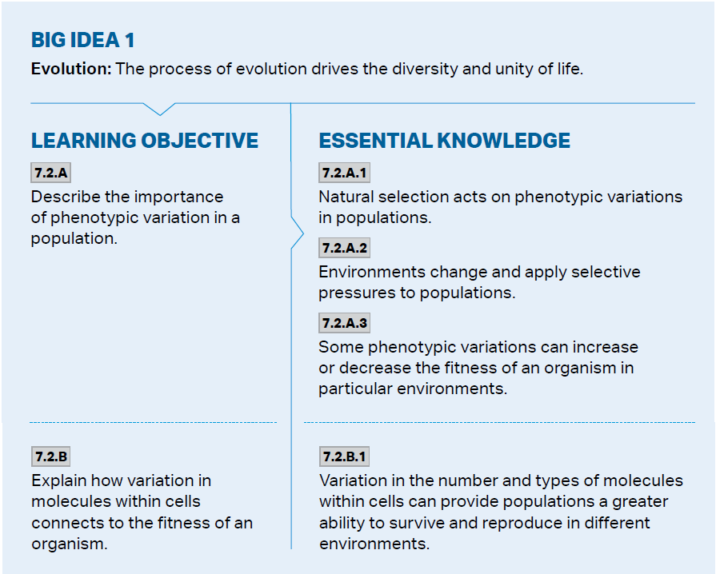
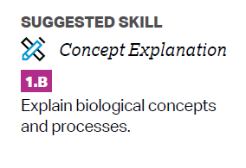
Objectives

Slide 3
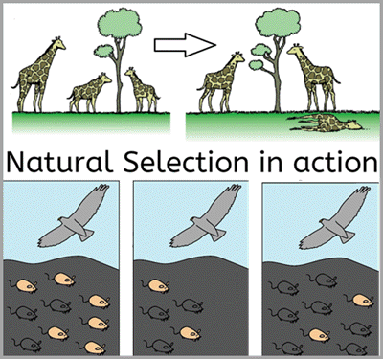

Natural Selection
Natural selection - individuals with certain inherited traits survive and reproduce at higher rates in an environment due to those traits
Leads to descent with modification
These traits are “selected” by nature
Changes genetic and phenotypic makeup of a population over time
Population – a group of individuals of the same species that live together and interbreed

Slide 4
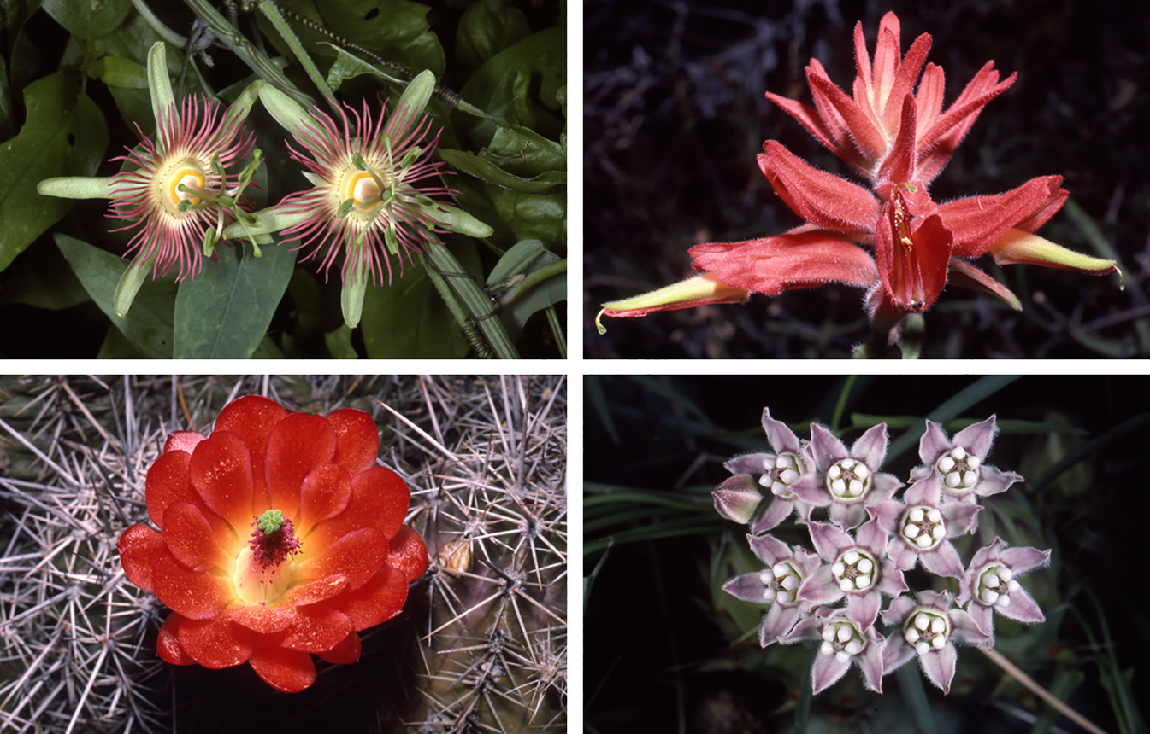

Genetic Variation
Natural selection acts on genetic/phenotypic variation
Without variation, it cannot occur
Environments change over time, changing which individuals have the best adapted traits for the environment – change in fitness
New individuals will be “selected” for
Higher genetic variation within a population increases chances of that population’s survival
Example: changes in flowering time due to climate change
Notes:
Flowers react more to temperature and will bloom earlier, disrupting pollinator-flower relationship – flowers and pollinators which have the traits that allow survival in this changed environment will reproduce

Slide 5
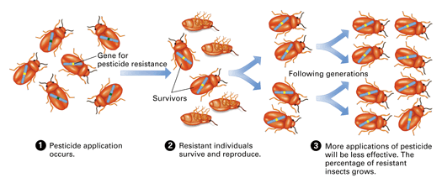
Illustrative Example: DDT Resistance
Some insects in a population have a mutation which allows them to survive being sprayed with pesticide -> will reproduce -> population will become resistant over time

Slide 6
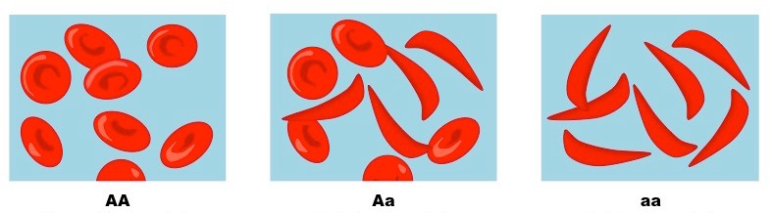

Illustrative Example: Sickle Cell Anemia
Sickle cell anemia is a trait that makes your blood cells look like sickles – block blood flow
Continues to be selected for due to heterozygote advantage – sickle cell trait offers protection against malaria
Carriers of sickle cell don’t have sickle shaped cells, but still retain the anti-malaria benefits
So still prevalent in areas with more malaria

Slide 7
Natural Selection Review
Genetic variation and natural selection

