Slide 1


AP BIO
TOPIC 7.3:
Artificial Selection

Slide 2
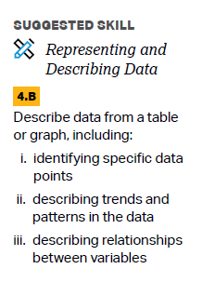
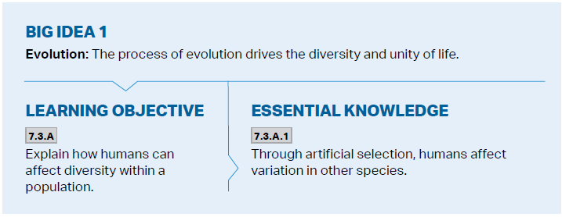
Objectives

Slide 3
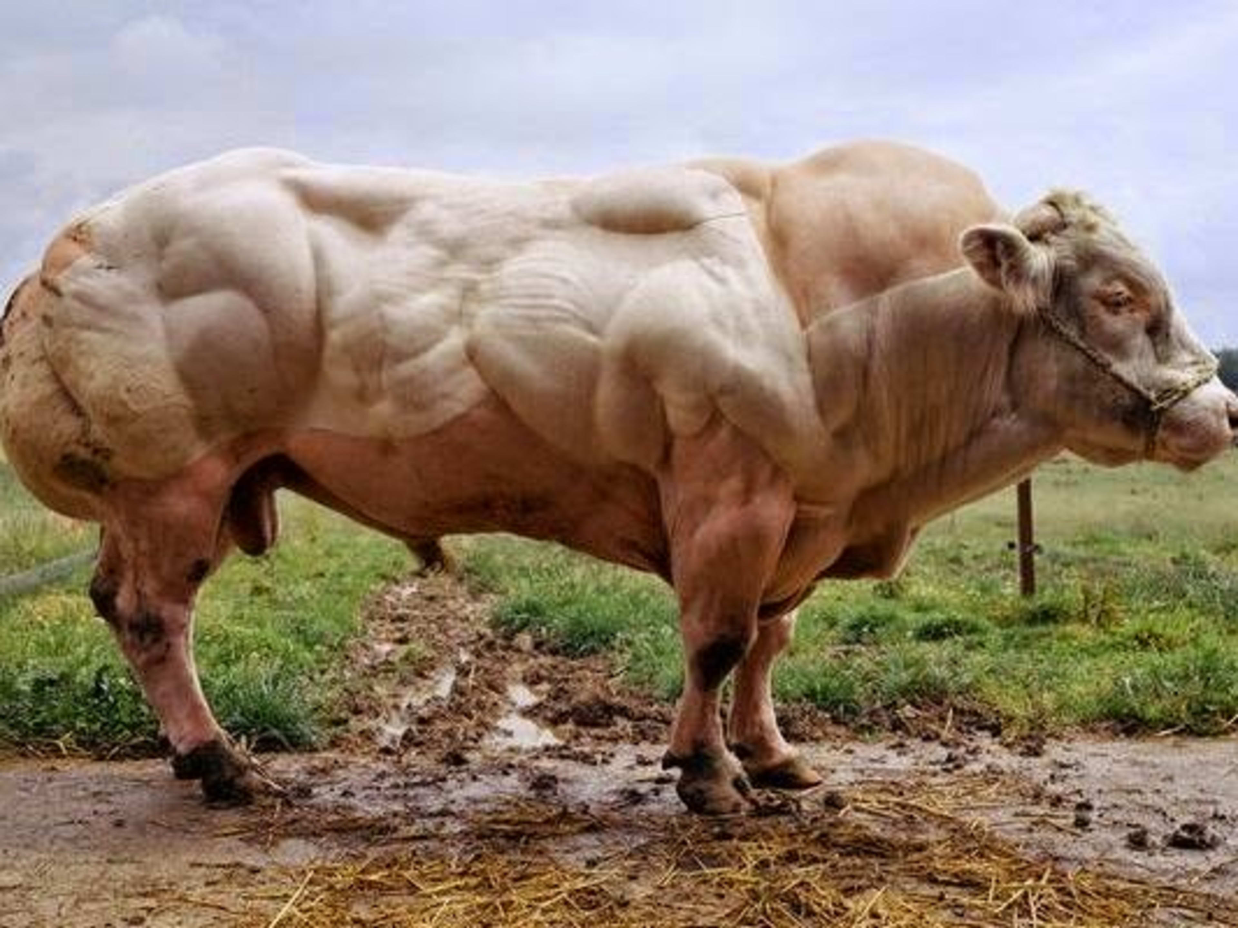
Artificial Selection
Artificial selection – the process by which species are modified by humans
Also known as selective breeding

Slide 4
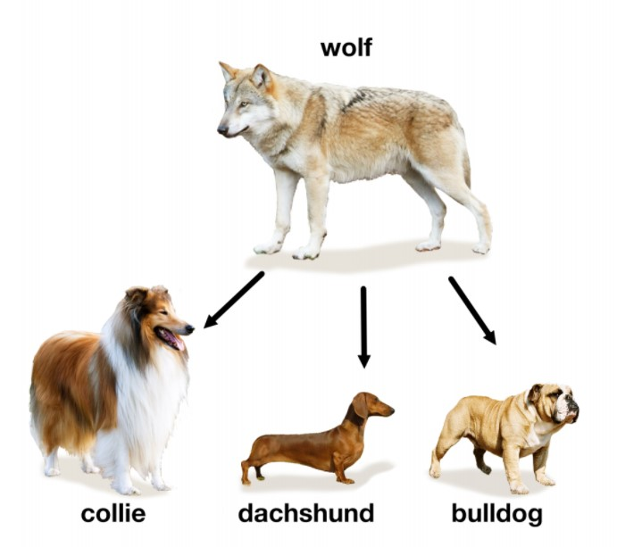
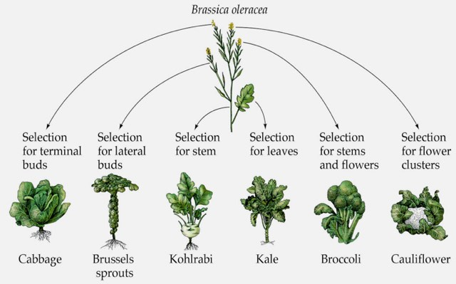
Examples of Artificial Selection
Dog breeding
Mustard plant

Slide 5
Artificial Selection Review
Artificial selection

