Slide 1


AP BIO
TOPIC 7.5: Hardy-Weinberg Equilibrium

Slide 2
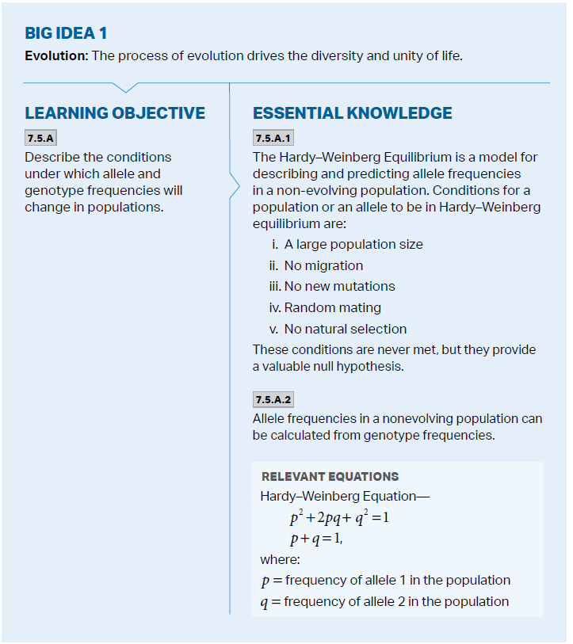
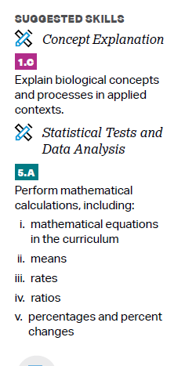
Objectives

Slide 3
Conditions for Hardy-Weinberg
Hardy-Weinberg Equilibrium – represent a nonevolving population (for a particular locus)
Allele frequency in a population will remain constant – unless something that isn’t segregation or recombination
Null hypothesis – no significant difference between two populations, if one is in Hardy-Weinberg Equilibrium and one isn’t = it’s evolving, null hypothesis rejected
Five conditions:
No mutation
No sexual selection (random mating)
No natural selection
No genetic drift (large pop. size)
No migration

Slide 4
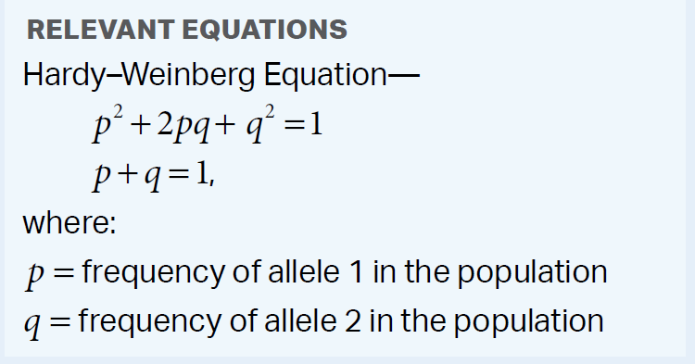
Hardy-Weinberg Equation
When the gene has two alleles (p and q), the allele frequencies add up to 1
The frequencies of homozygous dominant, heterozygous, and homozygous recessive individuals also add up to 1
Questions will often pair Hardy-Weinberg with Chi-square – are the expected population results under Hardy-Weinberg different from the observed (ie. is the difference significant enough to show evolution)
Notes:
Dominant homo = 2 dom alleles
Hetero = 1 of each
Dominant recessive = 2 recessive alleles
#/total alleles in population

Slide 5
Hardy-Weinberg Practice
You have sampled a population in which you know that the percentage of the homozygous recessive genotype (aa) is 36%. Using that 36%, calculate the following:
The frequency of the "aa" genotype.
The frequency of the "a" allele.
The frequency of the "A" allele.
The frequencies of the genotypes "AA" and "Aa."
Notes:
The frequency of the "aa" genotype. Answer: 36%, as given in the problem itself.
The frequency of the "a" allele. Answer: The frequency of aa is 36%, which means that q² = 0.36, by definition. If q² = 0.36, then q = 0.6, again by definition. Since q equals the frequency of the a allele, then the frequency is 60%.
The frequency of the "A" allele. Answer: Since q = 0.6, and p + q = 1, then p = 0.4; the frequency of A is by definition equal to p, so the answer is 40%.
The frequencies of the genotypes "AA" and "Aa." Answer: The frequency of AA is equal to p², and the frequency of Aa is equal to 2pq. So, using the information above, the frequency of AA is 16% (i.e. p² is 0.4 x 0.4 = 0.16) and Aa is 48% (2pq = 2 x 0.4 x 0.6 = 0.48).
The frequencies of the two possible phenotypes if "A" is completely dominant over "a." Answers: Because "A" is totally dominate over "a", the dominant phenotype will show if either the homozygous "AA" or heterozygous "Aa" genotypes occur. The recessive phenotype is controlled by the homozygous aa genotype. Therefore, the frequency of the dominant phenotype equals the sum of the frequencies of AA and Aa, and the recessive phenotype is simply the frequency of aa. Therefore, the dominant frequency is 64% and, in the first part of this question above, you have already shown that the recessive frequency is 36%.

Slide 6
Hardy-Weinberg Equilibrium Review
Hardy-Weinberg Equation and conditions for Hardy-Weinberg Equilibrium

