Slide 1


AP BIO
TOPIC 7.6: Evidence of Evolution

Slide 2
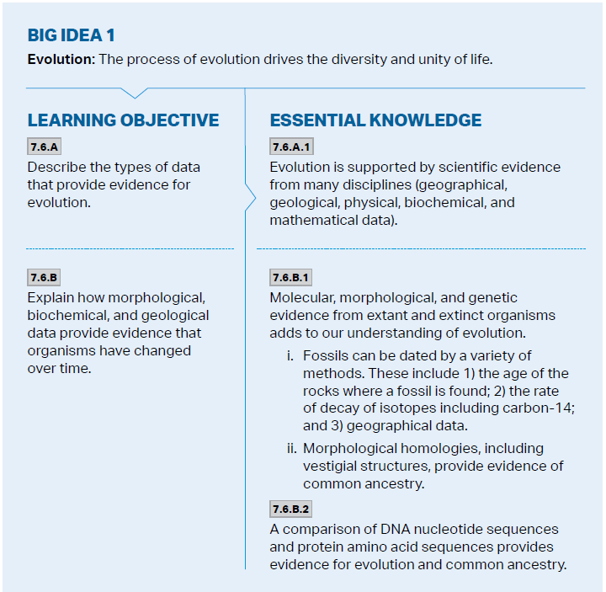
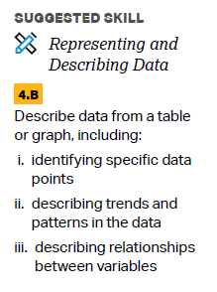
Objectives

Slide 3
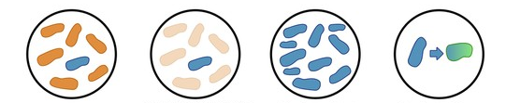
Direct Observations
Populations continue to evolve in real time
Antibiotic and pesticide resistance
Response to invasive species
Notes:
Bacteria reproduce quickly

Slide 4
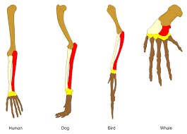
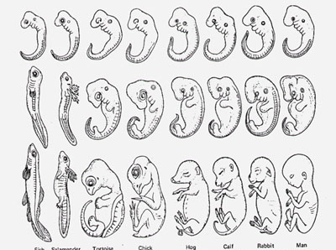
Homology
Homology - similarity from common ancestry
Homologous structures – anatomical signs of evolution – same body part used for different functions (forelimb)
Embryonic homologies – anatomical homologies in embryos (all vertebrate embryos have a post-anal tail and pharyngeal pouches)
Vestigial organs – no function now but used to serve a function in ancestors (appendix)
Molecular homologies – shared molecular characteristics (same genetic language and similarities in genetic sequences)

Slide 5
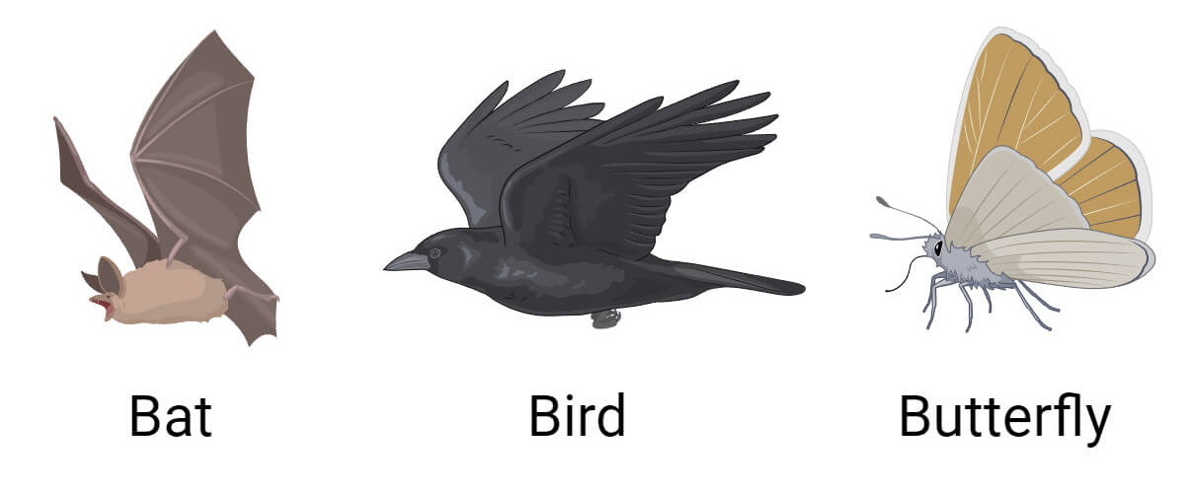
Convergent Evolution
Convergent evolution – two species develop similarities over time to adapt in a new environment (not due to common ancestry)
Analogous structures – penguin, dolphin, and shark all have torpedo shape
Practice: which one represents homology? Analogy?
 | Genetic Similarity | Function | Form/Structure
A) | Low | Same | Different
B) | Low | Different | Same
C) | High | Same | Different
D) | High | Different | Same

Slide 6
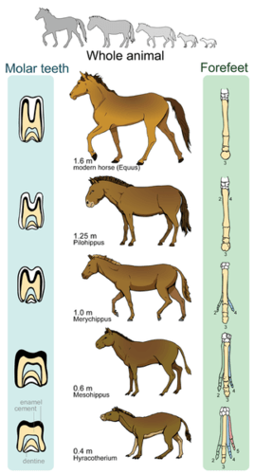
Fossil Record
Fossils – remains or traces of organisms from the past
Located in strata – layers of rock (older fossils deeper)
Fossil record - collection of fossils found throughout the world, arranged in chronological order
Fossils show change over time – link ancient organisms to modern species
Following extinctions, new species appeared in rock above others

Slide 7
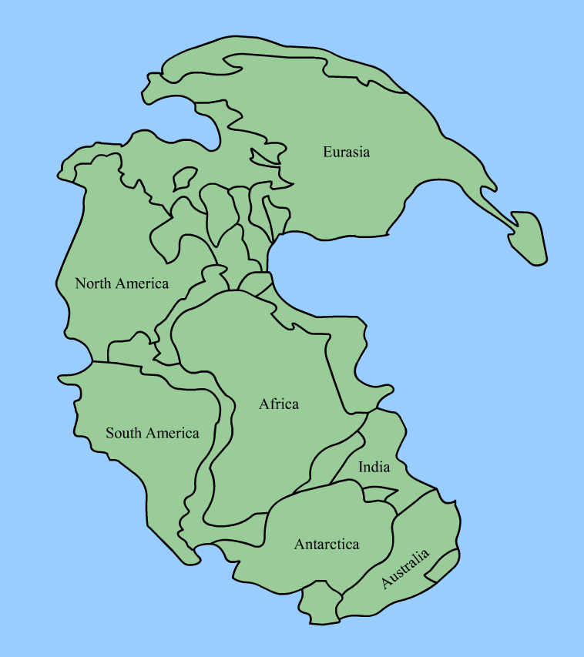
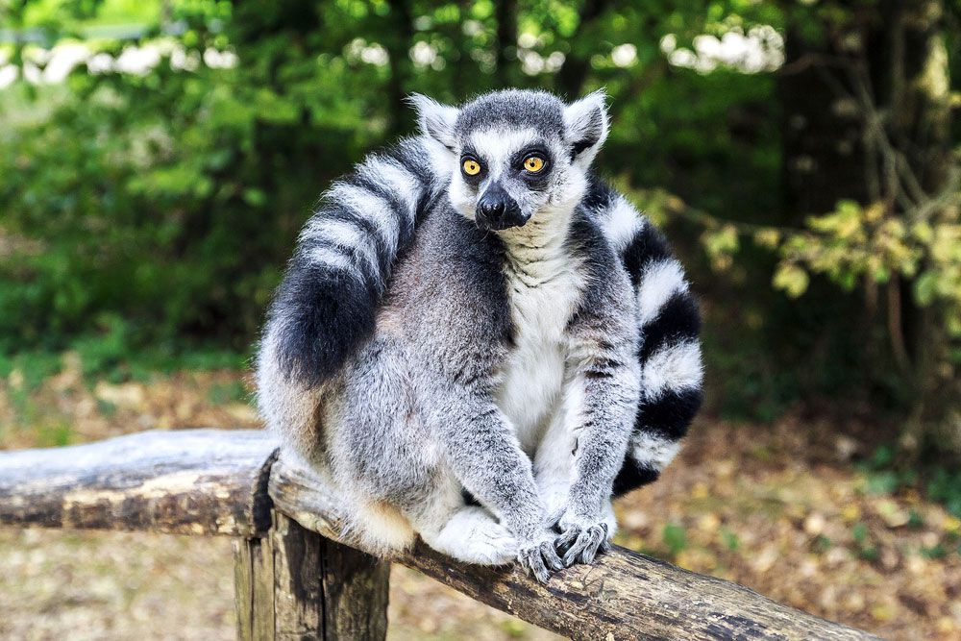
Biogeography
Biogeography – the geographic distribution of species
Species in a geographic area are more closely related to each other than to species in a distant area (desert animals in one area are more closely related to local species than desert animals on another continent
Continental drift – (and breakup of Pangea) can explain the similarity of species on different continents
Endemic species – species found in a certain area and nowhere else
Marsupials

Slide 8
Evidence of Evolution Review
Evidence for evolution
Observation
Fossils
Homology
Biogeography

