Slide 1


AP BIO
TOPIC 7.7:
Common Ancestry

Slide 2
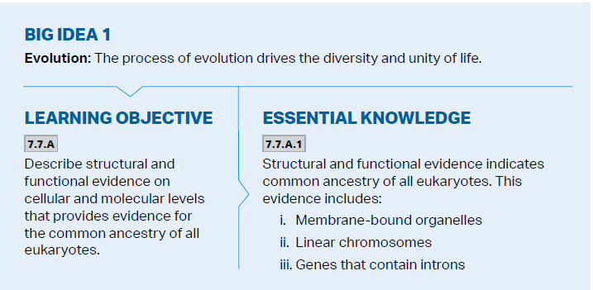
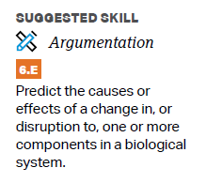
Objectives

Slide 3
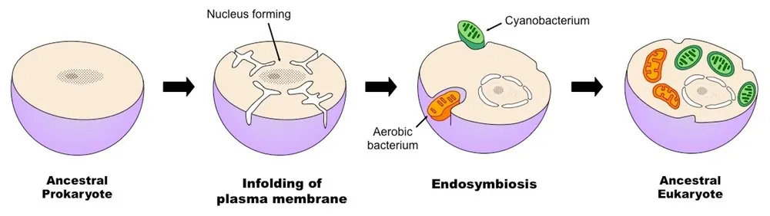
Endosymbiotic Theory Review
Endosymbiotic theory - eukaryotic cells evolved by incorporating into themselves individual prokaryotes, which eventually became organelles
All cells share common structures (DNA, membrane, ribosomes)
Mitochondria and chloroplasts (similarities to prokaryotes)

Slide 4
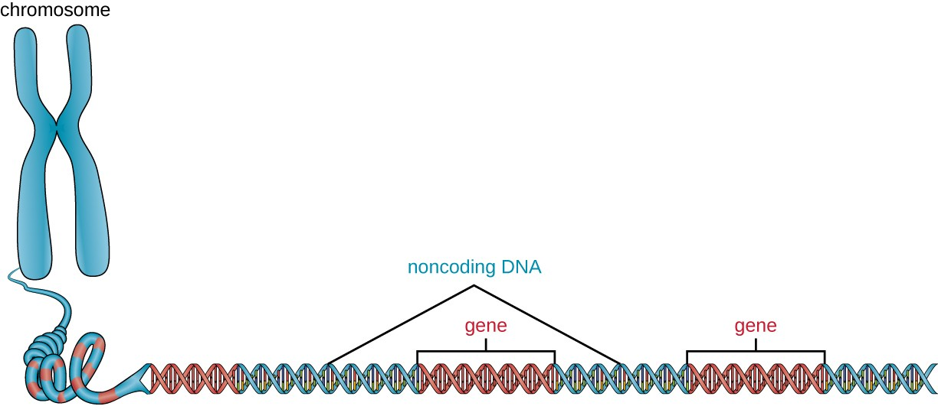
Common Ancestry
All eukaryotic cells share structures that suggest common ancestry
Membrane bound organelles
Linear chromosomes
Genes that contain introns (noncoding regions)

Slide 5
Common Ancestry Review
Evidence for common ancestry of all eukaryotes

