Slide 1


AP BIO
TOPIC 7.8:
Continuing Evolution

Slide 2
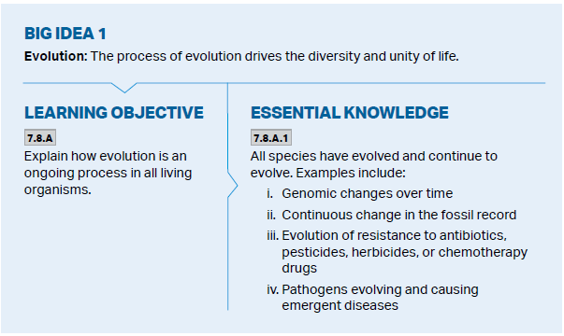
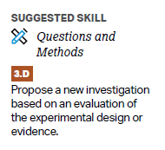
Objectives

Slide 3
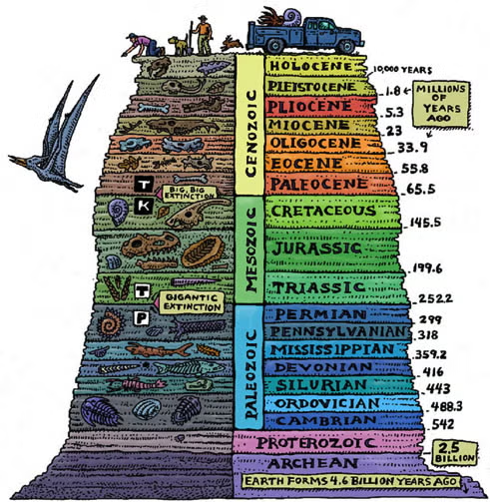
All Species Have Evolved…
Environments continue to change -> population continue to evolve through natural selection
Gene pools change over generations; evolution is ongoing and indefinite
Evidence for evolution having occurred continuously through the fossil record
Notes:
The fossil record is the collection of fossils found in Earth's crust, arranged in chronological order, that provides evidence of past life and how it has changed over time.

Slide 4
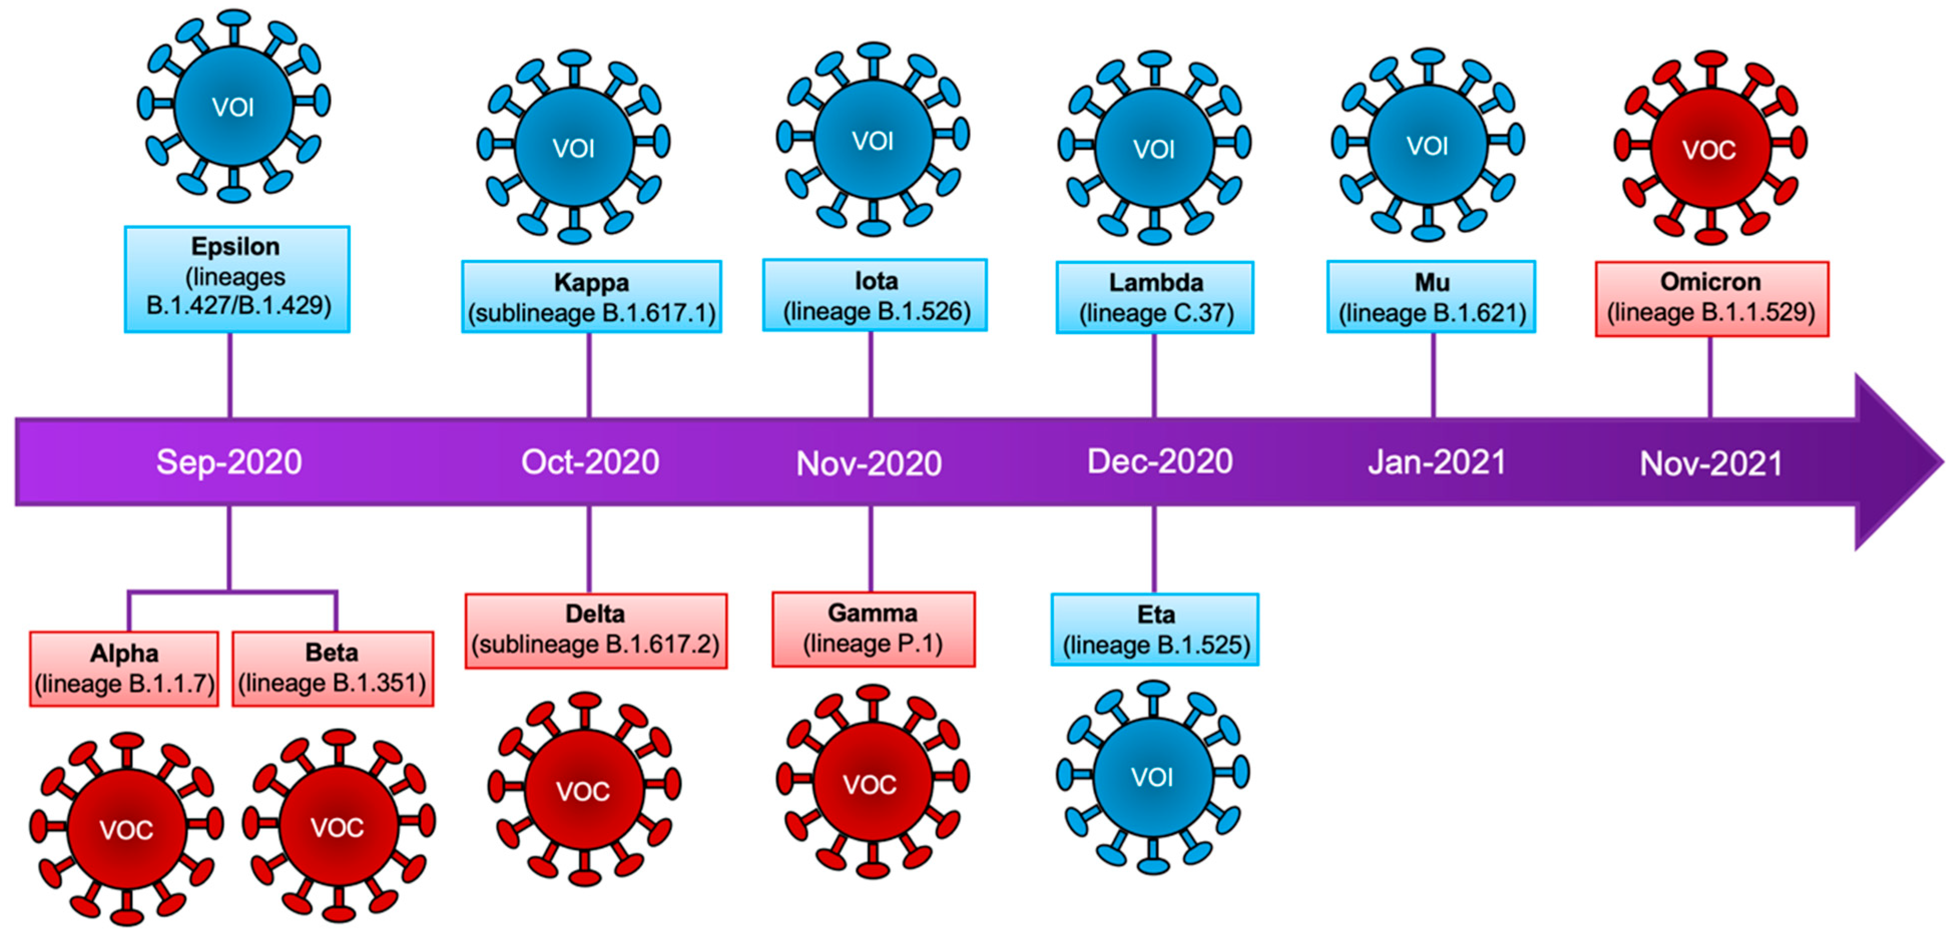
…And Continue To Evolve Over Time
Within present day evolution is seen
Genomic changes – mutations, allele frequency shifts due to genetic drift
Resistance to antibiotics (bacteria) and pesticides such as DDT (insects)
Pathogens evolving and causing emergent diseases - SARS-CoV-2, originating in bats and spreading to humans, causing the COVID-19 pandemic

Slide 5
Continuing Evolution Review
Evidence for ongoing evolution

