Slide 1


AP BIO
TOPIC 8.1:
Responses to the Environment

Slide 2
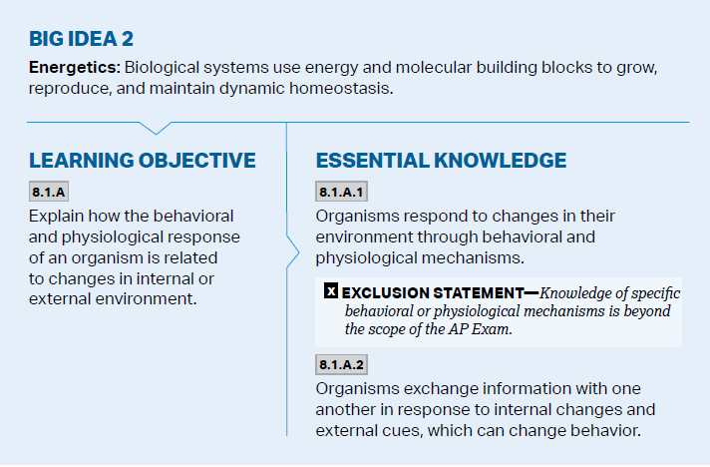
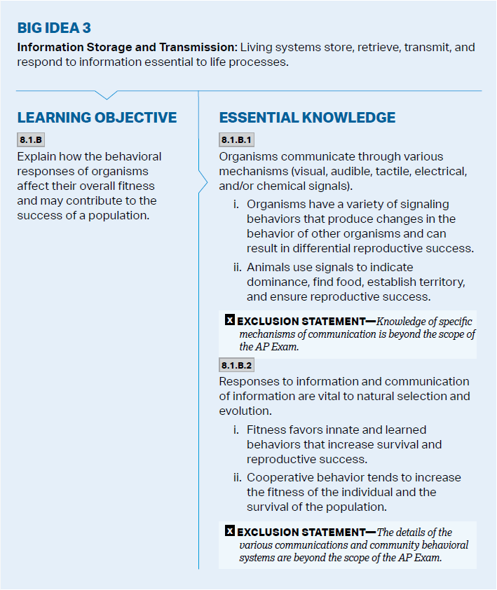
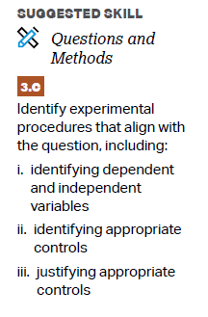
Objectives

Slide 3
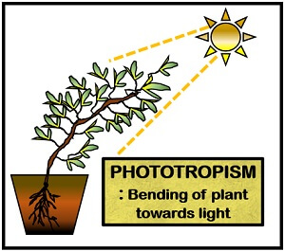
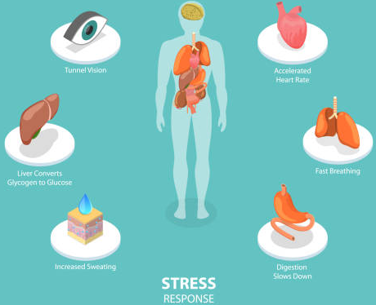
Response
Organisms respond to their environment through behavioral and physiological changes
Behavior – what an organism does and how it does it – a result of genetic + environmental factors, can change
Physiological change – change in body’s structure/function
Taxis and kinesis
Organisms exchange information in response to stimuli, changing behavior
Predator warnings – colors, sounds
Fight or flight response
Notes:
Taxis and kinesis are two types of animal movement in response to stimuli, but they differ in how the movement is directed. Taxis is a directed movement towards or away from a stimulus, while kinesis is a non-directional change in speed or turning rate in response to a stimulus

Slide 4
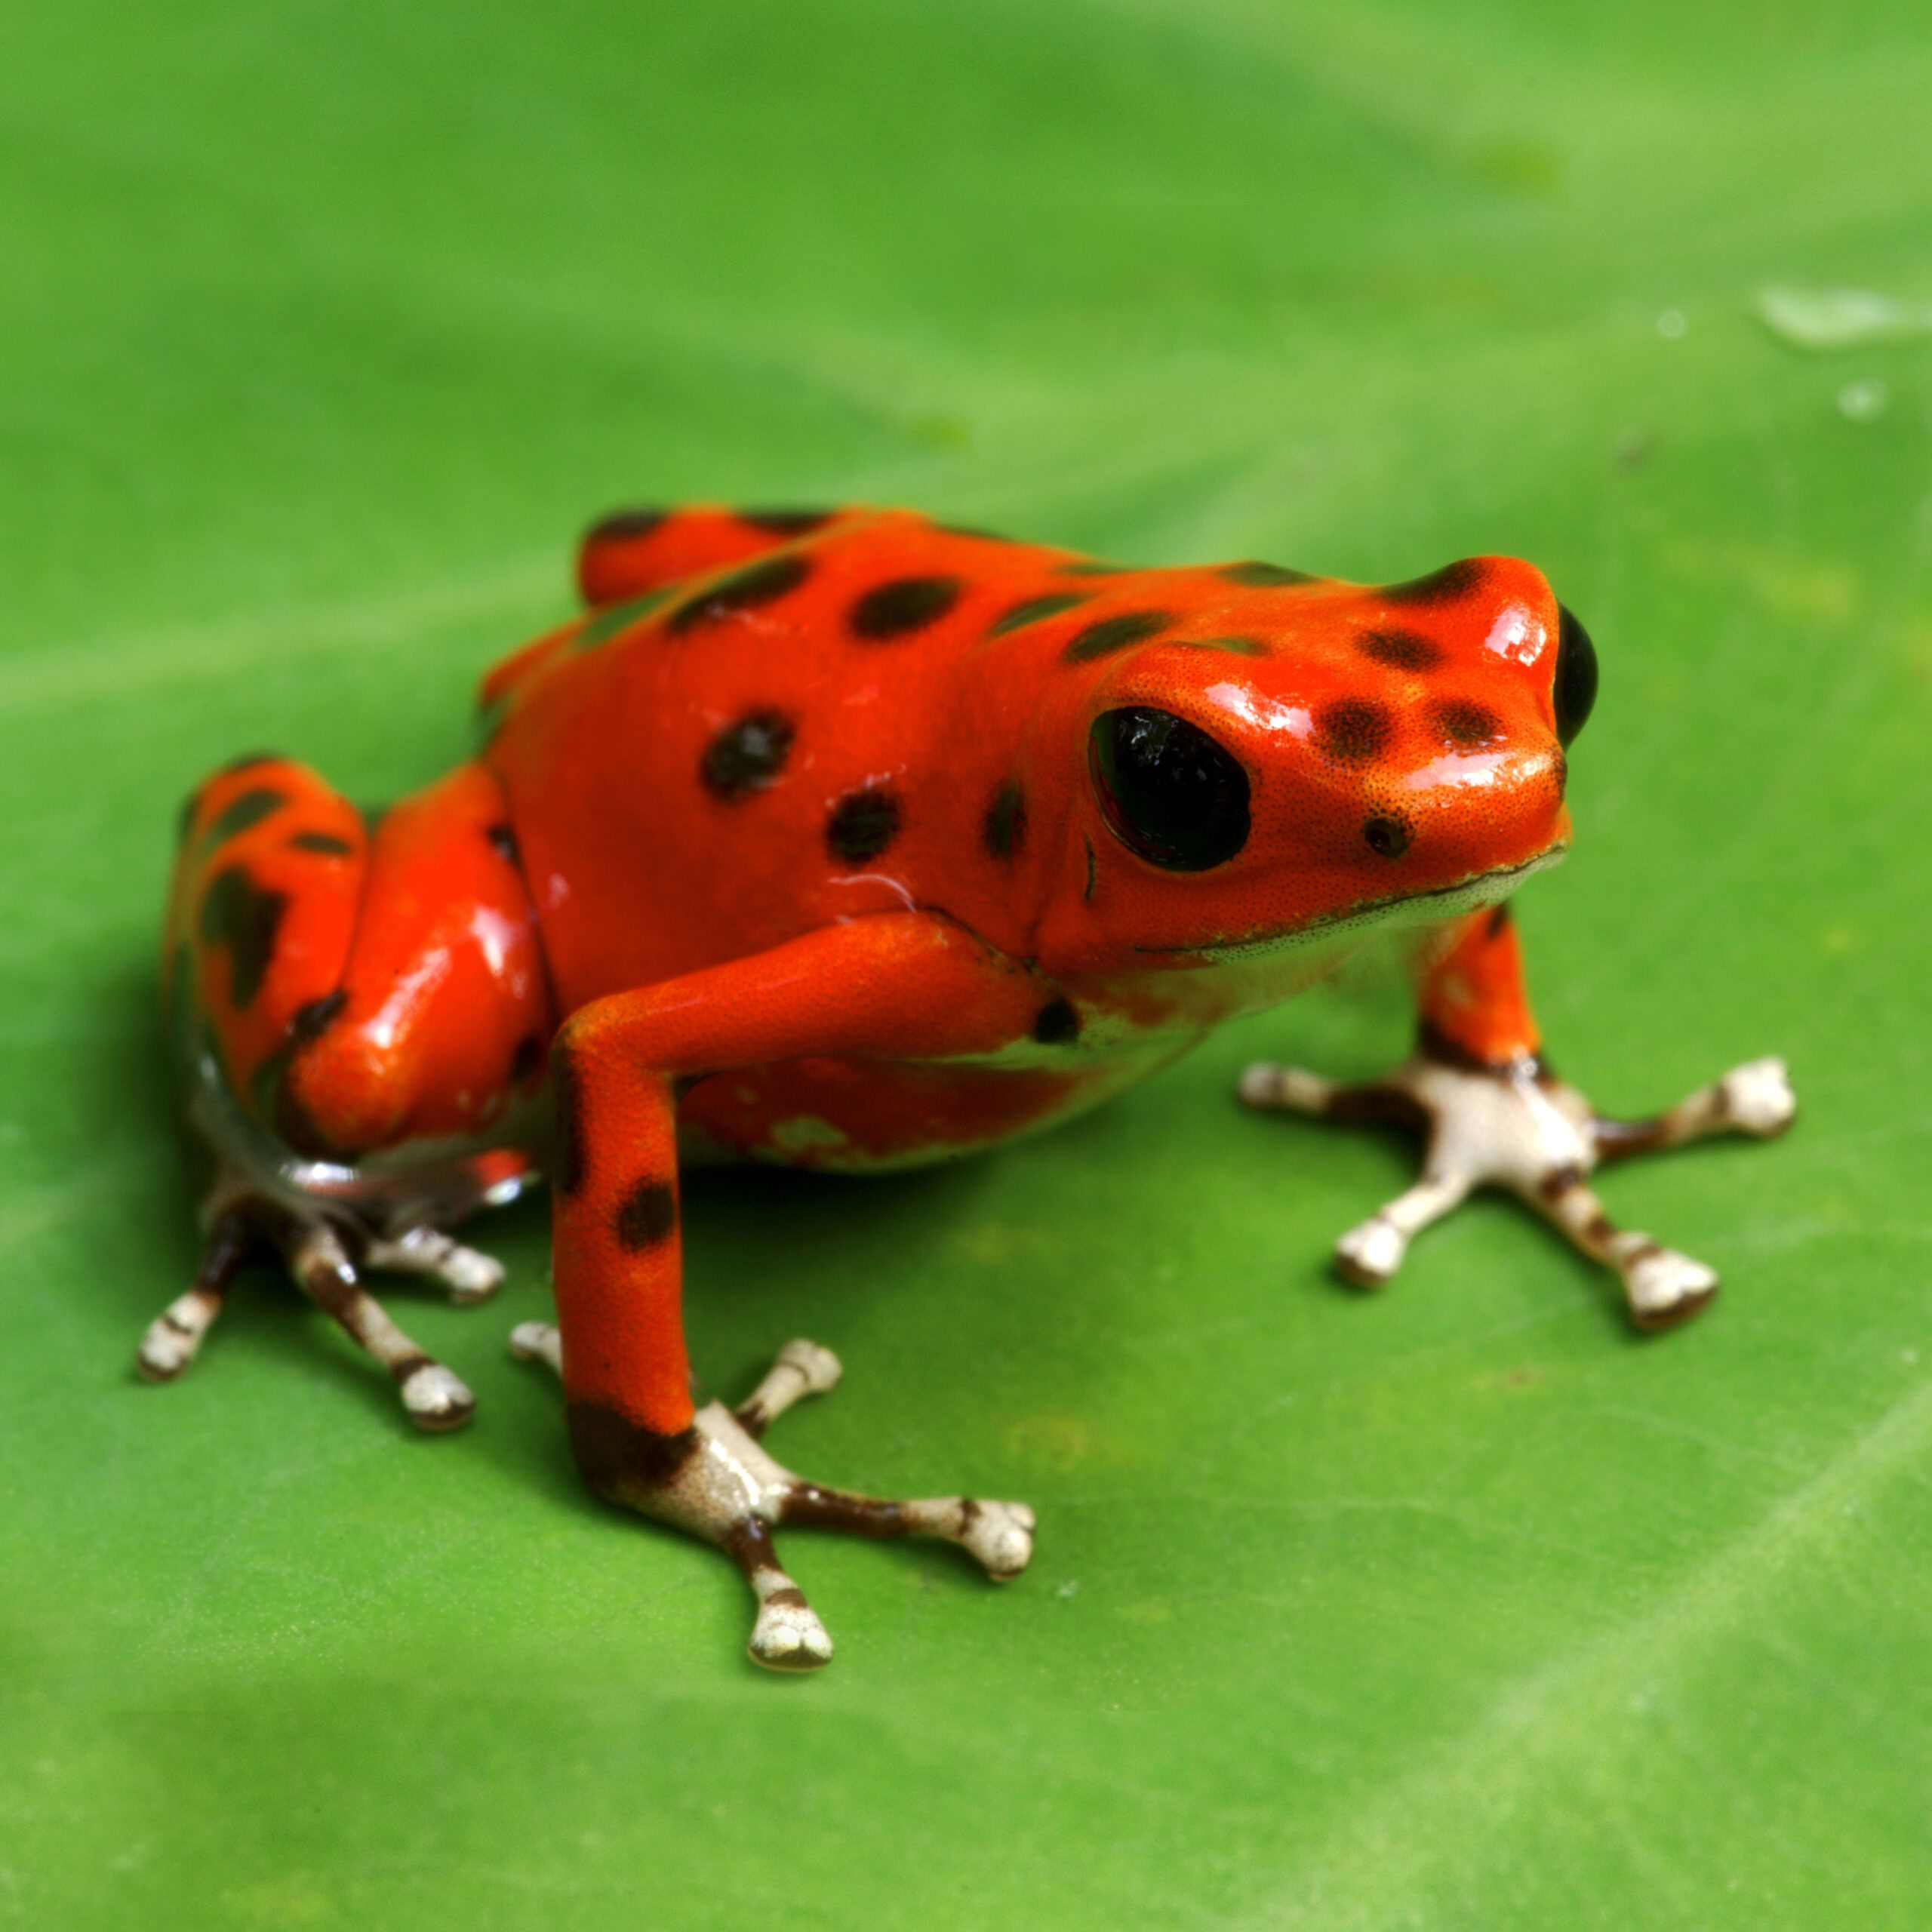
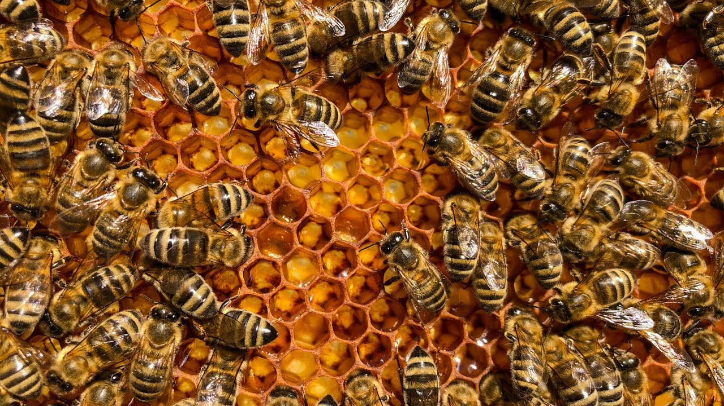
Communication
Organisms communicate – signals (stimulus that changes behavior)
Visual – warning colors, attraction for mating
Audible – mating songs
Tactile – herd interactions
Electrical – prey detection
Chemical – pheromones
Can change behavior in others and affect reproductive success
Signals are used to establish dominance, find food, establish territory, ensure reproduction
Notes:
Dominance – wolf pack

Slide 5
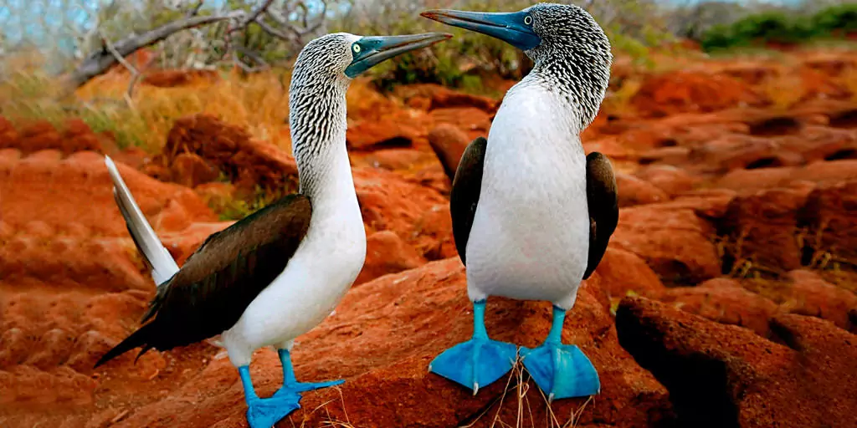
Innate and Learned Behaviors
Innate behaviors – developmentally fixed, inherited and unlearned (reflex)
Learned behaviors – behaviors modified based on specific experiences (imprinting, conditioning)
Fitness favors behaviors that increase survival and reproductive success

Slide 6
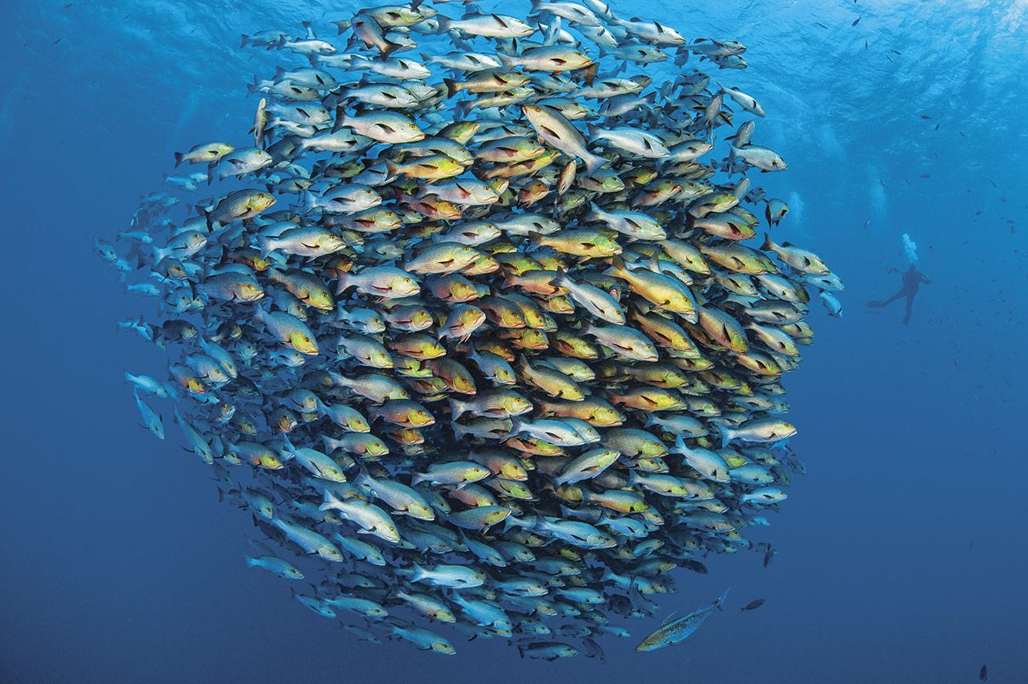
Cooperative Behaviors
Cooperative behaviors tend to increase the fitness of both the organism and the population
Altruism – reduce individual fitness but increase the fitness of others (warning calls)
Kin selection – providing aid that enables other close relatives to produce offspring
Herd, flock, schooling behavior

Slide 7
Responses to the Environment Review
Organisms respond to stimuli which increases their survival and reproductive success
Types of signaling
Innate and learned behaviors
Cooperative behaviors

