Slide 1


AP BIO
TOPIC 8.3:
Population Ecology

Slide 2
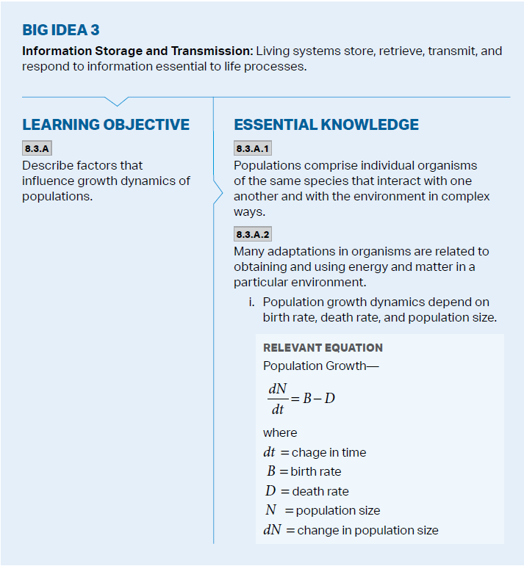
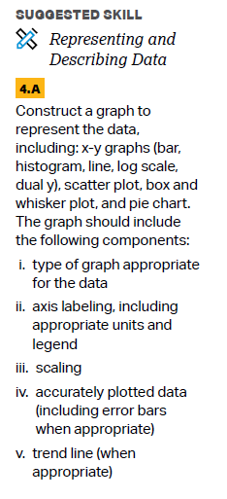
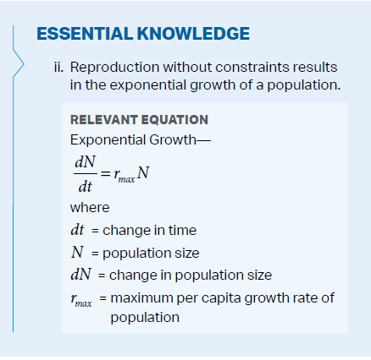
Objectives

Slide 3
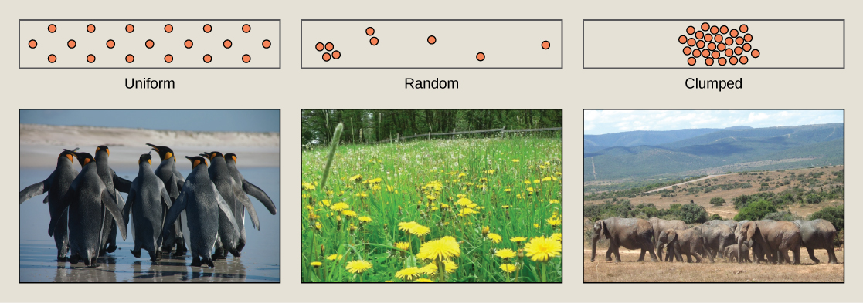
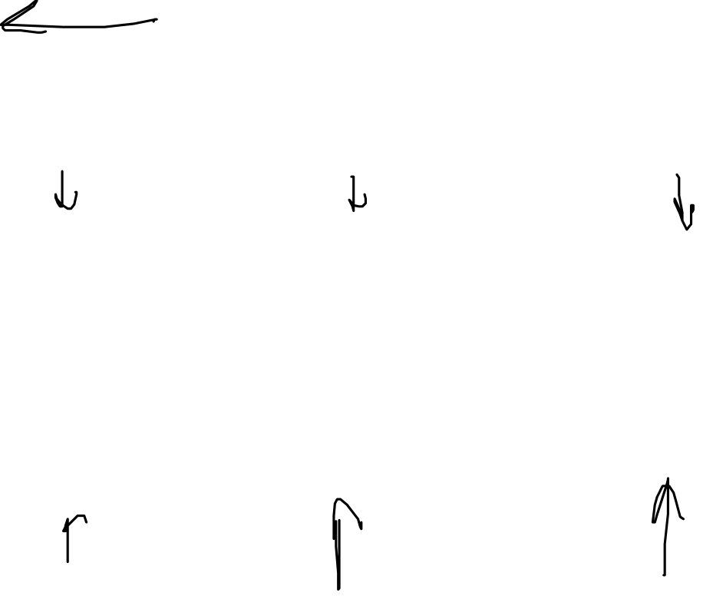
Populations
Population – group of individuals of a single species living in the same general area
Population ecology – explores factors that influence size, density, distribution, and age structure of populations
Density - # of individuals per unit of volume – different dispersions
Clumped
Uniform
Random

Slide 4
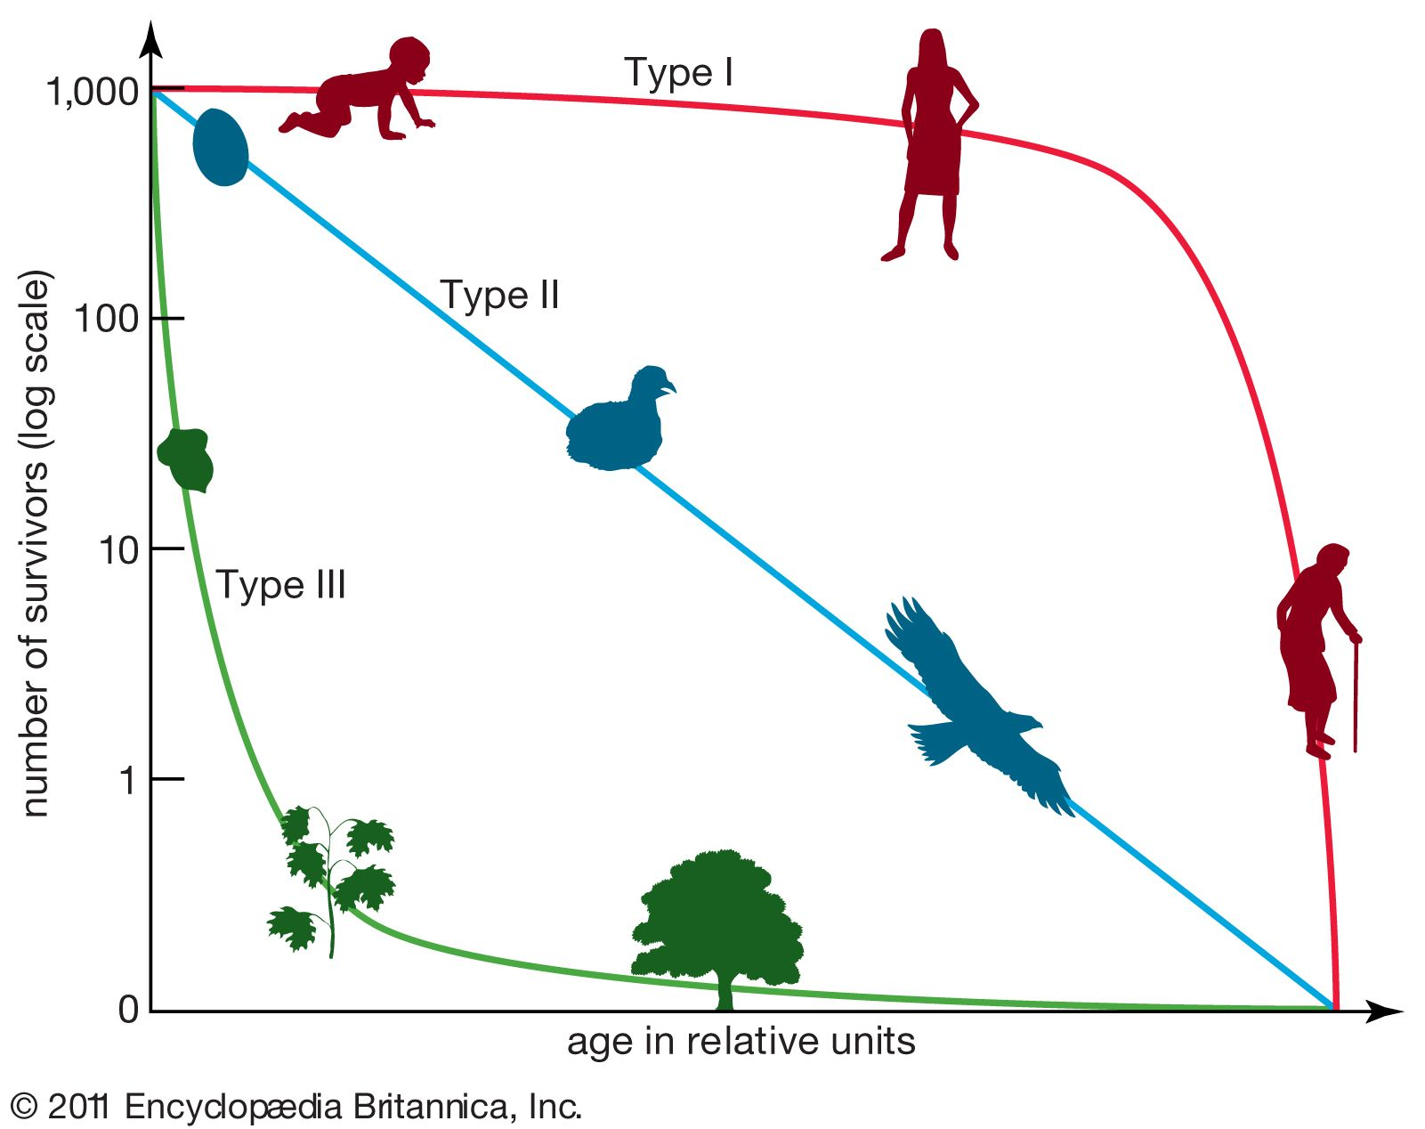
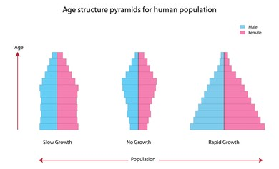
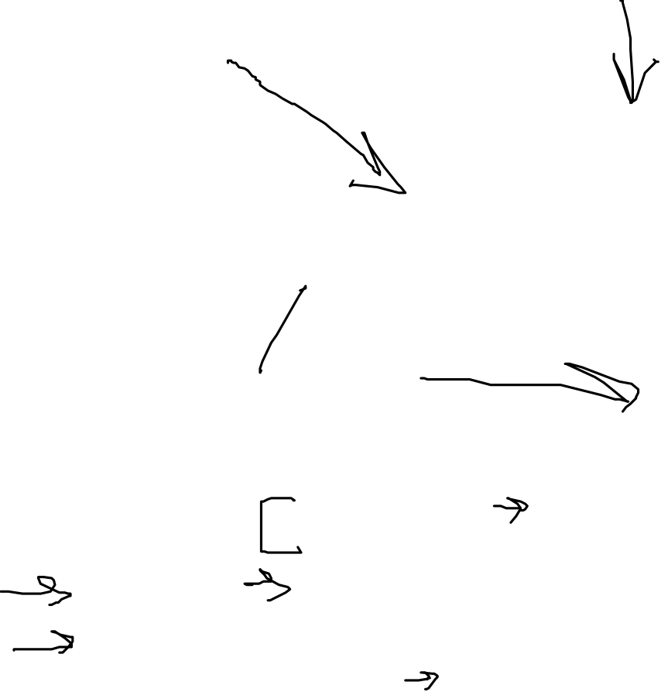
Population Demographics
Survivorship curves – rate of survival over time
Type I (long life), Type II (preyed upon), Type III (survivor curve)
Age-structure pyramids – relative # of individuals of each age in a population
Rate of population growth in relation to births/deaths

Slide 5
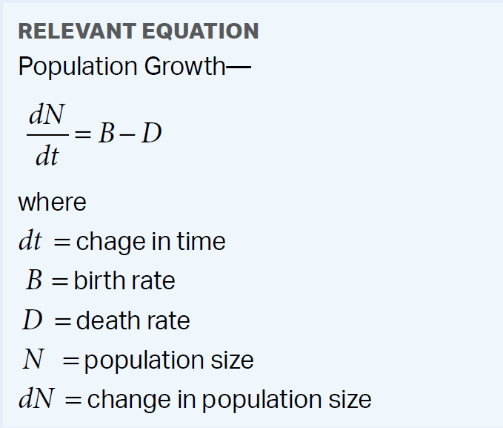
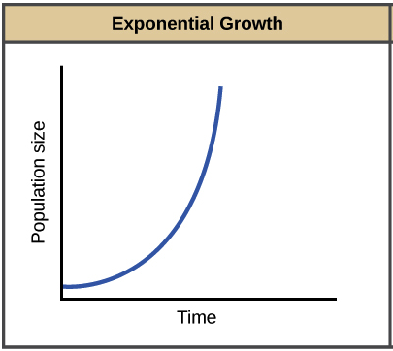
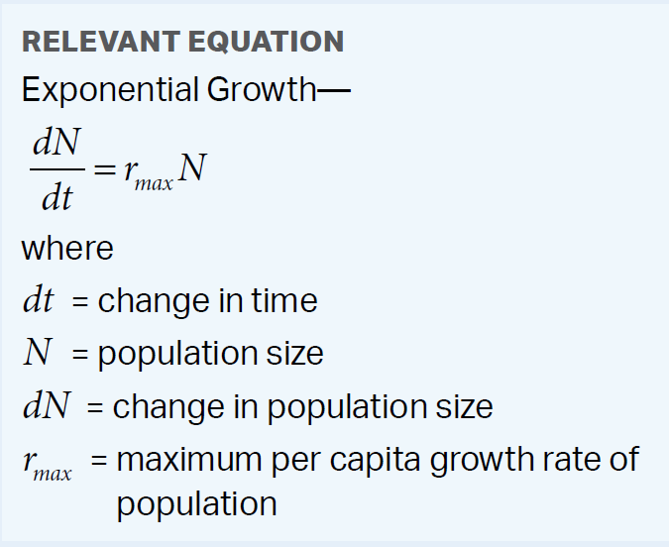
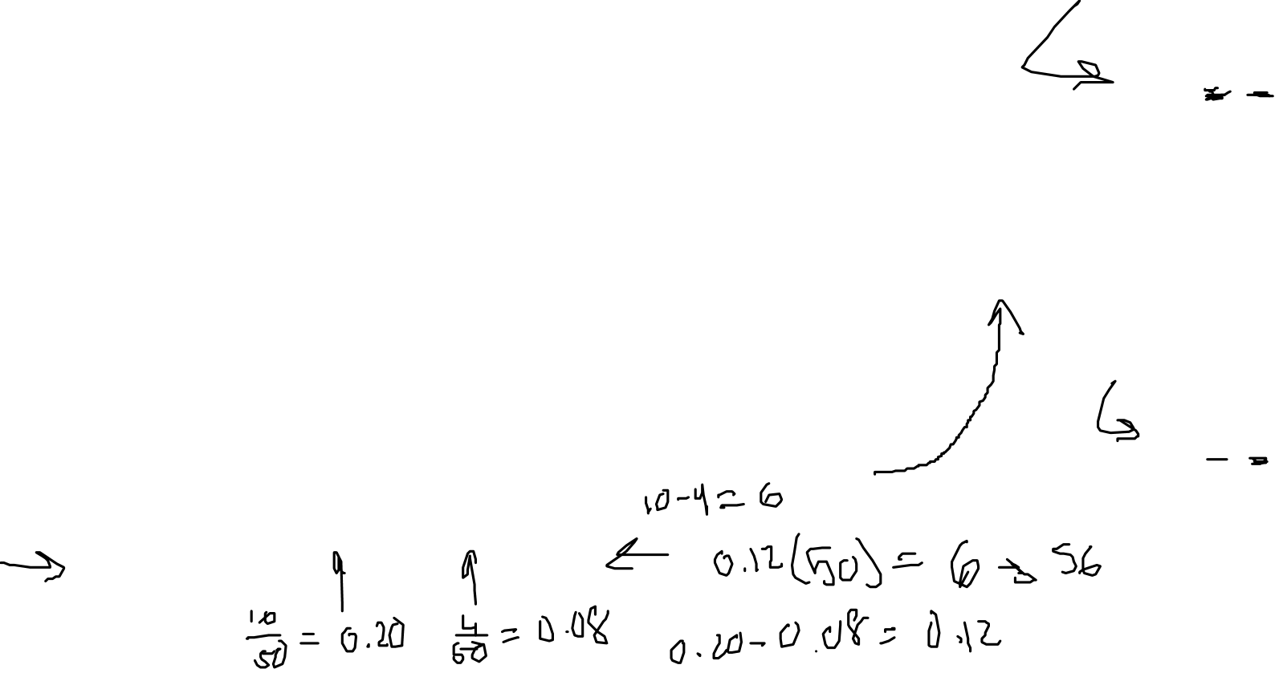
Population and Exponential Growth
Population growth over time = individuals born – individuals died (usually measured in years)
Population grows when birth rate > death rate
Exponential growth – growth of a population under ideal conditions (abundant resources)
Exponential population growth = initial population * max growth rate
As pop. gets larger, grows faster
Find growth rate and pop after 1 gen
Initial Pop | Births | Deaths | Rate
50 | 10 | 4 | 0.12

Slide 6

Population Ecology Review
Population
Dispersion, survivorship, age-structure
Population growth
Exponential growth

