Slide 1


AP BIO
TOPIC 8.4:
Effects of Density on Populations

Slide 2
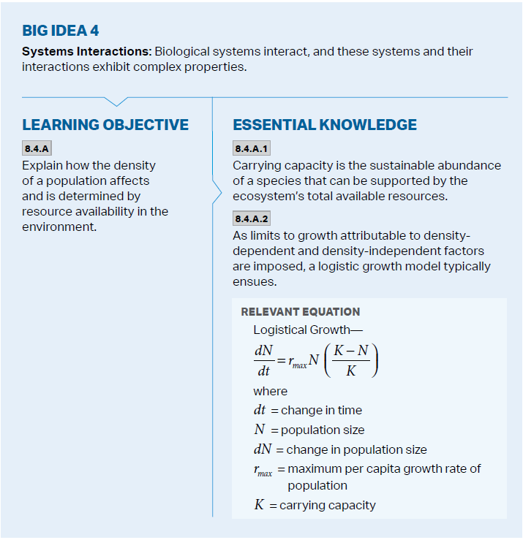
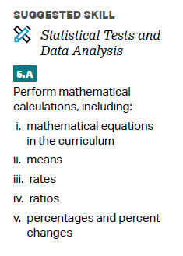
Objectives

Slide 3
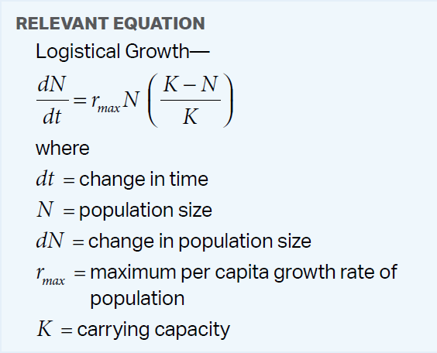
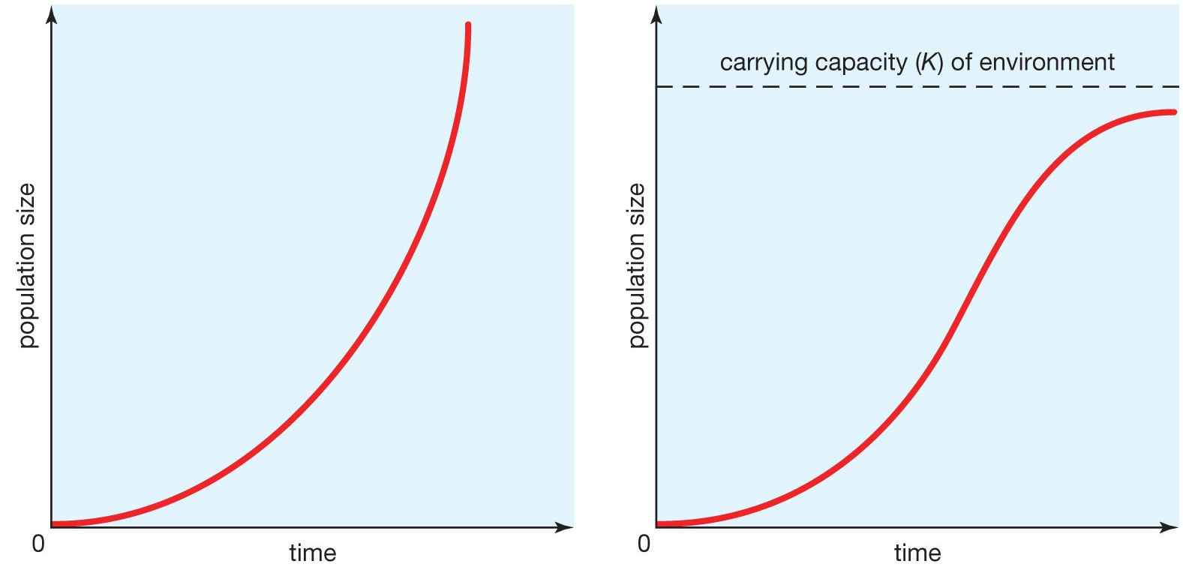
Carrying Capacity and Logistic Growth
Exponential population growth is unlimited – resources are abundant
Not possible for a long time
Carrying capacity – the maximum population size that a certain environment can support at a particular time -> logistic population growth – rate of growth declines as carrying capacity is reached
Affects reproduction (life history)
Ex. R= 1.0, Pop. = 1200, K = 1500
Notes:
+ 240

Slide 4
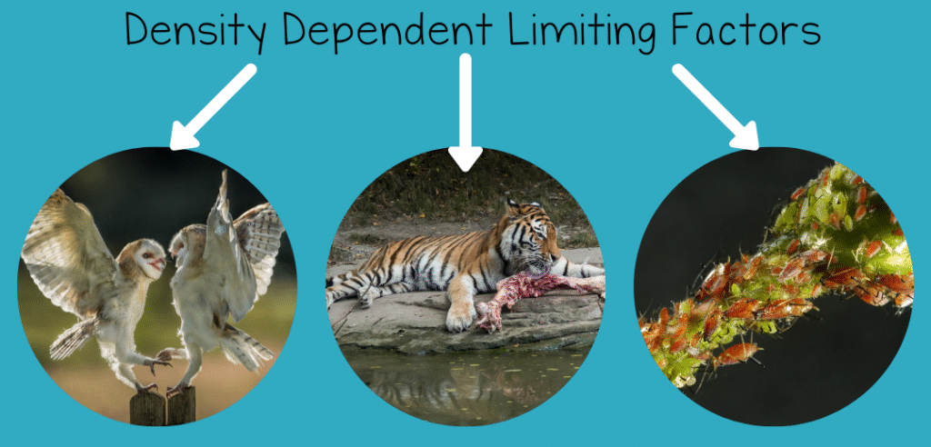
Limits to Growth: Density Dependent
Density dependent factors – when there is a higher population density (individuals per unit of area) death rate increases/birth rate decreases
Competition for resources – food, space
Territoriality – nesting
Disease – easier transmission
Predation – easier to find prey
When population gets too high, these factors will cause it to shrink

Slide 5
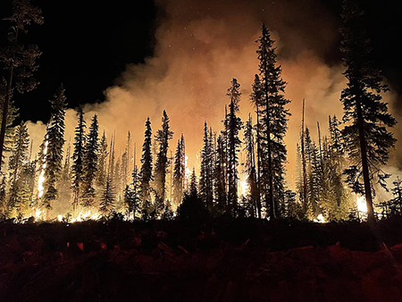
Limits to Growth: Density Independent
Density independent factors – death rate changing regardless of a change in population density
Natural disasters
Human involvement

Slide 6
Effects on Populations Review
Logistic growth
Density dependent and independent limiting factors

