Slide 1


AP BIO
TOPIC 8.5:
Community Ecology

Slide 2
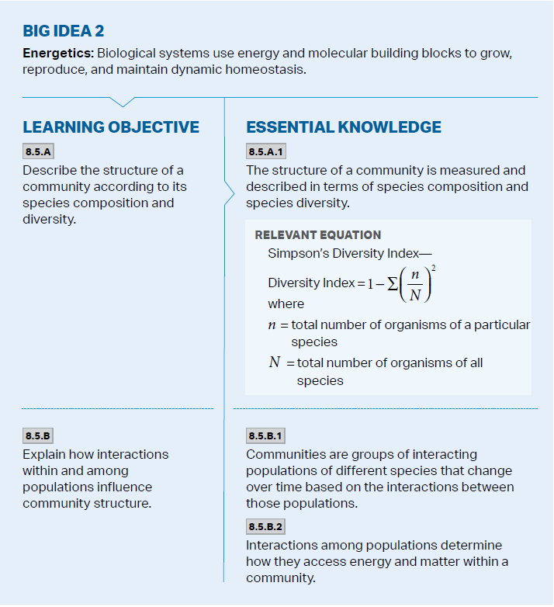
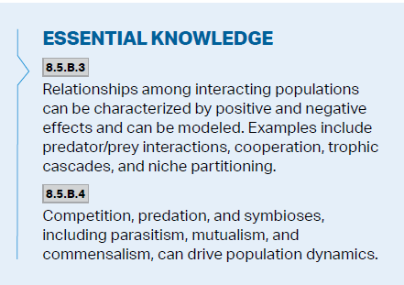
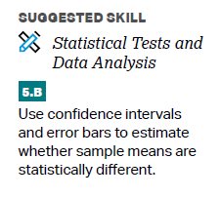
Objectives

Slide 3
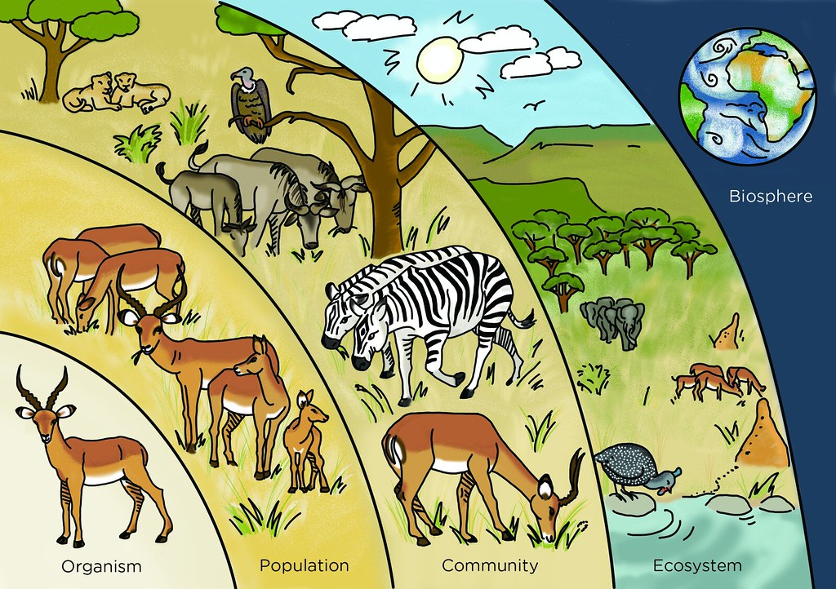
Community
Community – a group of populations of different species living close enough to each other to interact
Interspecific interaction can be positive for a species, negative for a species, or neutral – cause community to change over time
Interactions determine how each species accesses energy and resources
Described in the number of species and number of individuals of each species

Slide 4
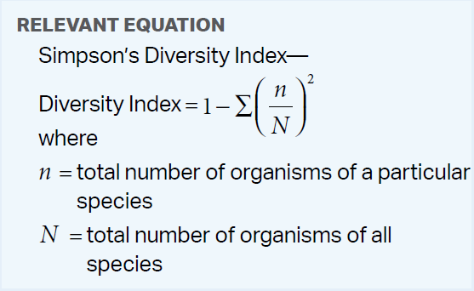
Simpson’s Diversity Index
Measure diversity using Simpson’s Diversity Index
Organisms in a species/by all organisms
Square and add up all of these values
Subtract from 1
Accounts species richness - # of species
Relative abundance - % each species makes up of the total community
More diverse = more stable, greater productivity
Find the diversity:
Species A | 10
Species B | 15
Species C | 35
Species D | 40
Notes:
More diverse = more species that have different niches = less competition
1-0.315=0.685

Slide 5
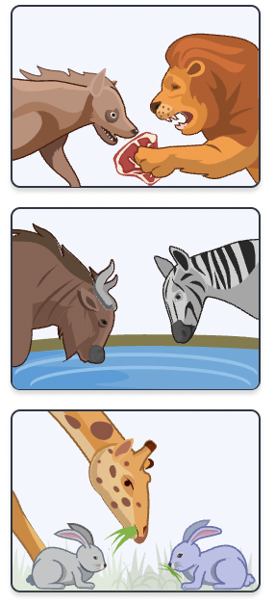
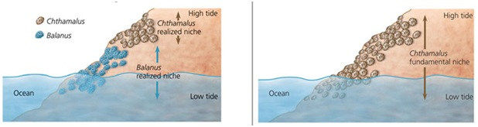
Competition and Niches
Interspecific competition (-/-) – competition between 2 species when resources are in short supply
Less reproductively advantaged species may be eliminated (competitive exclusion)
Ecological niche – sum of biotic/abiotic resources a species uses
Has both fundamental and realized niche
Natural selection favors behaviors that lesson competition -> niche partitioning (move to realized niche) – similar species split up resources
Notes:
more species (more diversity) that have different niches = less competition

Slide 6
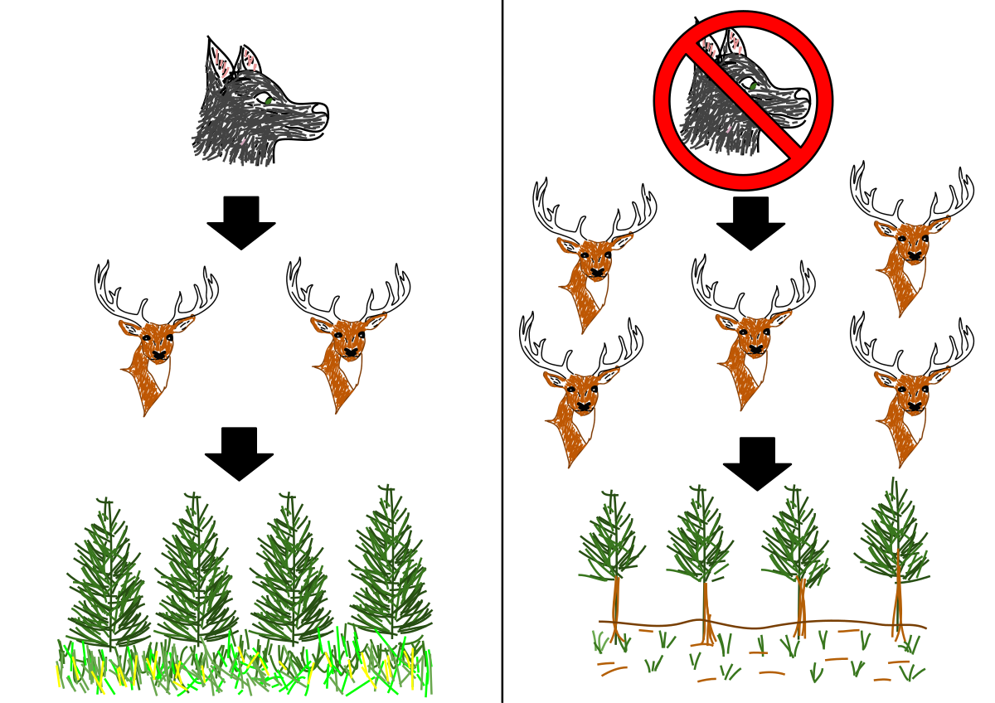
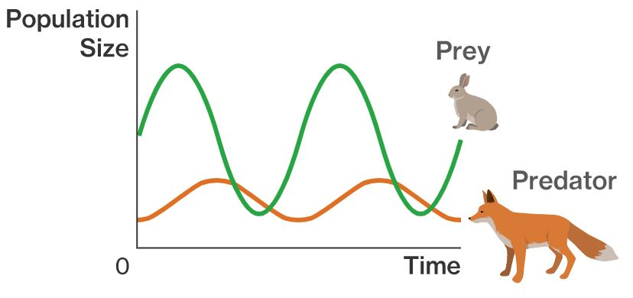
Predation and Trophic Cascades
Predation (+/-) – one species kills and eats the other (predator and prey)
Herbivory (+/-) – organism eats plant
Prey has developed adaptations – camouflage, warning color, mimicry
Predator-prey cycles – regulate size of both species
Trophic cascade – changes in one level of a food web can affect other levels
Notes:
Food web = energy relationships

Slide 7
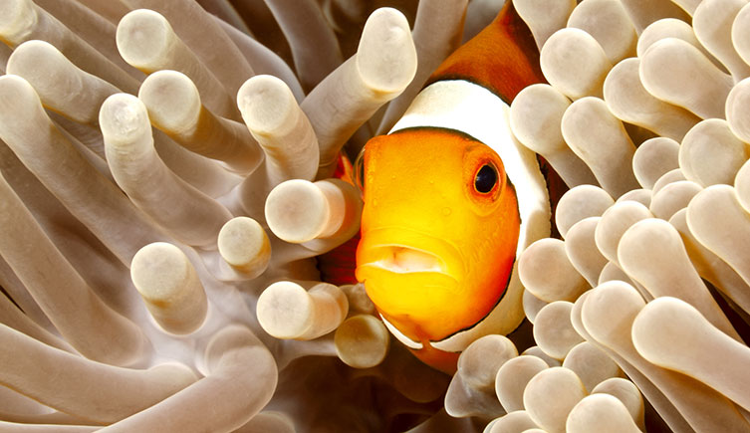
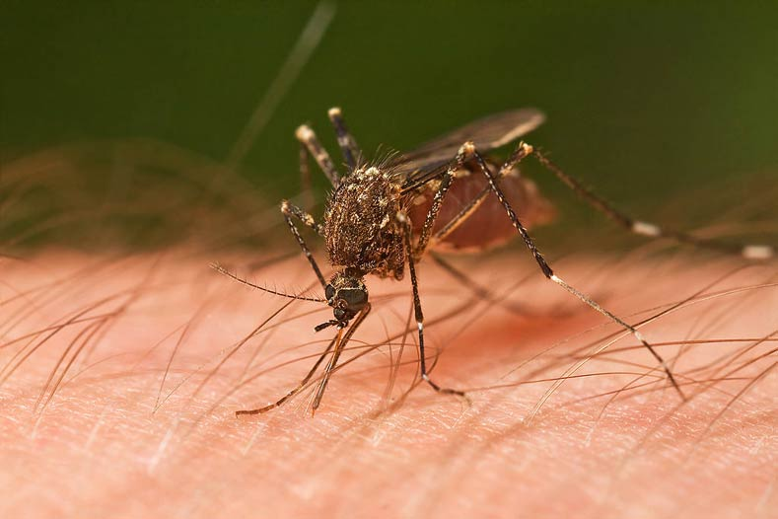
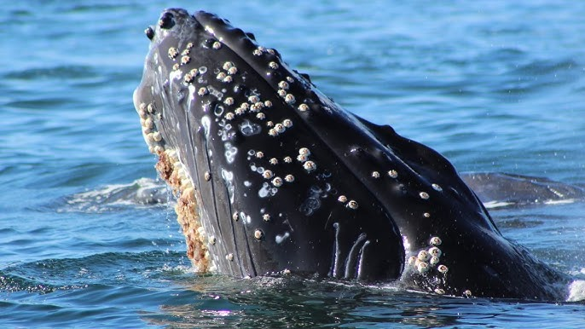
Symbioses
Symbiosis – close and long-term relationship between 2 species
Parasitism (+/-) – one species (parasite) gets nourishment from the host, which is harmed in the process
Mutualism (+/+) – both species benefit from the relationship
Commensalism (+/0) – interaction that helps one species but neutrally affects the other
Notes:
Clownfish find shelter and protection within the stinging tentacles of the anemone, while the anemone benefits from the clownfish's presence by being cleaned of parasites and attracting prey
Barnacles get food and ride, no detriment to whale
Mosquito takes our blood and leaves disease or itchiness

Slide 8
Community Ecology Review
Simpson’s Diversity Index
Interspecific interactions
Competition
Niches
Predation
Trophic cascades
Symbiosis

