Slide 1


AP BIO
TOPIC 8.6:
Biodiversity

Slide 2
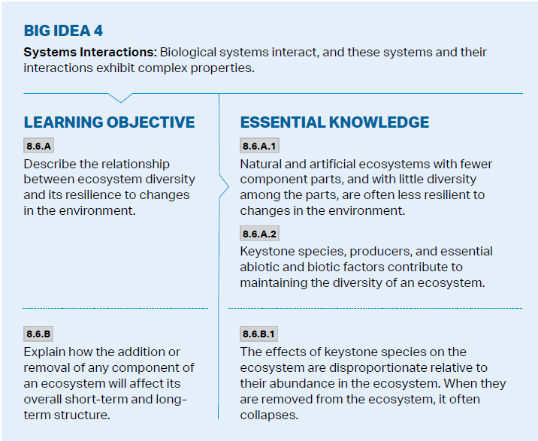
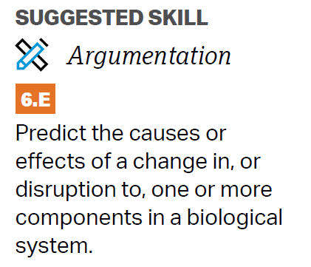
Objectives

Slide 3

The Benefits of Biodiversity
Biodiversity – the variety of living things and life processes within a population (group of a species), community (multiple species), or ecosystem (abiotic + biotic factors)
More diversity/species means an ecosystem has more resilience – just like genetic variation, higher chance it can adapt to changes

Slide 4

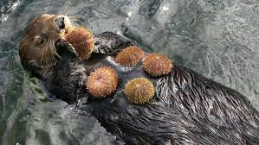

Key Elements of an Ecosystem
Vital abiotic factors
Producers – without them no energy to higher trophic levels
Dominant species – are the most abundant in a community – as a result can often exhibit resilience when the environment changes (more variation within the species)
Keystone species – not abundant, but exerts control over the community structure due to its niche
When removed, the community collapses
One change can have a large effect

Slide 5
Biodiversity Review
Benefits of biodiversity
Keystone species

