Slide 1

Strings in python

Slide 2

Session topics
What is a string ?
String Declaration
String Operations
String Indexing & Accessing
String Slicing
String Methods
String Formatting

Slide 3

what is a string ?

Slide 4
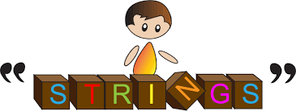
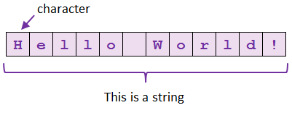
string DEFINITION
String is a sequence of characters and it is immutable.
We can create a string by using single or double or triple quotes.

Slide 5
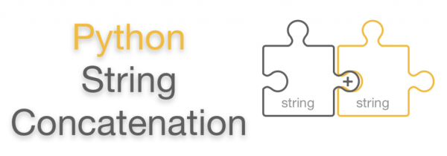
String operations
Basically we can perform three operations on strings.
1) Concatenation

Slide 6
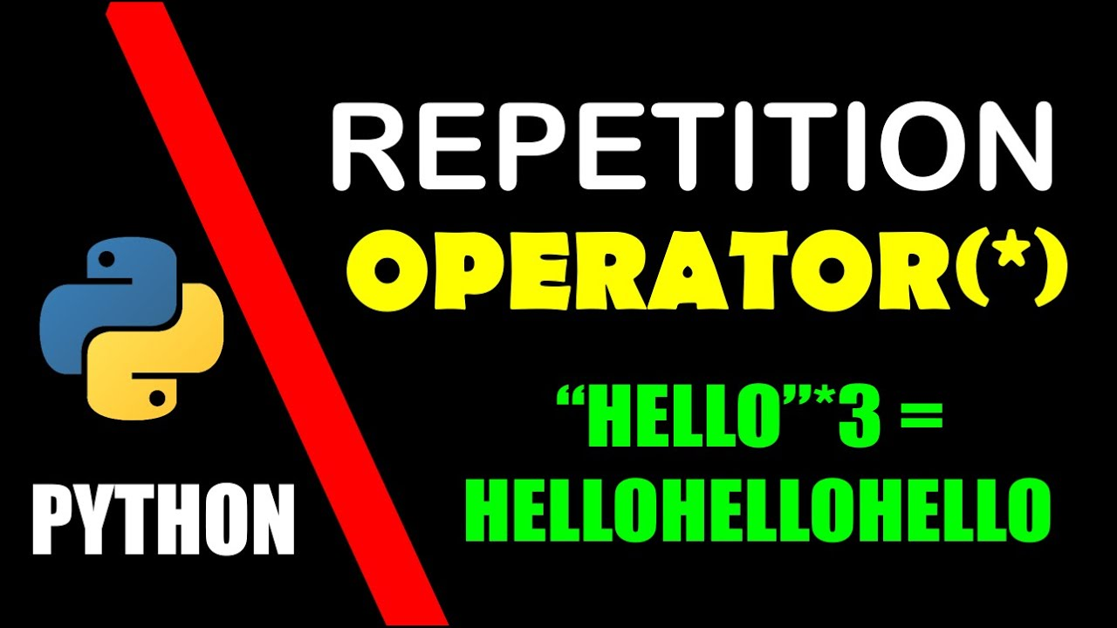
Conti…
2) Repetition

Slide 7
Conti…
3) Membership Operation: in and not in
in : if the given substring is present in the original string then’the output is True else False
Not in : This is work like inverse to the in operator.

Slide 8
CONTI…
Iterate through a loop: We can get all the elements in a string by using for loop and this is called as iterate over a loop.

Slide 9
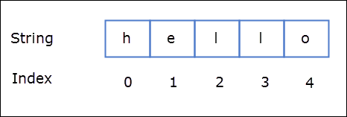
String indexing
In python string indexing starts from 0.

Slide 10
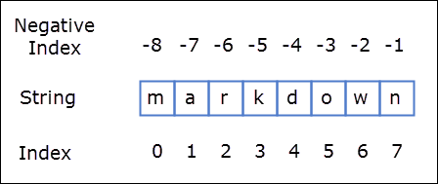
Types of indexing
In strings we have two types of indexing.
1) Positive Indexing
2) Negative Indexing

Slide 11
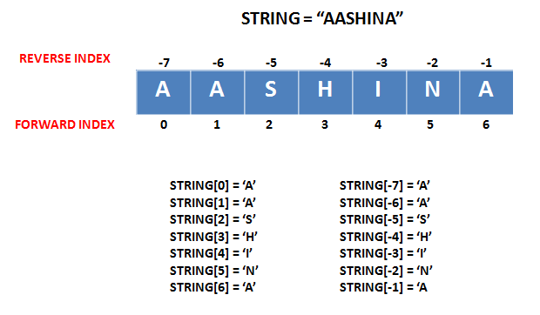
How can we access strings
We can able to access strings by using index numbers.
We can access through positive indexing or negative indexing.

Slide 12

Query
WHAT IS MEAN BY SLICING ?

Slide 13
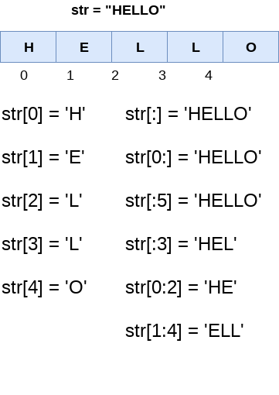
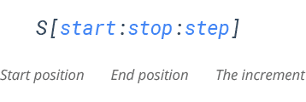
String slicing
If we want to return a range of characters by using the slice syntax.

Slide 14

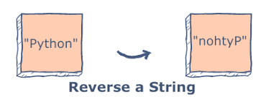
How can I get a reverse string ?

Slide 15
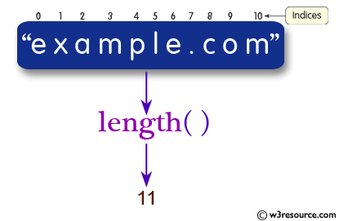
String methods
We have many built-in methods in strings.
Among that length is the most commonly used method.

Slide 16
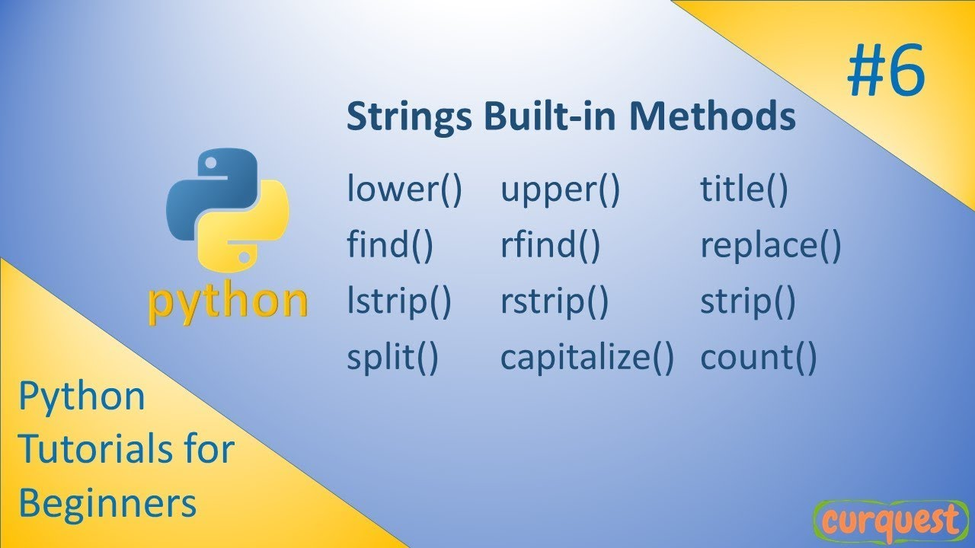
CONTI…

Slide 17
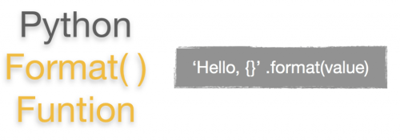
STRING FORMATTING
The string format() method formats the given string into a nicer output in Python.

Slide 18
Tasks
Write a Python program to count the no of occurances of characters in a string.
Write a Python program to remove the characters which are in odd index positions.
Write a Python program to reverse a string without using s[::-1] and any built-in methods.
Write a Python program to print all the vowels in a given string.
Write a Python Program to print repeated characters in a given string.

Slide 19
