Slide 1



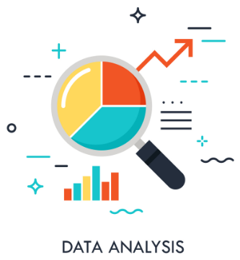
Data Analysis Using Python

Slide 2

Agenda of the Training
Day1
Intro to Data and Data Manipulation with NumPy
Day2
Dzata Analysis with pandas
Day3
Data Preprocessing with Scikit-Learn
Day4
Cleaning Data in Python
Day5
Introduction to Data Visualization & Matplotlib
Day6
Data Visualization using Seaborn

Slide 3
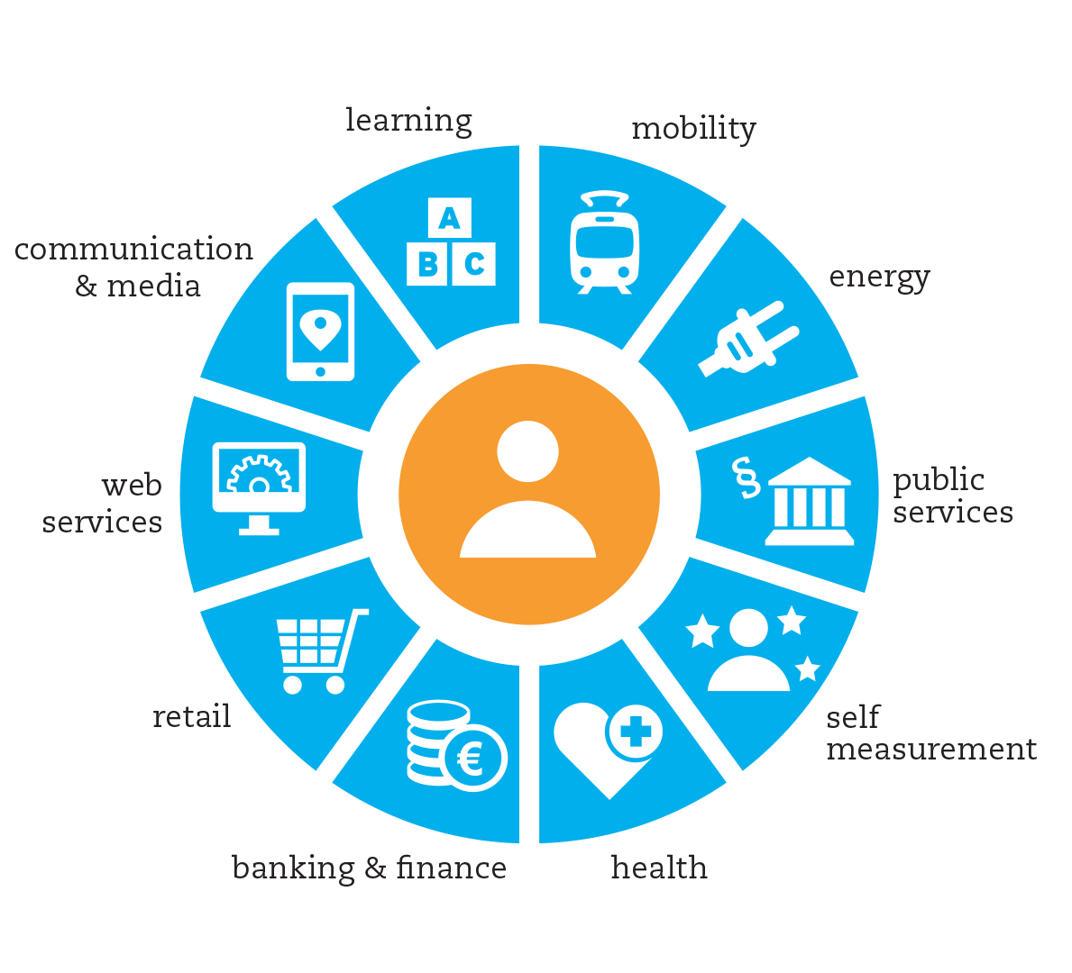
Data Generation

Slide 4
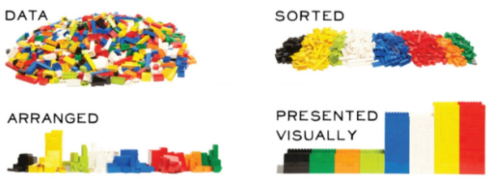
Introduction
Data Analysis is the process of collecting and organizing data.

Slide 5

Why Data Analysis is Required
Data analysis for B2C marketing plays a critical role in improving your business strategy.
It is important in business to understand problems facing an organisation, and to explore data in meaningful ways.

Slide 6
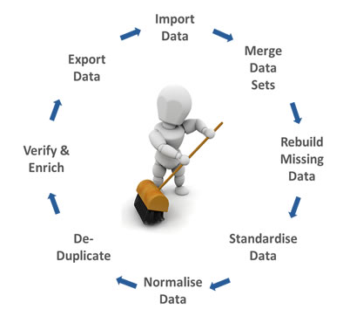
Process of Analysing the Data
Import data sets
Clean and prepare data for analysis
Manipulate pandas DataFrame
Visualize the data
Build machine learning models using scikit-learn

Slide 7

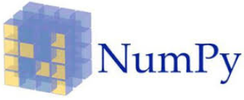

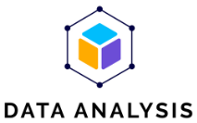


Python Libraries for Analyzing Data

Slide 8
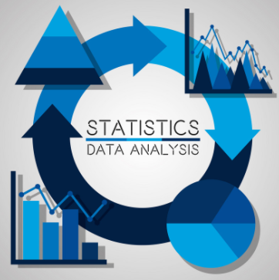
Types of Data in Statistics
Numerical data
Discrete data
Ex: 0,1 or 0,1,2,3
Continuous data
Ex: 122,134.6,150,180,232,....
Categorical data
Ex: Yes/No, A Grade/ B Grad/ C Grade,Male/Female, etc,..

Slide 9
Print(“THANK YOU”)
Slides created, maintained and distributed by Andhra Pradesh State Skill Development Corporation

