Slide 1


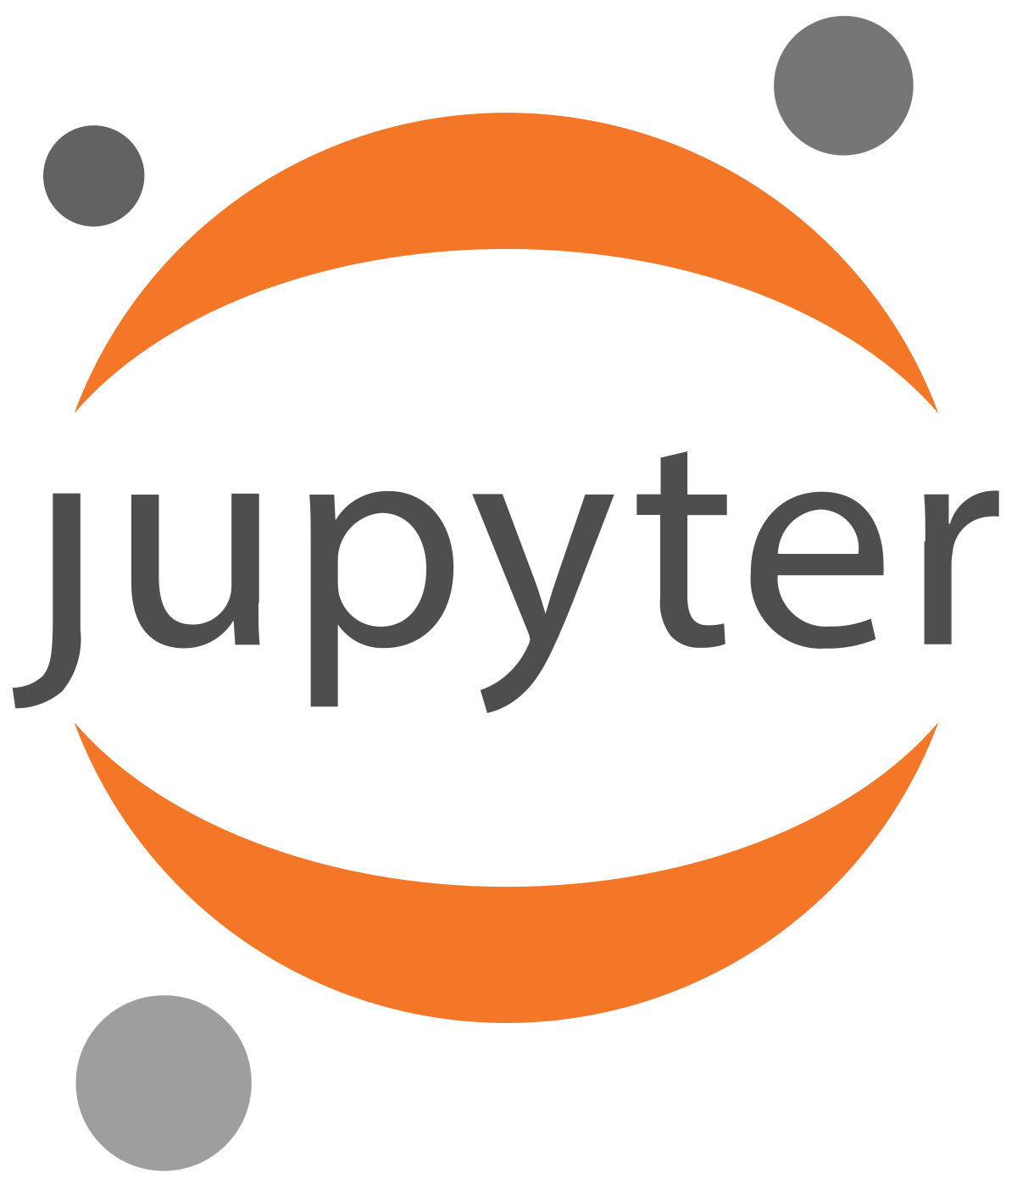
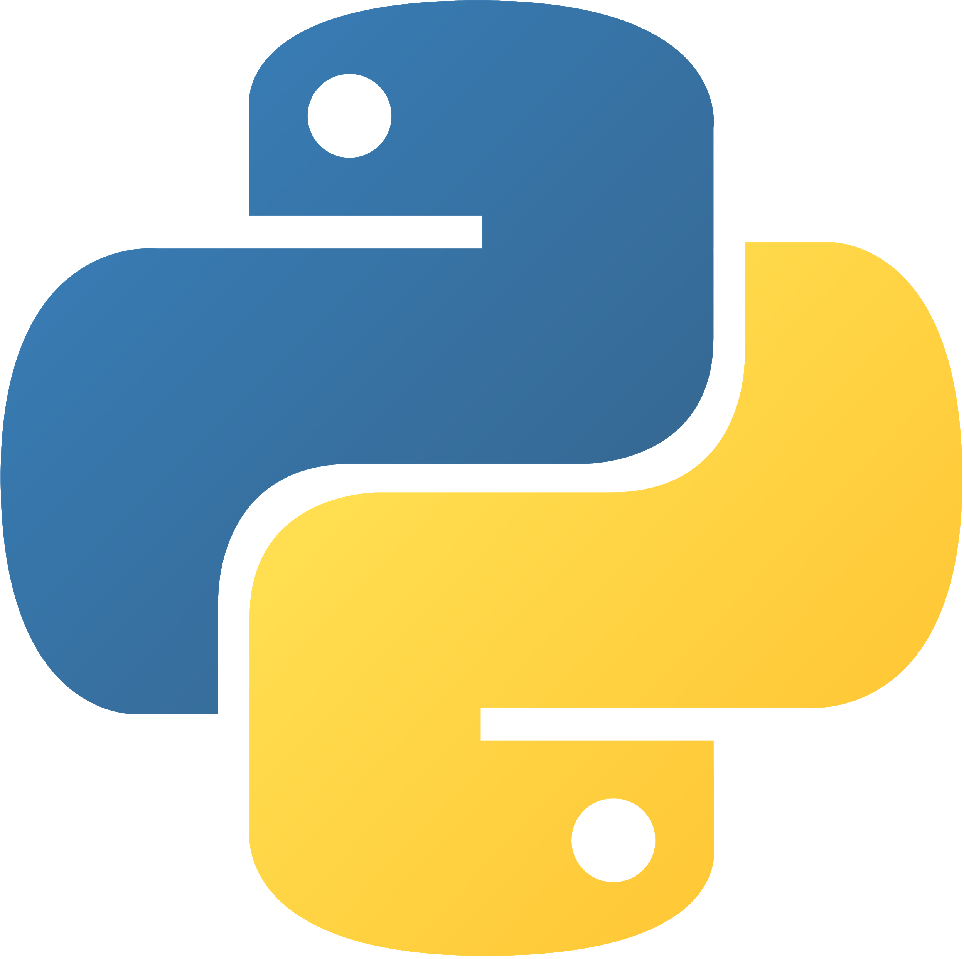
Programming Using Python
Lavanya Polamarasetty

Slide 2
Student Registration
http://engineering.apssdc.in/register/
Lavanya Polamarasetty

Slide 3
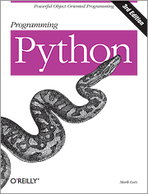

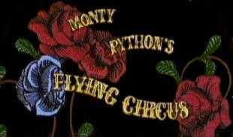

Python is the language of the Python Interpreter and those who can converse with it. An individual who can speak Python is known as a Pythonista. It is a very uncommon skill, and may be hereditary. Nearly all known Pythonistas use software initially developed by Guido van Rossum.

Slide 4
Why python?

Slide 5
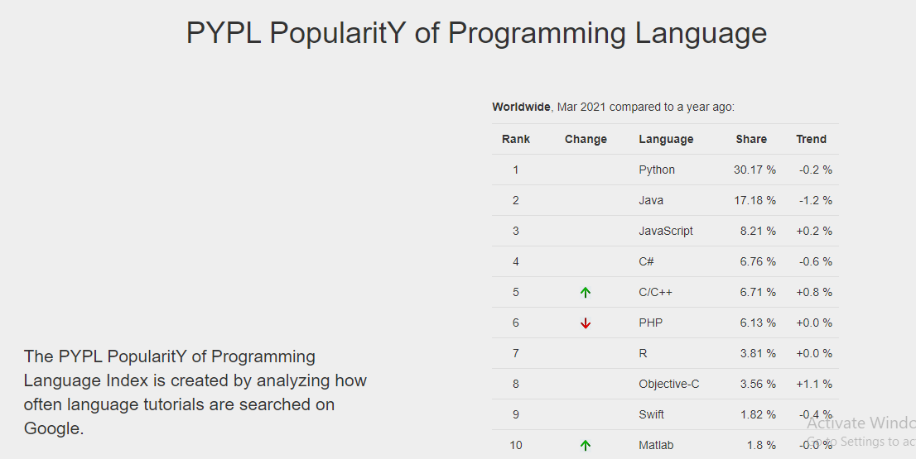
Why python
Notes:
http://pypl.github.io/PYPL.html

Slide 6
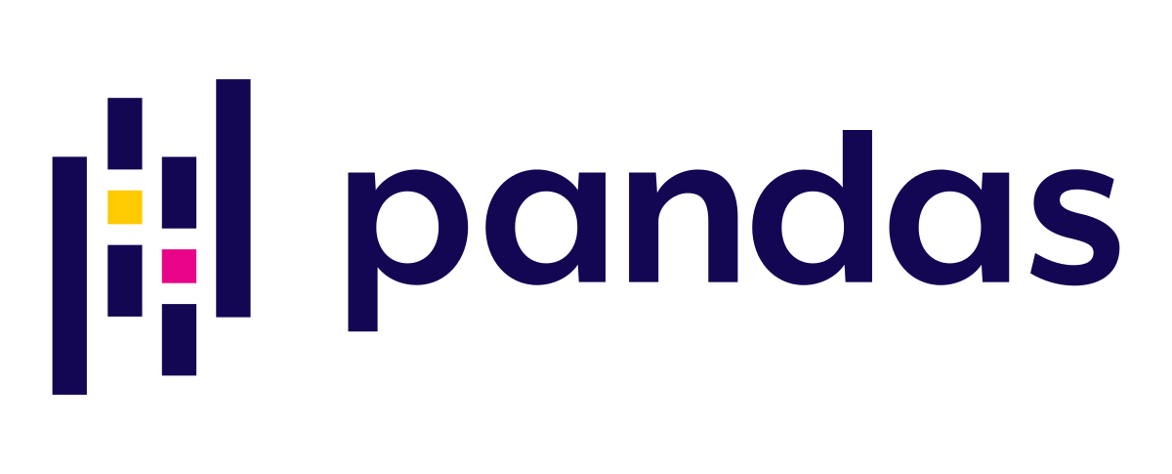
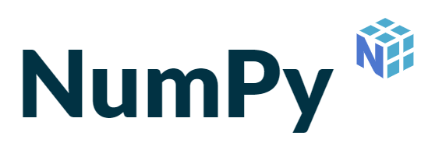

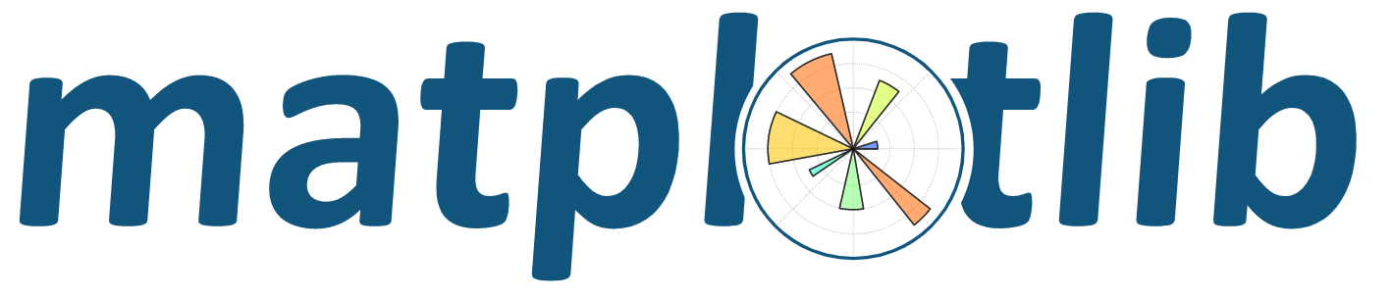
Libraries used in Python
Notes:
https://docs.python.org/3/library/

Slide 7

History
Python is an interpreted, high-level, Object-Oriented Programming and general-purpose programming language.
1994 -----> v1.0
2000 -----> v2.0 – 2020 2.7
2008 -----> v3.0
2019 -----> v3.8 3.7+
2020 -🡪 3.9.0
Guido Van Rossum

Slide 8
Features of Python
Easy To Learn, Code And Read
Free And Open-source
High-level Programming Language
Portable And Extensible
Interpreted
Object-oriented
Embeddable
Large Range Of Library

Slide 9
Python Programming Applications
Python had been developed to assimilate and work dynamically across various platforms.
Here is a list of applications on its functional role:
1. Artificial Intelligence
2. Machine Learning
3. Data Analysis
4. Web Development
5. Game Development
6. Embedded Applications
7. Scripting Applications
Notes:
1. Web development – Python is used in web frameworks such as Django and Flask. These application help in writing server-side code which helps to manage database, write back-end programming logic, mapping the urls’ etc.
2. Machine learning – Python has been integrated in writing many machine learning applications. Machine Learning focuses on writing a logical code for the machine to solve a particular problem on its own. For example, route recommendation on apps like Ola, Uber, Rapido, etc. is a machine learning algorithm that recognises user’s destination map. Fingerprint and Voice recognition in your phone is another example of machine learning.
3. Data Analysis – Python can develop Data analysis and data visualisation in form of charts.
4. Scripting – Small programs can automate simple tasks such as sending automated response emails etc with help of scripting form of writing. Such type of applications can also be written in Python programming language.
5. Game development – Python is also used majorly to develop games such of World of Tanks, The Sims 4, Civilization 4, Battlefield 2, etc.
6. Most of the industrial embedded applications use Python.
7. Desktop applications – You can develop desktop application in Python using library like TKinter or QT.
The facilitator discusses the use of Python scripts in UNIX/Windows

Slide 10
High-level data types
Numbers: int, float, complex
Strings: immutable
Lists, Tuple, Sets, dictionaries: containers
Other types for e.g. binary data, regular expressions
Extension modules can define new “built-in” data types

Slide 11
Softwares

Slide 12
Basic python IDLE
from https://www.python.org/downloads/
VS Code
PyCharm
Sublime Text
Atom
Spyder
Jupyter Notebook by Anaconda Distributions
From https://www.anaconda.com/products/individual
Google Colab by Google cloud service
From https://colab.research.google.com/
DataLab
Different online editors
From https://repl.it/languages/python3
Kaggle
Azure Jupyter notebooks

Slide 13
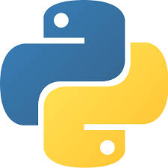

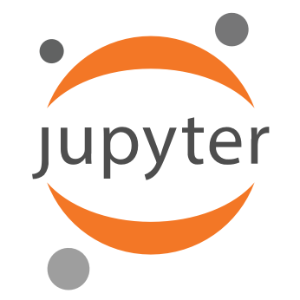

Anaconda for Python

Slide 14
Anaconda
It Is a platform/navigator to run python
Why should we use Anaconda for Python?
Many scientific packages require a specific version of Python to run. It’s difficult to keep various Python installations on one computer from interacting and breaking, and harder to keep them up-to-date.
Anaconda Distribution makes management of multiple Python versions on one computer easier, and provides a large collection of highly optimized, commonly used data science libraries to get you started faster Link for installation of Anaconda Software: https://www.anaconda.com/distribution/

Slide 15
Jupyter
Jupyter is a web - application
Jupyter name is a reference to the three core programming languages supported by Jupyter, which are Julia, Python and R
Jupyter Notebook: The Jupyter Notebook is an open-source web application that allows you to create and share documents that contain live code, equations, visualizations and narrative text.
Uses include: data cleaning and transformation, numerical simulation, statistical modelling, data visualization, machine learning, and much more.
Advantages: Best for data exploration, data preparation, data validation, ….

Slide 16
Anaconda Installation

Slide 17
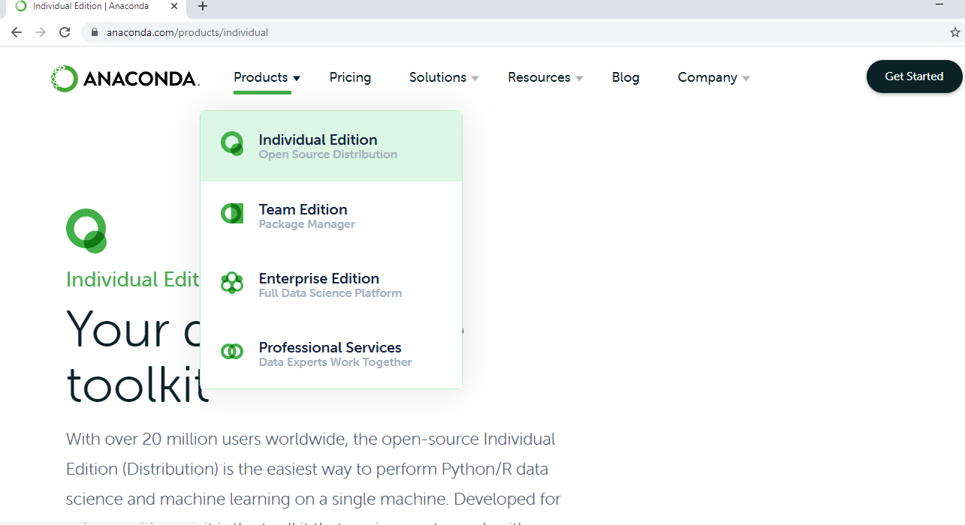
Installation

Slide 18
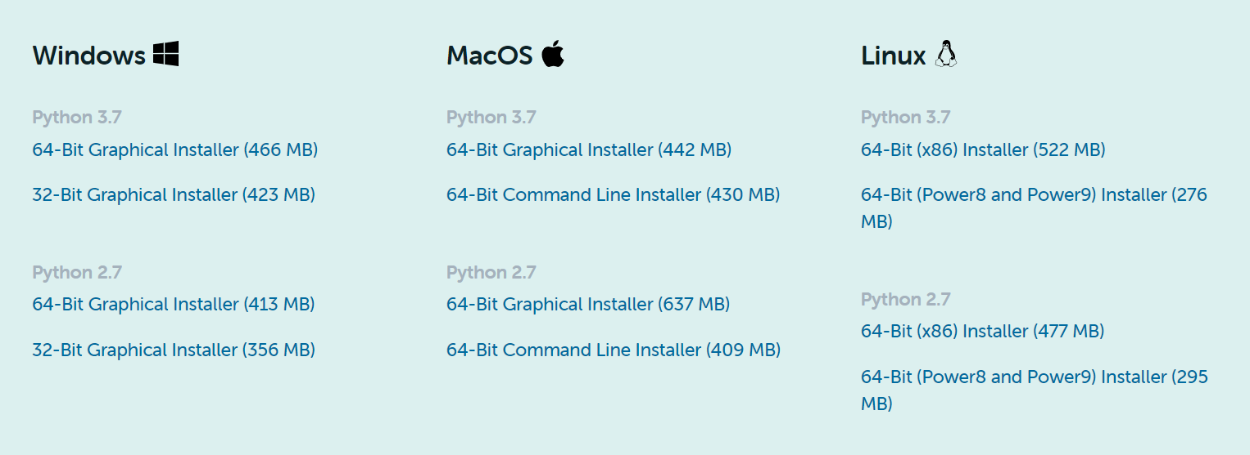
Downloading Anaconda Software
Visit: https://www.anaconda.com/products/individual

Slide 19
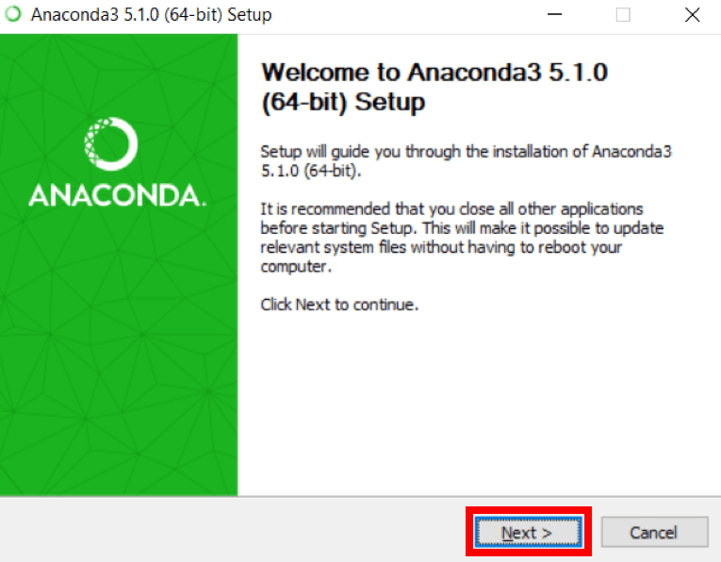
Installation

Slide 20
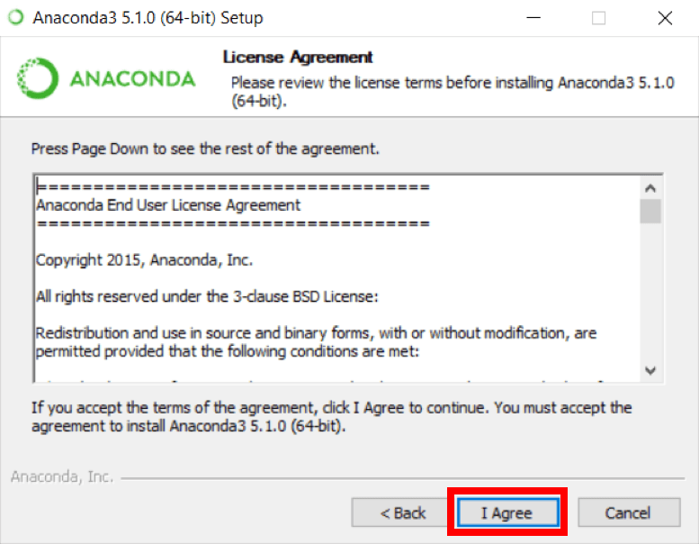
Installation

Slide 21
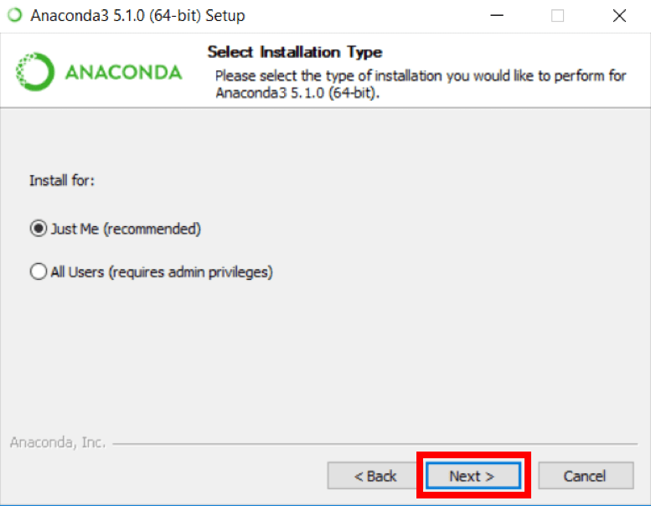
Installation

Slide 22
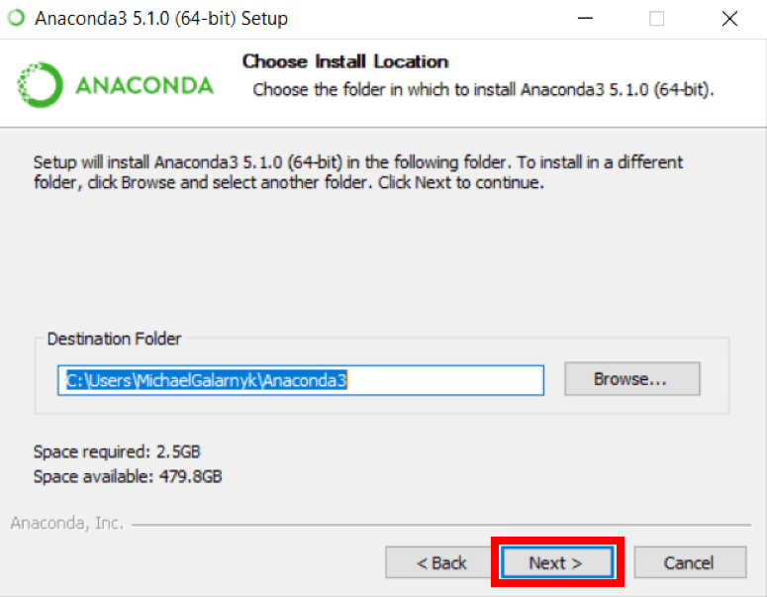
Installation

Slide 23
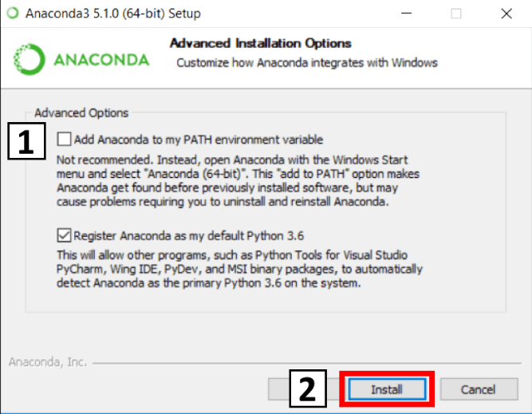
Installation

Slide 24
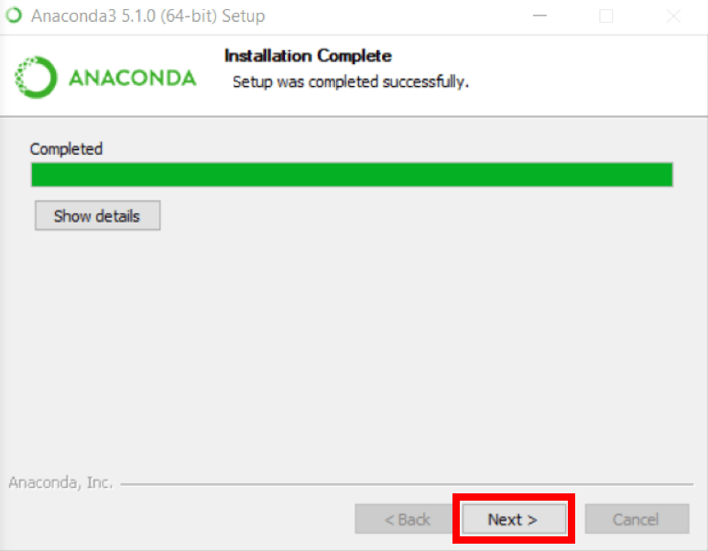
Installation

Slide 25
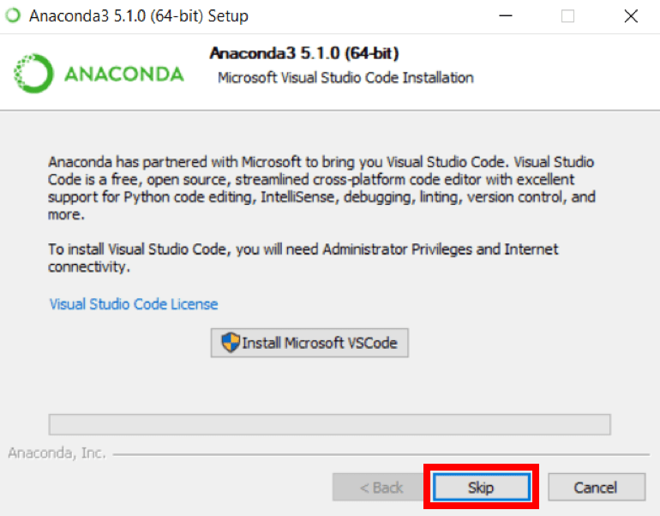
Installation

Slide 26
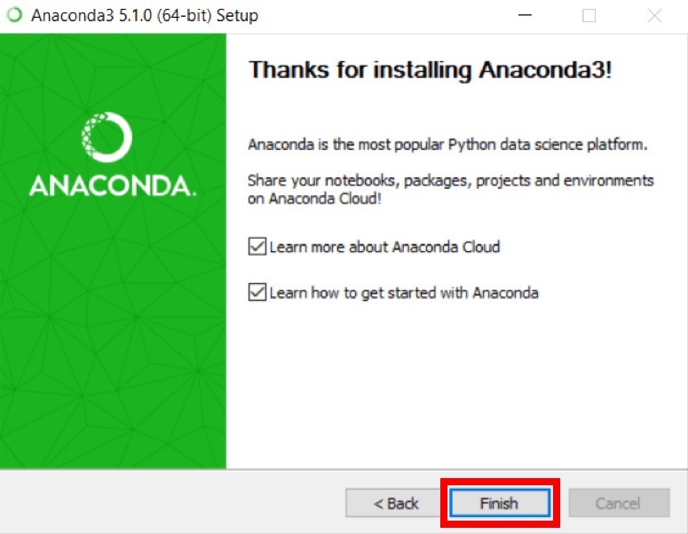
Installation

Slide 27
Let us start Jupyter Notebook
Lavanya Polamarasetty

Slide 28
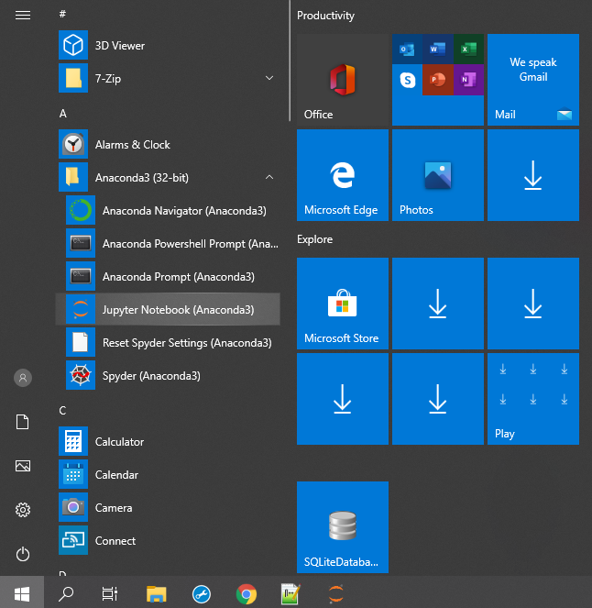
Launch Jupyter Notebook

