Slide 1
Bias is the simplifying assumptions made by the model to make the target function easier to approximate.
Variance is the amount that the estimate of the target function will change given different training data.

Slide 2
Overfitting: Good performance on the training data, poor generalization to other(test) data.
Underfitting: Poor performance on the training data and poor generalization to other(test) data

Slide 3
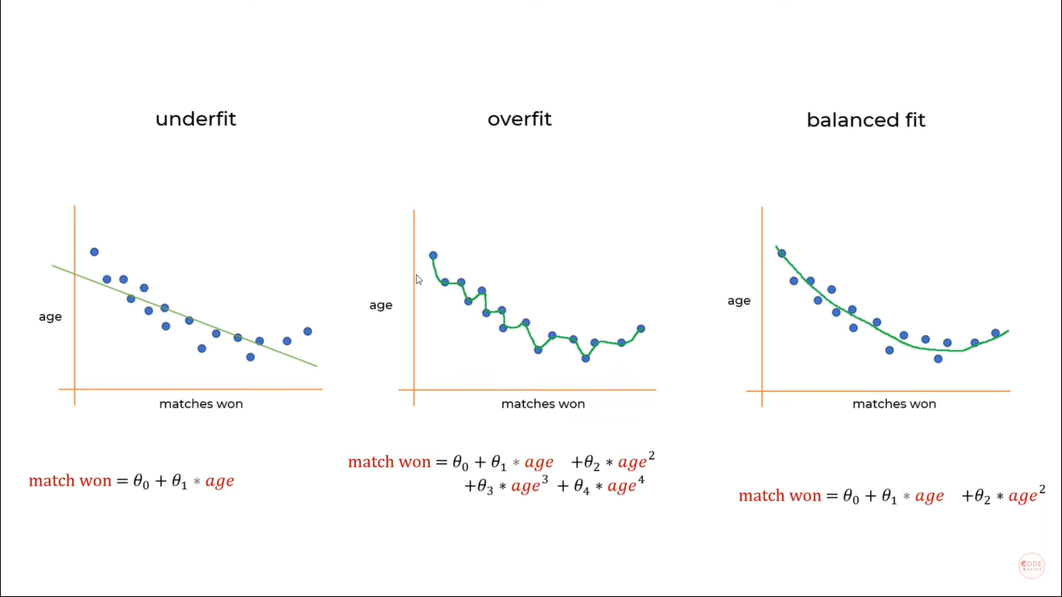

Slide 4
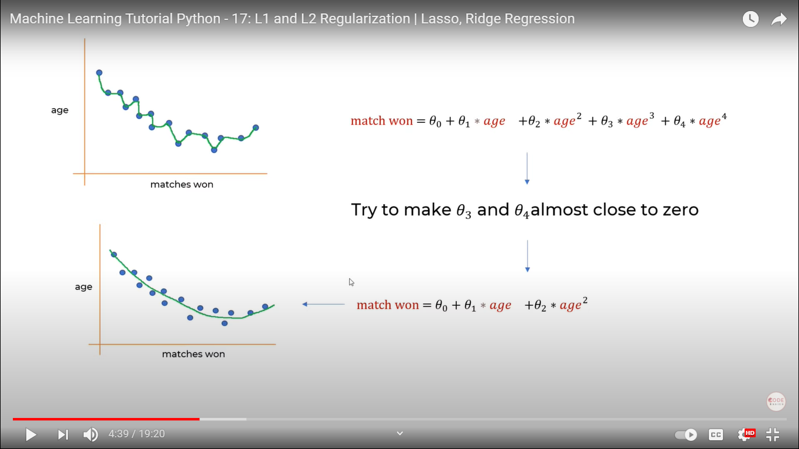

Slide 5
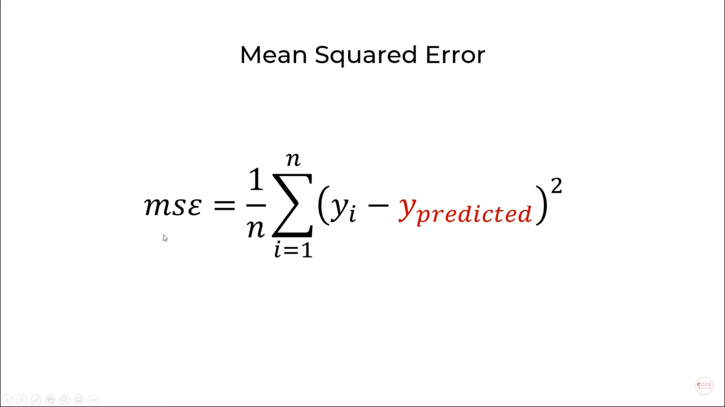

Slide 6
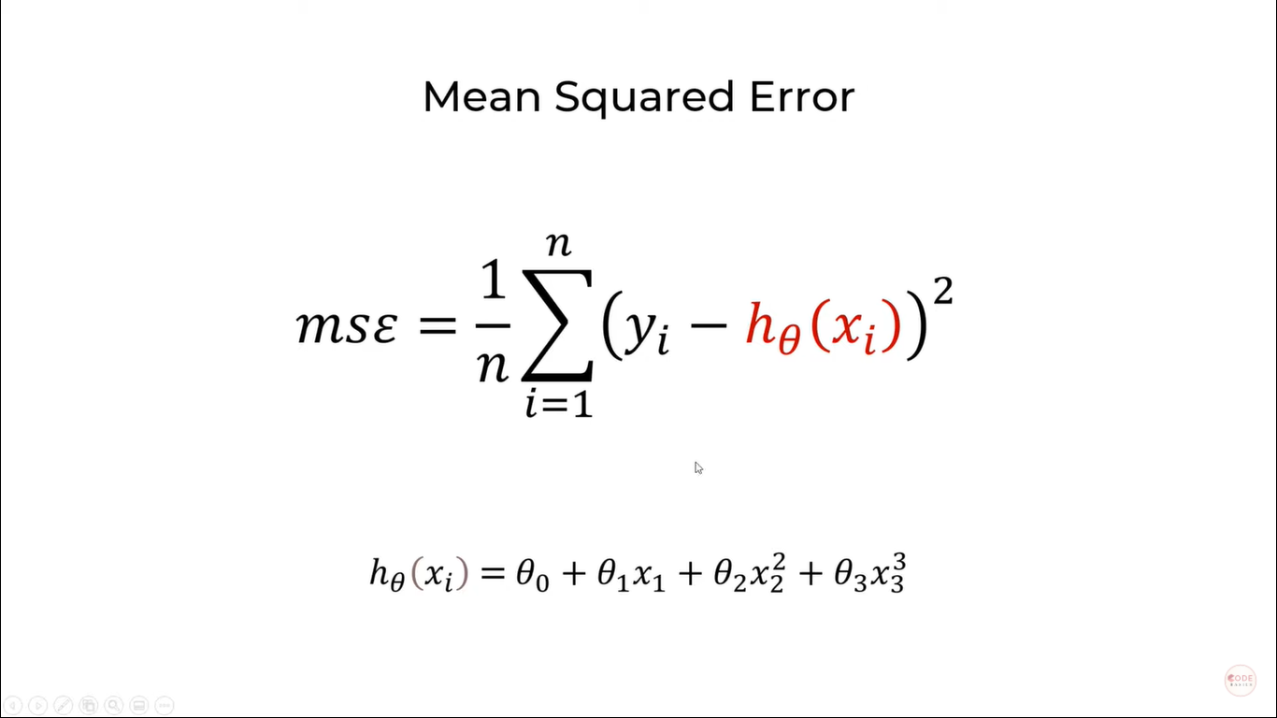

Slide 7
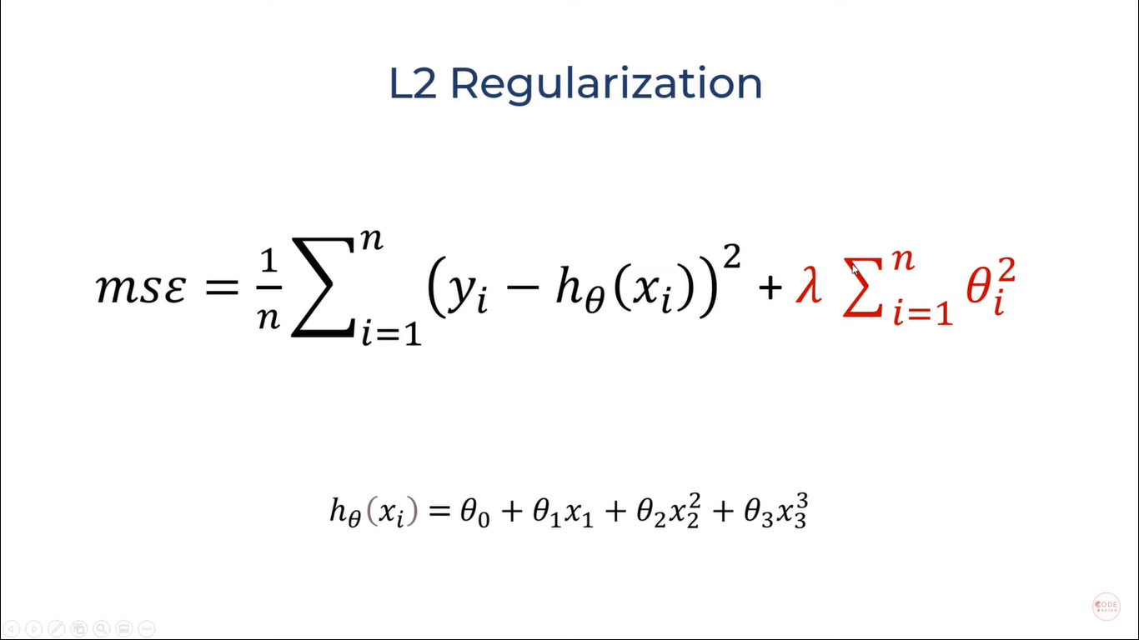

Slide 8
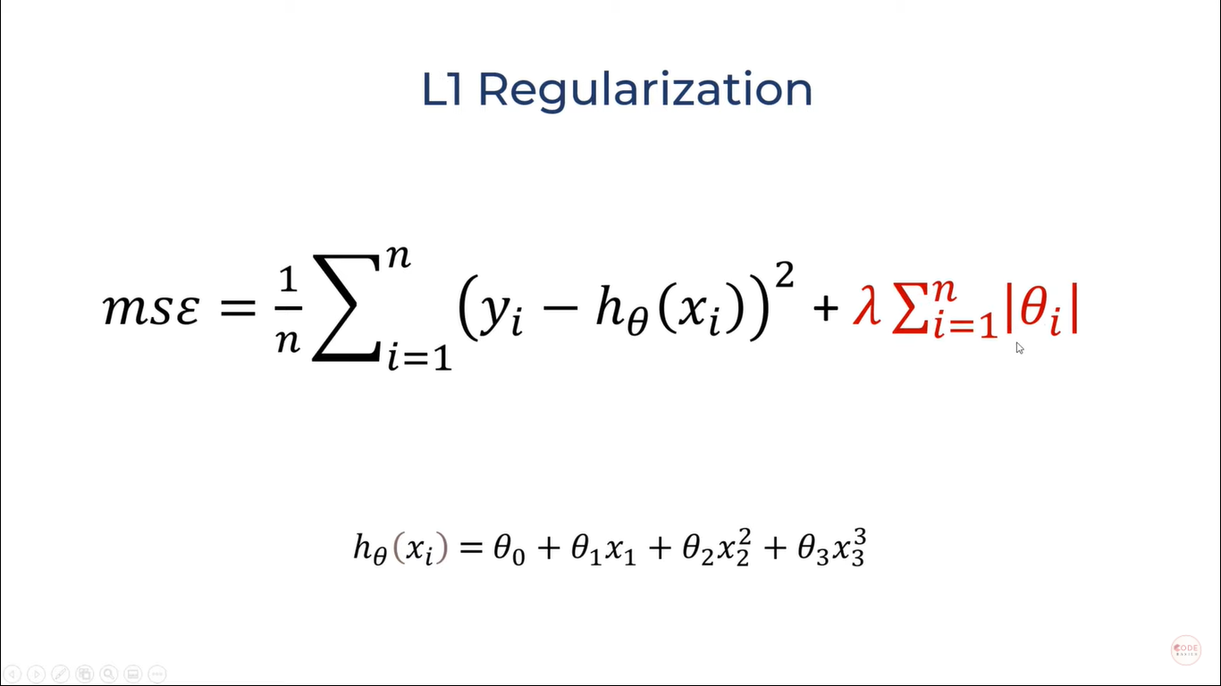

Slide 9
Ridge regression adds “squared magnitude” of coefficient as penalty term to the loss function
Lasso Regression (Least Absolute Shrinkage and Selection Operator) adds “absolute value of magnitude” of coefficient as penalty term to the loss function.

Slide 10
How to Prevent Overfitting or UnderFitting
Cross-validation. Cross-validation is a powerful preventative measure against overfitting. ...
Train with more data. It won't work every time, but training with more data can help algorithms detect the signal better. ...
Remove features. ...
Early stopping. ...
Regularization. ...
Ensembling.

