Slide 1

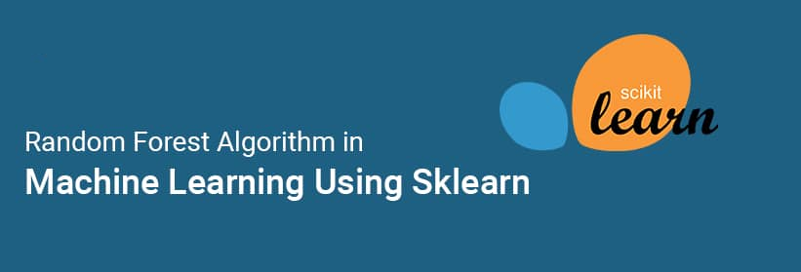

Slide 2
Day07 Agenda
Decision Tree Regressor
Random Forest Algorithm

Slide 3
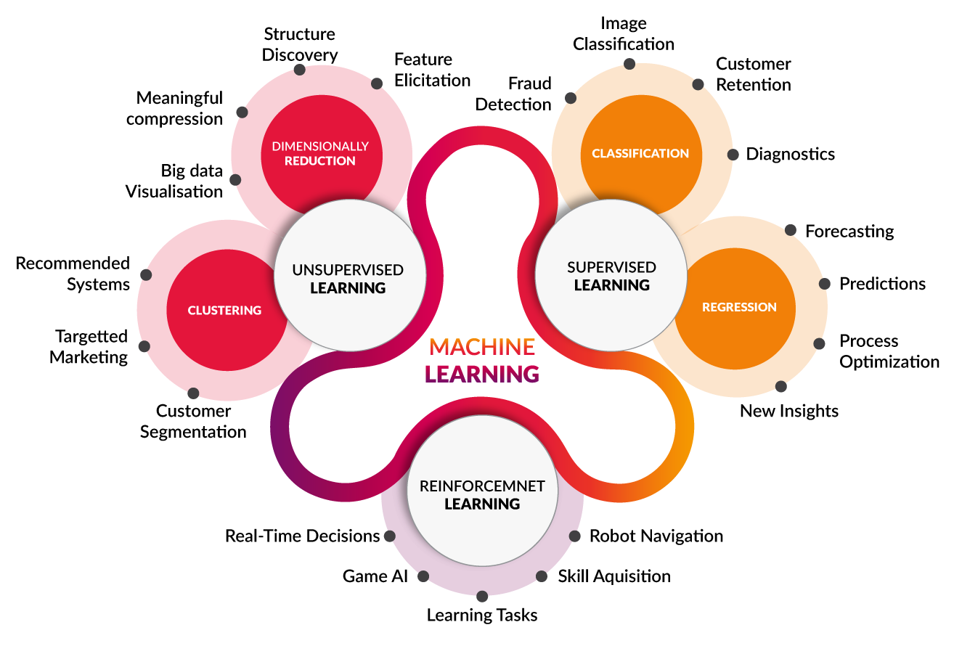
Machine Learning Categories

Slide 4
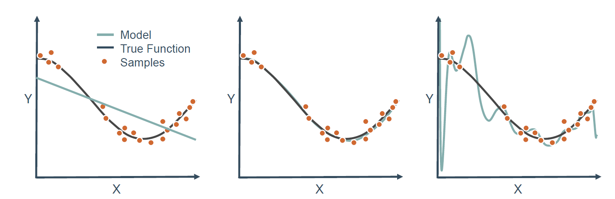
Under Fitting Vs Best Fit vs Over Fitting

Slide 5
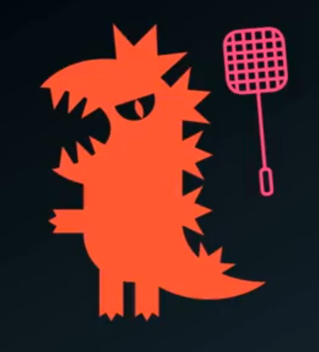

Over Fitting vs Under Fitting
Under Fitting
Over Fitting

Slide 6
Bias-Variance Trade-Off
Bias are the simplifying assumptions made by a model to make the target function easier to learn.
Low Bias: Suggests less assumptions about the form of the target function.
High-Bias: Suggests more assumptions about the form of the target function.
Variance is the amount that the estimate of the target function will change if different training data was used.
Low Variance: Suggests small changes to the estimate of the target function with changes to the training dataset.
High Variance: Suggests large changes to the estimate of the target function with changes to the training dataset.

Slide 7
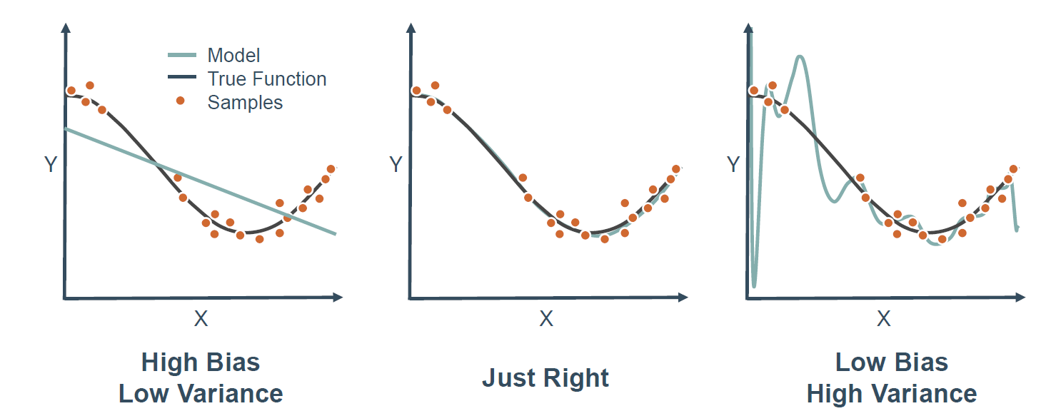
Bias-Variance Trade-Off

Slide 8
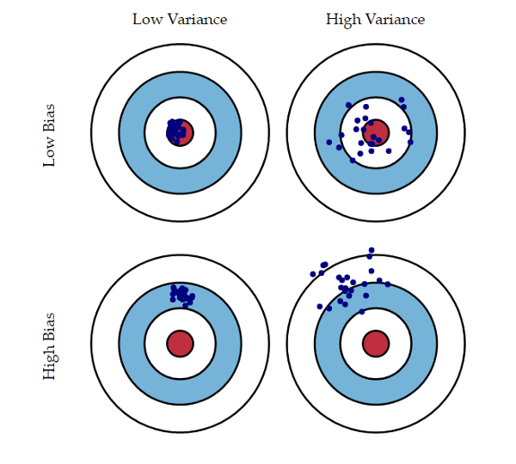
What is bias and variance?
Bias is the difference between the average prediction of our model and the correct value which we are trying to predict. Model with high bias pays very little attention to the training data and oversimplifies the model. It always leads to high error on training and test data.
Variance is the variability of model prediction for a given data point or a value which tells us spread of our data. Model with high variance pays a lot of attention to training data and does not generalize on the data which it hasn’t seen before. As a result, such models perform very well on training data but has high error rates on test data.

Slide 9
underfitting
In supervised learning, underfitting happens when a model unable to capture the underlying pattern of the data. These models usually have high bias and low variance. It happens when we have very less amount of data to build an accurate model or when we try to build a linear model with a nonlinear data.

Slide 10
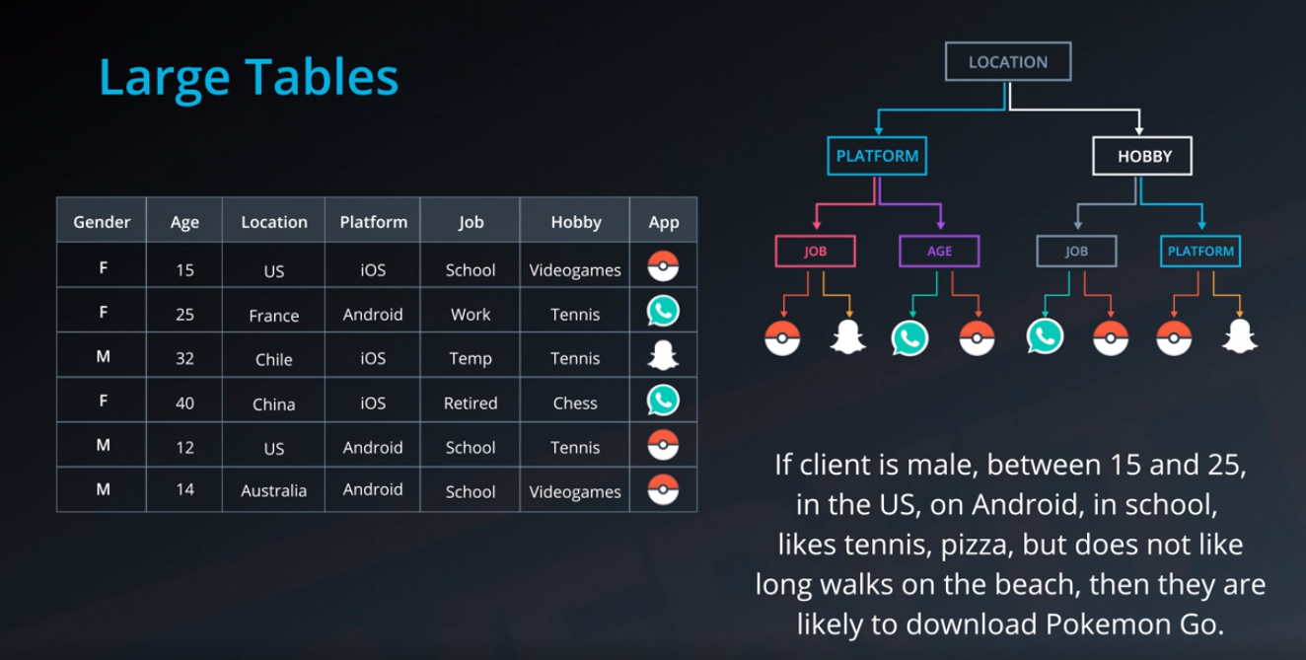
Overfitting Problems in Decision Trees

Slide 11
Ensemble
What are ensembles?
When multiple models used together to make more powerful model. Combining the models.
Actual Meaning of Ensemble is “Group of Musicians” in ML it is referred as combination of Multiple Models
Bagging
Boosting
Stacking
M1
M2
M3 …. Mn
M

Slide 12
Ensemble methods
A single decision tree does not perform well
But, it is super fast
What if we learn multiple trees?
We need to make sure they do not all just learn the same

Slide 13
Bagging
If we split the data in random different ways, decision trees give different results, high variance.
Bagging: Bootstrap aggregating is a method that result in low variance.
If we had multiple realizations of the data (or multiple samples) we could calculate the predictions multiple times and take the average of the fact that averaging multiple onerous estimations produce less uncertain results
Notes:
General purpose method, here only for decision trees

Slide 14
Bagging
Reduces overfitting (variance)
Normally uses one type of classifier
Decision trees are popular
Easy to parallelize

Slide 15
Random Forest
Random forest (or random forests) is an ensemble classifier that consists of many decision trees and outputs the class that is the mode of the class's output by individual trees.
The term came from random decision forests that was first proposed by Tin Kam Ho of Bell Labs in 1995.
The method combines Breiman's "bagging" idea and the random selection of features.

Slide 16
Features and Advantages
The advantages of random forest are:
It is one of the most accurate learning algorithms available. For many data sets, it produces a highly accurate classifier.
It runs efficiently on large databases.
It can handle thousands of input variables without variable deletion.
It gives estimates of what variables are important in the classification.
It generates an internal unbiased estimate of the generalization error as the forest building progresses.

