Slide 1
Payment behavior prediction model
BY AYAN PAL

Slide 2
index
topics | Page numbers
Objective & approach | 3-7
codes | 8-23
Summary table explanation | 24
Model accuracy | 25-27
Model output | 28-30

Slide 3
OBJECTIVE AND APPROACH EXPLANING THE DATA
HERE WE ARE GIVEN PAYMENT’S DATA FOR FIVE MONTHS FROM JAN 2020 TO MAY 2020 WITH THE FOLLOWING VARIABLES:
1. CUSTOMER ID
2. REGION
3. DIVISION
4. MONTH
5. YEAR
6. PAYMENT
7. BUCKET

Slide 4
(contd.)
CUSTOMER ID HAS SERIAL NUMBERS FOR 223 CUSTOMERS
REGION HAS ONLY ONE REGION “R1”
DIVISION HAS FOUR DIVISIONS “D1”, ”D2”, ”D3”, D4”
MONTH HAS FIVE MONTHS IN FIVE SEPARATED SHEETS, STARTING FROM JAN TO MAY
YEAR IS 2020
PAYMENT IS THE ONLY QUANTITATIVE VARIABLE IN THE DATA, CONTANING PAYMENTS FOR RESPECTIVE CUSTOMERS
BUCKET, CLUSTERS THE CUSTOMERS BASED ON WHEN THEY PAYS THEIR PAYMENT.
THE CLASSIFICATIONS ARE: (D, D+3, D+6, D+15, D-3) WHERE,
D : DENOTES ONE PAYS IT ON DUE DATE
D+ : DENOTES ONE PAYS IT AFTER DUE DATE
D- : DENOTES ONE PAYS IT BEFORE DUE DATE

Slide 5
OBJECTIVE AND APPROACH OBJECTIVE
WE ARE TO FIND THE PAYMENT BEHAVIOR OF EACH CUSTOMER.

Slide 6
OBJECTIVE AND APPROACH APPROACH
HERE WE USE “THE LOGISTIC REGRESSION” TO PREDICT THE PAYMENT BEHAVIOR OF CUSTOMERS.

Slide 7
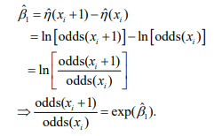
OBJECTIVE AND APPROACH: LOGISTIC REGRESSION
INTRODUCTION: When the study variable is a qualitative variable, then its values can be expressed using an indicator variable taking only two possible values 0 and 1. In such a case, the logistic regression is used. For example, y can denotes the values like success or failure, yes or no, like or dislike, which can be denoted by two values 0 and 1.
What is logit?
In case of linear regression g(μi) = μi serves as a good link function (The link function in generalized linear model relates the linear predictor ηi= g(μi) to the mean response μi)
In the case of logistic regression, the link function is defined as η=ln (π/1−π)
This transformation is called as the logit transformation of probability π and π/1−π is called as odds. The link η is also called as log-odds.
What is odds ratio?
Odds ratio is the estimated increase in the probability of success when the value of explanatory variable changes by one unit. Consider a simple case of logistic model with only one explanatory variable:

Slide 8
Odds ratio interpretation
If the odds is equals to 5:1 and odds ratio is 2, the 1 unit change in explanatory variable makes the odds 5:1 to 10:1
Odds(xi+1)=OR * Odds(xi)

Slide 9
OBJECTIVE AND APPROACH PREPROCCESSING
1. Firstly, we merge all five month’s data W.R.T the customer id
2. The preprocessed data has id, division, five payments & five buckets columns
3. Then we change the bucket columns to categorical variables,
Here, on-time payment (denoted as 1) if the payment done within 5 days of due date, otherwise late (denoted as 0)
4. Then we create a “target variable” named “payment behavior”. It is also a categorical type variable taking only two values 0 & 1.
5. The target column is created by adding the updated bucket columns, if the sum is 3 or more we denote it by 1, otherwise 0. (I.E. If a person did 3 or more times “on-time payment” then it is likely that in future he will do the same)

Slide 10
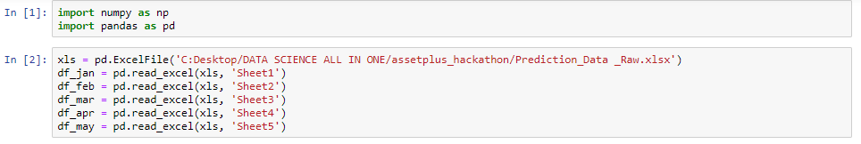
Codes importing necessary packages & dataset

Slide 11
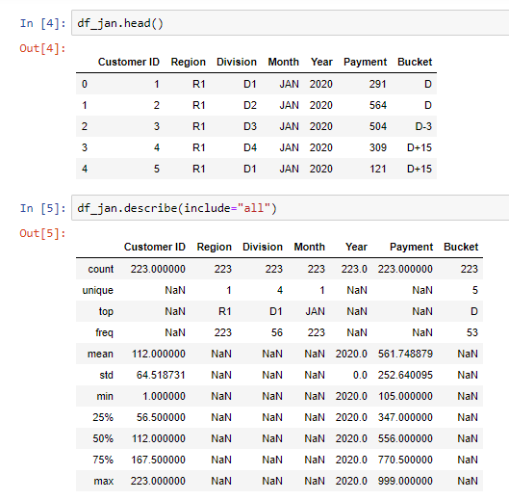
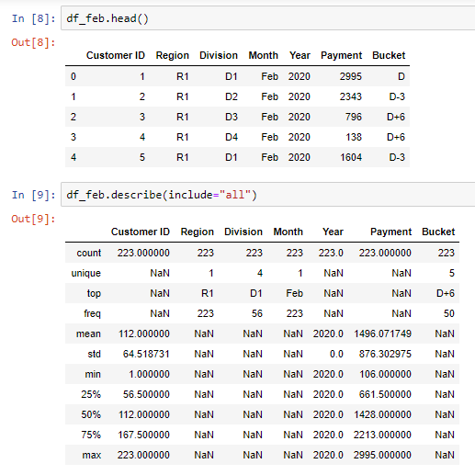
Codes Summary
For the month of January
For the month of February

Slide 12
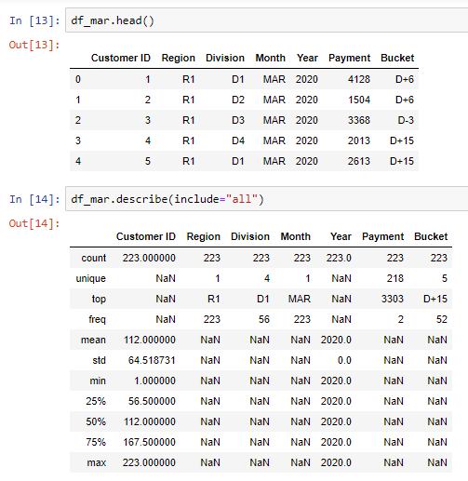
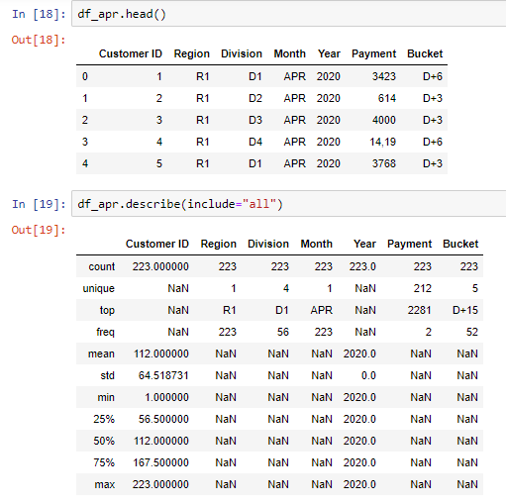
codes Summary
For the month of March
For the month of April
Here the column payment has string values so that we don’t get the summary for that columns in these two months, we preprocessed this column later

Slide 13
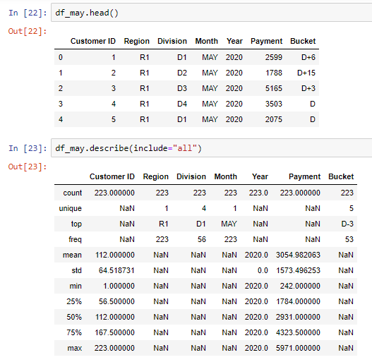
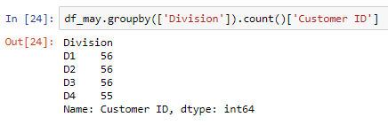
codes summary
For the month of may
Frequency distribution of customers w.r.t divisions
** This distribution is same for each of the five months

Slide 14
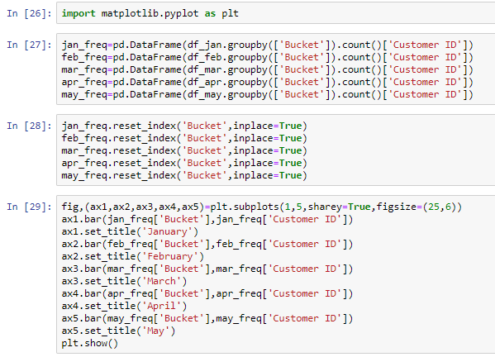
Codes Plotting bar graph for bucket frequency

Slide 15
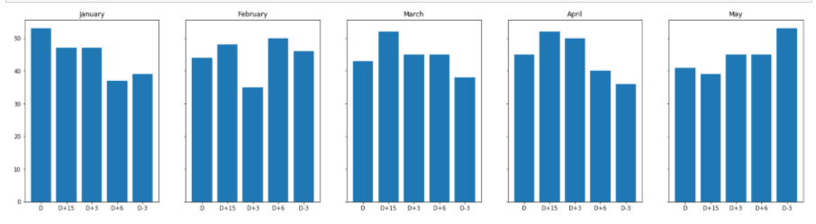
Codes Plotting bar graph for bucket frequency

Slide 16
Codes predictive analysis
First we use MS-EXCEL to do some preprocessing with the data to make it suitable for analysis
Here we merge payments columns and bucket columns for five months using VLOOKUP function
e.g.
=VLOOKUP(A1:A224,Sheet2!A1:G224,6,FALSE) (for payments)
=VLOOKUP(A1:A224,Sheet3!A1:G224,7,FALSE) (for buckets)
If we change the sheet numbers in these above function we get our corresponding payments or bucket columns.

Slide 17
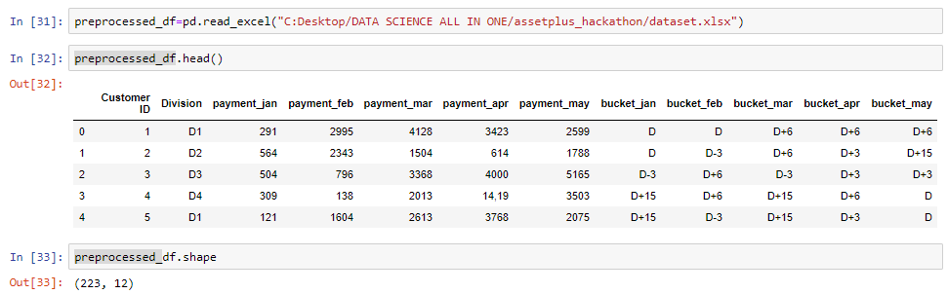
Codes importing the preprocessed data

Slide 18
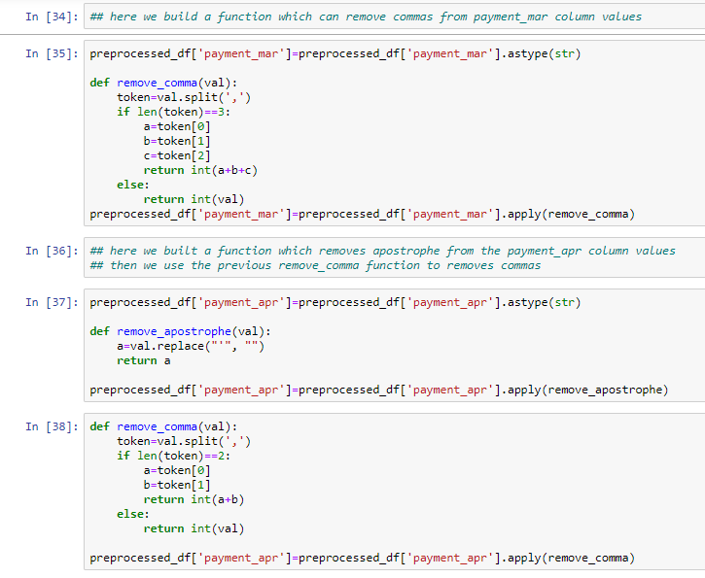
Codes Building different functions to remove comma and apostrophe from payments column in the months of March and April

Slide 19

Codes creating dummies
Creating dummies for different bucket clusters

Slide 20
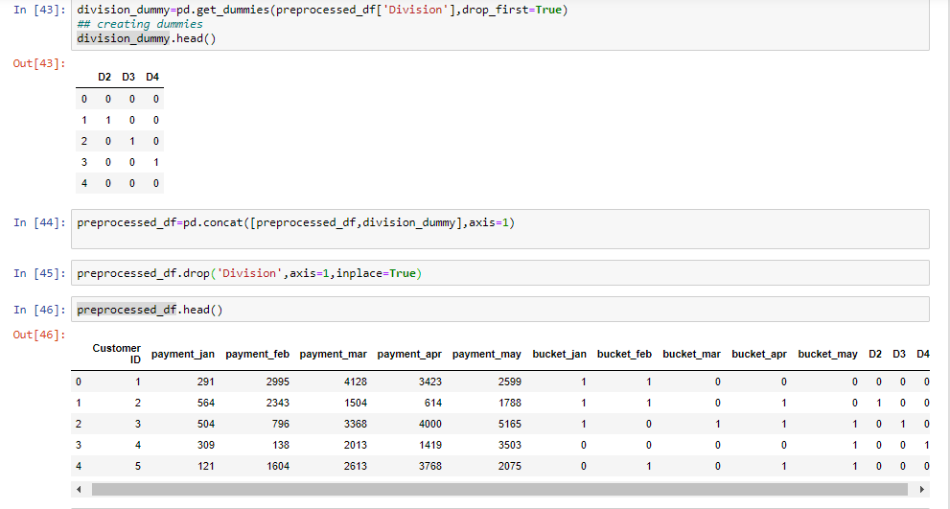
Codes
Creating dummies for different divisions

Slide 21
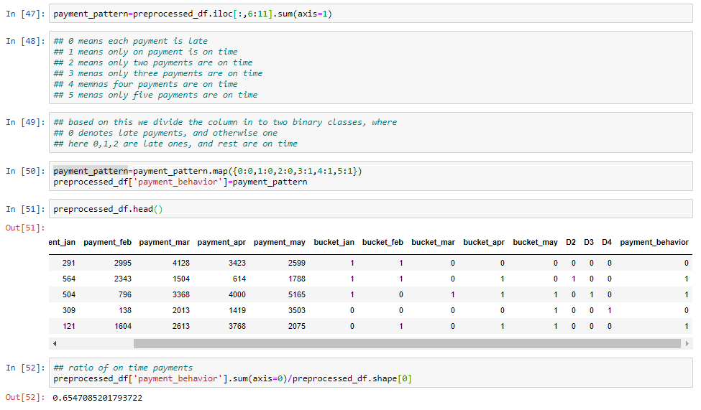
Codes creating response variable ** If one pays ON-TIME three or more times during these months we can say that it is likely that he/she will pay his/her bill on time in future also, and we denotes it by 1, otherwise zero.

Slide 22
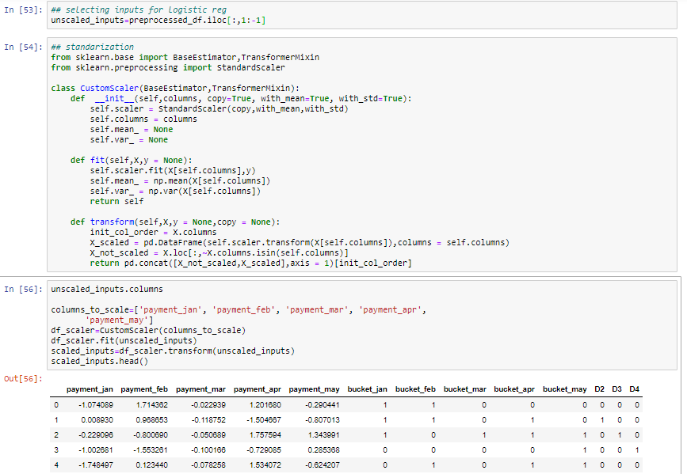
Codes: selecting inputs for logistic regression

Slide 23
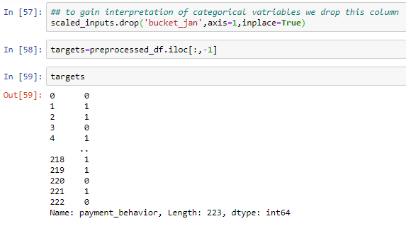
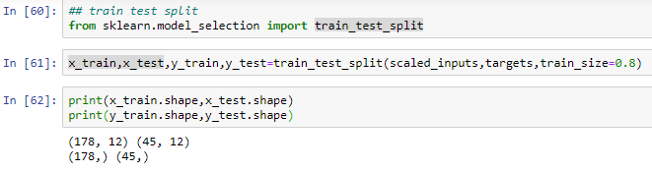
Codes
selecting targets for logistic regression
Train and test data splitting

Slide 24
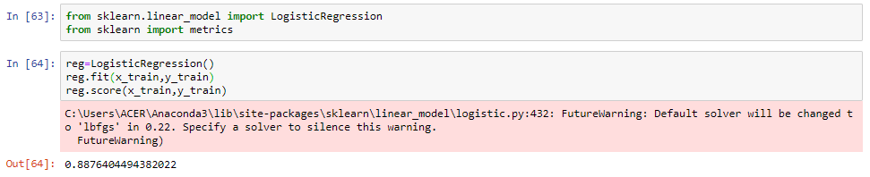
codes fitting of logistic regression and regression score based on train data reg.score (x_train, y_train)=0.89 (approx) which is quite good. Regression score implies our model’s prediction is 89% correct for training data, i.e. it predicts 0 when it is really 0, and 1 when it is really 1 with 89% accuracy.

Slide 25
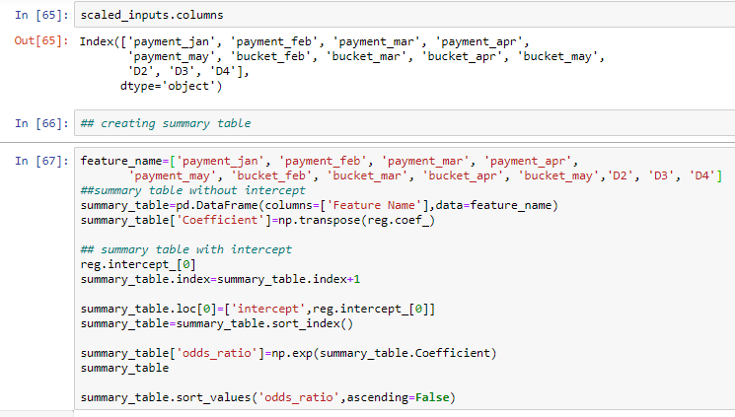
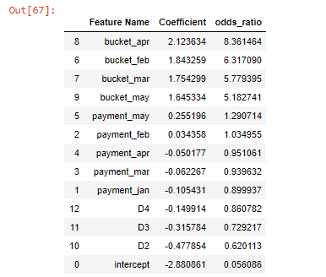
Codes summary table of logistic model

Slide 26
Summary table explanation
In here we have the most important features to predict the payment behavior at the top of the table, our main criteria to find the important features are
Their coefficient must be far from 0, as a weight of 0 implies no matter the feature value we will multiply it with 0
Their odds ratio must be far from 1, as for a unit change in feature , the odds increase by a multiple equals to the odds ratio
e.g. we have the odds ratio for bucket_apr 8.36
Which means the chances of on-time payment in future based on customer behavior in April is 8 times higher than based on customer behavior in January.

Slide 27

Model accuracy this logistic model predict payment behavior of completely new customers, which it doesn’t see while training WITH 91% ACCURACY

Slide 28
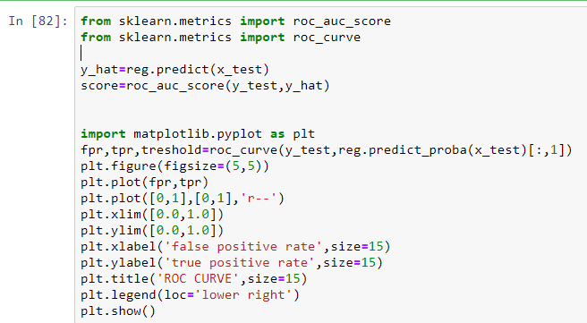
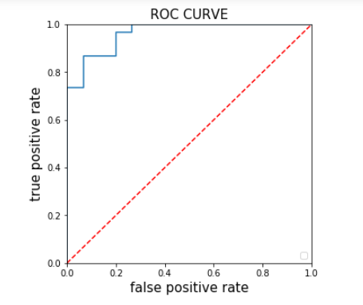
Model accuracy roc curve roc curve is a plot of signal(true positive rate) against Noise(false positive rate). The model performance is determined by the area under curve (AUC), if the AUC IS 1 THEN IT WILL BE THE BEST POSSIBLE MODEL AND IF IT IS 0.5 THEN WORST CASE. HERE AUC IS 0.91.

Slide 29
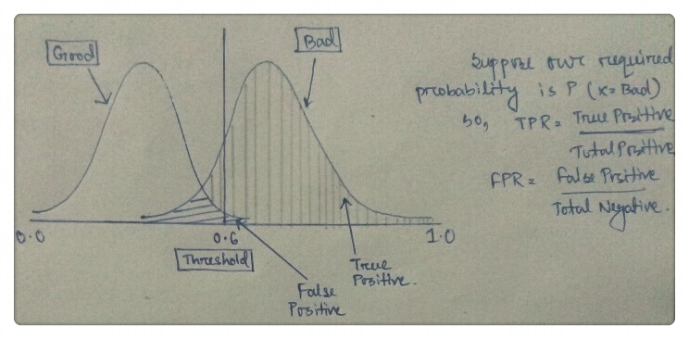
PROCEDURE TO EVALUATE ROC CURVE
First we draw a normal plot to get the TPR(true positive rate) & FPR(false positive rate)
The ‘total positive’ is the area under the right side curve and ‘total negative’ is the area under the left.
The ‘true positive’ is the area designated as bad on the right side of the threshold and ‘false positive’ is the area designated as good on the right side of the threshold.
Now we evaluate the curve by plotting FPR on x-axis and TPR on y-axis for different threshold points.

Slide 30
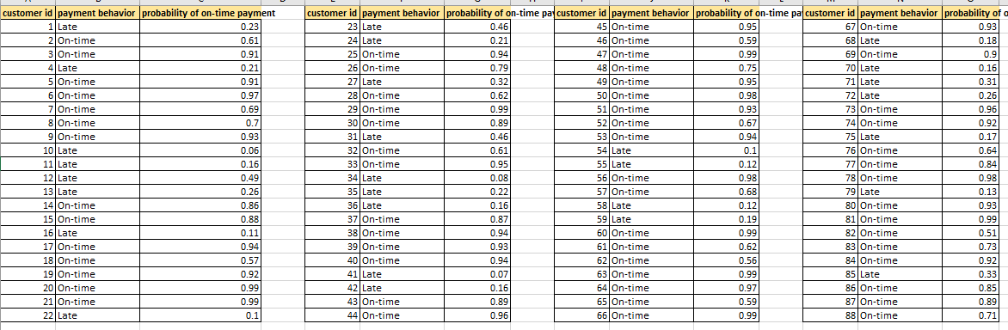
Model output we divide the payment behavior of customers in two categories 1. Late 2. on time CODE: REG.PREDICT(SCALED_INPUTS) / THEN USING EXCEL “IF” FUNCTION TO CHANGE 0-1 INTO LATE AND ON-TIME RESPECTIVELY HERE WE EVALUATE WITH HOW MUCH PROBABILITY ONE CUSTOMER PAYS BILL ON-TIME. CODE: PREDICTED_PROBA=REG.PREDICT_PROBA(SCALED_INPUTS) LIST(PREDICTED_PROBA[:,-1].ROUND(2))

Slide 31
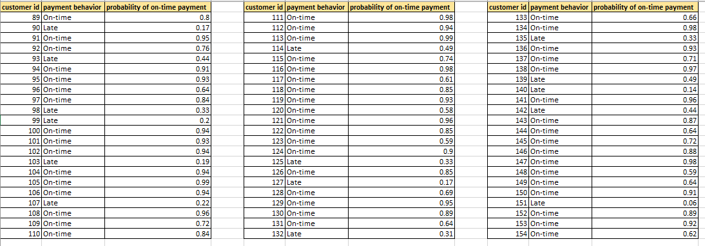
Model output

Slide 32
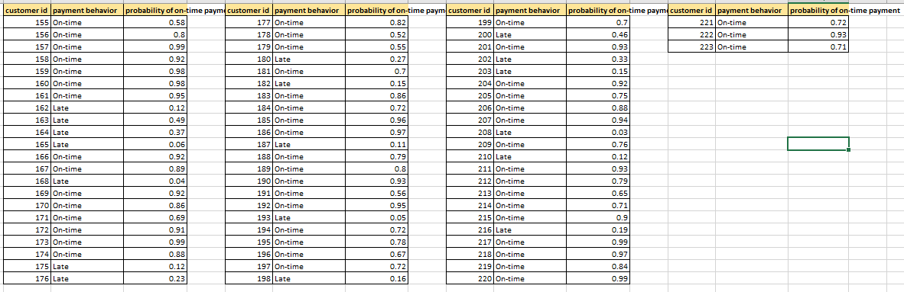
Model output

Slide 33
Thank you
Very much

