Slide 1
DIGITAL IMAGE PROCESSING
WAVELET-BASED
IMAGE DENOISING
Using DWT and Soft / Hard Thresholding
MAJOR PROJECT PRESENTATION • DIP
Name: Gudimalla Apoorva
Enrollment no.: 24CS003334
Section: D

Slide 2
01 Project Summary
What the system does and why it is useful.
THE PROBLEM
THE APPROACH
THE APPLICATION
Digital images can contain grain-like noise that affects clarity, texture and visual quality.
Use the Discrete Wavelet Transform to separate image details, threshold noisy coefficients, then reconstruct.
A web interface uploads an image, lets users choose soft/hard thresholding and displays a returned output.
PROJECT PIPELINE
Upload → Set threshold → DWT → Threshold details → Inverse DWT → Display / Download
Main aim: reduce noise while keeping important edges, colours and fine details.
02

Slide 3
02 Objectives
The key goals of the implementation.
• Create a simple, responsive web interface for image denoising.
• Connect the browser interface to a Python Flask backend.
• Apply DWT to represent image information at multiple scales.
• Support both soft and hard thresholding of detail coefficients.
• Let users adjust threshold strength and compare input/output images.
• Show image metadata and provide download controls.
INPUT
JPG / JPEG / PNG image
PROCESSING
OpenCV + PyWavelets
OUTPUT
Reconstructed PNG image
03

Slide 4
03 Technical Method: DWT
Wavelets analyse an image at multiple resolutions.
1. DECOMPOSITION
2. NOISE ESTIMATION
DWT separates the image into an approximation band (LL) and detail bands (LH, HL, HH).
The backend estimates noise level from the finest diagonal detail coefficients.
3. THRESHOLDING
4. RECONSTRUCTION
Small detail coefficients are reduced or set to zero; the selected method controls how larger values behave.
Inverse DWT recombines the filtered coefficients into the output image.
Colour handling: the current backend processes the luminance channel in YCrCb, then converts back to BGR.
04

Slide 5
04 Soft vs. Hard Thresholding
Both methods remove small coefficients, but handle retained coefficients differently.
SOFT THRESHOLDING
HARD THRESHOLDING
• Values with magnitude below the threshold become zero.
• Values above it are shrunk toward zero.
• Often creates smoother results and can reduce harsh artefacts.
• Values below the threshold become zero.
• Values above it are kept unchanged.
• Can retain strong detail but may leave sharper transitions.
Threshold trade-off: stronger filtering may remove more noise, but can also erase fine textures and edges.
05

Slide 6
05 System Architecture
The frontend sends the image and settings to the backend.
01
02
03
04
05
Browser UI
➜
User controls
➜
HTTP request
➜
Image processing
➜
PNG response
HTML + CSS
JavaScript
POST /denoise
Flask + OpenCV + PyWavelets
Display / Download
FRONTEND RESPONSIBILITIES
BACKEND RESPONSIBILITIES
Select image, read threshold controls, send request, show output and metadata.
Decode image, run wavelet processing, reconstruct image and return PNG bytes.
06

Slide 7
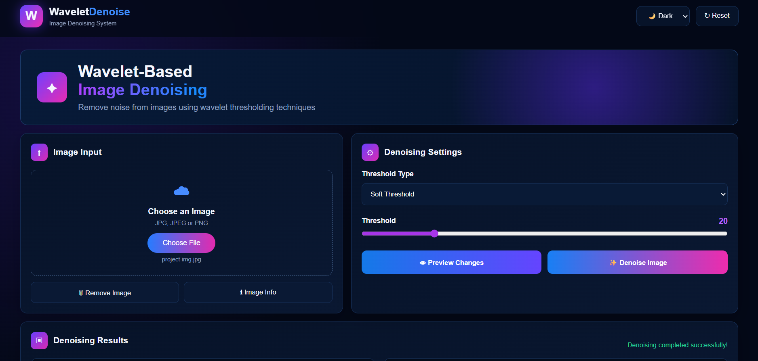
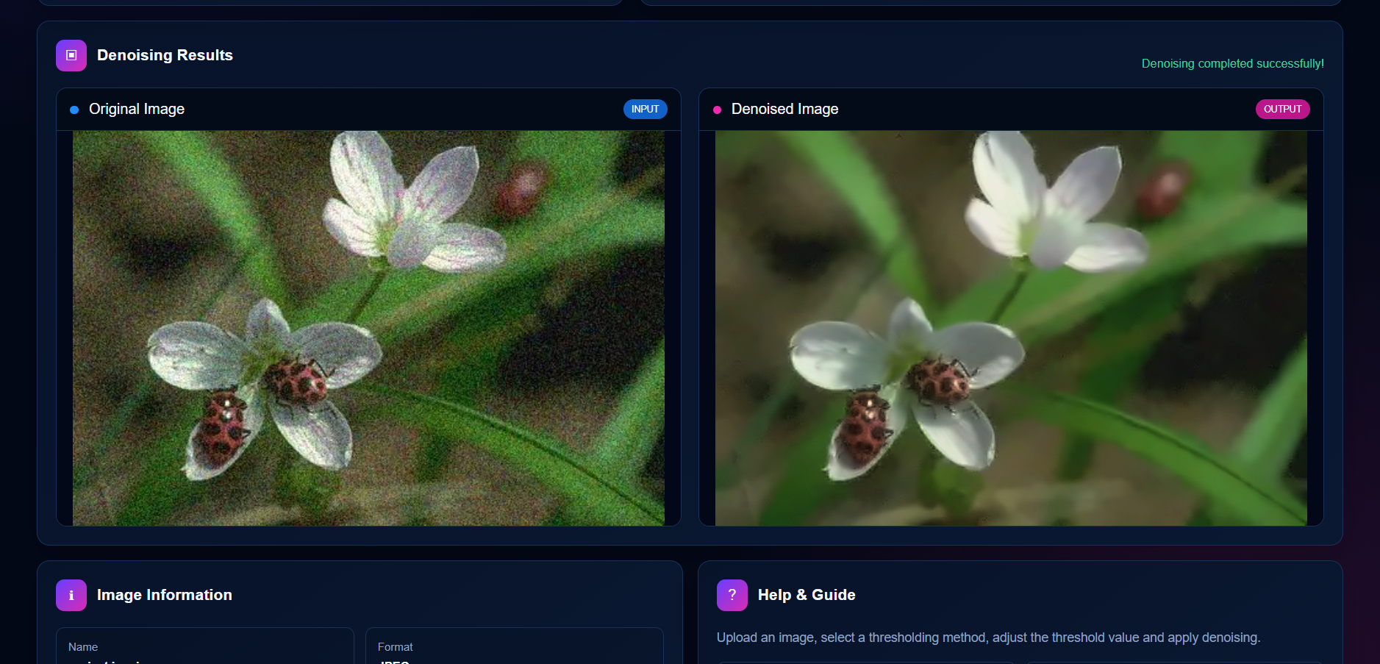
06 Application Screenshot
Corrected orientation of the submitted project output.
07

Slide 8
07 Output Analysis
What can be concluded from the current screenshot.
ORIGINAL IMAGE
DENOISED PREVIEW
INTERPRETATION
The flower and ladybugs are visible, with noticeable grain-like noise in the background and image details.
The output is displayed successfully, but its visible difference from the original is subtle in the supplied screenshot.
A screenshot alone cannot prove strong noise reduction. Compare outputs at several thresholds and inspect pixel differences.
Suggested test settings
Soft: 20 / 50 / 80 • Hard: 20 / 50 / 80 • Use the same image for every test.
Evaluation tip: measure mean absolute pixel difference; for known clean references, also use PSNR or SSIM.
08

Slide 9
08 Testing and Evaluation
A repeatable way to check whether denoising is working.
TEST 1 — FUNCTION
TEST 2 — THRESHOLD
TEST 3 — COMPARISON
Upload a valid image and confirm the backend returns a PNG output without errors.
Run the same image with low, medium and high threshold values.
Inspect fine detail, background grain and edges at the same zoom level.
OPTIONAL NUMERIC CHECK
Mean absolute difference = average of |original pixel − denoised pixel|. A value of 0 means the images are identical; a nonzero value means at least some pixel values changed.
Note: a changed image is not automatically a better image—visual quality and detail preservation matter too.
09

Slide 10
09 Technologies Used
Each technology has a specific role in the system.
HTML
CSS
JavaScript
Defines page structure, controls and image panels.
Provides layout, responsive styling, colours and theme.
Handles file selection, settings, API requests and output display.
Python + Flask
OpenCV
PyWavelets + NumPy
Receives uploaded files and returns processed image data.
Decodes images and converts between colour spaces.
Performs DWT, thresholding, reconstruction and array operations.
API endpoint: POST /denoise | Response format: PNG image | Local Flask port: 5000
10

Slide 11
10 Conclusion
Key takeaways from the project.
• The project connects a web interface to a Python image-processing backend.
• DWT separates image details; soft/hard thresholding modifies detail coefficients.
• Inverse DWT reconstructs an image that can be previewed and downloaded.
• Output quality should be verified through visual comparison and, where possible, objective metrics.
THANK YOU • QUESTIONS?
11

