Slide 1
“Calculating Rank of Matrix”
By :- Amit Puranik

Slide 2
Index
Problem Statement
Methodology/ Proposed system block diagram
Implementation
Results
Conclusion

Slide 3
Problem Statement
Calculating Rank of Matrix and it’s linear dependance and independence on rank.

Slide 4
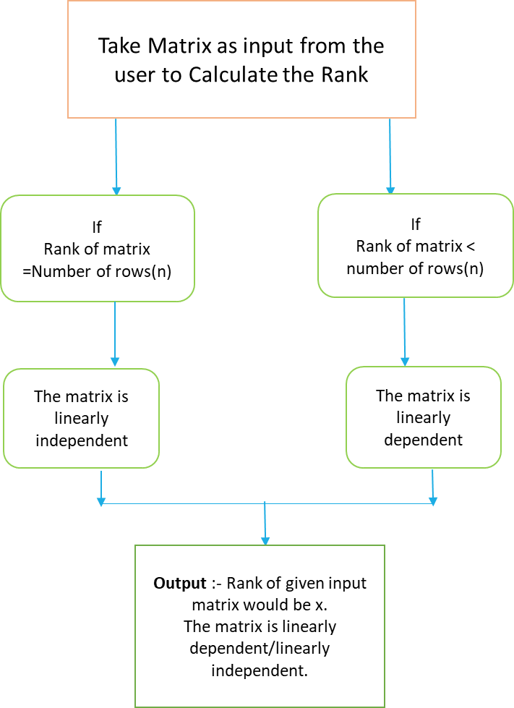
Proposed system block diagram

Slide 5
Implementation
The user enters the order of the matrix and enters the respective elements of the matrix.
If the user enters wrong input then error message will get printed on console and again asks the user to enter input.
Elements are sorted and then values of echelon form are calculated.
Now rank of matrix is calculated with help of echelon form.
We are comparing rank of matrix with number of rows of input matrix for determining whether the input matrix is linearly dependent/independent.

Slide 6
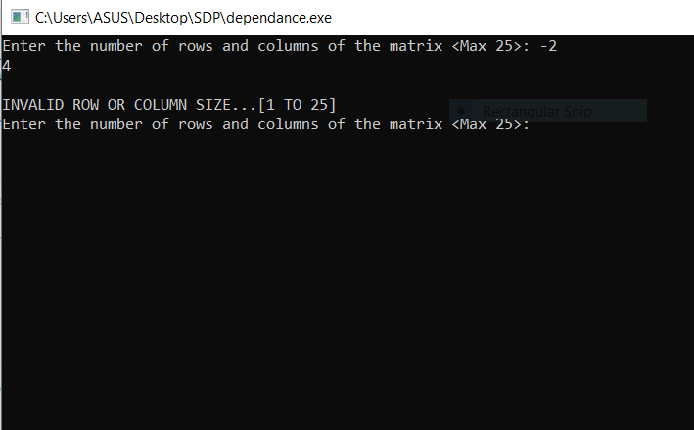
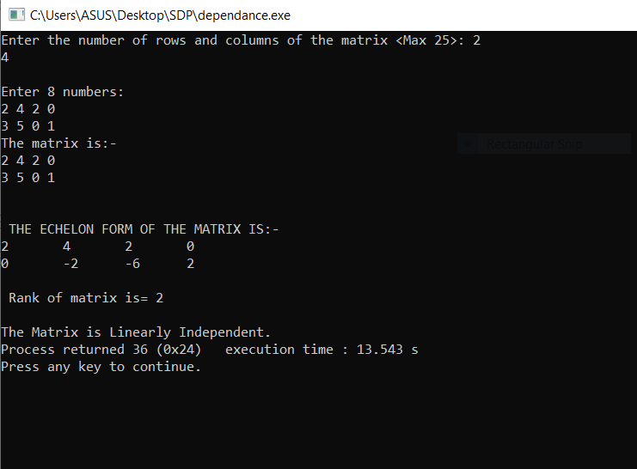
Results
Input 1)Prints Error Message. Input 2)Rank and its linear
independence of matrix size 2x4.

Slide 7
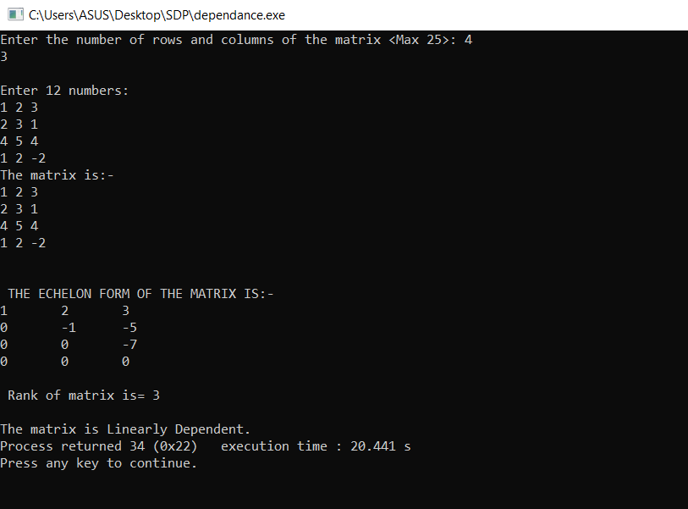
Results
Input 3)Rank and its linear dependance of matrix
size 4x3.

Slide 8
Conclusion and Future Scope
Conclusion:
To find the rank of matrix.
To check whether the given matrix is linearly dependent / linearly dependent with the help of rank.
This Code will help to automate the process of Calculating rank and its dependency and getting results quickly.

Slide 9
Thank you !

