Slide 1
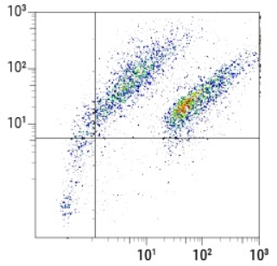
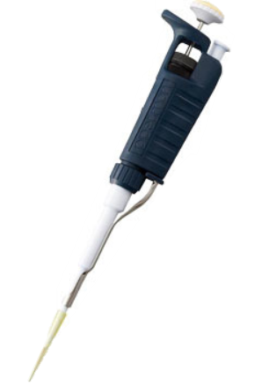
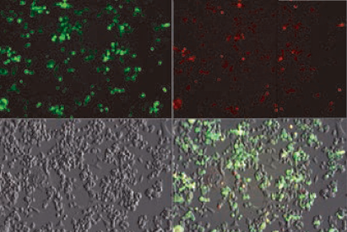
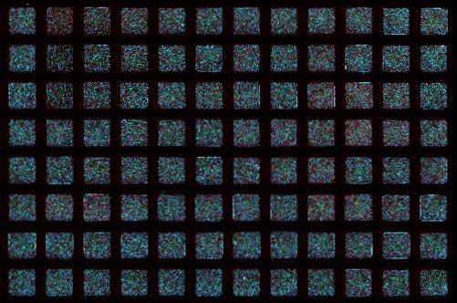
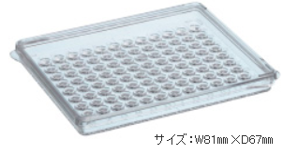
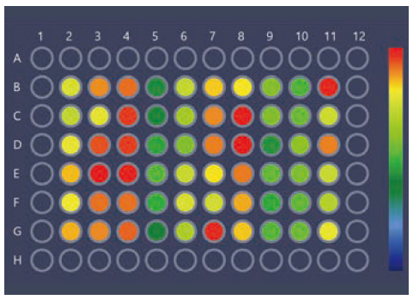


Customer experiment workflow
FACS sorting
Dispensing
Imaging
Analysis
・5 fluorescence
・Sorting cells
・Dispensing
・Small 96 well plate
・using 10～20wells
・Small 96 well plate
・10～20wells
・5 fluorescence＋Ph
・multi scenes
・Cell numbers
・FL intensities
Imaging on
ZEN blue
Analysis on ZEN
Core w/ OAD and GxP
Plan A
Imaging and Analysis on
ZEN Core with OAD and GxP
Plan B

Slide 2
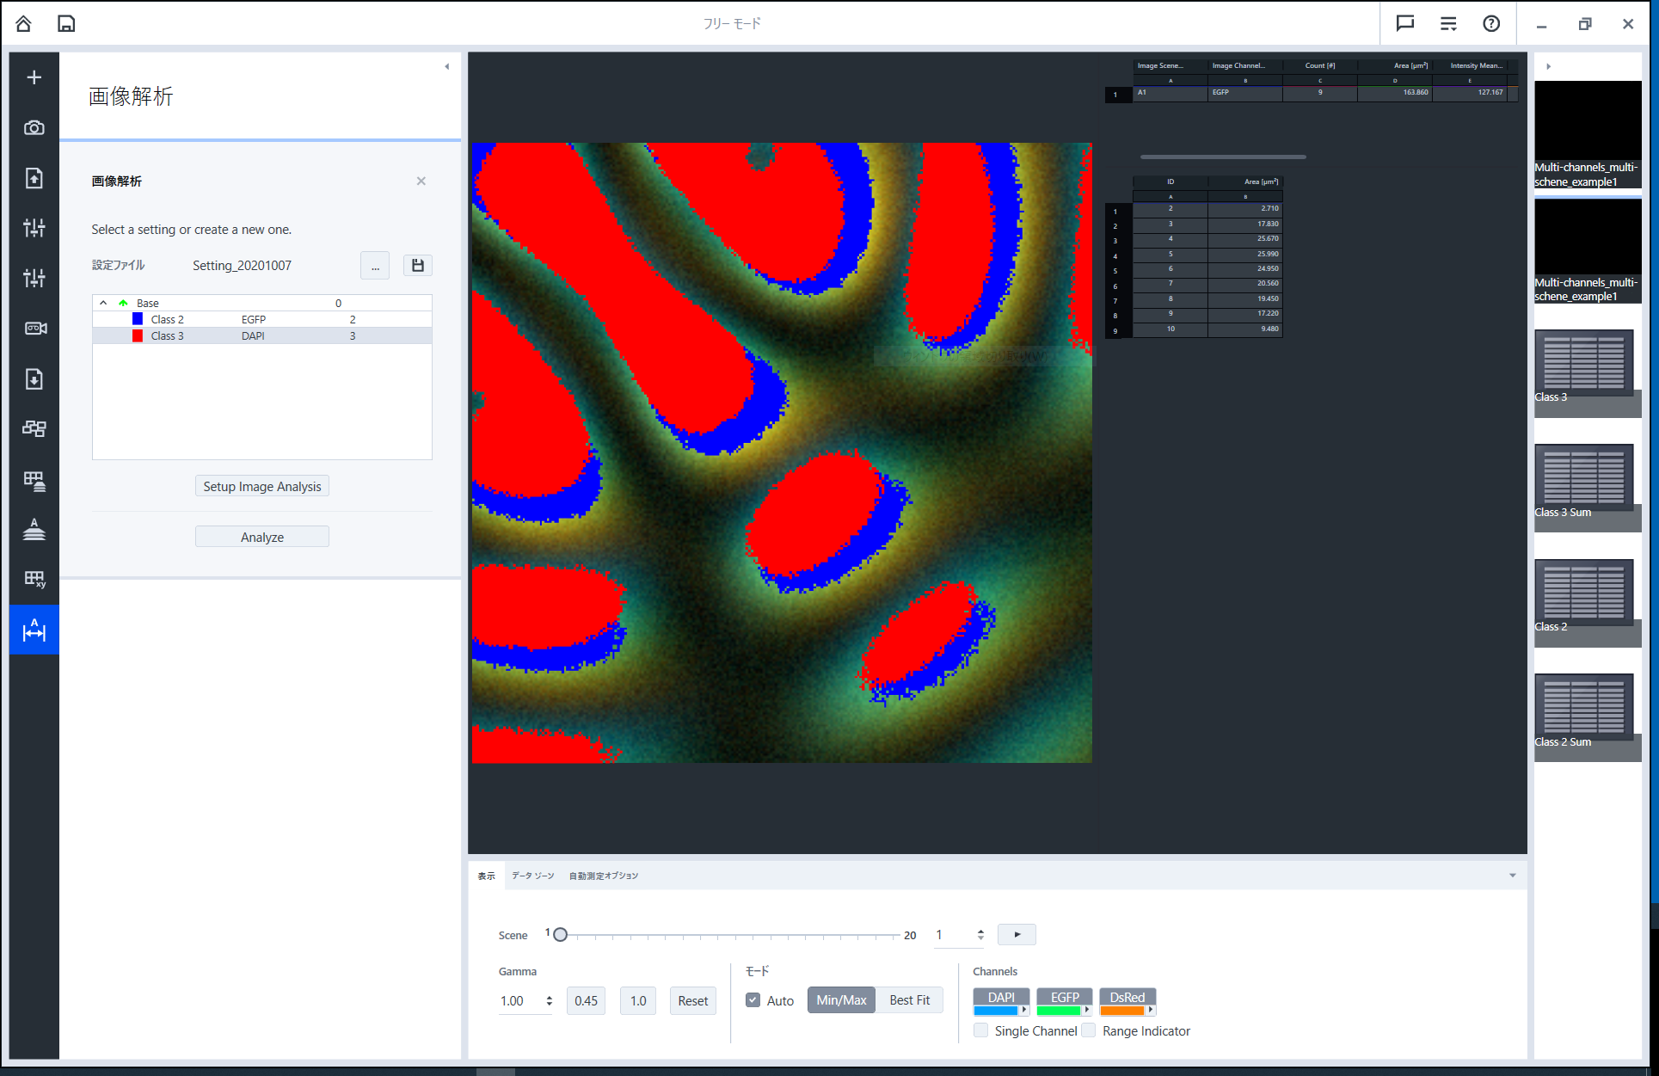
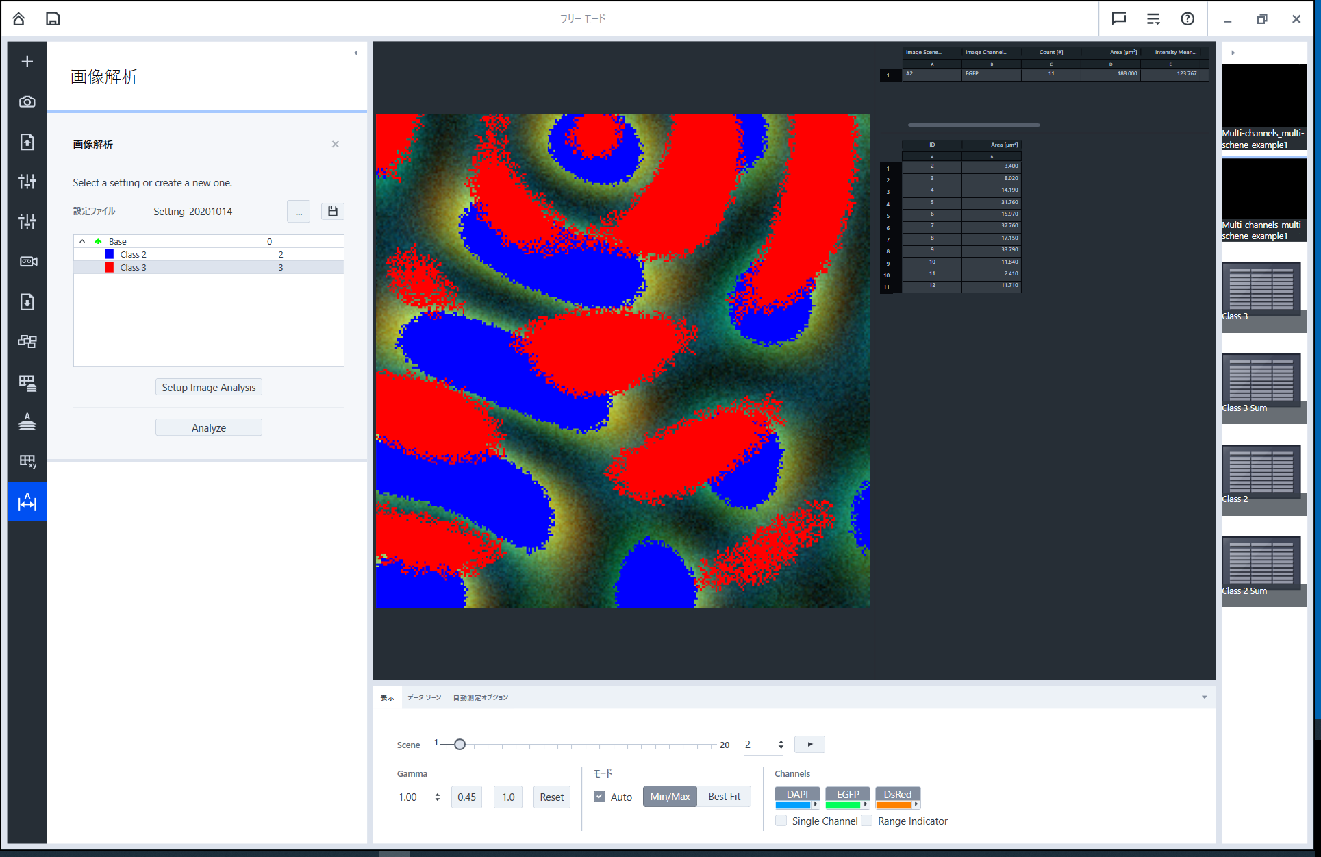
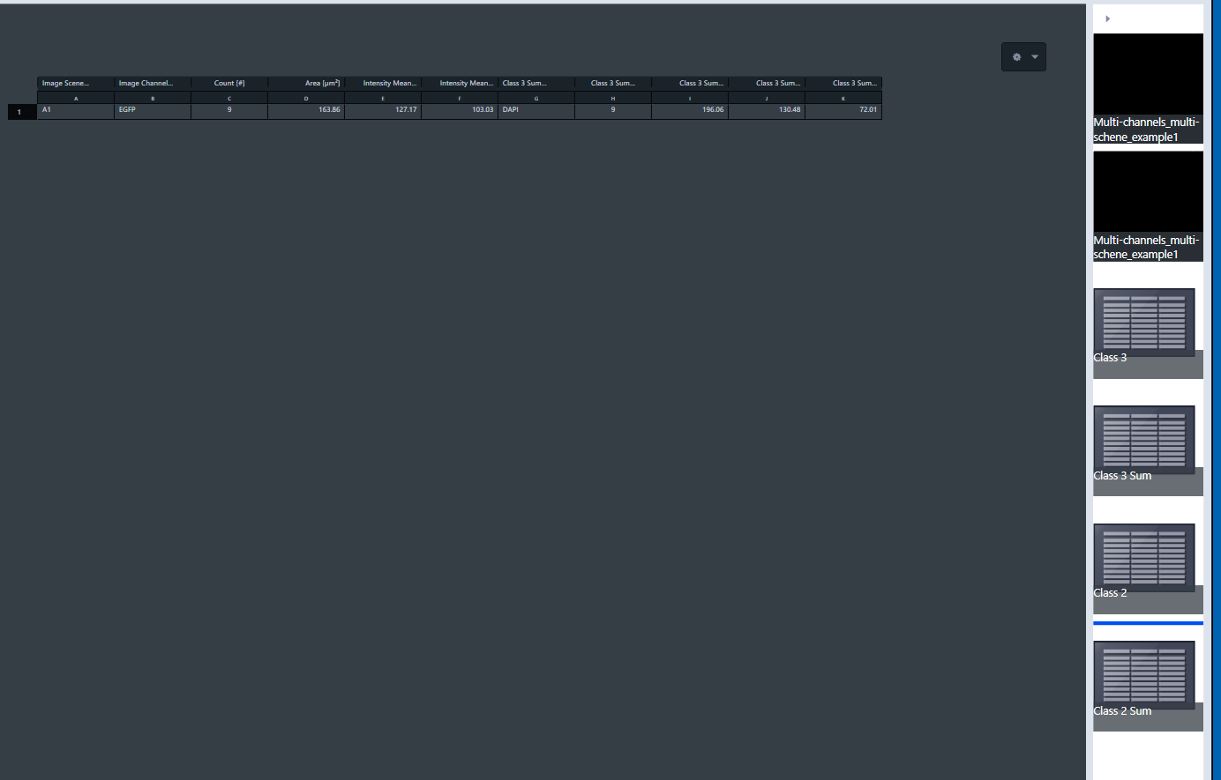
ZEN Core image analysis module doesn’t support multi scenes?
A1
A2
A1
A2
A sample image includes multi scenes.
An image analysis is done in ZEN Core.
All scenes looks like analyzed.
But sum-classes doesn’t include multi sceanes.
An saved XML file is also same.
There is a way to extract all scene table?

