Slide 1
Control
ALU
ALU
ALU
ALU
Cache
DRAM
DRAM
CPU
GPU

Slide 2

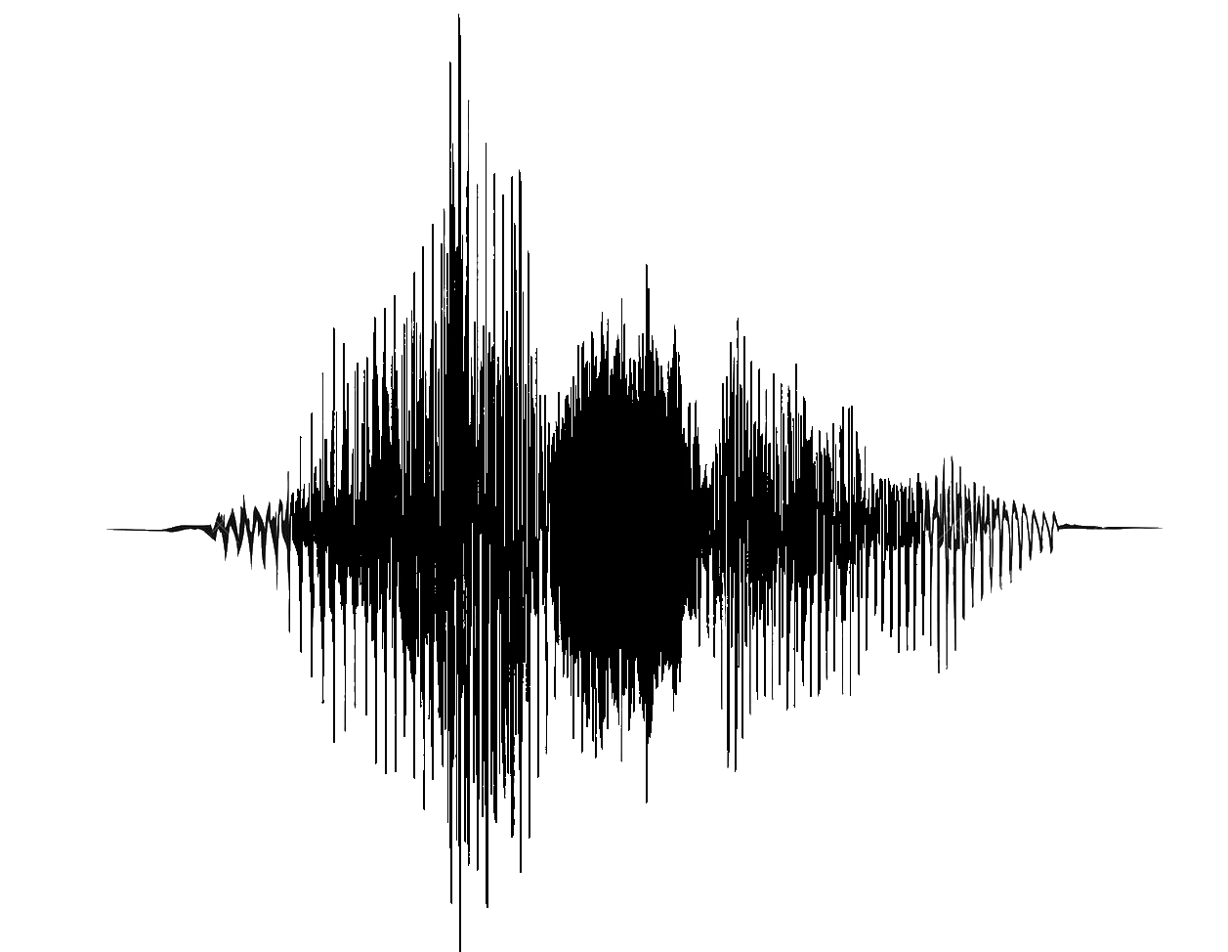
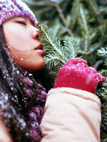

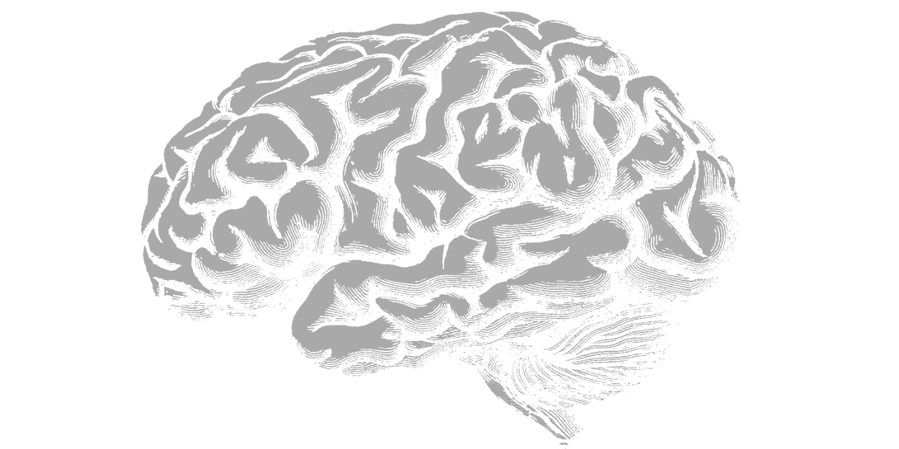


data
model
boom
b
o
o
m
leren

Slide 3

data
model
Dominante kleur
Donker-licht verhouding
Gemiddelde contrast
Intensiteit pixel {1, 1}
Intensiteit pixel {1, 2}
…
Intensiteit pixel {b, h}
Is Boom?
leren
$$g\left(𝒳→𝒴\right)$$

Slide 4
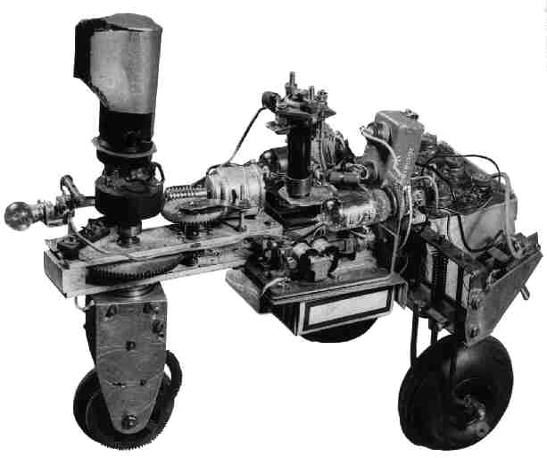

Slide 5
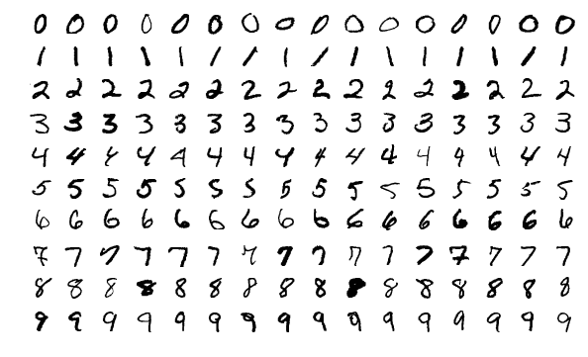

data
model
0
1
2
3
4
5
6
7
8
9
Varianten
Antwoord
leren
$$g\left(𝒳→𝒴\right)$$
0
1
2
3
4
5
6
7
8
9

Slide 6


Slide 7
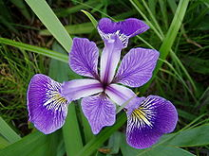
kroonblad (petaal)
kelkblad (sepaal)

Slide 8
instance₃₀₀
grijswaarde_{[22, 18]} = 0.220
grijswaarde_{[22, 17]} = 0. 863

Slide 9



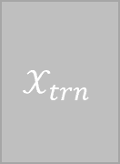


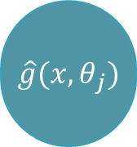
Begeleid ML
test data
$$𝒳_{tst}$$
training data
$$𝒳_{trn}$$
$$𝒴_{trn}$$
model
gewichten $θ_{j}$
$$\hat{g}({x, θ}_{j})$$
$$ℓ$$
leeralgoritme
hyper-
parameters
leren
hyperparameters
voorspellen
$$\hat{y}$$
voorspelling

Slide 10

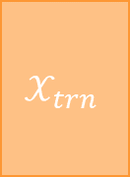
Begeleid ML
test data
$$𝒳_{tst}$$
training data
$$𝒳_{trn}$$
$$𝒴_{trn}$$
model
gewichten $θ_{j}$
$$\hat{g}({x, θ}_{j})$$
$$ℓ$$
leeralgoritme
hyper-
parameters
leren
hyperparameters
voorspellen
$$\hat{y}$$
voorspelling

Slide 11


Onafhankelijke variabele
(eng: feature)
Afhankelijke variabele
(eng outcome, label)
Variabele namen
of hoofding
(eng: header)
Instantie
(eng: instance, example)
Instantienamen
Rijnamen
(eng: row names)
$𝒳$ = alle invoer
$𝒴$ = uitvoer

Slide 12




hond
$$τ$$
kat
$$p_{kat}$$
0
0.5
1
gezond
$$τ$$
ziek
$$p_{ziek}$$
0
0.33
1
bepaald door arts

Slide 13
Nominaal = categorisch
Ordinaal
Numeriek discreet lineair
10
2
2
5
1
1
#
log ₁₀(#)
log ₂(#)
0
0
0
Toys
Food
Weak
Good
Expert
0
1
2
3
4
5
Electro
Clothing
Gardening
Hygiene
Insufficient
Sufficient
Promising
Delay (# days)
Product type
Score
Numeriek continu lineair
Numerisch discreet circulair
Numeriek continu circulair
.02
0
N
.01
Density
Hour of day
Wind direc-tion
18
6
W
E
12
0
S
0
0
4
5
8
10
-10
0
10
20
# sold (x1000)
log₁₀ (# sold)
Temperature at arrival

Slide 14
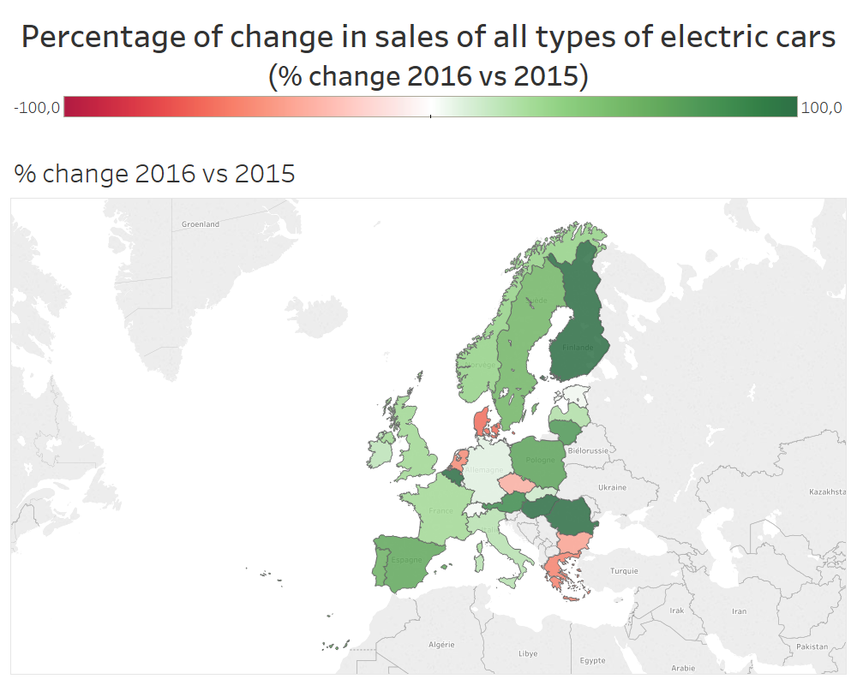
Numerical continuous linear
versus
Numerical continuous linear
Ordinal
versus
Numerical continuous linear
2
2
Product Travel Time
Product Travel Time
1
1
log ₂(#)
log ₂(#)
0
0
-10
0
10
20
Weak
Good
Expert
Insufficient
Sufficient
Promising
Temperature at arrival
Score
Categorical
versus
Numerical continuous circular
A
B
N
Wind direc-tion
C
W
E
0
S
5
10
log₁₀ (# sold)

Slide 15
Fruit |  | Banana | Orange | Strawberry
strawberry |  | 0 | 0 | 1
orange |  | 0 | 1 | 0
orange |  | 0 | 1 | 0
banana |  | 1 | 0 | 0
orange |  | 0 | 1 | 0
strawberry |  | 0 | 0 | 1
banana |  | 1 | 0 | 0
banana |  | 1 | 0 | 0
N
mean(α₂,α₂)=345°
α₁=30°
α₂=300°

Slide 16
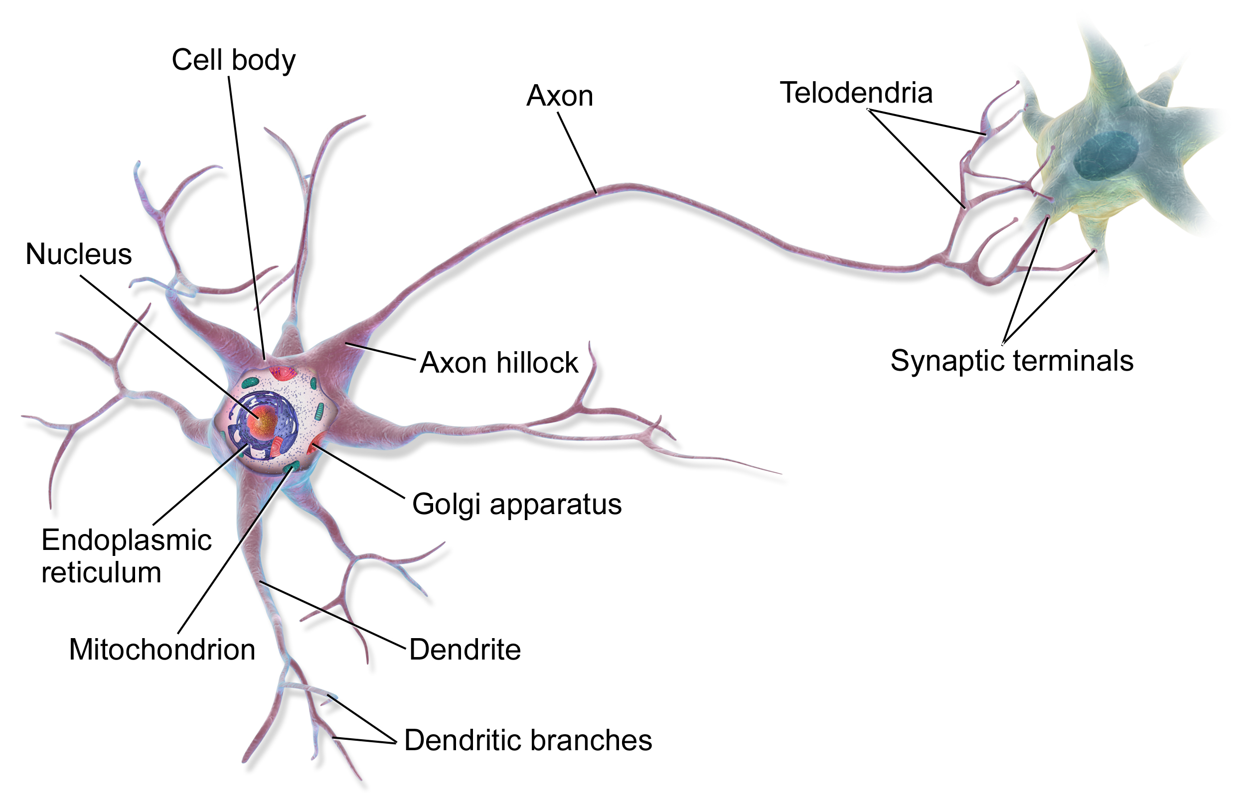






$$x_{1}$$
$$x_{2}$$
$$x_{n}$$
$$θ_{1}$$
$$θ_{2}$$
$$θ_{n}$$
…
…
$$f(x, θ)$$
$$z$$
$$t(z)$$
$$\hat{y}$$

Slide 17
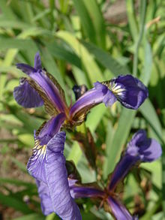

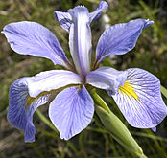
Kroonblad
(petaal)
Kelkblad
(sepaal)
Iris setosa
Iris versicolor
Iris virginica

Slide 18









$$θ^{T}$$
data
mask
data[mask,]
F
T
T
F
T
F
$$θ_{12}^{T}$$
$$θ_{22}^{T}$$
$$x_{11}^{T}$$
$$x_{12}^{T}$$
$$z_{12}^{}$$
$$x^{T}$$
$$z$$
$z_{12}^{}=θ_{12}^{T}∙$ $x_{11}^{T}$+ $θ_{22}^{T}∙x_{12}^{T}$

Slide 19



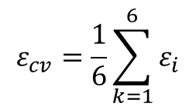


test fold
…
training set
training fold
$$ε_{final}$$
$$ε_{1}$$
$$ε_{2}$$
$$ε_{3}$$
$$ε_{6}$$
$$ε_{cv}=\frac{1}{6}\sum_{k=1}^{6}{ε_{i}}$$
test set

Slide 20

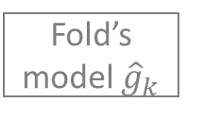


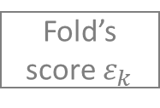
Data
Split
Training set
Test set
For each fold
Split
Fold’s training set
Fold’s test set
Fit
Fold’s model ${\hat{g}}_{k}$
Predict & score
Fold’s score $ε_{k}$
Next fold
Summarize
CV score $ε_{cv}$
Model $\hat{g}$
Predict & score
Final score $ε_{final}$

Slide 21

Verzamelen méér data
Data
Opzetten ANN
architectuur
ANN architectuur
Splitsen
Validatie set
Training set
Test set
Training
epoch
ja
Wordt restterm
training kleiner?
Wordt restterm
validatie kleiner?
ja
neen
neen
Restterm training
voldoende klein?
neen
ja
neen
Restterm test
voldoende klein?
ja
Model $\hat{g}$

Slide 22
kwadratisch
convex
grillig

