Slide 1

Resurrection: Melodie

Slide 2
Table of contents
OUR TEAM
GAME OVERVIEW
PROJECT OVERVIEW
OBJECTIVES
SCOPE AND LIMITATIONS
SOFTWARE AND HARDWARE
DIAGRAMS

Slide 3



OUR TEAM
John Bernard Durano
David Aldwin De Guzman
Gian Marlo Sobrevinas
Team Leader
Member
Member

Slide 4
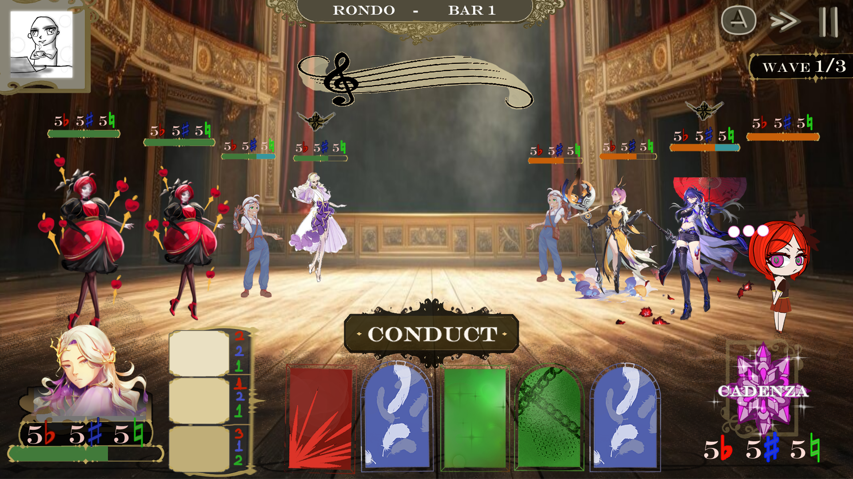
GAME OVERVIEW
Resurrection: Melodie is a 2D narrative-driven game set in a post-apocalyptic world where artistic inspiration and music are banned. The story follows a Conductor named Morgan and their team of 'Performers,' each representing a piece of music, as they fight to restore humanity's lost art and confront the oppressive Church of Evils. Combining elements of a visual novel with turn-based JRPG combat, the game allows players to experience a deep story, character progression, and strategic battles, with music and inspiration woven throughout the gameplay and narrative to create a unique, immersive experience.

Slide 5
PROJECT OVERVIEW
The Node-Based Visual Novel System for Holy Grape Productions provides an intuitive, customizable framework for creating interactive narratives in Unity using XNode. This system enables rapid prototyping, testing, and iteration of story elements, significantly enhancing workflow efficiency and streamlining both narrative development and quality assurance.

Slide 6
OBJECTIVES
The objective of this project is to create a Visual Novel System, as stated by our client to the team, that does the following:
Develop a node-based visual novel system that can trigger camera effects, sounds, or display changes before and after dialogue events.
Implement a testing feature in the system that allows developers to load from any scene or specific dialogue node, reducing testing time by a significant amount.

Slide 7
SCOPE AND LIMITATIONS
Scope:
The project will focus on integrating a node-based visual novel system, ensuring seamless narrative transitions and the ability to trigger prefabs for effects and sounds.
The system will also prioritize the ability to load from any specific scene or dialogue node, facilitating faster testing during development.
Limitations:
Limited development time will restrict the number of functionalities that the team may be able to add to the system.
The game’s performance on lower-end devices might be limited due to its high reliance on Unity’s graphical and audio features, potentially reducing the visual and sound quality on older platforms.

Slide 8
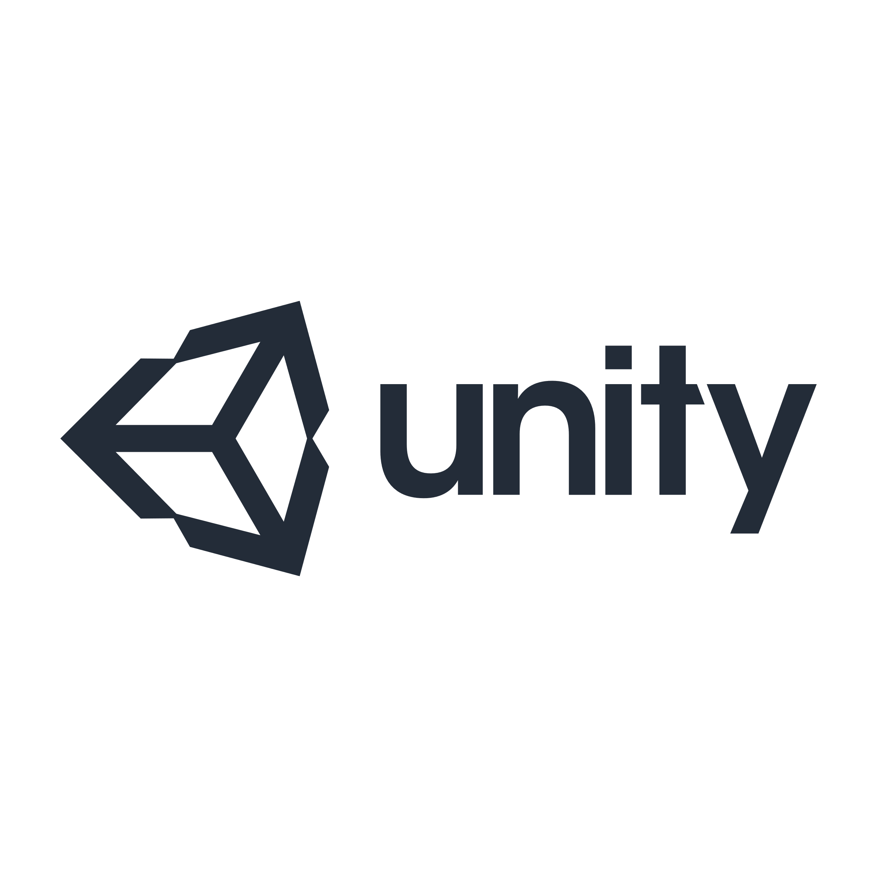




SOFTWARE AND HARDWARE
xNode
Unity
VS Code
Mid-range windows pc
GitHub

Slide 9
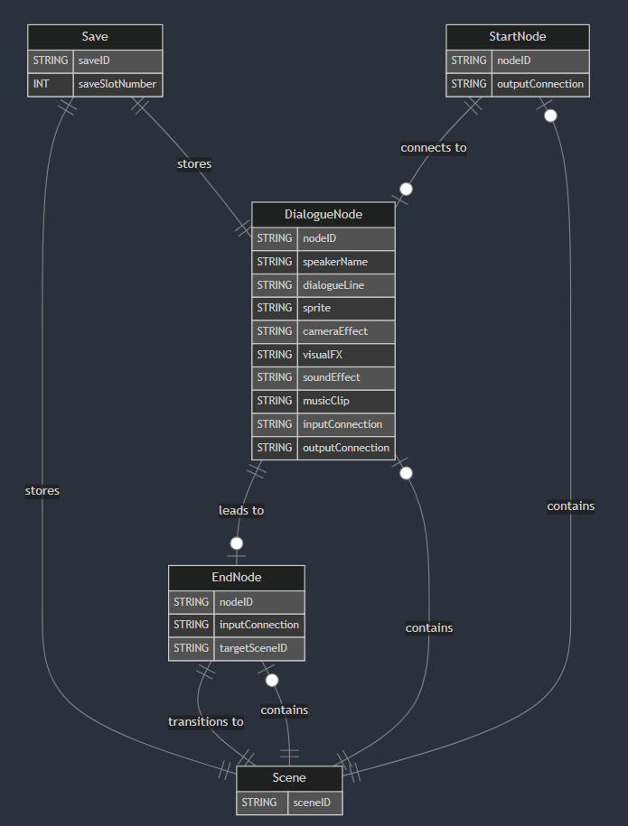
DIAGRAMS
Entity Relation Diagram

Slide 10
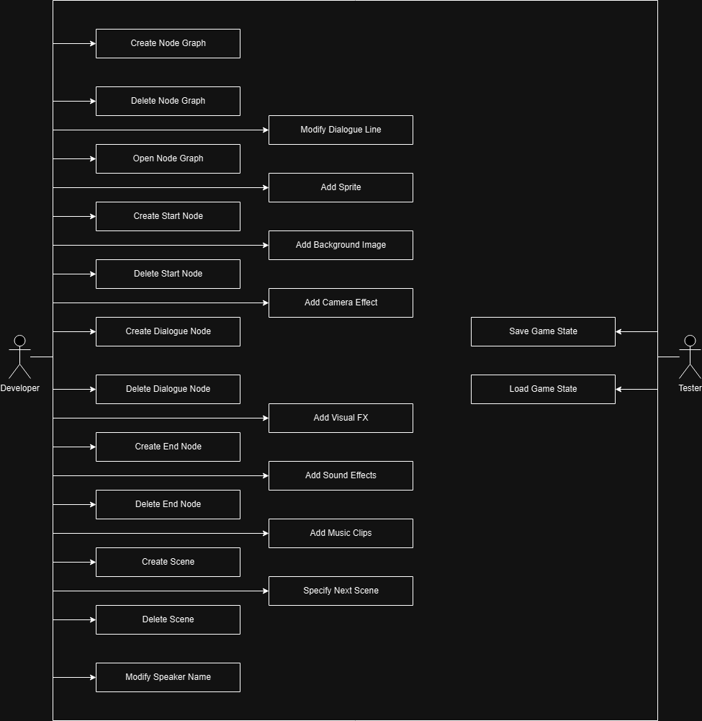
DIAGRAMS
Use Case Diagram

Slide 11
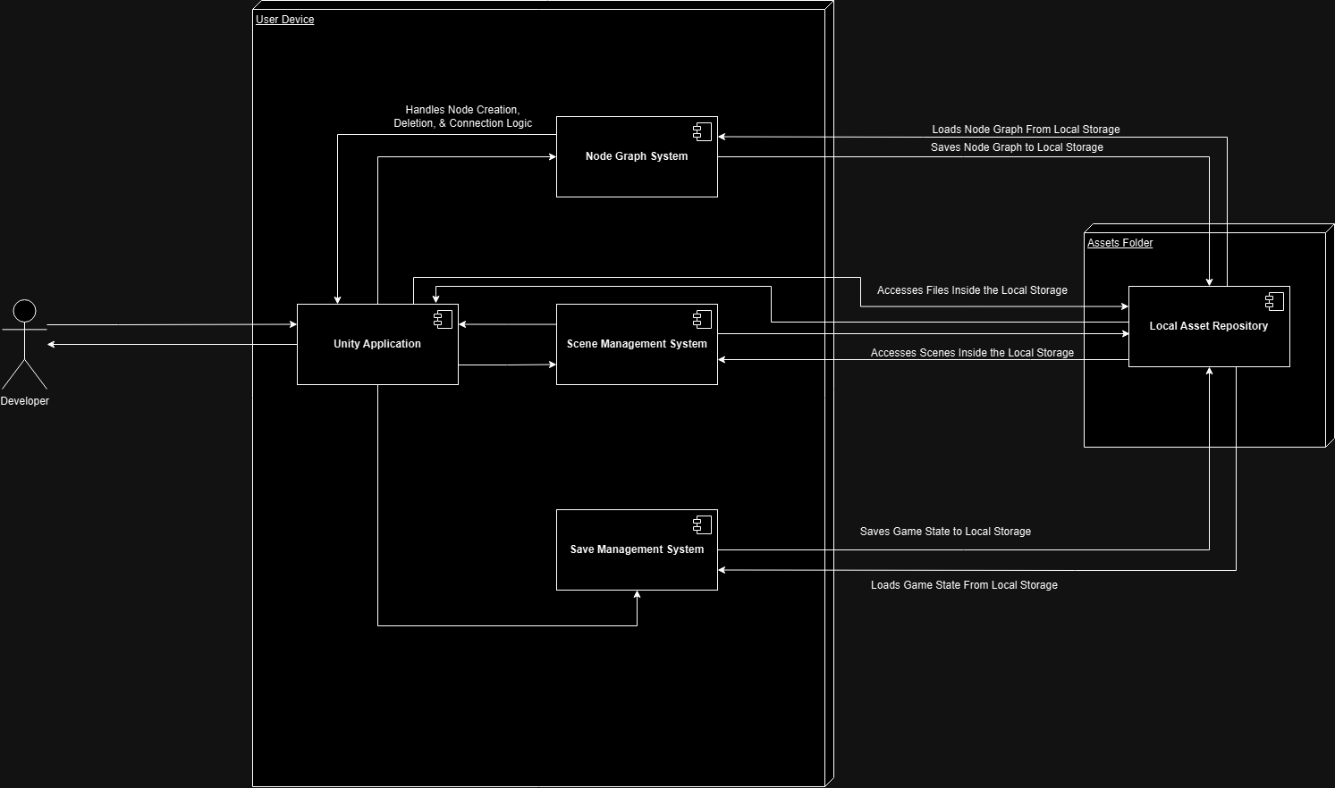
DIAGRAMS
Deployment Diagram

Slide 12
System demo

Slide 13
Q&A

