Slide 1
APC524 Final project Time series analysis in python
Wenyan Gong, Zongxi Li, Cong Ma
Qingcan Wang, Zhuoran Yang, Hao Zhang
Jan 12, 2017

Slide 2
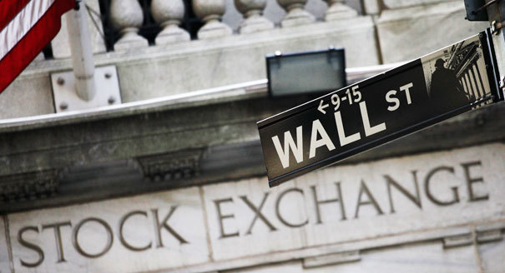
Trading, Research, Product

Slide 3
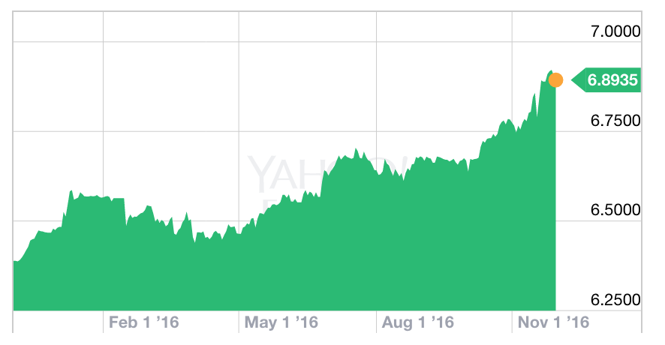
Project Basics
We provide a python library for time series analysis of financial data, i.e., stock price, in order to replicate businesses in investment bank, such as trading, research and product.
We choose Python since it’s free, and widely distributed.
There are many powerful packages available, e.g., numpy (linear algebra), scipy (scientific computation), pyplot (visualization)
Object orientated programming
Version control, Github, collaboration between 6 group members
USD to CNY exchange rate, Nov 2015-Nov 2016. Yahoo

Slide 4
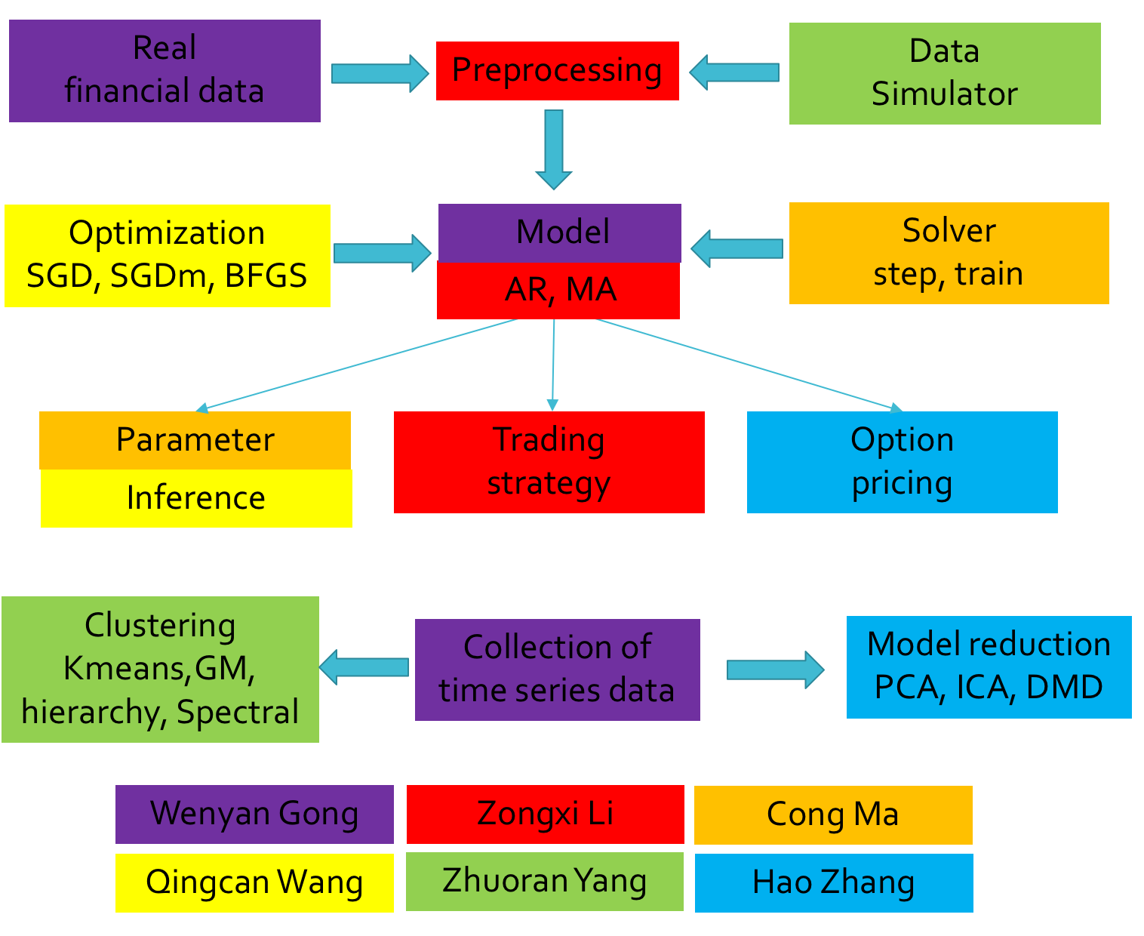
Program structure, division of work

Slide 5
Python libraries, files
model.py, Model class
optim.py, optimization method
solver.py, Solver class
inference.py, Parameter inference
trading.py, trading strategy
clustering.py, Cluster class
reduction.py, model reduction
optionPricing.py, Option pricing

Slide 6
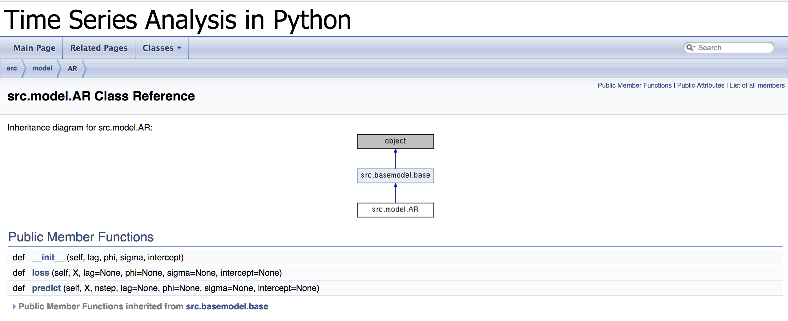
Documentation: Doxygen

Slide 7
Demo: ipython notebook
Model validation (Simulated data, Cong Ma)
Financial data (Google stock, Wenyan Gong)
Trading strategy (Google stock, Zongxi Li)
Clustering (S&P 500, Zhuoran Yang)
Model reduction (S&P 500, Hao Zhang)
Option pricing (Google stock, Qingcan Wang)

Slide 8
Summary and learned lesson
First time, coding collaboration in a project group
Various languages, Unix tools, Ipython notebooks
Object oriented programming
Cython: integration of C code and Python code

