Slide 1
Time series analysis in python (TSAP)
Wenyan Gong, Zongxi Li, Cong Ma, Qingcan Wang, Zhuoran Yang, Hao Zhang
(alphabetic order of last name)

Slide 2
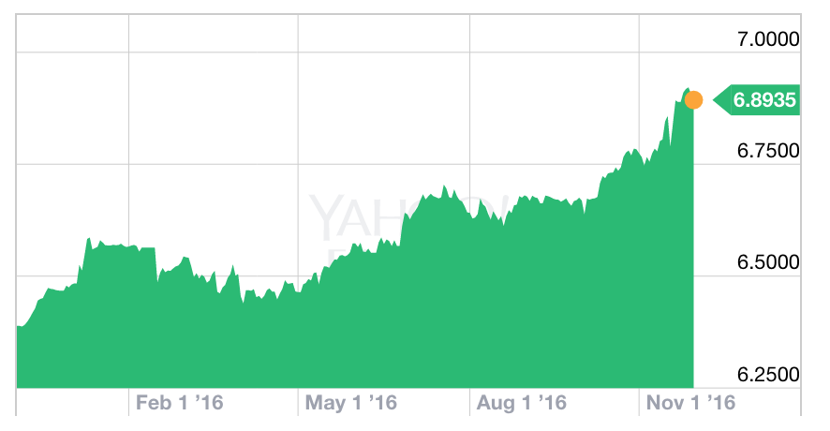
Project definition
USD to RMB exchange rate, Nov 2015-Nov 2016. Yahoo
Time series analysis interests us due to its application in financial market (stock prices history)
We aim to build a python library for time series analysis
Notes:
Python is simple to use and has a very powerful numerical computation library numpy.

Slide 3
Organization & structure
Real
financial data
Data
Simulator
Preprocessing
Optimization
SGD, SGDm, BFGS
Model
Solver
step, train
AR, MA
Parameter
Trading
strategy
Option
pricing
Inference
Clustering
Kmeans,GM, hierarchy, Spectral
Model reduction
PCA, ICA, DMD
Collection of time series data
Wenyan Gong
Zongxi Li
Cong Ma
Qingcan Wang
Zhuoran Yang
Hao Zhang

Slide 4
Languages, packages/libraries
Python is free-distributed, and user-friendly, equipped with powerful packages for various purposes
Numpy, numerical linear algebra
pyplot, visualization tools
scikit-learn (http://scikit-learn.org/), a python library for machine learning (cluster, regression, etc)
Focus on interface design, and how to communicate between various modules

Slide 5
Program structure, and interface
Optimization Methods (GD, Newton)
Visualization
Time history
Accuracy, test error
Development philosophy, Object Oriented Programming (OOP)
Testing tools, unitest
Solver class(Model, opt method)
Model class（data,param）
AR,MA,ARMA…
(likelihood, gradient)
Time series data
Inference class(Model, Solver methods)
Confidence interval
Significance test (P-value)
Clustering class(data)
Kmeans
Gaussian mixtures
Spectral clustering

Slide 6







Organization Structure
Zhuoran Yang
Inference, cluster
Zongxi Li
Model
Qingcan Yang
Optimization
https://github.com/APC524/tsap
Wenyan Gong
Model
Cong Ma
Solver
Hao Zhang
Cluster, visualization

Slide 7
Tentative schedule of progress
6 Dec: Prototype
13 Dec: Alpha version.
1 Jan: Beta version.
12 Jan: Project presentations.

