Slide 1
A+ Computer Science
Math
OPERATIONS

Slide 2
Calculations

Slide 3
Expressions
average = total / 5
sum = one + two
Expressions usually consist of operators, variables, and/or literal values.
Notes:
In the example above, 5 is a literal value.

Slide 4
Operators
+ | addition
- | subtraction
* | multiplication
/ | division
% | modulus

Slide 5

Integer Math
out.println("6 + 5 == " + (6+5));
out.println("6 - 5 == " + (6-5));
out.println("6 * 5 == " + (6*5));
out.println("6 / 5 == " + (6/5));
OUTPUT
6 + 5 == 11
6 - 5 == 1
6 * 5 == 30
6 / 5 == 1
Notes:
Math operations can be performed on integers and on decimals.
An integer divided by an integer results in an integer.
2/3=0
3/2=1
5/4=1
4/5=0
7/2=3
2/7=0

Slide 6
Real Math
out.println("6.1 + 5.2 == " + (6.1+5.2));
out.println("6.1 - 5.2 == " + (6.1-5.2));
out.println("6.1 * 5.2 == " + (6.1*5.2));
out.println("6.1 / 5.2 == " + (6.1/5.2));
OUTPUT
6.1 + 5.2 == 11.3
6.1 - 5.2 == 0.8999
6.1 * 5.2 == 31.72
6.1 / 5.2 == 1.17307
Notes:
Math operations can be performed on integers and on decimals.
As long as one part of the math is a decimal, the result is a decimal.
2.0/3=0.66
3/2.0=1.5
5/4.0=1.25
4.0/5=0.8
7.0/2=3.5
2/7.0=0.2857142

Slide 7
intmath.java
realmath.java

Slide 8
Division
1/2 = ??
1.0 / 2.0 = ??
1/2 = 0
1 and 2 are integer constants.
1.0/2.0 = 0.5
1.0 and 2.0 are decimal constants.

Slide 9
Division
1 / 2.0 = ??
1.0 / 2 = ??
1/2.0 = 0
1.0/2 = 0.5
As long as one value is a decimal,
the result is a decimal.

Slide 10
Division
1 / 0 = ??
0 / 1 = ??
Dividing by 0 causes a runtime exception to be thrown.
Dividing 0 results in a value that is not a number - nan.

Slide 11
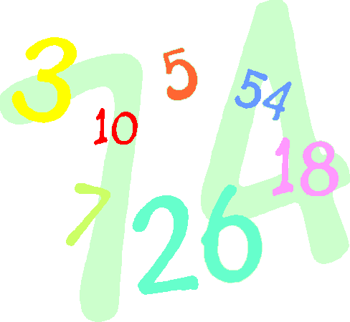
Remainder
mod(%) gives you the integer remainder of integer division.
OUTPUT
2
1
out.println(2 % 3);
out.println(3 % 2);
Notes:
Modulus is the remainder of division.
0
3|2
0
2 is the remainder
1
2|3
2
1 is the remainder

Slide 12
Remainder
mod(%) gives you the integer remainder of integer division.
OUTPUT
5
4
num = 45;
out.println(num%10);
out.println(num/10);

Slide 13
Remainder
mod(%) gives you the real number
remainder of real number division.
OUTPUT
0 0.2
out.println(9 % 3);
out.println(9.2 % 3);
Notes:
Modulus is the remainder of division.
3
3|9
9
0 is the remainder
3
3|9.2
9
0.2 is the remainder

Slide 14
divide.java
modulus.java

Slide 15
Precedence
() | HIGH
! ++ --
* / %
+ -
= += -= *= /= %=
, | LOW

Slide 16
Assignment
int num = 10;
out.println(num); num = num + 5;
out.println(num); num = 10 * 2 + 7;
out.println(num);
OUTPUT
10 15 27
Notes:
num starts out with the value 10.
num is then increased by 5. num = 10+5
num is now 15.
num is lastly assigned the value 10*2+7. num=27
* and / have higher precedence than + and -.

Slide 17
Assignment
num *= 2;
out.println(num);
num /= 5;
out.println(num);
num = num + 4 / 2 - 8;
out.println(num);
num = (4 + 5)/2+7;
out.println(num);
OUTPUT
54 10 4 11
Notes:
num starts out with the value 54. num=27*2
*= is equal to num=num*2
*= is also the same as num=num*(int)2
*= auto casts
num is now 54.
num is then divided by 5. num = 54/5
num is now 10.
num is then assigned the value 10+4/2-8. num = 4
num is then assigned the value (4+5)/2+7. num = 11
Parenthesis have higher precedence than math operations.

Slide 18
Shortcuts
num = 11;
out.println(num);
num++;
out.println(num);
num--;
out.println(num);
num++;
out.println(num);
OUTPUT
11 12 11 12
Notes:
num starts out with the value 11. num=11
++ is the same as num=num+1
num is then increased by 1. num = 12
-- is the same as num=num-1
num is then decreased by 1. num = 11
num is then increased by 1. num = 12

Slide 19
Compound Assignment
num = 11;
num += 3;
out.println(num);
num %= 3;
out.println(num);
num *= 5;
out.println(num);
OUTPUT
14 2 10
Notes:
num starts out with the value 11. num=11
num += 3 is the same as num = num + 3
num becomes 14
num %= 3 is the same as num = num % 3
14 % 3 = 2
num *= 5 is the same as num = num * 5
5 * 2 = 10000
+=, -=, *=, /=, and %= are compound assignment operators.

Slide 20
assignment.java
shortcuts.java

Slide 21
Casting
Casting is used to temporarily
change the type of a value.
(int)3.14159
(double)3
Casting is often used to create compatibility among data types.

Slide 22
Casting
int one = 0; //32 bit int
long big = 453; //64 bit int
double dec = 7.56; //64 bit real
one = dec; //illegal
one = big; //illegal
one = (int)dec; //legal
one = (int)big; //legal
Casting is often used to create compatibility among data types.

Slide 23
cast.java

Slide 24
Casting
int one = 11;
int two = 5;
double dec = (double)one/two;
As long as one part of the division
is a decimal value, the result will
be a decimal.
one is temporarily converted to a double before the division.

Slide 25
Casting
out.println("1/2 = " + (1/2));
out.println("(double)1/2 = " + (double)1/2);
out.println("5/2 = " + (5/2));
out.println("5/(double)2 = " + 5/(double)2);
OUTPUT
1/2 = 0
(double)1/2 = 0.5
5/2 = 2
5/(double)2 = 2.5

Slide 26
intcast.java

Slide 27
Work on Programs!
Crank
Some Code!

Slide 28
A+ Computer Science
Math OPERATIONS

