Slide 1
Revature Project 1
By: adam pesch

Slide 2
Project overview
Project 1 was focused around analyzing Wikipedia data using big data tools
Wikipedia data is public and is quite vast due to its popularity
For this project, I mainly used Hive due to its simplicity and because when we began the project we hadn’t yet learned MapReduce

Slide 3

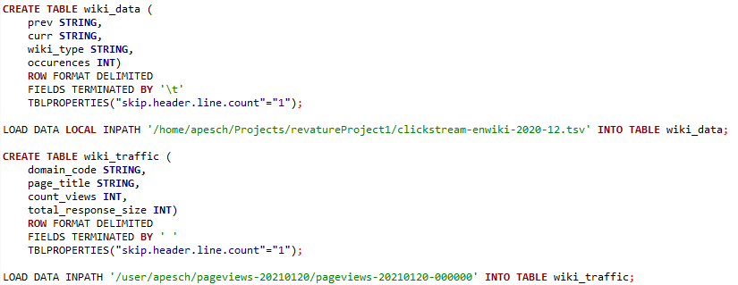
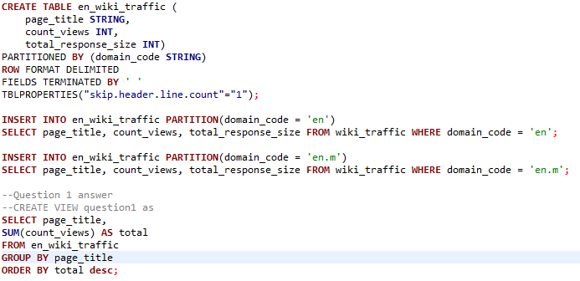
Query one: the most traffic
Which English Wikipedia article got the most traffic on January 20, 2021?
This is probably the simplest query, we just need to get the pageviews data on that day and then sum them all together

Slide 4
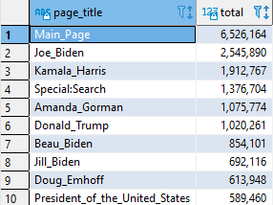
Query one: the most traffic
On January 20th, the article that got the most traffic (not counting the main page of Wikipedia) was Joe Biden’s, which makes sense because that was the first day of his presidency
The rest of the top 10 is also made up of various political figures, such as the Vice President, the First Lady, and the leaving president, among others

Slide 5
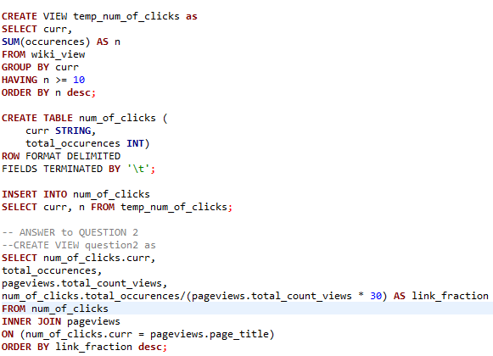
Query Two: Fraction of Internal links
What English Wikipedia article has the largest fraction of its readers follow an internal link to another Wikipedia article?
We had to make the assumption that each user isn’t clicking on multiple links, or the same link multiple times, which can create error
We also have to extrapolate the viewer data from one day out to an entire month, which will prove to be a problem.

Slide 6
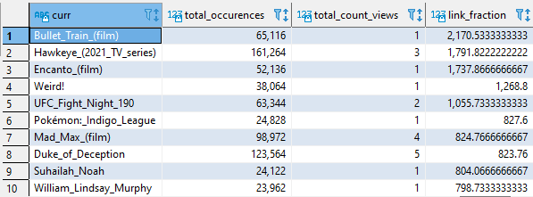
Query Two: Fraction of Internal links
According to the math, the article with the largest fraction of readers clicking a link to another Wikipedia article is the one about the upcoming movie Bullet Train, which had over 65 thousand links followed off approximately 30 viewers (total_count_view only covers 1 day)
It’s important to note that the reason that this is so high is because we cannot estimate for the entire month that the clickstream data covers because of how large that data would be, and we can’t condense the clickstream data down to one day either because it wouldn’t be representative of that day, so despite the math being correct, we can still end up with these sorts of errors

Slide 7
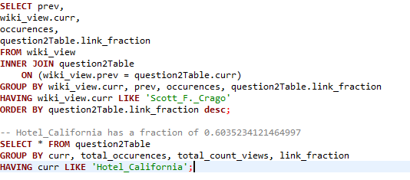
Query three: series of internal links
What series of wikipedia articles, starting with Hotel California, keeps the largest fraction of its readers clicking on internal links?
For this I used the values from query 2 to multiply together. This assumes that people clicking out of a page go to other pages at the same rate. It’s not the most accurate, but it is much more cost efficeint

Slide 8
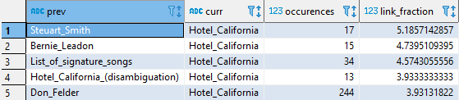
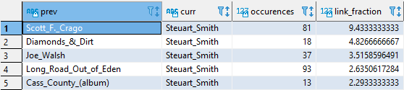
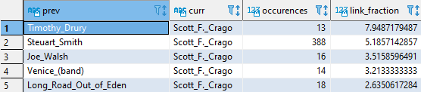
Query three: series of internal links
The series of links with the highest fraction of internal links starting with Hotel California is
Hotel California
Steuart Smith
Scott F. Crago
Timothy Drury
Between the 4 articles, the fraction of continuous readers is 234.673999365

Slide 9
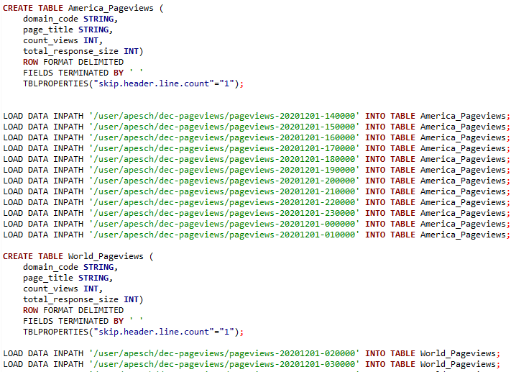
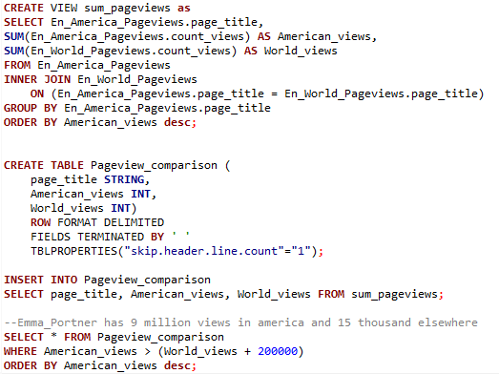
Query four: American popularity
Find an example of an English Wikipedia article that is relatively more popular in the Americas than elsewhere.
There is no location data associated with the Wikipedia pageviews data. You'll need to make some assumptions about internet usage over the hours of the day.
I made the assumption that America would be most active from 9am EST to 6pm PST, since that would cover the work day of both continents, and the rest would be the rest of the world

Slide 10
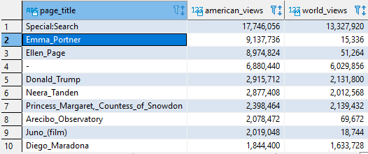
Query four: American popularity
Emma Portner’s article has 9 million views in The Americas and only 15 thousand elsewhere
What was most interesting about this is how drastic the difference is between what different countries are interested in.

Slide 11
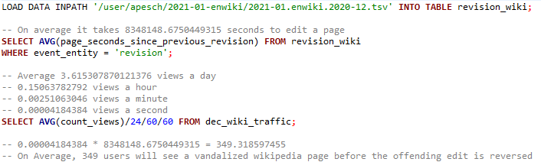


Query five: Vandalized articles
Analyze how many users will see the average vandalized wikipedia page before the offending edit is reversed.
For this query we had to pull a new dataset: Page Revision and User History
After getting the average amount of time for a revision to be edited and the average views a Wikipedia article gets per day, we can multiply them together to discover that on average, 349 users will see a vandalized Wikipedia page before the offending edit is reversed

Slide 12
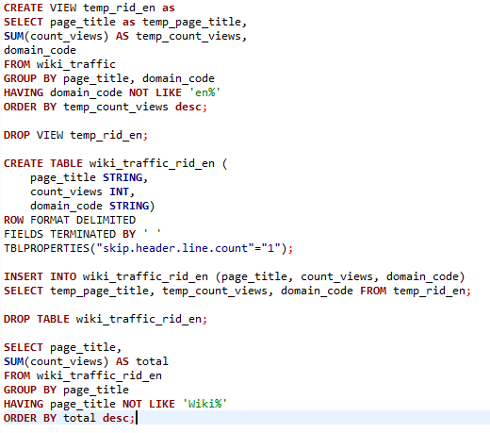
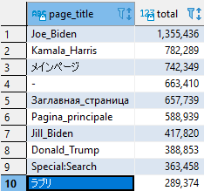
Query six: international popularity
For my own personal query, I was interested to see what articles the rest of the world cares about, and by extension which countries use Wikipedia the most.
I created a table with every domain code EXCEPT English and ran the results
Turns out a lot of the world also cares about American politics, but there were a lot of queries for Izumi Shirahama as well that day. She’s also known as Loveli, and she is a Japanese fashion model

Slide 13
Conclusion
To me, the most interesting queries were the popularity queries, which is why I did my own one for international views
The most difficult part was understanding how all the data related to each other and how to interpret it between the different databases
I’m excited to utilize my new knowledge on even more interesting queries in the future

Slide 14
The end
Any questions?
https://github.com/APCompEeng/RevatureProject1

