Slide 1
Project(C$-A-A)
Made by: Ákos Szabadi

Slide 2
Plans
working database that can be connected to the website and the desktop application
to store employee datas
to store user details
creating different user privileges

Slide 3
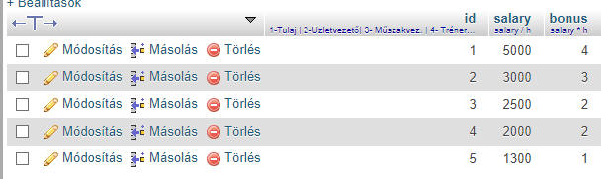
First Table(rank)
Different ranks that entail different salaries

Slide 4
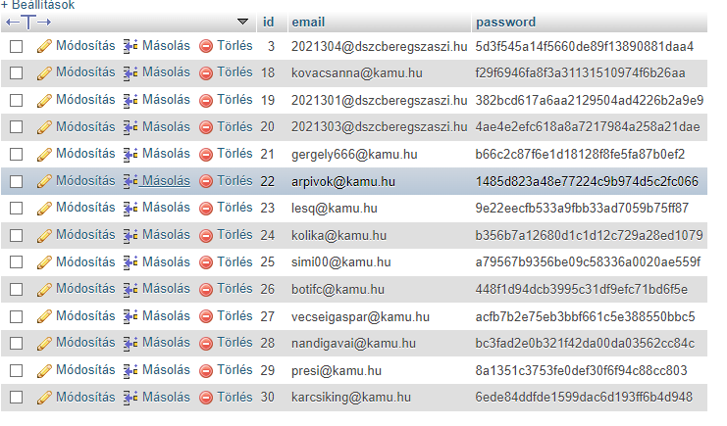
Second Table(users)
Stores login data of users

Slide 5
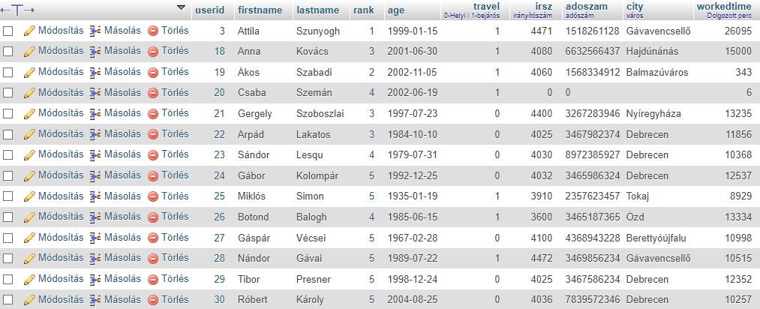
Third Table(user_details)
Stores user details like names, ages, zip codes etc…

Slide 6
Thank you for the attention!

