Slide 1
How To CUDA
A way to speed up Dijkstra SSSP algorithm
Dinu Ion George

Slide 2
What is CUDA ?
CUDA is a parallel computing platform and programming model for general computing on graphical processing units (GPUs).
GPUs were designed for highly parallel computations
GPU-accelerated applications offload the time-consuming routines and functions (also called hotspots) to run on GPUs and take advantage of massive parallelism. The rest of the application still runs on the CPU.

Slide 3
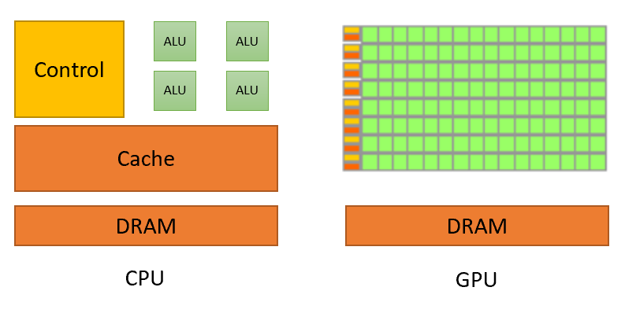
CUDA Architecture
GPUs devote more resources to compute data processing.

Slide 4
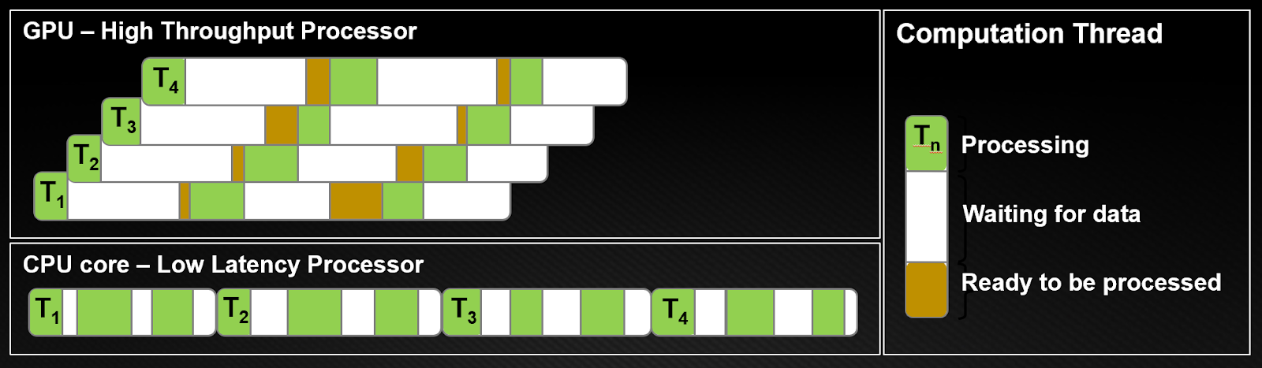
Why not CPU ?
CPU architectures must minimize latency within each thread.
To achieve this, CPUs requires large caches and complex control logic.
Caches work best with only a few threads per core, as context switching between threads is expensive.
GPU architecture hides instruction and memory latency with computation. In GPUs, threads are lightweight, so a GPU can switch from stalled threads to other threads at no cost as often as every clock cycle.

Slide 5
Conclusions
GPUs need many overlapping concurrent threads to hide latency.
As a result, we want to use as many threads as possible to experience the real power of your GPUs.

Slide 6
Reverse engineering on Dijkstra ?
Dijkstra's algorithm allows us to find the shortest path between any two vertices of a graph.
To do that we visit each node and its neighbors to find the shortest subpath to those neighbors.
In brief, we find the next best solution hoping that the result is the best solution for the whole problem.
Hmmm……, but what if we visit each node and process his neighbors, at the same time in parallel ?

Slide 7
Where do we go from here…
We know that we want to process more than one node at a time.
Doing that, we can guess that our algorithm will have an unknown number of steps.
From the serial version we know that we will encounter a data race condition between some distances.
But … how do we know that our algorithm finish?

Slide 8
We almost did it …
The main idea, is keeping a list of finalized and unfinalized vertices
Doing that we can also skip the distances to nodes that are already minimized.
Init
N2
N6
N1
N7
N3
N5
N4

Slide 9
Done
Implement scheduling
Init
N2
N6
N1
N7
N3
N5
N4
To do
N1
N2
N3
N4

Slide 10
Done
Huston, we have a problem …
Init
N2
N6
N1
N7
N3
N5
N4
To do
N1
N2
N3
N4
N6
N6
N5

Slide 11
Use of spinlocks
We can not minimize the distance to a node, from two difference sources at the same time. Why ? Memory might raise an MPU and the location might be corrupted.
How to solve it? We can use atomic operations or locks.
Downs: The lock and unlock operation consume time, which slows down threads.
Ups: Using CUDA, we can minimize this time, requesting the lock only on one memory location using the build in methods.

Slide 12
Done
Return of N3
Init
N2
N6
N1
N7
N3
N5
N4
To do
N1
N2
N4
N7
N3
N6
N5

Slide 13
Done
Recreating the path
Init
N2
N6
N1
N7
N3
N5
N4
To do
N1
N2
N4
N6
N5
N7

Slide 14
Done
We are almost done
Init
N2
N6
N1
N7
N3
N5
N4
To do
N1
N2
N4
N7
N6
N5

Slide 15
We did it
We have shown that, using one thread for each node in a graph, in at most n iterations we can process all the nodes in the graph.
Additionally, implementing this method with CUDA, allows us to speed up the algorithm even more, as the number of high threads usage is required.
More nodes => more threads => better acceleration.

Slide 16
Let’s see some code now

