Slide 1
REQUIREMENTS & USER STORIES
CIS 440 ∙ Dr. Joseph Clark

Slide 2
objectives
Purposes of the product backlog: long-term planning
Introducing user stories
Breaking down stories into tasks
Estimating/sizing
Adding detail to user stories
Mapping stories to traditional requirements breakdown

Slide 3
What to do and how to do it
In Scrum and other Agile approaches, there is a separation of responsibility.
the Product Owner is responsible for “what to do” (requirements definition and prioritization)
the Development Team decides “how to do it” (the breakdown of requirements into tasks)
the ScrumMaster is primarily a coach, facilitator, trainer, and problem-solver
Functional managers are still in charge of hiring, firing, assigning people to teams, and creating an environment for productivity.
Requirements are documented in a way that reflects this distinction:
Product Backlog Items (“PBIs”) describe what will get done
Tasks are to-dos defined by the developers for their own consumption

Slide 4
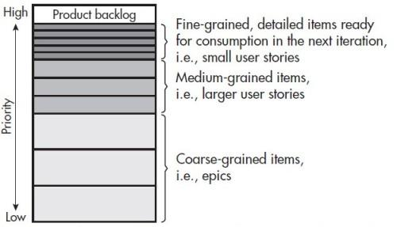
The product backlog
One of the key artifacts of an Agile project is the Product Backlog.
Scrum does not dictate the format of requirements or method of estimating their size/duration; the only hard and fast rule is that the backlog items (PBIs) be in forced-rank priority order.
The Product Owner has the final say in prioritization, nevertheless, the developers should give him input that will help, such as estimates of how difficult the items will be, and any technical dependencies that would suggest doing certain things earlier than others.
At the beginning of each sprint (iteration), the team typically slices off the top few items and commits to do them in the coming iteration. This becomes the Sprint Backlog. The deal is usually that the Product Owner agrees not to make other demands within the scope of a sprint. He has complete liberty to re-define and re-prioritize requirements between iterations.

Slide 5
User stories
Many agile teams use “user stories” to document requirements.
A user story is a sentence in the form of: AS A ____________ I WANT ____________ SO THAT ___________ .
User stories are strictly focused on the business point of view, since it is the Product Owner writing them. Other items like bug fixes can be added to the product backlog, but are not called user stories.
The purpose of user stories in the backlog is to enable long-term planning. They are a low-fidelity description of requirements that can be estimated (sized) quickly and project out the future of the project.
An Agile principle is that highly precise estimates will take more time and likely be wrong.

Slide 6
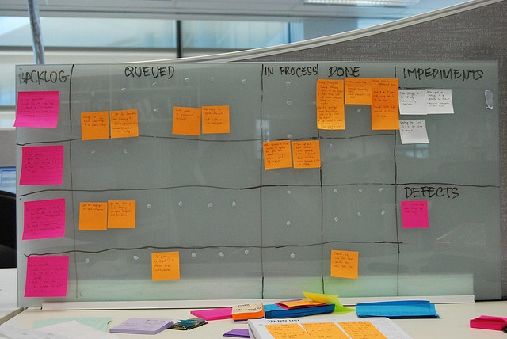
User stories are broken down into tasks by the team
Product Backlog Items (PBIs) don’t tell the team how to deliver the requirement. It is assumed that the developers are the experts here. For each story committed to the upcoming sprint, they identify tasks. For example:
Create the new database tables
Write a new piece of code
Write tests, design graphics, etc.
Tasks are for the team’s own consumption. At the end of the iteration, the product owner is only going to care if the story itself is done. It’s either “done” or “not done” – no “almost” allowed.
Tasks are usually broken down precisely because their purpose is to plan the actual work.
They need not be estimated. Some teams do.
The figures on pp. 108-109 of your book are good task board examples.

Slide 7
Your PRODUCT BACKLOG in CIS440
Your README file should contain:
High-level backlog items like user stories (but you can vary the format) – these are low-fidelity descriptions of all things that may be done soon, or not so soon. Size them using the method we will demonstrate today.
For the top few items (which we will consider your sprint backlog), break them down into tasks. Estimates are optional.

Slide 8
estimation
You can use either absolute estimates or relative estimates, but relative estimates are preferred.
When requirements and tasks are estimated in natural-sounding units of time, like “ideal days” or “ideal hours”, it gives the false impression that it’s a prediction of the completion date.
In reality, a “2 hour” task could take a full day or two, in between meetings, other tasks, and other obligations.
Therefore it’s recommended that you estimate in artificial units, like t-shirt sizes (S,M,L,XL) or “story points” which may follow an exponential or Fibonacci-like sequence (1,2,4,8,16…) or (1,2,3,5,8,13,…)
If you have a way of converting these into numbers, then after several sprints you may compute “velocity”, that is, the average number of story points completed in a sprint. Then you can make realistic predictions about when things will be done.
Typically PBIs/stories on the backlog are estimated separately (and in different units) from tasks in a sprint.
“Planning Poker” (p.131 of your book) is the most popular method for story sizing, but I will recommend a method similar to the “team estimation game” (p.125) which Larry Apke presented at the last PHXSUG meeting.

Slide 9
Release planning
Once the team determines its velocity, you can begin to plan more than one sprint out.
This is not a description of what the team will do, but an estimate of what the team could do.
This enables you to provide information to the business which is valuable for their decision making and probably more accurate than in any waterfall method, without locking the team into a rigid plan.

Slide 10
Backlog grooming, aka “story time”
http://scrumtrainingseries.com/BacklogRefinementMeeting/BacklogRefinementMeeting.htm
This is a great video at scrumtrainingseries.com which shows how the team can interact with the product owner to define and estimate requirements.
They recommend a special meeting just to do this, rather than trying to squeeze it into a sprint planning meeting.
But, do what you can!

Slide 11
Aren’t we being a little too casual about specifying requirements here?
Some teams can work effectively with just user stories and tasks, however, user stories can be augmented with two powerful additions:
Acceptance Criteria = (often plain-English) specifications that objectively determine whether a user story is done or not
Definition of Done = an additional set of criteria that apply to all user stories in a project
Acceptance criteria help a struggling product owner better define his vision, e.g., “the required fields on the form are _____; the optional ones are _____; after submitting the form you should go to page X…”
Definition of done may represent standards of quality, e.g.:
Pages must load in < 200 ms.
Graphics must be approved by the art director.
Pages must be compatible with the following browsers: …

Slide 12
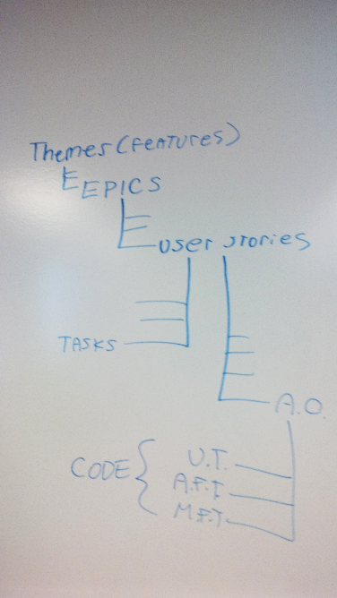
Mapping to traditional requirements documentation
Epics (or “themes”) map to chapter or section headings of a functional spec or requirements document.
User stories may map to sub-features or individual screens/pages within one of those chapters.
User stories break down into specific to-do tasks. This can map to a work breakdown structure (WBS) and even a Gantt chart or network diagram.
User stories are further documented with acceptance criteria. These are the lowest level of detail of the functional spec.
Each acceptance criterion can be mapped to an automated test (a unit test or functional test).
Thus, not only does the user story approach document requirements just as fully as the traditional approach, it also provides concrete data (the tests) to determine whether and when the requirements have been met.
The difference is that the planning is done “just in time”. As epics move toward the top of the backlog, they are broken down and criteria are defined.

