Slide 1
Information radiators
CIS 440 ∙ Dr. Joseph Clark

Slide 2
Objectives
Take a look at the types of information provided by “information radiators” such as task boards and burn charts.
Discuss the metrics that matter from a business standpoint.
Find ways to build data collection into the product and development process.
Introduce the “metrics” assignment due next week.

Slide 3
Information radiators
Information is vital to managing projects and processes. This is true in traditional and Agile methods.
If a team has its own shared workspace, a “team room” or the like, it will often be full of “big visible charts” or “information radiators” designed to make information public and hard to avoid.
The real trick is to find ways to generate data and information without requiring a lot of extra work. Ideally you want to design processes so that information is a by-product.

Slide 4
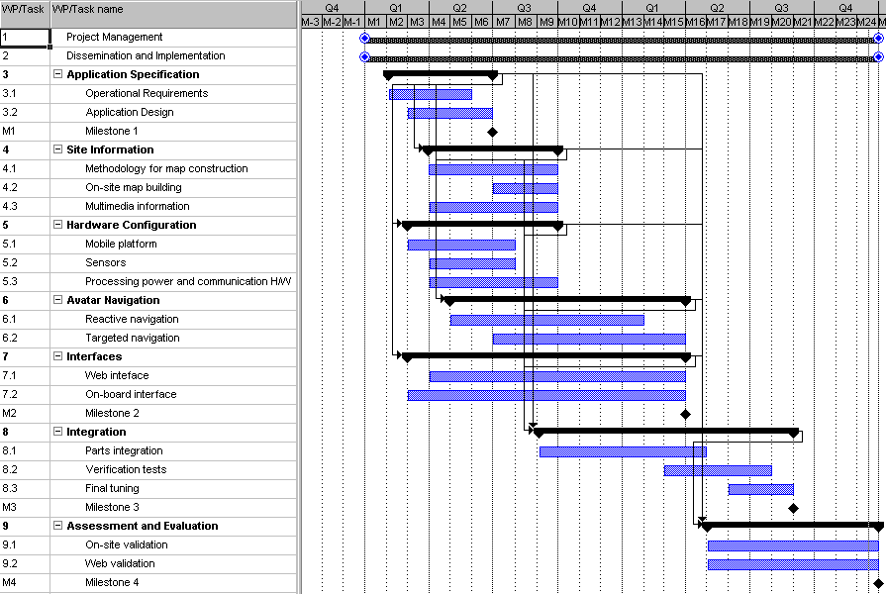
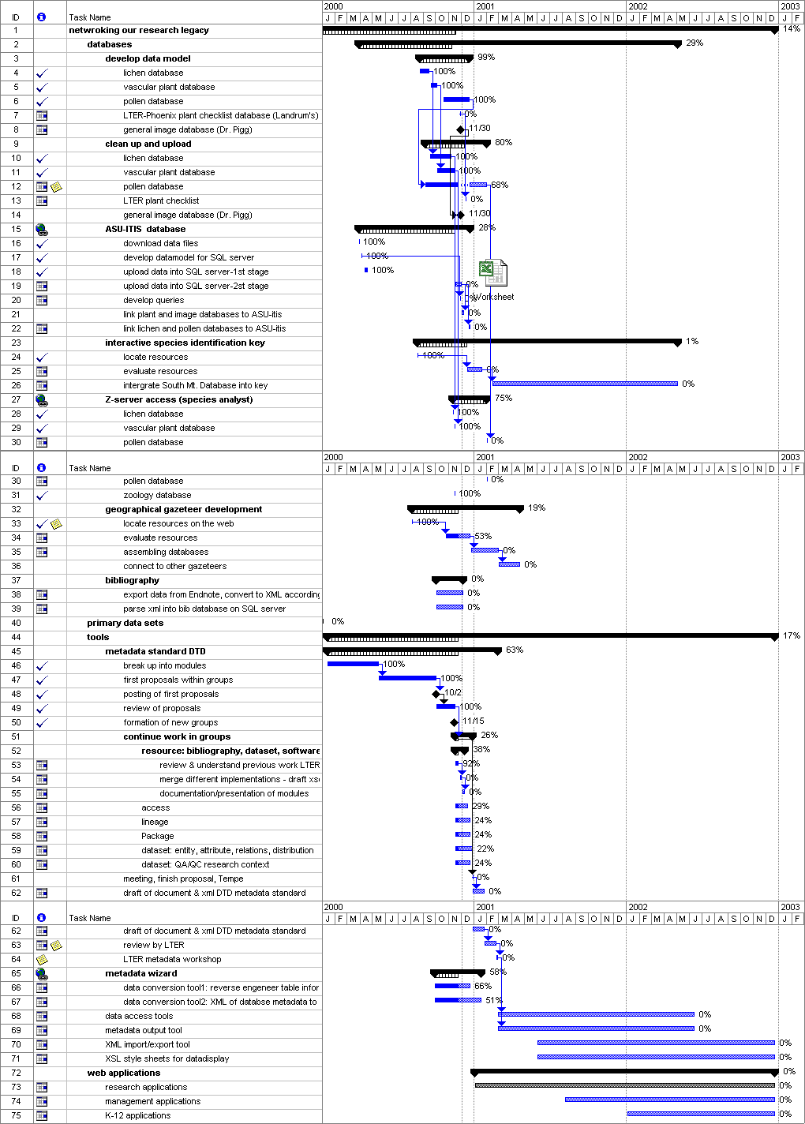
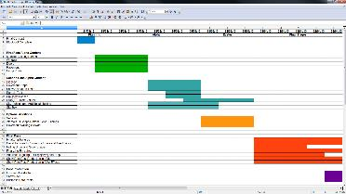
Gantt charts
A classic way of visualizing project schedules, Gantt charts show start and end dates for tasks and sub-tasks of a project.
They also allow visualization of task dependencies – which tasks must be finished before a particular task may begin.
Because the data is drawn on a timeline, it’s very easy to compare the forecast to the actual status of a project at any time.
Easy to produce in Excel, MS Project, or other software packages.
Typically associated with traditional project management because it’s based on a forecast and might be tedious to revise as requirements change.

Slide 5
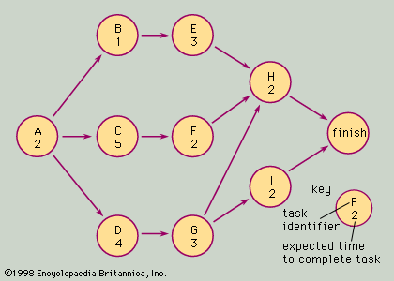
Network diagrams
First used in the 1960s, network diagrams are a tool for project planning that highlight the technical and business dependencies between tasks.
In the “task on node” version (depicted), each node features a subtask and an estimate of how long it is expected to take.
Arrows represent dependency rules – the most common is “when A is finished, B can begin”, but others are possible (such as “when A begins, B can begin”).
From this we can calculate the “earliest start date” for each task, as well as the “latest start date” that would not delay the project as a whole.
Many tasks will have “slack”, but there will be at least one path through the network with no slack. This is the critical path. Managing the critical path is vital to keeping the project on track.

Slide 6
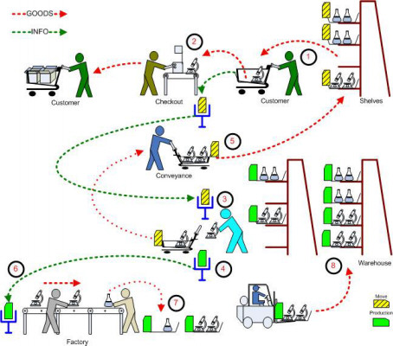
kanban
The term “Kanban” comes from Japanese manufacturing methods (i.e., Toyota, i.e. Deming). It refers to a method of using paper cards to signal the need to replenish inventory.
There are a couple of big ideas that we get from Kanban:
Limiting work “in process”, thereby limiting inventory.
Making demand visible. Everyone can see what needs to be worked on next, and (equally important) what doesn’t need to be done.
In software development, we also have “inventory” or “work in process” (WIP). These are programming tasks. Like inventory, they can pile up if two different “stations” are working at different paces. Like inventory, they can “spoil” if they pile up and are not managed.

Slide 7
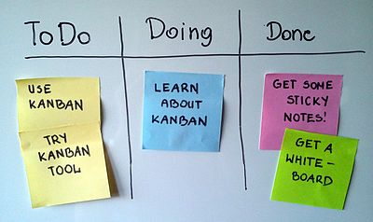
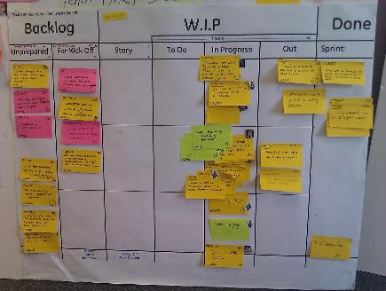
Scrum task boards
Scrum task boards (or workflow boards) are an adaptation of Kanban.
In a similar way, they allow the team to see:
What needs to be done?
What’s “in process” (and might need help getting done)?
A well-designed task board also makes the sprint backlog visible, shows tasks that are anticipated later in the task, and shows what’s already done.
Color codes may indicate different types of tasks, or different people responsible, etc. Some teams use stickers to identify problems, or mark up tasks in other ways.
In a hybrid method (Scrum-Ban), each W.I.P. column (“in progress”, “testing”, etc.) will have a W.I.P. limit, preventing the team from letting work “pile up”. This ensures that the team is working on the right things to ensure a steady flow of completed work.
Distributed teams struggle with the lack of a shared task board. Trello, etc, are generally seen as poor substitutes.
The best part about these boards is that all this information is captured “for free”, as a byproduct of the daily meetings and regular intra-team communication. There need not be anyone fussing about updating a spreadsheet!
simple Kanban board
Scrum task board

Slide 8
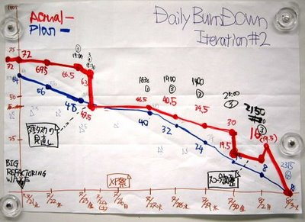
Burndown charts
Burndown charts report the amount of remaining work in the sprint on a daily basis…
… or the amount of remaining work in the product backlog on a longer time scale.
The units of the scale are whatever units you use for estimating – “task points” or ideal hours for tasks, “story points” for product backlog items.
This number is affected by two forces:
It decreases as the team completes work.
It increases as the team or the product owner discovers new requirements.
Thus, a strictly (monotonically) decreasing line is not always what you’d expect to see.

Slide 9

Deming and “statistical control”
After W. Edwards Deming basically rebuilt industrial civilization in Japan, he wrote this book to try to do the same for the USA.
One of his claims is that quality and production problems come from “the system”, not from individual workers.
His insistence is that you need to get your system under “statistical control”, by which he means you need your problems to be predictable. If you have a long-run average of say 5% defects, you can work on improving the system. But if your defects vary from 1% to 10% day to day, you have no idea if and when you are improving things.
Think about using your information radiators not to diagnose “special causes” but to understand the “typical” behavior of your system. Once you know how your team typically performs, you can improve it and measure your improvement.

Slide 10
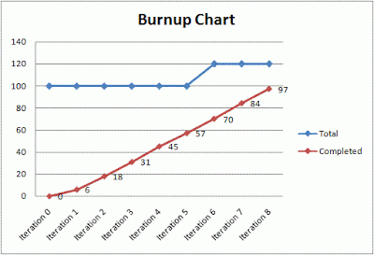
Burn-up charts and velocity
Burn-up charts separate these two forces, and simply plot the tasks or PBIs that have been declared “done”.
(The example at left also plots the changing total scope of requirements.)
From burn-up we can calculate velocity, the average number of story points the team expects to complete in a typical sprint.
Velocity is in the same units as your estimates, such as “story points”. For example you may estimate in t-shirt sizes (S,M,L,XL,…) and convert those to Fibonacci-like numbers (2,3,5,8,…).
FYI: the Space Shuttle was one of the first prominent engineering projects to use “relative complexity” estimates instead of hard estimates of real time units.

Slide 11
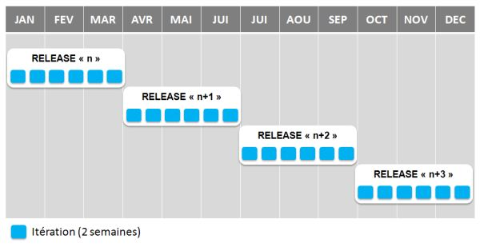
Using velocity in release planning
Given that the team has established a reliable velocity over several iterations, and the top of the product backlog has been well-estimated, a product owner can begin to estimate how the project will play out several sprints ahead.
Sprints may be grouped into “releases” which may correspond to when new versions will be shipped to end users, or other milestones.
This helps solve the problem of not being able to tell customers up front how long their project will take.
Since estimates are in relative units, velocity is specific to a team. Therefore, velocity from one team cannot be compared to another team… their “story points” may not be equivalent.

Slide 12
Technical debt
Other artifacts that serve as information radiators may include bug tracking logs.
Some teams also track the shortcuts they took and would like to refactor later. This is a way of dealing with technical debt.
"Shipping first time code is like going into debt. A little debt speeds development so long as it is paid back promptly with a rewrite... The danger occurs when the debt is not repaid. Every minute spent on not-quite-right code counts as interest on that debt. Entire engineering organizations can be brought to a stand-still under the debt load of an unconsolidated implementation, object-oriented or otherwise.” Ward Cunningham, 1992
Technical debt matters when a team owns its work. “No one washes a rental car.”

Slide 13
Metrics that matter to business
Businesses also have measures they need to see. Can we design products that generate data to help validate the theory implicit in our work?
From The Lean Startup, growth hypotheses might be:
Viral growth –early users spread use of the product to others
Marketing growth – fewer dollars of advertising will bring in greater dollars of sales
Repeat business growth – new customers will come back for more product/service if you can get them once
My claim: if, at your sprint reviews, you can show “validated learning” in terms of those metrics, you’ve demonstrated much more than the baseline of scrum allows.

Slide 14
Built-in data collection
How would we build some of these measures into our products?
For ads… track which ad resulted in a sale. Coupons have bar codes. Ads have discount codes.
Record invites in the database and recognize them at signup time. Or send invite emails with customized links.
Repeat business –some sort of user account.
Simply ask people – how did you find out, etc.
Use GPS to know where customers are.
Simple SQL query – if data is centralized
A/B testing?

Slide 15
Information radiator assignment
You will propose a new feature or mechanism to gather data/information/feedback that is of value to the client as he develops and/or uses your project.
Describe what the “output” is – i.e. a metric, or a chart/graph – and how you would build it. Try to estimate how easy or how difficult it would be.
You don’t actually have to build the proposal; but it should be well-reasoned so that your client could think about adding it to the backlog and deciding what its priority is.
Commit it to GitHub. It’s an individual assignment; but make sure you don’t offer the same proposal as a teammate.

