Slide 1
README-driven development
CIS 440 ∙ Dr. Joseph Clark

Slide 2
objectives
What’s the problem with IT/IS projects?
Introduce the Scrum approach
Explain the “README-based” variation
Review a list of modern IT/IS development toolsets
Sign up for Tech Talk assignments

Slide 3
Some dismal statistics…
A 2009 study showed that IT project success rates were:
32% of all projects succeeding
(on time, on budget, with all required features)
44% were challenged
(late, over budget, and/or without requirements met)
24% failed
(cancelled before completion, or finished but never used)
And this doesn’t even tell us if the client liked the product or used it!

Slide 4
What’s wrong?
The construction industry wouldn’t be viable if 24% of buildings collapsed.
The aerospace industry wouldn’t be viable if 24% of new jets blew up.
So what’s wrong with the IT industry?
Are we stupid?
No! We have some of the smartest people in the world.
Are we lazy?
No! Software developers will often work all night long on projects that interest them.
Do we not have process discipline?
No! There are hundreds of books about IT project management.

Slide 5
The Problems
The problems are that IT projects are different from construction projects, aerospace projects, and others. How are they different?
Uncertainty abounds!
Requirements change quickly as customer preferences shift, competitors release products, and new technologies are invented.
Software systems are hard to describe or envision up front. Users don’t know what they like until they see it.
Software development is creative work, and traditional project management processes stifle the best developers.
…

Slide 6
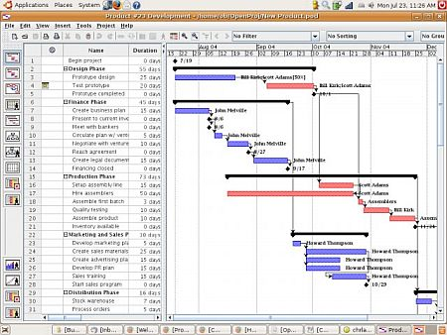
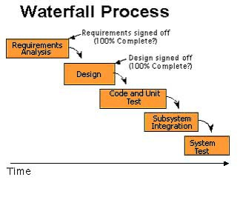
Predictive process control
Traditional project management is a form of predictive process control.
This term essentially means we have a predicted or forecast model of the project schedule, and manage by focusing on deviations from the forecast.

Slide 7
Problems with predictive process control
Assumes perfect information up front.
This is the time when you have the least information about the project!
Does not have project manager or team focused on what’s changing.
Focus is on the plan. You won’t even know anything’s changed unless the customer comes knocking on your door with a surprise request for changes.
Success is measured by completion of tasks, not by completion of project.
75% done = 75% of tasks complete, but 0% of project is working!
Too much wasted effort writing plans that are never used.
Every change request necessitates a new plan. So why plan in such detail so early on?

Slide 8
The Agile Manifesto
A group of software developers found that we needed a new set of values if we are going to find a better way to do projects that is suited to the IT world.
Their manifesto:
We are uncovering better ways of developing software by doing it and helping others do it. Through this work we have come to value:
Individuals and interactions over processes and tools
Working software over comprehensive documentation
Customer collaboration over contract negotiation
Responding to change over following a plan
That is, while there is value in the items on the right, we value the items on the left more.
Interesting to note… they discovered these values “by doing it” not “by theorizing about it”… initially they didn’t try to explain why these things worked, just that they did.

Slide 9
Empirical process control
An agile approach calls for empirical process control. Instead of managing based on a forecast, we manage based on data and experience, learning by doing.
We do not assume perfect info up front, but instead rely on lots of constant feedback.
We are focused on change and learning, collaborating as a team to discover new issues as they emerge.
Success is measured by working software that meets the client’s needs, not by the number of items we’ve checked off a checklist.
We plan in small chunks, iteratively, instead of doing lots of planning at the beginning.

Slide 10
Hungry for data
As empiricists, we’re constantly hungry for data. What kinds of data might we seek?
Observations about the technology. What does it let us do? What are its constraints? Can it solve the problem we need it to solve? What about alternative tools?
Feedback from the client about the product. Does it work the way he expected? Does the design look right? Are there things he didn’t ask for, but now realizes the product needs?
Learning about the end users and the business. Are customers buying the product? Which features are they using, and which are they not using? What bugs are they reporting? What are they happy about? What complaints do they have?
Discoveries about ourselves and our processes. Which tools for collaboration are working for us? Are we building quality products and making good use of time? Are we improving?

Slide 11
Obstacles to empirical control
What kinds of obstacles prevent us from getting the data we want?
Observations about the technology. What does it let us do? What are its constraints? Can it solve the problem we need it to solve? What about alternative tools?
Analysis paralysis might prevent us from trying it out, or doing pilot projects. Maybe it’s not possible to test the tools until all the different parts of the product come together, and we’re waiting on someone else to do their part.
Feedback from the client about the product. Does it work the way he expected? Does the design look right? Are there things he didn’t ask for, but now realizes the product needs?
We may be afraid to show the client an unfinished project. He may be too busy or not savvy enough to give us the kind of feedback we want. We might have a contract that prevents us from using his feedback even if we got it.
Learning about the end users and the business. Are customers buying the product? Which features are they using, and which are they not using? What bugs are they reporting? What are they happy about? What complaints do they have?
Customers may never see the product before it’s ready for sale. Or it may be years between versions, so we’ve got to interpret a lot of feedback on a lot of changes that we made at the same time.
Discoveries about ourselves and our processes. Which tools for collaboration are working for us? Are we building quality products and making good use of time? Are we improving?
Teams may be split up and re-constituted all the time, or we may go right from one project to the next without time for a retrospective.

Slide 12
Agile approaches are all about making it easier/cheaper/faster to get data
Daily “stand up” meetings let everyone know who’s working on what, and who needs something, so we spend less time waiting for work, and identify problems before they become serious.
We insist on “working software” (aka a “potentially shippable product increment”) every single iteration. That means that we all the parts will come together so we can see how the technology functions AND we can show it to the client AND the client can release it to his end users (if he wants). Every single iteration!
The client works together with the developers with the understanding that he’s the expert on the business need and they’re the experts on the technology. Both groups learn from each other.
Version control and automated testing make it much less costly (in time and money) to experiment with the technology and roll back experiments that don’t work.
Frequent retrospectives (and follow-through) allow us to try out process improvements and (importantly) to assess the results.

Slide 13
SCRUM

Slide 14
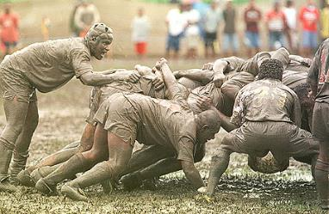

scrum
The term comes from rugby, and was inspired by a 1986 HBR article by Takeuchi and Nonaka about new product development. A “scrum” is contrasted with a relay race – in scrum, cross-functional teams work together to move the ball down the field (so to speak) instead of doing their jobs sequentially.
Scrum is an Agile framework for managing (software) projects. It is the most popular Agile framework today. There are other Agile practices often used in conjunction with it, but Scrum itself is very simple.

Slide 15
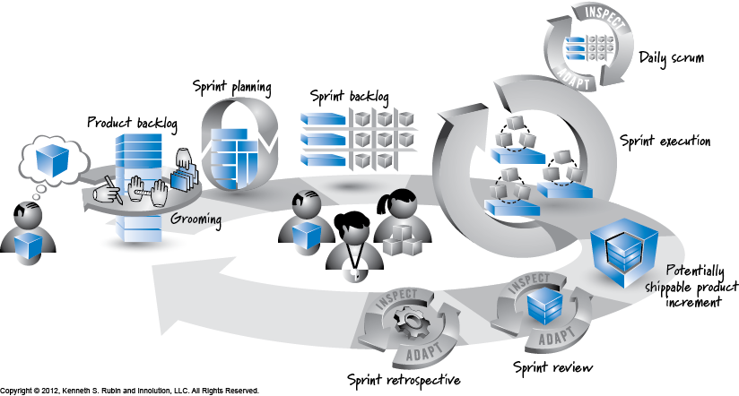
The scrum framework
Invented by Ken Schwaber and Jeff Sutherland, first described in a 1995 paper for the OOPSLA conference.
The “official” Scrum framework is given in the scrum guide at www.scrum.org.
It features:
3 roles
4 meetings
3 artifacts (or is it 4?)
graphic from Ken Rubin’s book “Essential Scrum”

Slide 16
sprinting
Scrum has a “rhythm” defined by the sprint, usually between a week and a month in length.
There are a few major benefits to an iterative method or process:
Frequent iterations allow you to “inspect and adapt” the product as it emerges, rather than “plan and execute”. This makes sure that there is room for learning.
The sprint cycle allows the team to work at a “sustainable pace” instead of oscillating between procrastination and burnout. Each sprint may be seen as a manageable mini-project.
For this reason, the word “sprint” is really about the worst word they could have chosen for an iteration.
Short sprints allow for frequent “victories” both for the team and for the client, who can provide working incremental products to his customers early and often.
By inspecting and adapting between sprints, we avoid the need to constantly do this during sprints. In other words, the sprint buys us a little chunk of stability or certainty in a larger context of change/uncertainty. I think that this must have a huge effect on programmers’ ability to do their jobs.

Slide 17
Three roles
Three roles in the Scrum Framework:
Product Owner
ScrumMaster
Development Team Member
Experts (including Schwaber and Sutherland) disagree about whether it’s acceptable for one person to play multiple roles. It may be better to have dedicated Product Owners and ScrumMasters, even if they need to serve more than one team in order to justify their cost.
Functional managers and others not mentioned in the Scrum Framework are also important. Scrum teams don’t operate in a vacuum.

Slide 18
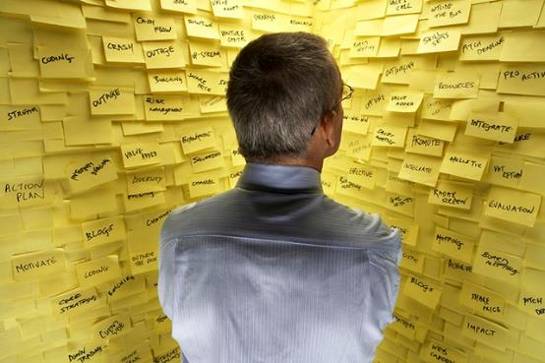
Role #1: the Product owner
The Product Owner represents the business (if the team is developing an internal product) or the customer (if the team is developing for a client).
He maintains the “product vision” and interprets those requirements in a way that developers can understand.
He also needs to be able to understand what the developers are telling him about the technology (constraints, dependencies, etc) and figure out what it means for the business.
He has ultimate responsibility for:
Defining requirements
Prioritizing requirements
Deciding when to start and end a project

Slide 19
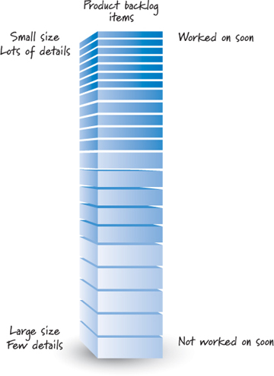
Artifact #1: the product backlog
The Product Owner’s main job is to develop and manage the Product Backlog, a prioritized list of requirements. These may include user stories, bug fixes, or other things that need to get done. Strict prioritization (#1,#2,#3) is critical.
Only the highest priority items need to be well-defined and estimated, therefore, items at the top of the backlog tend to be more granular and fleshed out with acceptance criteria. The product owner may have a regular “backlog grooming” meeting or work on this continually.
Good product owners are also available for face-to-face discussion of requirements on a daily basis. That way they can ensure that the developers understand the vision behind the requirements.
The product backlog describes “what” will get done, and gives a hint at “when”, but does not say “how” it will be done.

Slide 20

Role #2: the development team
A scrum development team is meant to be cross-functional and multi-functional. Team members should have (or will develop) “T-shaped skills” – breadth across many areas with depth in one or more specialties.
The team is responsible for deciding how to do the work. The insight behind this is that developers are probably more knowledgeable about their specialties than a project manager would be. If allowed to use their expertise and creatitivity, they will allocate tasks to themselves better than a PM could.
The team collectively commits to completing certain requirements in each sprint, and is collectively responsible for delivering a high-quality product. No individual takes credit or blame alone.

Slide 21
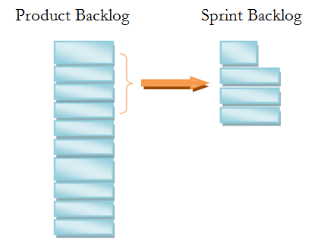
Artifact #2: The Sprint Backlog
At the beginning of an iteration (the sprint planning meeting), the development team “commits” (or “forecasts”) a set of requirements from the product backlog that will be done in the coming sprint.
The product owner decides which items are the top priorities. The development team decides how many items it can get done in the coming sprint (based on the difficulty, size, and technical dependencies).
Thus the business’s priorities are respected, and the developers’ expertise is also respected.
The sprint backlog typically includes estimates, and also breaks backlog items down into tasks.
Ideally, the sprint backlog does not change during the sprint. This allows the team to focus on their work. The team owns the commitment they have made.

Slide 22
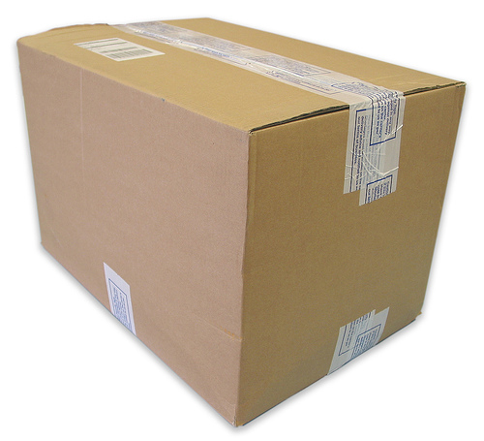
Artifact #3: The product increment
Each iteration is supposed to end by delivering a “potentially shippable product increment” to the product owner and/or his clients.
What “potentially shippable” means may vary according to context. It’s recommended that you have a “definition of done” that specifies what’s expected.
The purpose of this requirement is:
To show off new features by actually demonstrating them, so you can get quality feedback, instead of making excuses.
So the product owner can decide to “go live” or to terminate the project when it makes business sense, without finding himself empty-handed.

Slide 23

Role #3: the scrummaster
The ScrumMaster is the Scrum process expert on the team.
In the book “Coaching Agile Teams”, Lyssa Adkins identifies six roles:
Coach-Mentor
Facilitator
Teacher
Problem Solver
Conflict Navigator
Collaboration Conductor
In day to day practice, the ScrumMaster helps team members identify impediments to their work, and may lobby the outside organization to eliminate obstacles and solve problems. They also facilitate activities and teach the team about Scrum.
It’s important that the ScrumMaster does not have authority over team members (i.e., hiring and firing authority) so they can be “on their side”.

Slide 24
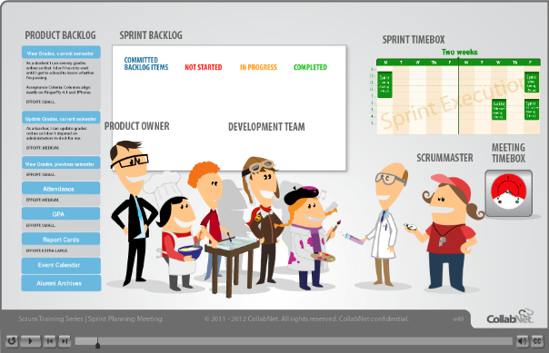
Meeting #1: Sprint PLanning
At the beginning of an iteration, the development team and the product owner collaboratively build the sprint backlog from the top few items on the product backlog.
A typical meeting flow:
Product owner introduces and describes the first (highest priority) item on the product backlog.
Development team estimates the size or difficulty of the product backlog item (PBI).
Development team decides “Can we commit to getting this item done in the coming sprint?”
If yes, repeat with the next PBI. If no, move on.
Finally, the development team takes the list of committed PBIs and breaks it down into the anticipated sub-tasks. This set of committed PBIs and tasks is the sprint backlog.

Slide 25
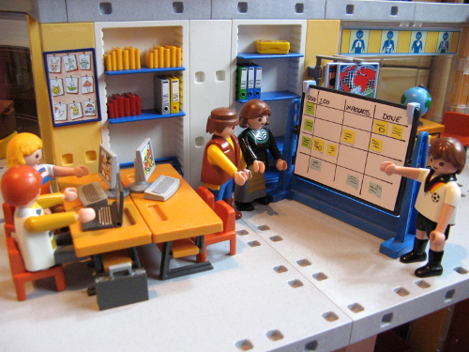
Meeting #2: The daily scrum
Also called the “daily stand-up”, this is typically a meeting held at the beginning of each work day to keep information flowing within the development team.
Team members take turns answering three questions:
What did I do yesterday?
What will I work on today?
What obstacles are preventing me from getting it done?
The meeting is strictly time-boxed – not allowed to start or end late – and must be aggressively facilitated so that it doesn’t turn into a tedious ritual.
The product owner is invited, but not required to attend in “textbook” scrum.

Slide 26
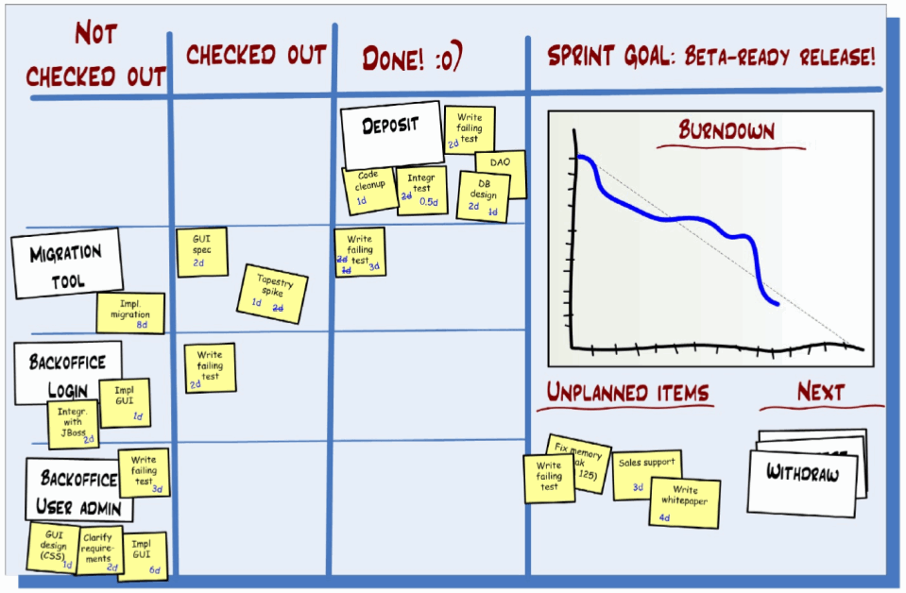
Artifact #4 (?): the workflow board
Not described in the official scrum guides, the “workflow board” or “scrum taskboard” is a commonly-used fourth artifact in a scrum process.
Distributed teams may use electronic substitutes like Trello, Asana, etc.
The value of a task board is to make things highly visible, so the team can see whether work is getting done, which tasks are stalled, and other issues. This is similar to a “kanban” in Lean manufacturing.
In an upcoming lecture I’ll talk more about the “information radiators” used by Agile teams.

Slide 27

Meeting #3: sprint review
At the end of each iteration, the development team presents the “potentially shippable product increment” (officially) to the product owner.
(But actually) the product owner is really presenting the product to his own stakeholders – his boss, his customers, his users, etc.
The purpose of this meeting is to celebrate success and also to get feedback from real use of the product.
Usually there is a “ceremony” where the product owner reviews the sprint backlog items and says “I declare this one Done” (or not).
This is the only scrum meeting to which outsiders (bosses, customers, other stakeholders) are usually invited.

Slide 28
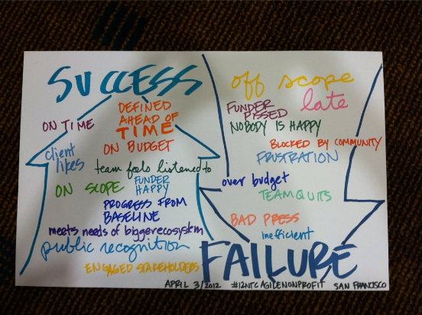
Meeting #4: Sprint retrospective
The sprint retrospective looks not at the product, but at the team’s process. It is an opportunity to “inspect and adapt” the structure of roles, meetings, and artifacts, as well as tools and practices for communication and collaboration.
Typically this meeting is the ScrumMaster’s big day, because they may build up a repertoire of activities for exploring issues and coaching the team to find solutions.
This is meant to be a candid and private meeting, so generally it is team-only, possibly with the product owner. This is one reason it helps if the product owner and scrummaster don’t have hiring/firing authority over team members.

Slide 29
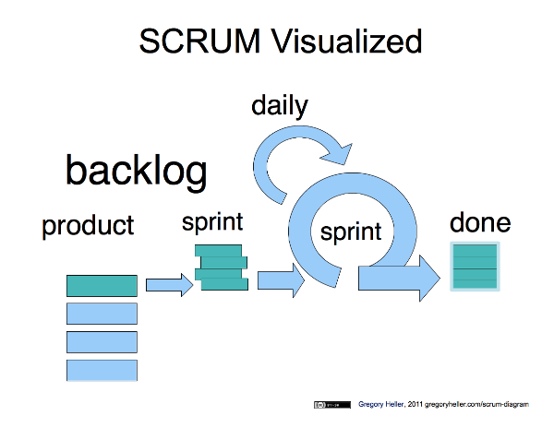
summary
Scrum is one of several Agile approaches. Its popularity may be explained by its simplicity and adaptability. Other Agile practices, such as the “extreme programming” engineering practices, are often coupled with Scrum but are not included.
Scrum gives work a “rhythm” that keeps the pace sustainable, tames uncertainty, and helps programmers achieve real productivity (as opposed to “theoretical” productivity).
The separation of authority between the product owner who decides “what gets done” and the developers who decide “how to do it” has proven to be a way to harness the creative expertise of developers to achieve business goals.

Slide 30
README-Driven development

Slide 31
Readme-driven development
The term was coined by GitHub co-founder Tom Preston-Werner in a blog post: http://tom.preston-werner.com/2010/08/23/readme-driven-development.html
The essence of his idea: “Until you’ve written about your software, you have no idea what you’ll be coding.”
My take on his idea:
The README file is given pride of place in GitHub. It’s rendered on screen automatically.
The README file tells people what the project is ([W] is a [X] that does [Y] through [Z].) http://www.slideshare.net/maetl/readme-driven-development-12783652
The README file usually contains a to-do list, instructions on how to use the software, and names of contributors.
The README file is version controlled.
Therefore, using the README file as the central design document and task tracker for the project enables a distributed team (no “team room”) to collaborate without technological complication (it’s all Git), forces you to define the project succinctly (no feature creep), and gives the professor access to the project’s history.

Slide 32
RDD How-to
Your repository must have a file entitled README
README.txt would be plain text
README.md is Markdown – plain text with a little bit of automatic formatting https://help.github.com/articles/github-flavored-markdown
I think you can also use a README.html and maybe some other types
The README file must contain at least:
Introduction: Your elevator speech, for example, “[W] is a [X] that does [Y] through [Z].” This is a statement of the core intent of this project. Don’t let it get confused by including lots of peripheral “features” here.
TO-DO: Your “product backlog”. It should be strictly prioritized. Backlog items can be broken down into sub-items and tasks, and documented with estimates, acceptance criteria, if possible. I will talk all about requirements discovery in an upcoming lecture.
Team: Your github account names. Don’t give out personal info like phone numbers if you don’t want it public.

Slide 33
RDD How-to
Other sections you might want in your README:
Screenshots
Links to website, wiki, Trello board, etc.
Instructions or “How to Install”
License
Change-log (aka what’s “done” since the previous release)

Slide 34
RDD How-TO
When you complete a new requirement or make a change:
Test and make sure it works (or check with client, if that’s part of your process)
Remove it from the TO-DO section
Add it to the “change log” if you have one. This is a way of celebrating what’s “done”.
Make a commit and push to GitHub.
When preparing a new release:
Change the “change log” to “new in version 0.3” or whatever. Add a new “change log” heading for next sprint. (This is all optional.)
Demo the project to the client and get his feedback.
Work with the client to update the TO-DO list so that it reflects his current priorities.
Commit and push by the Tuesday following “demo day”, because this is when the professor will check the README.

Slide 35
Modern toolsets

Slide 36
Modern toolsets
This is a big list of tools that people are using to develop web and mobile applications. Some of these have been used with success by past 440 students, others are things I’ve bookmarked and would like to try out.
These may be good topics for tech talks.
These slides are organized into the following topics:
Project management and collaboration
Application frameworks
Web front-end
Databases
Back-end / cloud
DevOps
Mobile development
Special recommendations

Slide 37
Project management & collaboration
File sharing:
Dropbox – free, syncs locally, has “undelete” capability
Microsoft OneDrive, Google Drive, and others
Project/Task management
Trello – simple to-do/doing/done task board, very easy to use
Asana – task management with communication, deadlines, subtasks, and other features
Pivotal Tracker, YouTrack, Slack, DashCube, Mingle, and others are alternatives

Slide 38
Project management – version control
Version Control tools enable multiple people to work on the same code-base without overwriting each other’s work, and also allow you to “rewind the clock” to undo bugs.
Dropbox is a very primitive way to do this, fraught with peril.
Real version control systems (VCS) come in two varieties:
Centralized VCS which maintain all files on a shared server – Subversion (subversion.apache.org) is the most famous
Distributed VCS which keep copies of all files on a server AND on all developer’s computers – Git and Mercurial are popular
Git can be used with GitHub (free for open-source projects) or Bitbucket (free for small closed-source work) to add in bug-tracking and other features.
If you’re using Microsoft tools, Visual Studio Online may be an alternative to look into.

Slide 39
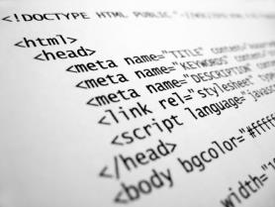
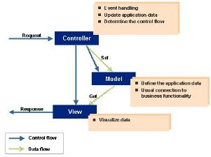
Application frameworks
If you’ve taken CIS 425, you’ve gotten a little bit of a look at how web apps can turn into “spaghetti code”: HTML interlaced with PHP (which itself calls on SQL) and with Javascript and CSS (possibly including external files).
This problem gets worse as you want to add more interactivity and complexity to your program.
Application “frameworks” are systems that allow us to avoid some of the complexity by neatly organizing the parts of our program.
Ruby on Rails was the first famous one, released by 37signals in 2004. It uses an “MVC” structure (model-view-controller) which separates data (model) from front-end (view) and program logic (controller). Some of the other popular ones are ASP.NET MVC (using C#) and Django (Python).
On the next slide I’ll show a couple of code examples from Flask, another Python-based MVC framework.

Slide 40
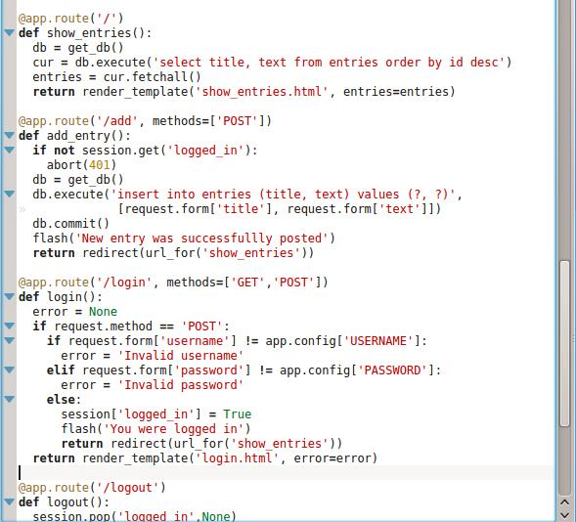
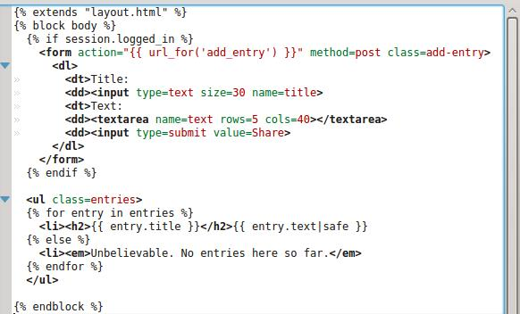
Application frameworks
Each “route” or URL within the site is defined, given some program logic, and sends the user to a “template”.
Templates are just HTML with some placeholders for data. They may have some limited if/then logic. This is where you put all the front-end design.
Note: this is not an endorsement of Flask or Python; use what works for you!

Slide 41
Your choice
Some of you are doing simple applications and would find an app framework to be overkill. You’re welcome to use plain old scripting languages (e.g. PHP, JSP, ASP) or static HTML.
There are also some frameworks where almost all of the code runs “client-side” – these are written in Javascript. Angular.js and Ember.js are two that I know about.
There are even PHP-based frameworks such as CakePHP.
I recommend you pick your favorite programming language(s) first, then find a framework to use.

Slide 42
Web front-end
The basic front-end technology for any website is HTML and CSS. Most browsers support most of the features of HTML5 and CSS. Still, make sure your code works across browsers.
Javascript is the key technology for interactivity on the page, such as rollover buttons and drag-drop functionality.
However, you don’t need to write your code from scratch! There are many templates and libraries available to help you.
For CSS, look into Bootstrap (getbootstrap.com) – it promises sites that work across computer, tablet, and mobile browsers (“responsive”) – many free themes are available
For Javascript, look into jQuery (jquery.com) – it’s very lightweight and simplifies a lot of common stuff you do in Javascript
If you don’t like the languages themselves, there are several “pre-processors” that let you write code in a different or simpler syntax and “compile” to HTML, CSS, and Javascript, for example:
Haml (haml.info)
{less} (lesscss.org) and Sass (sass-lang.com)
CoffeeScript (coffeescript.org)

Slide 43
AJAX
AJAX (asynchronous javascript and xml) is a programming paradigm in which Web pages already loaded in the browser continue to make requests to the server and load more content without refreshing the page.
Gmail was one of the first cases of this. Before AJAX, you had to refresh the page every time you clicked on a link, like an e-mail message header.
Another common usage is sites like Facebook which appear to allow you to “scroll down” infinitely. Actually what they do is load more data as you get near the bottom of what’s already been loaded.
I’m not sure that AJAX is necessary for any of this semester’s projects, but if it is, you may want to get a good book and try to learn it. This probably involves setting up web services on the back-end (i.e. URLs which serve data directly, instead of serving up HTML pages).
The front-end part requires using Javascript to capture the response and put it on the page. JQuery can be used for this.

Slide 44
Back-end: databases
Pretty much all the major relational database management systems (RDBMSs) work about the same. They are:
SQL Server, Oracle, IBM DB2 (proprietary)
MySQL (aka MariaDB), PostgreSQL (open-source)
Two things to consider:
Will your client have to pay extra to use a proprietary RDBMS, or is included in hosting or cloud backend services?
Can your development team all run the software on their computers? You have SQL Server free from Dreamspark, but it only runs on Windows. MySQL and PostgreSQL are cross-platform.
If you’re using a web development framework, you often have the option of accessing the database directly with SQL queries, or using an “object-relational mapper” (ORM) which manipulates the database for you. Evaluate both options and see what you prefer. This should be introduced in tutorials on the framework.

Slide 45
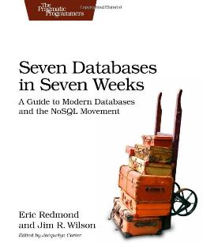
Back-end: NOSQL databases
There are a variety of non-relational databases becoming popular these days. Many of them are well-suited for web applications because they tend to emphasize high availability (fast query response) with the trade-off being less ability to do complex queries.
MongoDB and CouchDB are document stores – good for storing whole documents in JSON format without any strictly defined schema.
Neo4j is an up-and-coming graph database – good for modeling social networks.
If you’re interested, check out the book “Seven Databases in Seven Weeks”…
There are also some “databases as a service” you may check out, if you don’t want to run your own DBMS. Firebase (firebase.com) and Orchestrate (orchestrate.io) are two names I’ve bookmarked for further research.
These probably require use of Javascript and XML or JSON to transmit data to/from your application.

Slide 46
Back-end: Hosting/Cloud
The simplest way to host an application is to rent a web hosting account from a provider like GoDaddy (hint, hint: this is a local company that hires a lot of our students!). My personal site costs $7 per month and supports MySQL and PHP.
Perhaps a better way to host your site is to use a cloud service:
Microsoft Azure (formerly Windows Azure)
Amazon Web Services (“AWS”)
Rackspace Cloud
Cloud services typically have a free service tier which you can use to host your site while it’s under development, and you can (relatively) seamlessly scale out to more servers when your traffic increases. They are pay-as-you-go services. Search the web for tutorials.
Finally there are services like Heroku (heroku.com) which automate some of the administration and maybe make it even less of a learning curve to get started.

Slide 47
Back-End: tips
Even if you don’t use GoDaddy for hosting, this kind of company can be a good place to buy a domain name. Try to book the domain name your client wants (and all likely variations) before spending time and money creating a logo!
Make sure the client pays with their own credit card for any hosting or domain name registration services you need to buy. Not only is this fair, it will also make it much, much easier to transfer ownership/control at the end of the semester.
Consider the development environment(s) you’ll be using. Can your hosting service provide the same software and same version(s) that you’re using to develop the software? If not, you’ll definitely want to have a “test” environment on the hosting service in addition to the “live” environment.

Slide 48
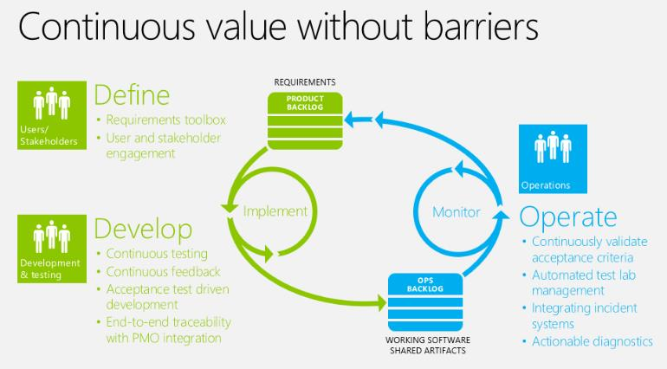
DevOps: defining the problem
“Development” is the creation of software. “IT Operations” is what happens after development – testing for quality assurance, provisioning servers, deploying software to customers, maintaining and upgrading it.
If we create software in an Agile way, with a new release every couple of weeks, then IT operations becomes the bottleneck. So how can we make the whole process run more smoothly?
This is DevOps, the marriage of development and operations.

Slide 49
DevOPs: Toward a Solution
There are a number of ideas floating around under the DevOps umbrella.
Test-driven development (TDD) (cf. behavior-driven development, BDD) means that testers are integrated into development teams and continually building quality into the product.
Continuous integration is the use of version control (i.e. git) to enable a team to work on the same codebase without stepping on each others’ toes.
Automated testing or regression testing means that tests are written down in code so that they can be re-run every time the code is updated. This allows you to find out if a change you made today causes something to break in the code you wrote six months ago, and immediately fix it.
Continuous delivery means that customers immediately (maybe invisibly) receive updates and bug fixes, instead of having to manually download them. This is easy with websites.

Slide 50
DevOps: some tools to research
Consider using virtual machines to get a consistent development environment. This way you may all have different types of computers but you can develop your code on a simulated Linux box (for example) with all the same software versions.
VirtualBox and VMware are two popular virtualization platforms.
Vagrant and Chef and Docker are software solutions to make it easy to provision matched virtual machines. You can even commit descriptions of your VMs to your version control systems.
For automated testing:
There are a number of ways to write “unit tests” depending on the language. “jUnit" is popular for Java, for example.
Selenium is a popular tool for automating web browser tests.
Cucumber is an emerging tool for BDD, in which you write tests in something like plain English.
It’s possible to program a test suite to run automatically when you commit code to VCS.
TravisCI is one tool for continous integration

Slide 51
Mobile (iOS) development
iOS development is different from Android development, Windows Phone development, Blackberry development
Apple has resources online: developer.apple.com
Xcode is their IDE. I believe it only runs on Macs.
Until a few weeks ago, the language for developing iPhone/iPad applications was Objective-C. Now Apple has a new programming language called Swift that may change the game. Search the web for tutorials.
You typically program on a desktop/laptop computer which simulates an iPhone/iPad in an “emulator” so you can see how your program will work without having to load it onto the device.
You may have to pay a fee for some of the software to develop for iOS. Get the client to fund this.

Slide 52
Mobile (iOS) development
You have a couple of alternative approaches:
There’s a tool called LiveCode that purports to let you develop once, then publish an app to all the major platforms – iOS, Android, etc. Some 440 students tried it out last semester with uncertain results. There are probably alternatives.
You may be able to program an app for the web using HTML, which goes into “full screen mode” and looks just like a native application. There are frameworks like Ionic which may help.

Slide 53
Sign up for tech talks
There are now five days on our schedule for “tech talks” and I’m planning on two talks each time. That means teams of 2-3 and maybe a couple of 4.
I’d prefer that these be “cross project” teams, i.e. not everyone from the same project.
Signups are first-come, first served. If you know what your talk will be about, great. If not, I can suggest topics in each general area
I may videotape the tech talks and share them with the class.
For the talks on October 21, you’ll create a video of your own. I’ll show you how.

