Slide 1
Introduction to cis440
CIS 440 ∙ Dr. Joseph Clark

Slide 2
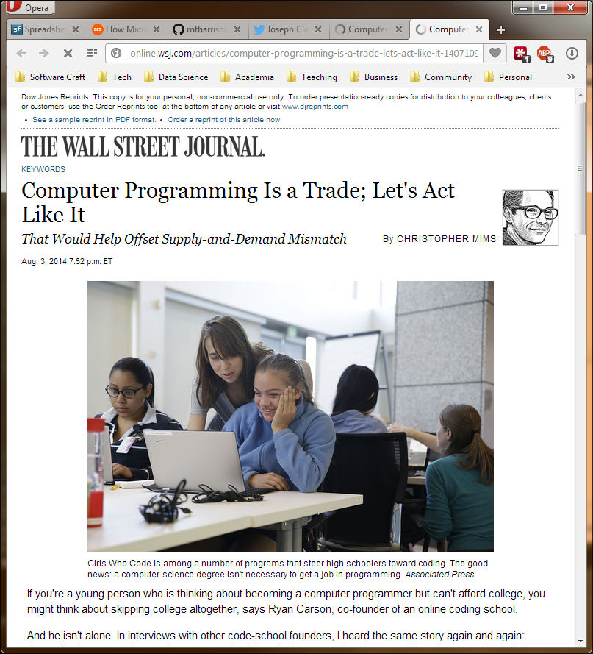
Is software development only a “trade”?
On August 3, 2014, a WSJ columnist argued that we should treat software development as a trade, and accept trade school or self-training as qualifications for programming jobs.
The study of computer science was seen as mismatched to the real work developers do:
“Take Facebook : The first thing that happens to a new engineer there is six weeks of intensive classes, many of which are—you guessed it—programming classes. This is in part because university courses in computer science favor theory over programming, which is a mishmash of skills ranging from practical knowledge of in-vogue programming languages to how to work on projects that involve dozens of other programmers and thousands or even millions of lines of code.”
So… are they right? Is knowledge of theory irrelevant to the knowledge a developer needs?

Slide 3
It depends which theory!
So… are they right? Is knowledge of theory irrelevant to the knowledge a developer needs?
I think the answer is that you do need theoretical knowledge to be more than an entry-level programmer, but it’s not necessarily the theory you’d learn in a computer science program.
Computer Science theories can teach you about algorithms, data structures, and the underlying logic to make better tools and solve tough problems. (I assume so… never took CS myself!)
So what else do you need to know?
Other programs (like ours) should teach you how to analyze requirements, to design processes, and to manage teams to overcome the (proven) challenges of getting real work done. The past 40 years of experience show that these problems are huge, and new theories need to be taught: Agile, Lean, and an overall attitude of empiricism.

Slide 4
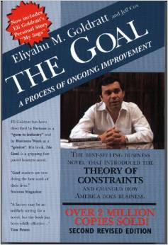
A starting point: the theory of constraints introduced to operations research in 1984
Eliyahu Goldratt’s 1984 novel The Goal introduced the T.O.C. to management. It is based on the premise that in any goal-oriented system the rate of production (“throughput”) is limited by some constraint (“bottleneck”).
To improve throughput, managers must:
Identify the bottleneck
Exploit the bottleneck (i.e. get the most out of the constraint)
Subordinate all other resources to the bottleneck (i.e. make sure the bottleneck has all it needs)
Elevate the bottleneck (i.e. make major changes to the bottleneck’s capacity)
Repeat (because something else might have become the new bottleneck)
In order to optimize software production, we need to use Kanban and Value Stream Mapping to figure out what our bottlenecks are, and adopt engineering disciplines targeted to manage them.
An important but counterintuitive corollary of the T.O.C.: any time or money spent working on something that’s not the bottleneck is waste and may make the problem worse!
It’s not, therefore, a “mishmash” of fashionable tools.

Slide 5
Total quality management for software
In manufacturing, a defective product coming off the assembly line represents waste – wasted materials, wasted money, wasted time, and potentially a lost customer. Improving quality means better use of materials and time, and elimination of rework.
In software development, projects are vulnerable to many kinds of waste:
Writing buggy software that leads to many hours of customer support and troubleshooting.
Delaying the release of software so long that potential users/customers choose something else.
Wasting developers’ time building partial features that never get finished.
Writing lots of software only to find out that it doesn’t match what the client thought he was asking for.
Writing software that matches the client’s specs, only to find out that he never uses it.
This is one of the theories that self-taught programmers aren’t going to learn: we need to deliberately design and execute processes based on an understanding of the types of waste in software development, with mechanisms that effectively address them.

Slide 6
Software development is an empirical engineering discipline
Empiricism is a philosophical preference for hard data and real experience. It’s what works.
For many years we have used predictive methods in which we build mathematical models of schedules, budgets, etc, because that’s what other engineering disciplines do (e.g. aerospace, architecture). We thought that was “the right way to do it”.
But it’s not! If other engineering disciplines could build prototypes for nearly zero cost and get feedback nearly instantaneously, they would do this too! The reason they use predictive methods and mathematical models is the cost and danger of testing prototypes.
The key to building great software, whether you’re a developer, a project manager, or a customer, is to find ways to try things out and learn from the experience.
Both parts of that formula are important!
We need to learn to treat our ideas as hypotheses to be tested, and to design experiments that allow us to test them cheaply and quickly.
We also need to develop tools to capture the outcomes, visualize what happened, and measure the impacts that we care about – without measurement, experiments are wasted opportunities.
We can experiment at macro/meso/micro levels, from the business model down to the individual line of code.

Slide 7
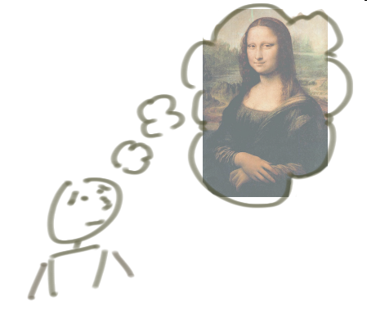

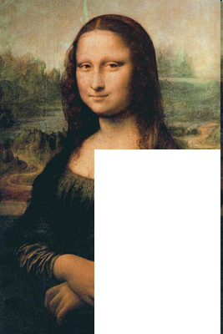

Incrementing vs. Iterating
“Incremental” means building something a bit at a time.
Incrementing calls for a fully formed idea
1
2
3
Notes:
Source of slide: http://agileproductdesign.com/downloads/patton_iterating_and_incrementing.ppt

Slide 8
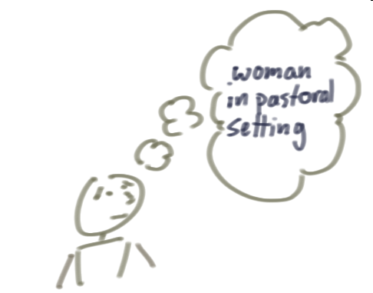
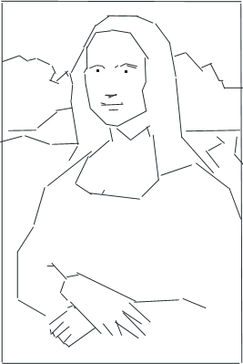
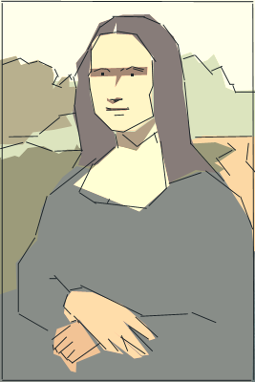
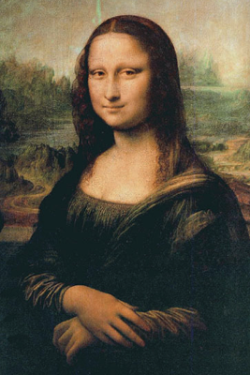
Incrementing vs. Iterating
By contrast, “Iterative” starts with a rough vision, validates it through feedback from the customer, improves it through learning, and continues to add more value.
Iterating allows you to move from vague idea to realization
1
2
3
Notes:
Source of slide: http://agileproductdesign.com/downloads/patton_iterating_and_incrementing.ppt

Slide 9
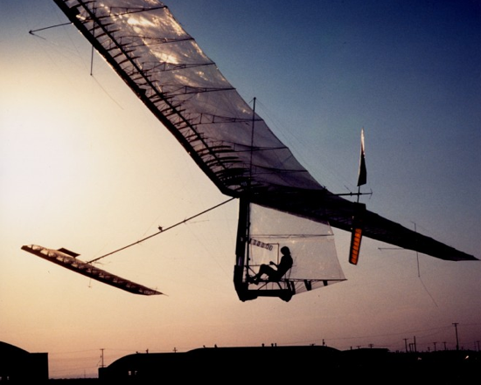
The story of the gossamer condor aka “solving the right problem”
The Kremer Prize for human-powered flight was established in 1959.
No one claimed it in 18 years.
In 1977, Paul MacReady won it in six months.
Wrong problem: How can you make a human-powered aircraft that would fly a mile on a figure-8 course?
The right problem: How can you build and test new airplanes in days instead of months and years?
“It’s not at all important to get it right the first time. It’s vitally important to get it right the last time.” -- Andrew Hunt and David Thomas.
see http://www.azarask.in/blog/post/the-wrong-problem/ for the story

Slide 10
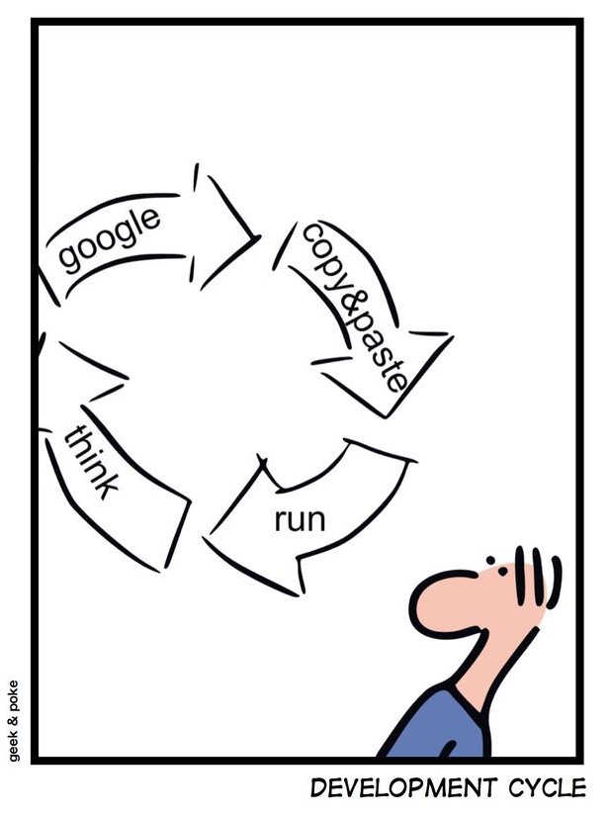
Critical assumptions of CIS 440
Software development is creative problem solving with other people. Communication is essential. Learning is essential. Feedback loops are essential.
Nobody begins a project knowing everything they need to know about the customer’s needs, the technology’s capabilities, and what the ultimate product is going to look like. Don’t be intimidated by the fear that other people know it all from the beginning. Chances are they’re probably just better at Googling.
Average programmers can compete with superstars if they work together and have the humility to experiment and learn. Pay attention to your process.
The easiest and most important “Agile” technique is the retrospective.
There are lots of tools out there under many different labels. Some of them may work for you, and some may not. Don’t rule anything out, and don’t worry about “purity”. You are scientists in your daily lives! The best way to know what works is to try it and find out.

Slide 11
Introducing the course
Your professor
The Capstone Project
Use of GitHub for the class
The Syllabus

Slide 12
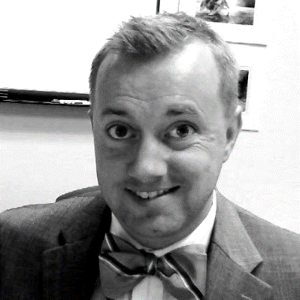
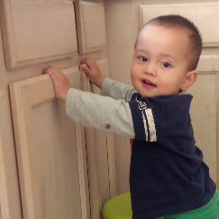
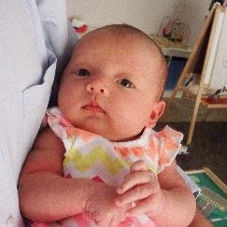
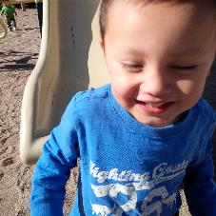
About dr. clark
Web developer in the 56kbps modem era. Best gig ever was for an infomercial company. Also, briefly worked for Mickey Mouse.
Went to business school, then ended up as a business lecturer.
Doctorate in Information Systems from USC in 2012.
Followed by a post-doc at the University of Nebraska at Omaha.
Came to ASU in August 2013. My main teaching is CIS 440, the undergrad IS capstone.
TOPICS TO TALK ABOUT
Doing data science in teams.
DevOps for Big Data?
Agility and Entrepreneurship.
Data Visualization.
NoSQL databases.
PLACES YOU’LL FIND ME
Startup Weekend
Phoenix Scrum Users Group
Pacific Telecoms Council
Chik-fil-A
Buying diapers & beer
ABOUT MY FAMILY
Long line of Maine-iacs
Married 5 years in June
Kermit, 3½ years old
Declan, almost 2
Virginia, 3 months

Slide 13
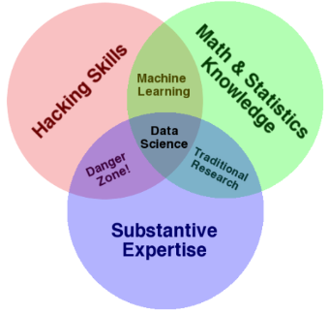

Dr. Clark’s Research Backlog
Project BANDIT
Extends a canonical simulation model of sequential decision-making under uncertainty to show the impacts of fast and accurate feedback loops.
Big idea: demonstrate importance of excellent information systems by showing how business is impacted when they aren’t there.
Looking for a new project to go here….
Project TORCH
Challenge: There’s a lot of hype around the “data scientist” job description, but what it denotes is super-human.
Big idea: Managers in the real world cannot rely on hiring superstars; instead, we need to know how to build data science teams.
How are these teams composed? How many people? What roles?
Bigger idea: Is there a data science DevOps? What new disciplines are needed by those who support and enable data science teams?
Project MAVERICK (with Dr. Read)
Big Idea: adapting the Agile approach to the CIS capstone course to enhance learning and improve project success.
Pedagogical questions:
Do agile practices support the teaching objectives of an IS capstone course? Does Agile enable students to draw on learning from their other courses, and succeed in their projects?
Broader research questions:
What sorts of learning or development occurs in the first few sprints for a new Agile team and for a (new/experienced) Agile project client?
Does our students’ experience give us a window into hidden processes that occur when teams and clients are new to Agile?

Slide 14
Introducing cis 440
This is the CIS “capstone” course. You will use all of the knowledge you’ve acquired in the CIS major, as well as your ability to learn on-the-job, to complete a meaningful IT/IS project for a real business.
The content of the course includes Agile project management techniques and engineering practices such as Scrum, XP, and TDD.
The most interesting challenges will be found in communicating with your client as you and they gain a better understanding of the technology and the evolving business requirements.
At the end of this course:
You will have a successful project that you can put on your resume, talk about at interviews, and/or show your parents.
You will have the experience of working with an Agile project methodology.
You will be able to talk intelligently about version control, automated testing, continuous delivery, and DevOps.
You will have some specialized skills to distinguish you from your classmates.

Slide 15
specialization
I cannot teach you about every technology that you will need for your projects, therefore, you’re going to be expected to specialize and dig deeper on your own into one facet of IS development.
As you form teams, you’ll probably want to make sure these specialties are covered:
Programming (i.e., an app development framework)
Front-end (e.g., interactivity)
Back-end (e.g., database)
Testing (not as easy as it sounds)
Other specialties that may be needed:
Graphic design
Analytics or data visualization
Digital marketing or SEO
Mobile interfaces
Together with other “specialists”, you will give a tech talk to share your research with the class.

Slide 16
Team formation
We will form teams next Tuesday, 8/26.
I have invited several outsiders to pitch projects for you to work on; these include a broad range of businesses (startups to multinationals) and a good variety of projects (mostly websites).
You can come to both the 10:30 and 1:30 sections if you would like to see more options; but don’t come to a different time slot if you’re unwilling to switch to that section for your regular attendance.
Each project sponsor will have 4 minutes to tell you about their proposed project.
We will then break, so you can talk to them one-on-one and try to find a project and a role that suits your interests and abilities. Keep in mind the specializations you’re most interested in.
Be on time, and dress professionally, next Tuesday.

Slide 17
expectations
You are expected to be a good team member. Part of this means being honest from the beginning about your capabilities, other commitments, and any issues that may be important. The whole team is in the same boat.
ABPR policy is that you’re expected to work outside of class about twice as many hours as in the classroom. These projects are much easier when you work together instead of separatelyl, so I strongly recommend you make a habit of working together with your team for a big block of time after class and/or on the weekends.
You’re not expected to know how to accomplish these projects yet. You are expected to be able to find resources and ways to learn what you need to know.

Slide 18
Github and the syllabus
https://github.com/asu-cis-capstone/course-info
Don’t let me leave until your questions are answered!

