Slide 1
SentinelAI
Problem Statement ID – 1
Problem Statement Title- AI-Powered Autonomous Smart Building Optimization Challenge
Theme- Artificial Intelligence / Smart Buildings
PS Category- Software
Student Name (Registered on portal): Soumyadip Chakrabarti
Student ID: 23BAI1265

Slide 2
SentinelAI: Autonomous AI-Powered Building Management System
Proposed Solution
How SentinelAI Works
Collects live telemetry from EnergyPlus
Builds a compact building-state context
Agent Council (LLM) optimizes:
Energy Consumption
Thermal Comfort
Carbon Emissions
Equipment Health
Safety Validator verifies all AI decisions
MCP Tool Server executes validated control actions
Dashboard visualizes system performance and Digital Twin
Innovation
Autonomous closed-loop AI control using EnergyPlus.
Open-Source LLM-powered Agent Council.
Model Context Protocol(MCP) tool execution.
Safety Validator with retry and Last-Known-Good fallback.
Rolling Context Builder for efficient LLM prompting.
Human-in-the-Loop approval for critical actions. Interactive Dashboard with Digital Twin visualization.
Baseline vs AI performance comparison with measurable energy savings

Slide 3
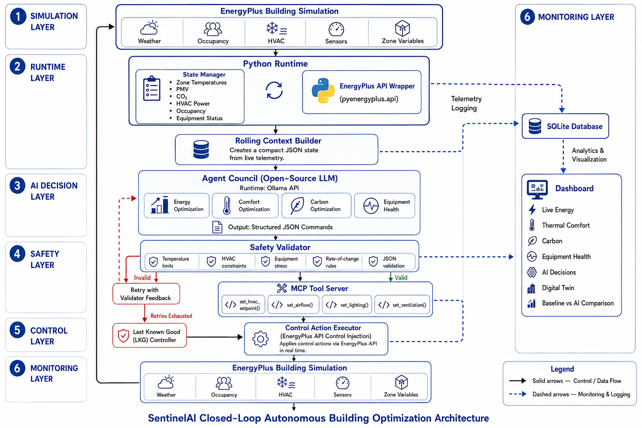
TECHNICAL APPROACH
Technologies Used
Simulation & AI
EnergyPlus
PyEnergyPlus API
Open-Source LLM (via Ollama API)
Model Context Protocol (MCP)
Backend
Python
FastAPI
SQLite
Frontend
HTML/CSS/JavaScript
Plotly
SVG Digital Twin
Architecture

Slide 4
FEASIBILITY AND VIABILITY
Feasibility
Industry-Standard Foundation: Built on EnergyPlus, Python, FastAPI, and open-source LLMs.
Real-Time Closed-Loop Control: Continuously monitors building telemetry and applies validated control actions.
Modular & Scalable: Components (AI engine, dashboard, control layer) can be deployed independently and extended to larger buildings.
Cost-Effective: Uses open-source technologies, reducing deployment and licensing costs.
Potential Challenges and Risks
AI-generated unsafe control actions.
Large EnergyPlus simulation logs.
LLM response latency.
Balancing energy efficiency with occupant comfort
Strategies
Safety Validator checks every AI-generated control action before execution.
Retry & Last-Known-Good Fallback ensures reliable operation if AI output is invalid.
Rolling Context Builder summarizes telemetry, reducing prompt size and improving response time.
MCP-based modular architecture enables integration with existing Building Management Systems and simplifies future expansion.

Slide 5
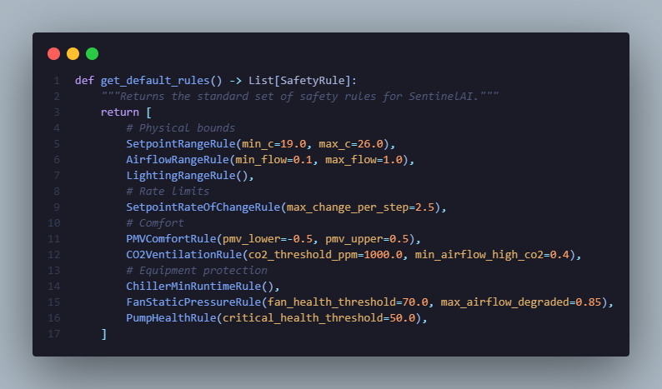
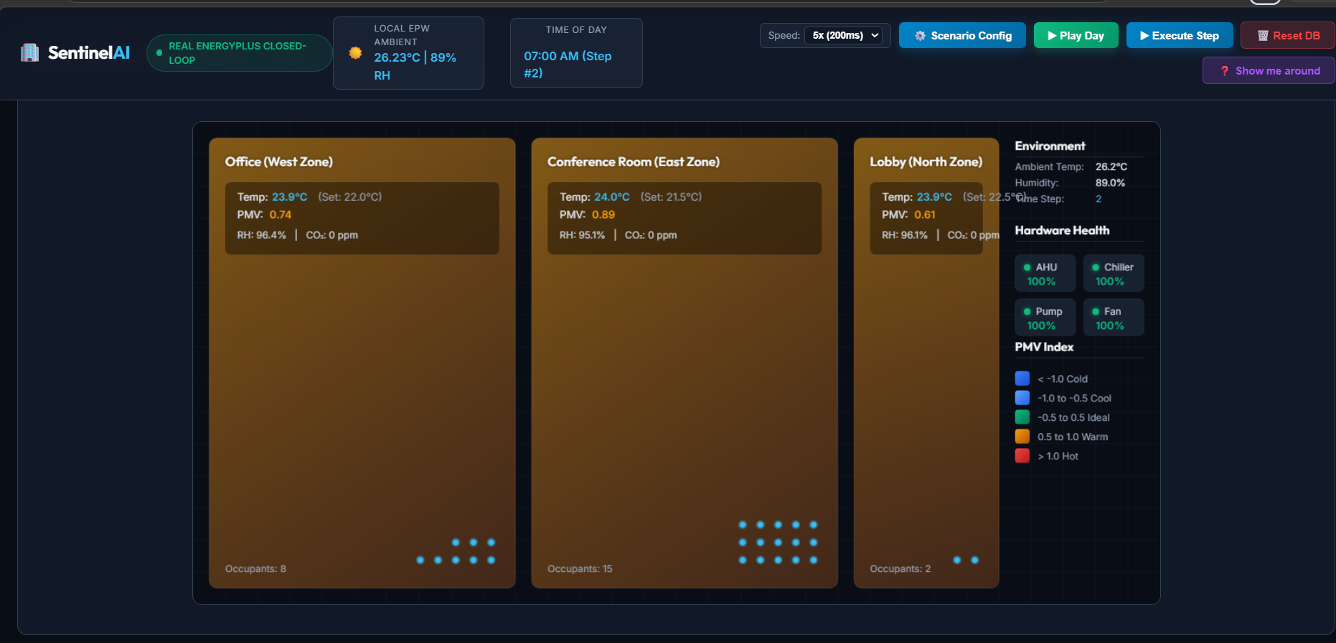
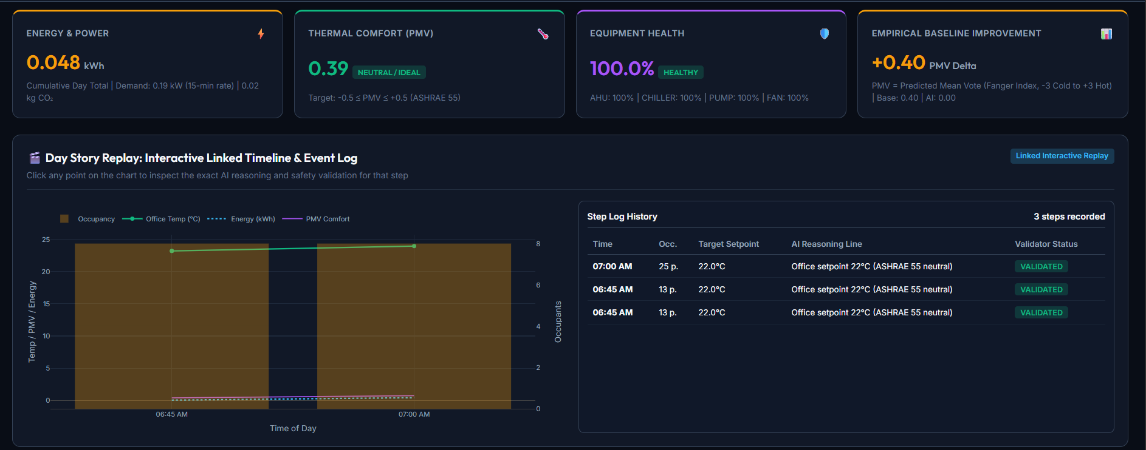
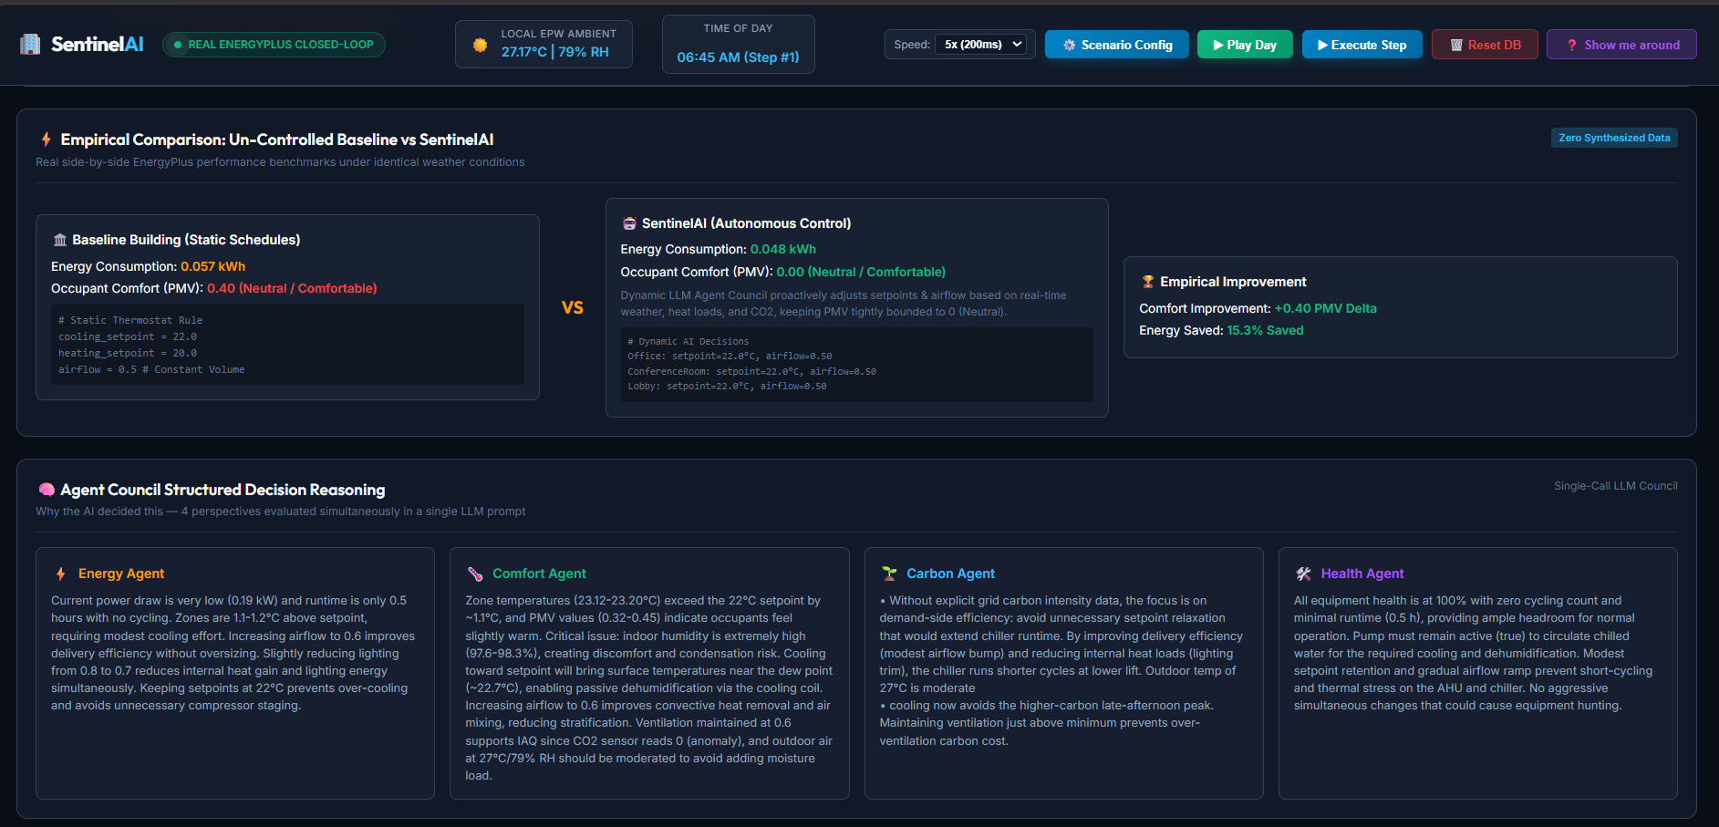
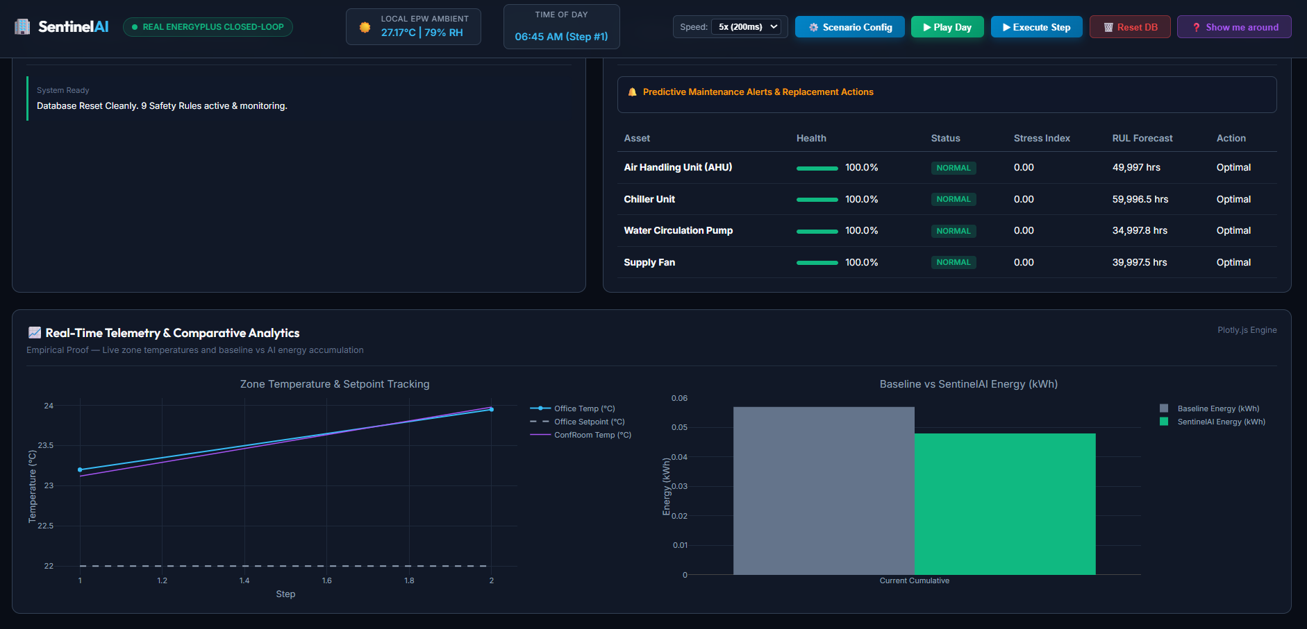
ARTIFACTS
GITHUB LINK: https://github.com/APEXPRE123207/SentinelAI
VIDEO LINK: Google drive (Video also in github)

Slide 6
RESEARCH AND REFERENCES
Richard J. de Dear, Gail S. Brager, Thermal comfort in naturally ventilated buildings: revisions to ASHRAE Standard 55, Energy and Buildings, Volume 34, Issue 6, 2002, Pages 549-561, ISSN 0378-7788, https://doi.org/10.1016/S0378-7788(02)00005-1. (https://www.sciencedirect.com/science/article/pii/S0378778802000051)
ANSI/ASHRAE Standard 55-2023 Thermal Environmental Conditions for Human Occupancy. (https://www.ashrae.org/technical-resources/bookstore/standard-55-thermal-environmental-conditions-for-human-occupancy)
U.S. Department of Energy – EnergyPlus Documentation https://energyplus.net/documentation

