Slide 1


Slide 2
Brown Bag: Javascript
24 April 2015

Slide 3
SESSION OBJECTIVES
Javascript capabilities
What can be done with Javascript?
How can we still use our best practices?

Slide 4


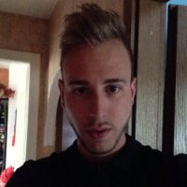

Slide 5

What about you?
What do you know Javascript?

Slide 6
Feedback on Goblin Shark project…
Let’s be happier: change scope!
We will sell some products…

Slide 7
Goblin Shark involve Javascript from the language to the tooling.
Client: AngularJS
Server: NodeJS
IDE:
Atom.io (Github)
WebStorm (JetBrains)
Deploy: NodeJS custom tool

Slide 8
Client

Slide 9
Server

Slide 10
Server
Layered in :
Routes (controller)
Services
Repository

Slide 11
Best practice, tooling, etc.

Slide 12
Unit test - sinonJS
Runtime: mocha
Framework: sinonJS
Spies
Mocks
Stubs
And more…

Slide 13
sinonJS - Spies
A test spy is a function that records arguments, return value, the value of this and exception thrown (if any) for all its calls. A test spy can be an anonymous function or it can wrap an existing function.

Slide 14
sinonJS - Stubs
Test stubs are functions (spies) with pre-programmed behavior. They support the full test spy API in addition to methods which can be used to alter the stub’s behavior. As spies, stubs can be either anonymous, or wrap existing functions. When wrapping an existing function with a stub, the original function is not called.

Slide 15
sinonJS - Mock
Mocks (and mock expectations) are fake methods (like spies) with pre-programmed behavior (like stubs) as well as pre-programmed expectations. A mock will fail your test if it is not used as expected.

Slide 16
Server
Layered in :
Routes (controller)
Services
Repository

Slide 17
Server
Layered in :
Routes (controller) → i/o glue
Services → Business logic
Repository → db glue

Slide 18
Server
Layered in :
Routes (controller) → integration test
Services → unit test, stubs, mocks…
Repository → “don’t test the product”

Slide 19
Server

Slide 20
Server
Layered in :
Routes (controller) → i/o glue
Services → Business logic
Repository → db glue

Slide 22

QUESTIONS & ANSWERS

Slide 23
YOUR FEEDBACK

Slide 24
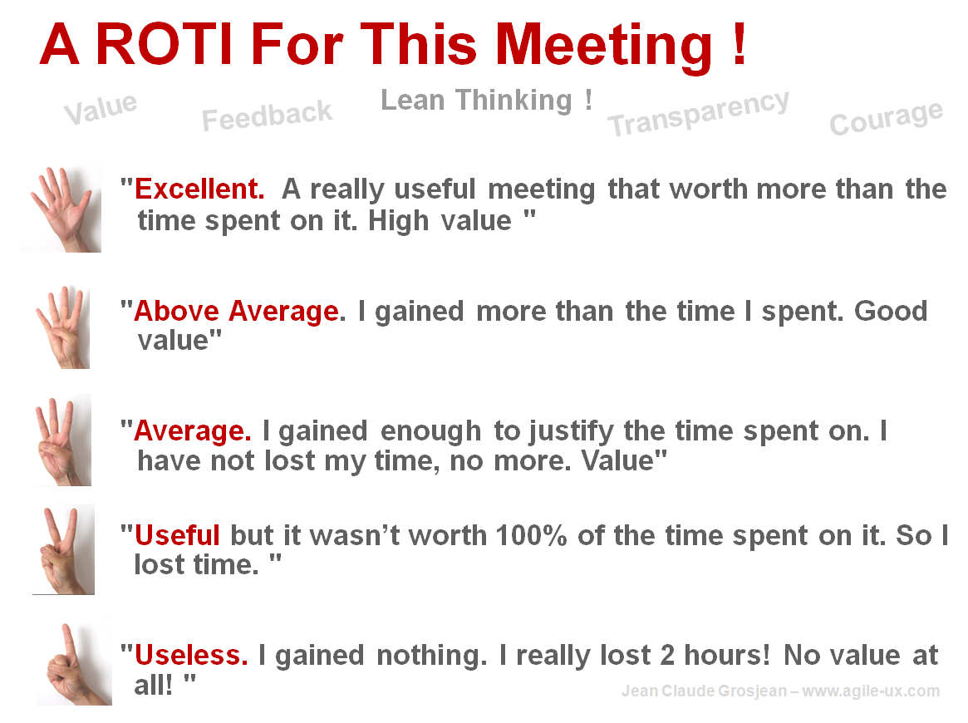
R.O.T.I for this SESSION
Source: www.qualitystreet.fr

Slide 25
A FEW MORE QUESTIONS…
What did you like about it?
To make it better… what shall we do?
What topic(s) would you like to discuss during a future session?

Slide 26
TAKE AWAY
Conclusion…

