Slide 1


Slide 2
Brown Bag: Javascript
24 April 2015

Slide 3
SESSION OBJECTIVES
Javascript capabilities
What can be done with Javascript?
How can we still use our best practices?

Slide 4


Slide 5

What about you?
What do you know Javascript?

Slide 6
LET’S PLAY
Ball Point Game

Slide 7

QUESTIONS & ANSWERS

Slide 8
YOUR FEEDBACK

Slide 9
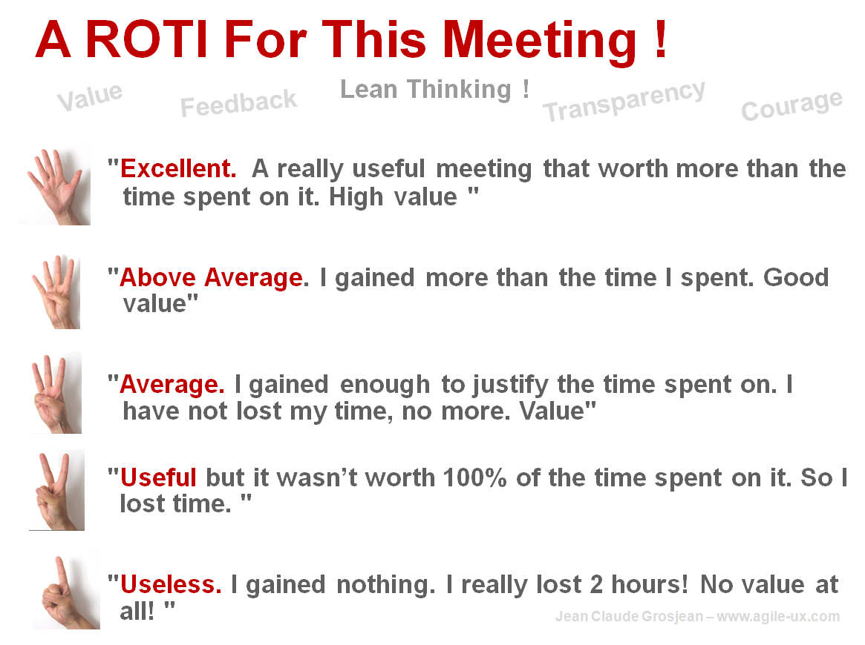
R.O.T.I for this SESSION
Source: www.qualitystreet.fr

Slide 10
A FEW MORE QUESTIONS…
What did you like about it?
To make it better… what shall we do?
What topic(s) would you like to discuss during a future session?

Slide 11
TAKE AWAY
Conclusion…

