Slide 1


Slide 2
Agile Mëtteg : Introduction to Agile Methods
Seminar – 26 February 2015

Slide 3
SESSION OBJECTIVES
Agile Awareness Session
Discover Agility
Understand the basics of the main agile methods

Slide 4
AGILE PARTNER
Who we are…

Slide 5







OUR SERVICES
Bespoke
Customized
Data exchange
Software Development
Innovation Support
Knowledge Transfer
Consulting
Technology
Methodology
6.

Slide 6
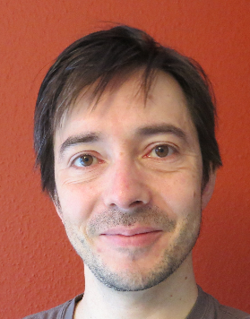
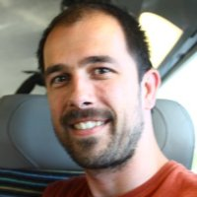


Yann GENSOLLEN | Eric FERROT
Agile Coach | Senior Developer

Slide 7
Software Development
Consulting
Knowledge Transfer
Innovation Support
6.

Slide 8

What about you?
What do you know about agility?
What are your expectations?

Slide 9
Manifesto for Agile Software Development or Agile Manifesto
People and interactions
Working software
Customer collaboration
Responding to change
Processes and tools
Comprehensive documentation
Contract negotiation
Following a plan
over
over
over
over

Slide 10
LET’S PLAY
Ball Point Game

Slide 11
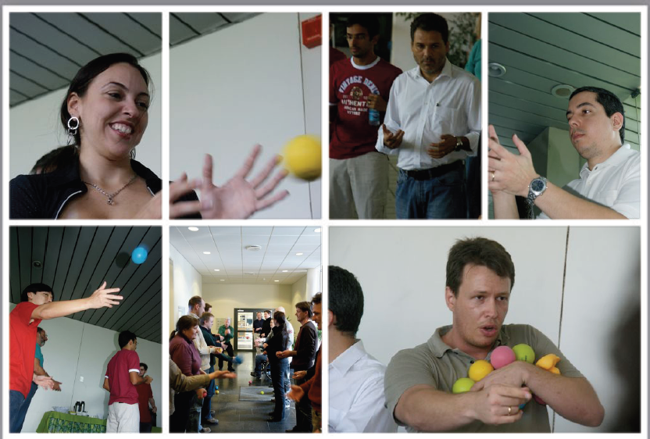

Slide 12
LE « BALL POINT GAME »
Le « Ball Point Game »
de Boris Glogger
Règles :
Vous formez une seule équipe
Les balles ne peuvent pas passer de main en main (elles doivent passer un moment en l’air)
Interdit de passer la balle à son voisin direct
Le point de départ = le point d’arrivée
Itération = 2 minutes
Intervalle = 1 minute
Le jeu compte 5 itérations

Slide 13
THE « BALL POINT GAME »
Debriefing

Slide 14
TAKE-AWAY
How to deal with uncertainty?
Self-organisation - Communication
Continuous improvement
Feedback culture – customer validation
Pragmatism and adaptability
Limit work in progress – work in small batches

Slide 15
AGILITY
A short introduction

Slide 16


Slide 17
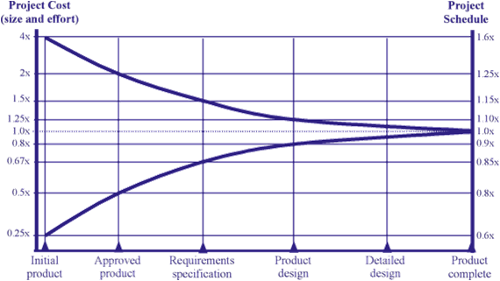
MANAGE UNCERTAINTY

Slide 18
LOW PROJECT SUCCESS RATE
Source: Standish Group
Notes:
Successful means on-time, on-budget, and with all features and functions as defined in the initial scope
Challenged means late, over budget, and/or with less features and functions than defined in the initial scope
Failed means cancelled prior to completion, or delivered but never used.

Slide 19
AGILITY…
is primarily…
a MINDSET
formalized
In the Agile Manifesto
http://www.agilemanifesto.org

Slide 20
THE 4 VALUES
Quote from the Manifesto for Agile Software Development:
[…] we have come to value:
Individuals and interactions over processes and tools
Working software over comprehensive documentation
Customer collaboration over contract negotiation
Responding to change over following a plan
That is, while there is value in the items on
the right, we value the items on the left more
Source: http://www.agilemanifesto.org/

Slide 21
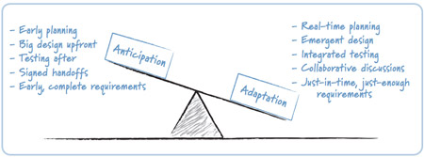
ADAPTATION vs. ANTICIPATION
Source: Succeeding with Agile: Software Development using Scrum, Mike Cohn , Addison-Wesley, 2009

Slide 22

PROJECT – AGILE KEYS
Fixed budget – Flexible scope – Fixed time
SCOPE
QUALITY
TIME
COST

Slide 23
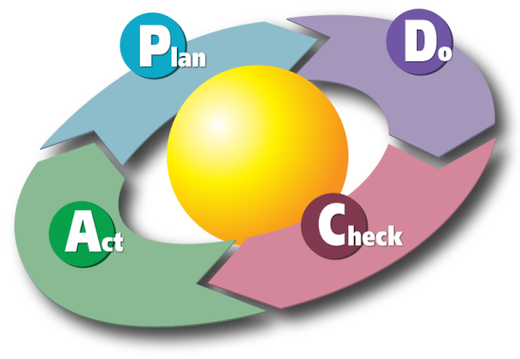
A CONTINUOUS IMPROVEMENT CULTURE
Learn and consolidate
D
P
C
A

Slide 24
“House of agile values”
HIGH ADDED-VALUE PRODUCT
TRANSPARENCY
INSPECTION
AdaptatiON
AGILES VALUES AND PRACTICES

Slide 25
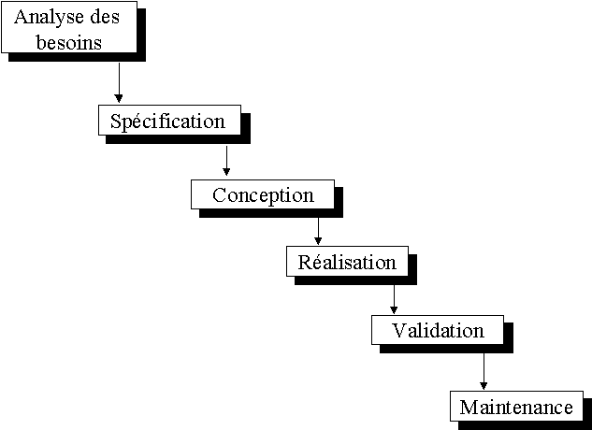
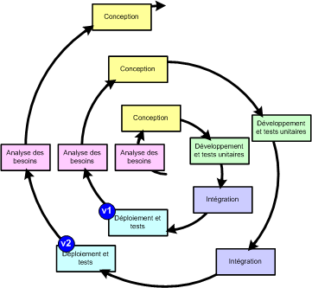
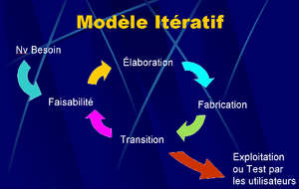
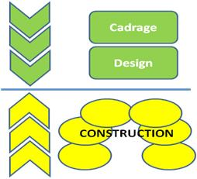
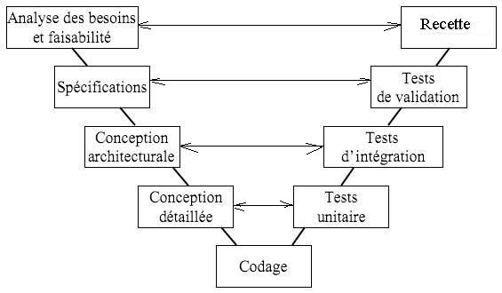
A 30 YEAR EVOLUTION
SCRUM
XP
KANBAN
1970’s
1980’s
1990’s
2000’s
2010’s
LEAN SWD

Slide 26
AGILE METHODS

Slide 27

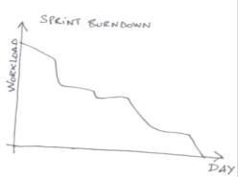
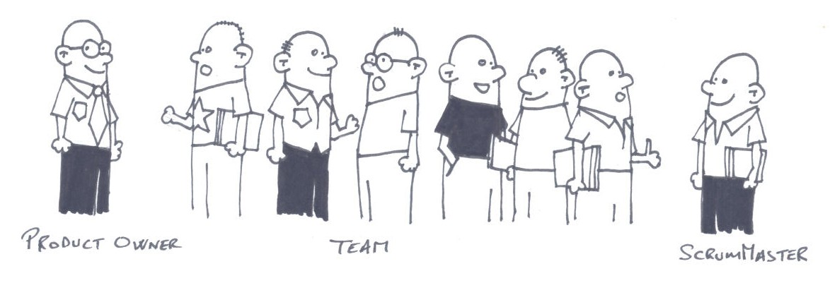
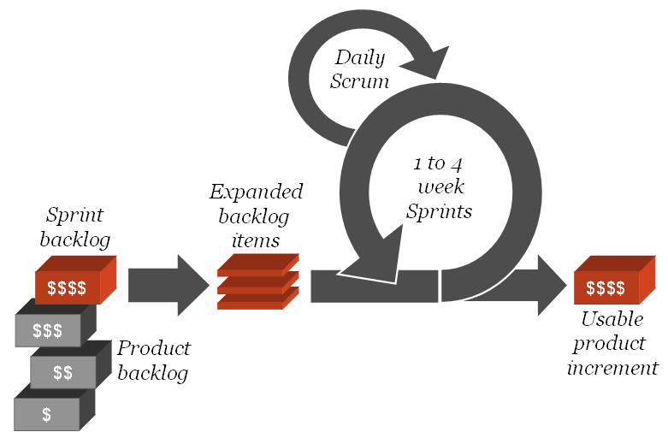
SCRUM
Vision

Slide 28





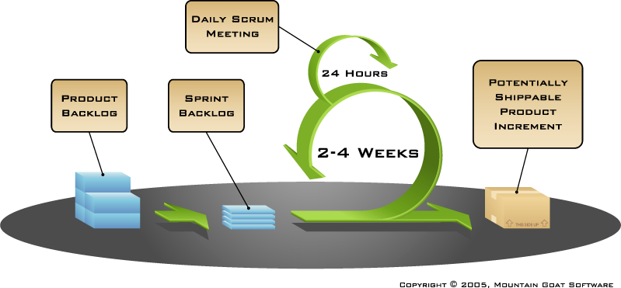

SCRUM – Pratique de gestion de projet
Product Vision
Team
Scrum Master
Product Owner

Slide 29
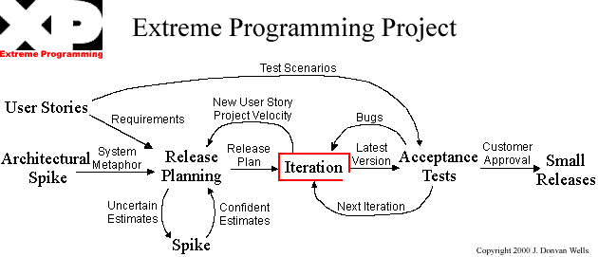
eXtreme Programming
Source: http://xprogramming.com/xpmag/whatisxp

Slide 30
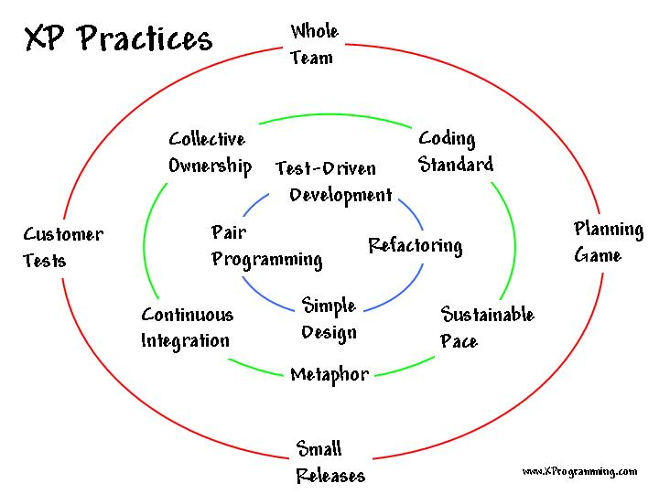
eXtreme Programming

Slide 31
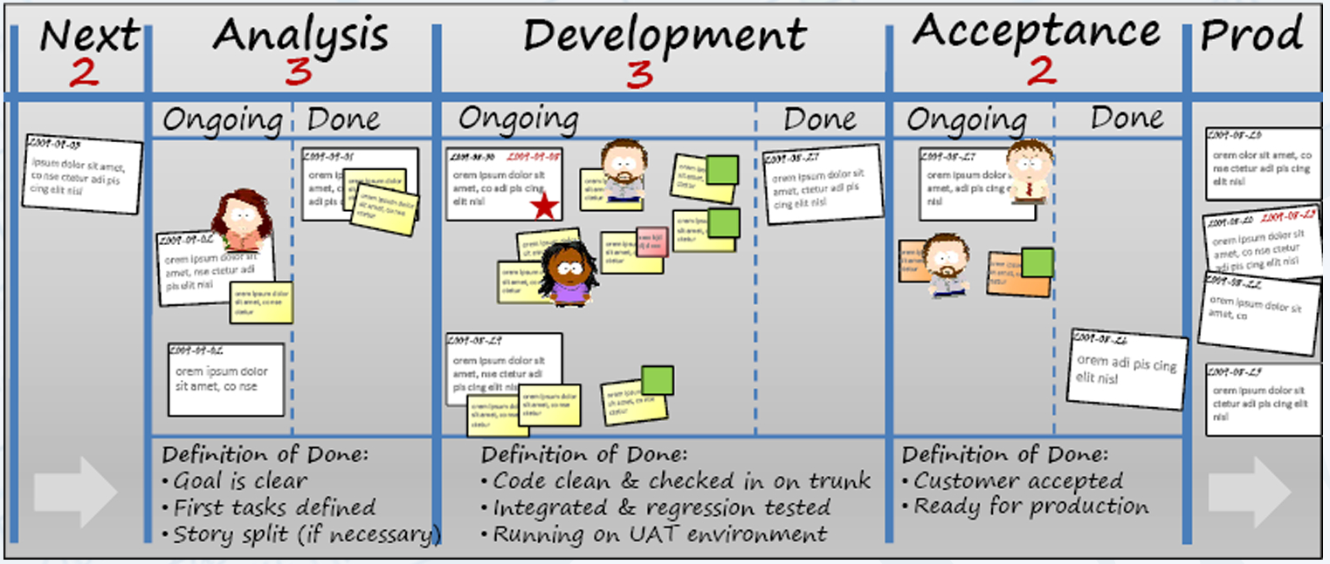
KANBAN
Source: Kanban and Scrum making the most of both – Henri Kniberg & Mathias Skarin
Notes:
Visualize the workflow
1) Split the work into pieces, write each item on a card and put on the wall
2) Use named columns to illustrate where each item is in the workflow.
3) Limit Work In Progress (WIP) - assign explicit limits to how many items may be in progress at each workflow state
4) Measure the lead time (average time to complete one item, sometimes called “cycle time”), optimize the process to make
lead time as small and predictable as possible

Slide 32
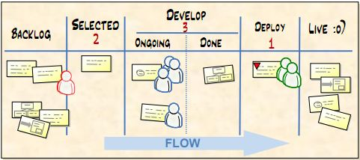
KANBAN

Slide 33

QUESTIONS & ANSWERS

Slide 34
YOUR FEEDBACK

Slide 35
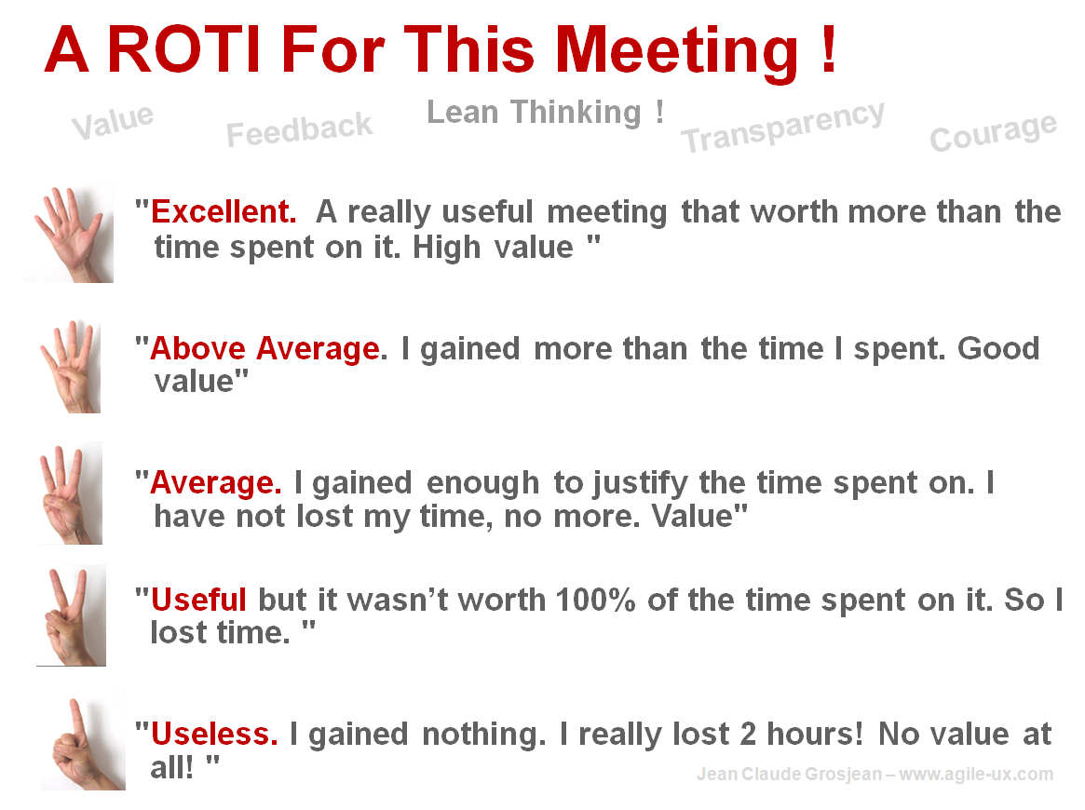
R.O.T.I for this SESSION
Source: www.qualitystreet.fr

Slide 36
A FEW MORE QUESTIONS…
What did you like about it?
To make it perfect… what shall we do?
What topic(s) would you like to discuss during a future session?

Slide 37
TAKE AWAY
Conclusion…

Slide 38



TWO MAIN CHALLENGES
Deliver a product that meets the real customer needs
Work together as an efficient and productive team to produce a high quality outcome

Slide 39




THANK YOU
Retrouvez nous sur :
Agile Partner: www.agilepartner.net & http://blog.agilepartner.net

