Slide 1


Slide 2
Brown Bag: Javascript
24 April 2015

Slide 3
SESSION OBJECTIVES
Javascript capabilities
What can be done with Javascript?
How can we still use our best practices?

Slide 4




Slide 5

What about you?
What do you know Javascript?

Slide 6
Feedback on Goblin Shark project…
Let’s be happier: change scope!
We will sell some products…

Slide 7
Goblin Shark involve Javascript from the language to the tooling.
Client: AngularJS
Server: NodeJS
IDE:
Atom.io (Github)
WebStorm (JetBrains)
Deploy: NodeJS custom tool

Slide 8
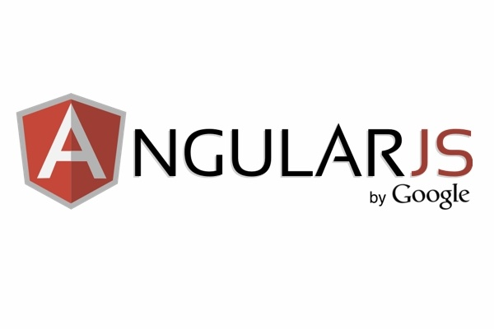
Overview
Overview

Slide 9
Superheroic JavaScript MVVM framework
MVVM framework
Single Page Application
TODO

Slide 10
Tools you’ll need
Bower
NPM

Slide 11
Different ways to start
Different ways to start

Slide 12
Angular Seed
Checkout seed project
https://github.com/angular/angular-seed
Install dependencies (with npm and bower)

Slide 13

Yeoman
http://yeoman.io/codelab/setup.html
Generator
Comes with Grunt
Become a « standard »

Slide 14
How it works ?
How it works ?

Slide 15
Dependency Injection
Inline array annotation

Slide 16
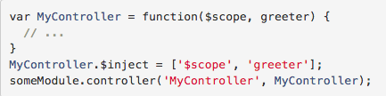
Dependency Injection
$inject property

Slide 17

Dependency Injection
Implicit annotation

Slide 18
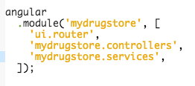
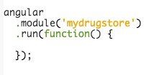
Configuration
Module
Run

Slide 19
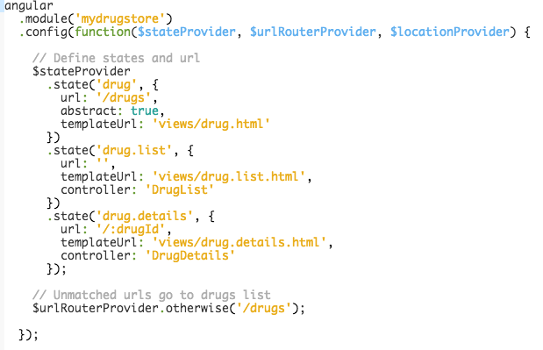
Configuration
Config
Scope = data model

Slide 20
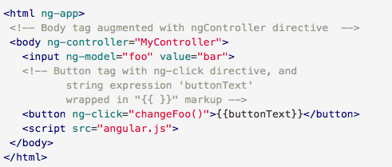
Template HTML
HTML + CSS + Angular directives

Slide 21

Controllers
Init scope
Behaviour

Slide 22
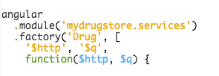
Services
Singleton
Lazy instantiated
Built-in services are prefixed with $

Slide 23
Directives
DOM marker (attribute, element, comment)
Specific behaviour for HTML compiler ($compile)
compilation: attach event listeners to the HTML to make it interactive

Slide 24
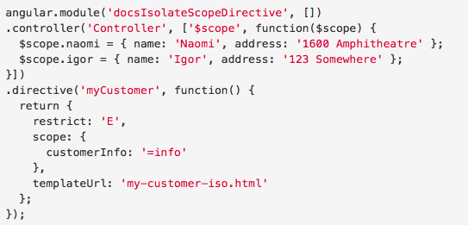
Directives
+

Slide 25
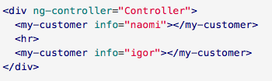

Directives
+
=

Slide 26
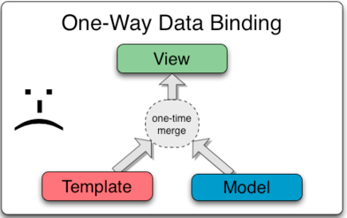
Data Binding

Slide 27
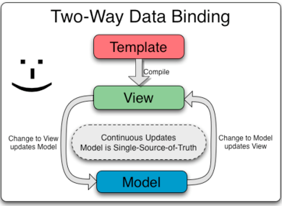
Data Binding

Slide 28
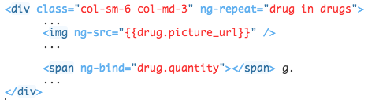
Data Binding
{{…}} VS ng-bind
ng-click
ng-repeat

Slide 29

Routing
ngRoute VS ui.router
State
ui-sref
Default route

Slide 30
Routing

Slide 31
Server

Slide 32
Best practice, tooling, etc.

Slide 33
Unit test

Slide 34
Runtime: mocha
Framework: sinonJS
Spies
Mocks
Stubs
And more…

Slide 35
sinonJS

Slide 36
sinonJS - Spies
A test spy is a function that records arguments, return value, the value of this and exception thrown (if any) for all its calls. A test spy can be an anonymous function or it can wrap an existing function.

Slide 37
sinonJS - Stubs
Test stubs are functions (spies) with pre-programmed behavior. They support the full test spy API in addition to methods which can be used to alter the stub’s behavior. As spies, stubs can be either anonymous, or wrap existing functions. When wrapping an existing function with a stub, the original function is not called.

Slide 38
sinonJS - Mock
Mocks (and mock expectations) are fake methods (like spies) with pre-programmed behavior (like stubs) as well as pre-programmed expectations. A mock will fail your test if it is not used as expected.

Slide 39
Server
Layered in :
Routes (controller)
Services
Repository

Slide 40
Server
Layered in :
Routes (controller) → i/o glue
Services → Business logic
Repository → db glue

Slide 41
Server
Layered in :
Routes (controller) → integration test
Services → unit test: spies, stubs, mocks…
Repository → “don’t test the product”

Slide 42
Test service layer
Product

Slide 43
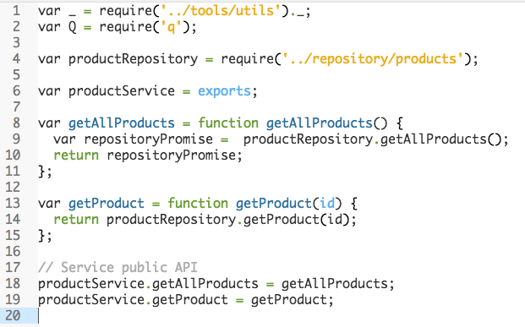
Service API

Slide 44
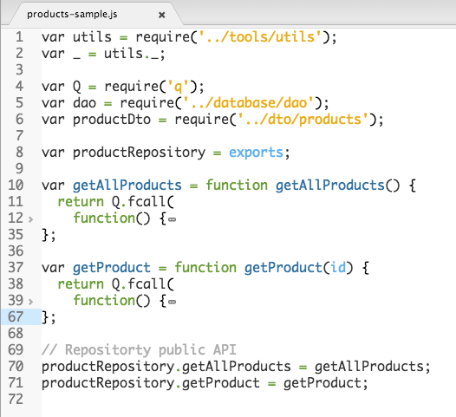
Repository API

Slide 45
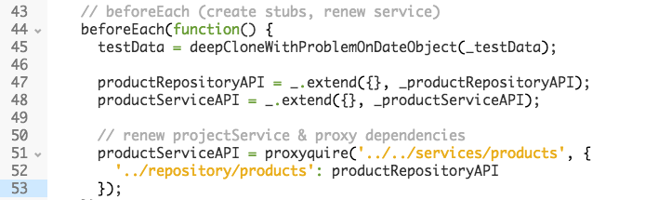
Unit test: substitute layer
How to mock the repository layer?
proxysquire!

Slide 46
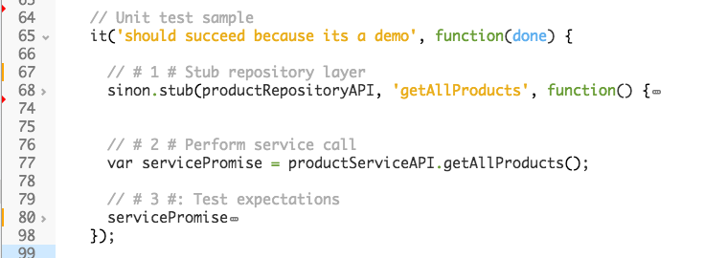
Test skeleton

Slide 47
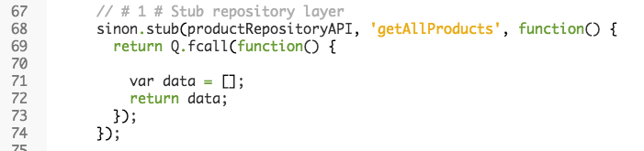
Stub repository

Slide 48
Call the service

Slide 49
Call the service

Slide 50
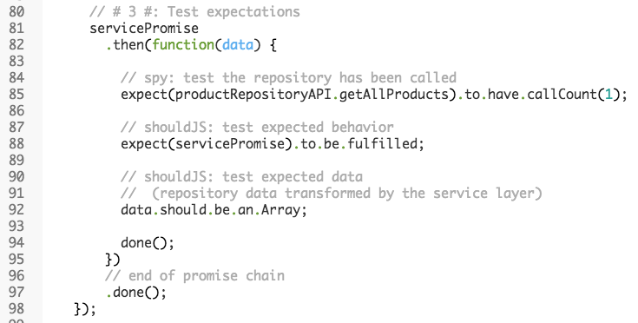
Test expectations

Slide 51
Use libraries!
Better readability
Safe everywhere!

Slide 52
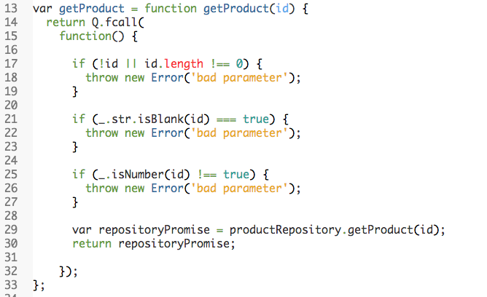

Slide 53

QUESTIONS & ANSWERS

Slide 54
YOUR FEEDBACK

Slide 55
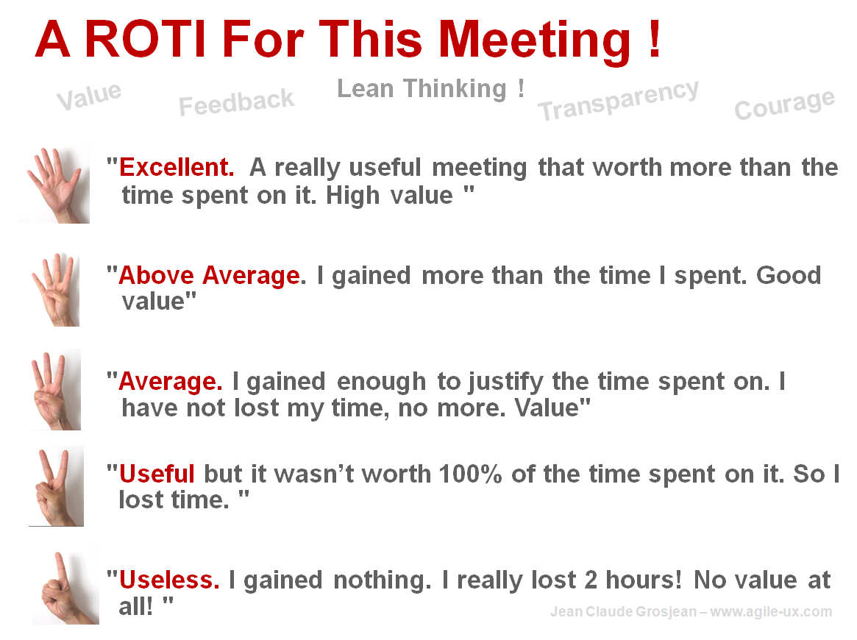
R.O.T.I for this SESSION
Source: www.qualitystreet.fr

Slide 56
A FEW MORE QUESTIONS…
What did you like about it?
To make it better… what shall we do?
What topic(s) would you like to discuss during a future session?

Slide 57
TAKE AWAY
Conclusion…

