Slide 1


Slide 2
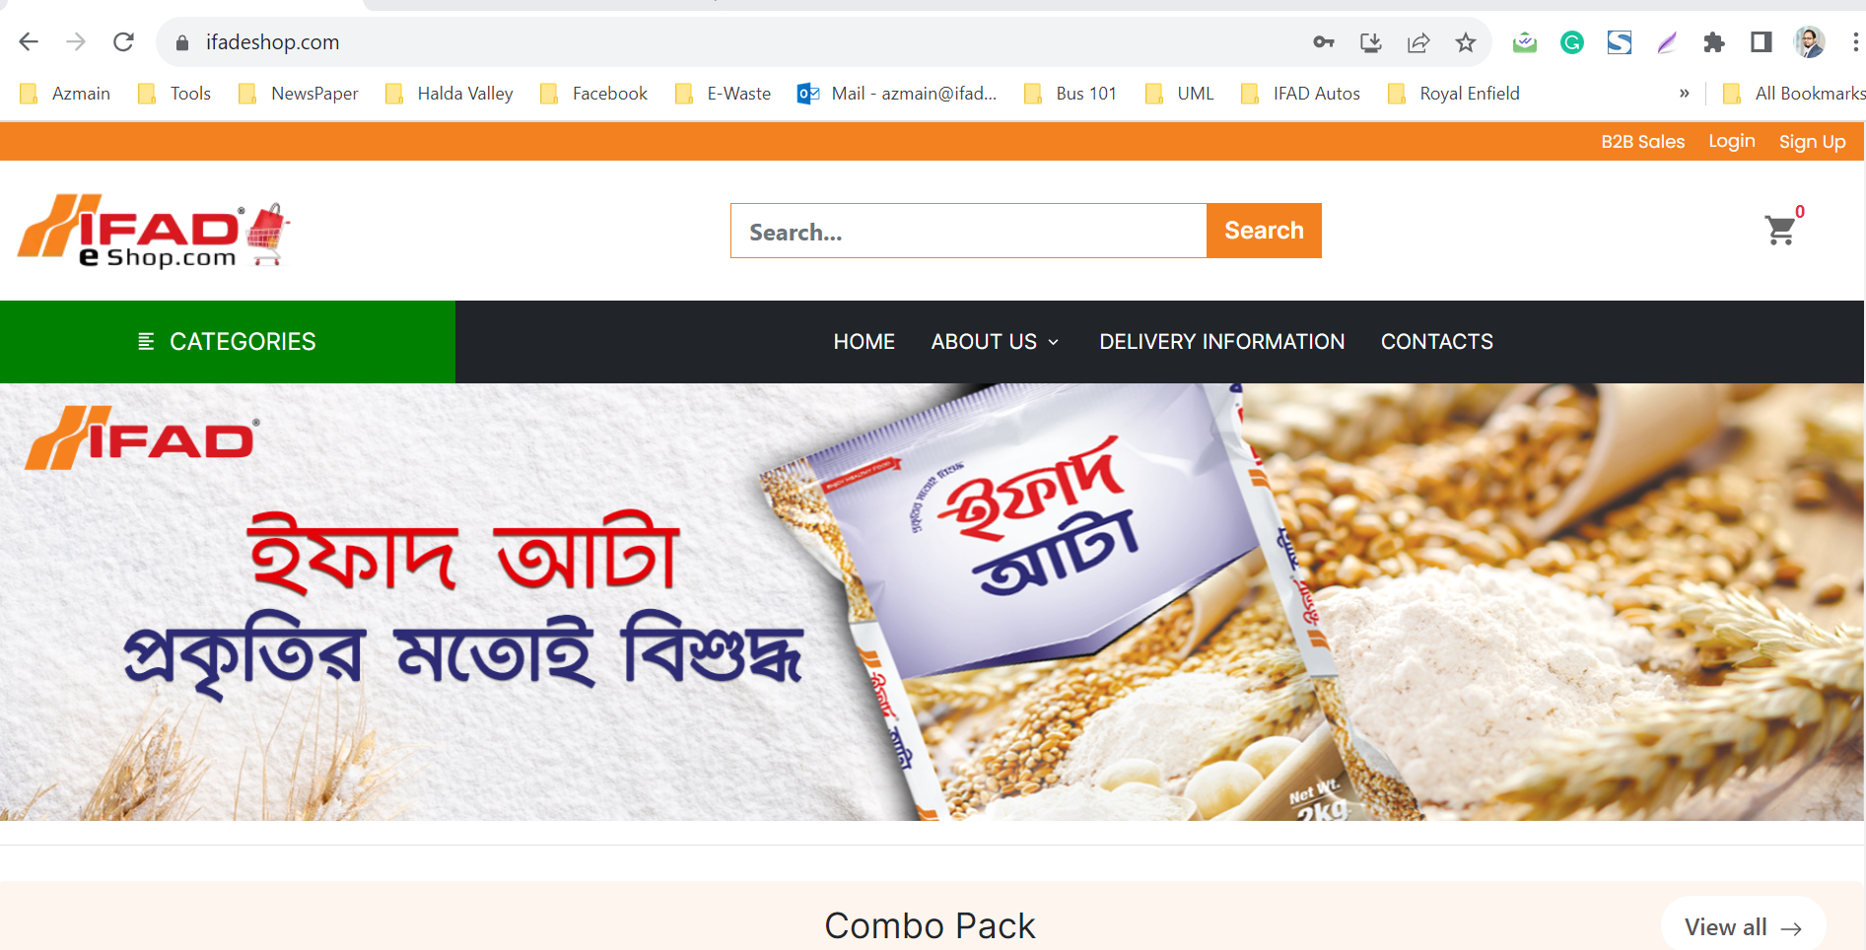
Step 1
Visit IFAD E-Shop site: www.ifadeshop.com
Need to add “How to Buy” Button
How to Buy

Slide 3

Step 2
Click “Buy Now” for directly going to PAYMENT option.
Click “Add to Cart” for more exploring.

Slide 4
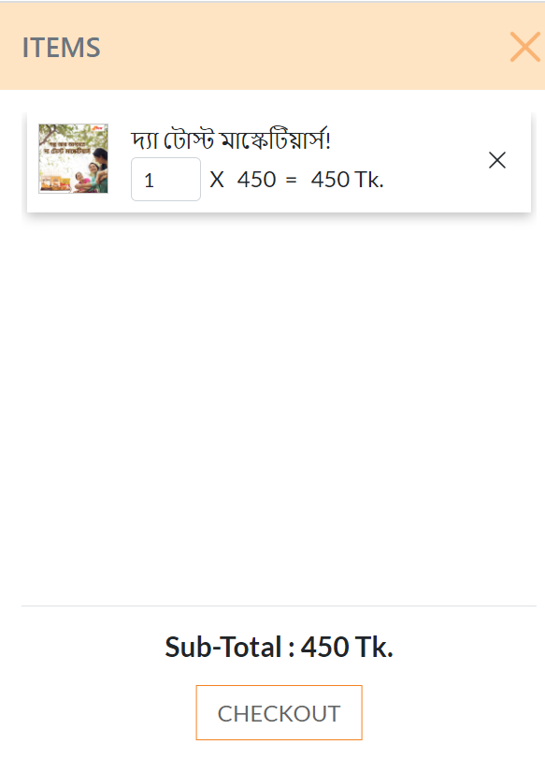
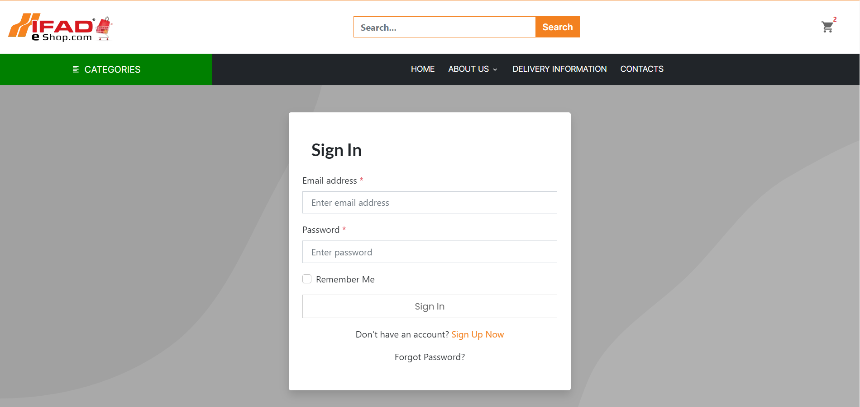
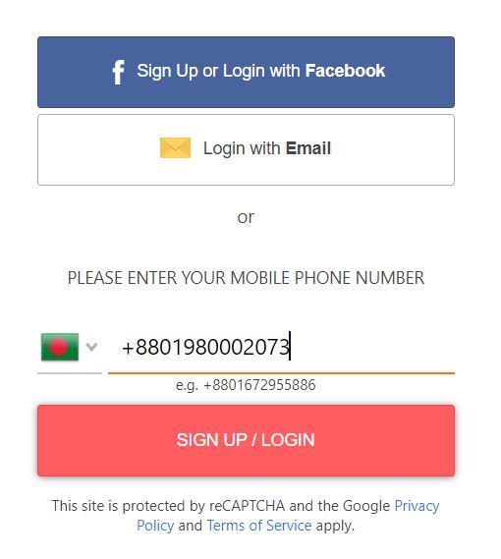
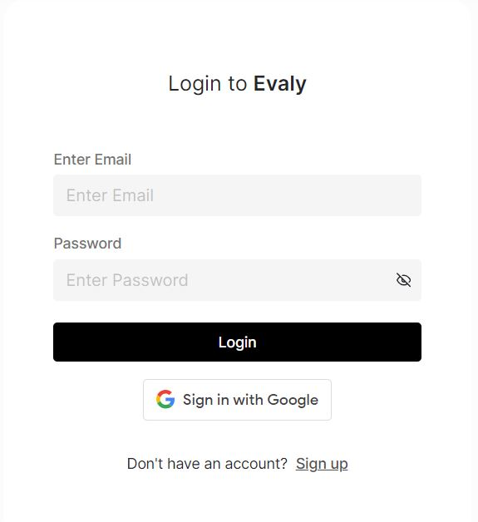
Step 3
Click on “Add to Cart” icon for check out.
Clicking on checkout will bring the user to Sign In & Log In page.
Suggestions
It is suggested to add “Sign in with Google” or “Mobile Number” for faster sign up.

Slide 5
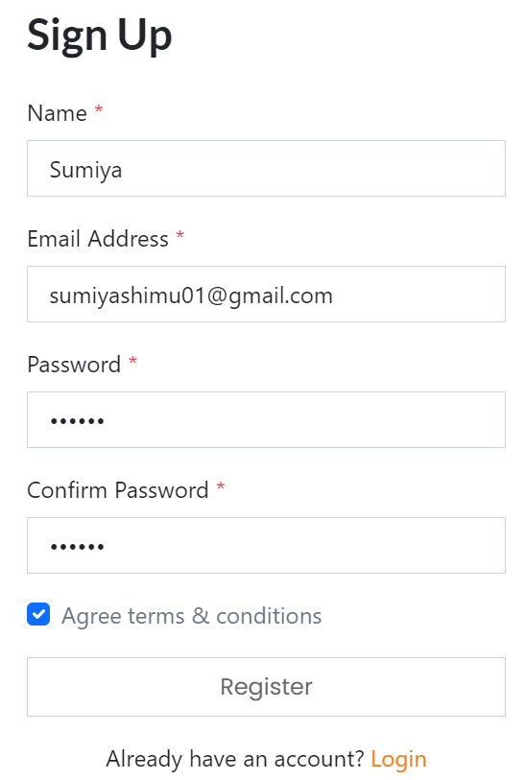
Step 4
Fill up “Sign Up” form and click on register.
A verification mail will be send on registered email address. (Suggestion: OTP is more convenient)

Slide 6
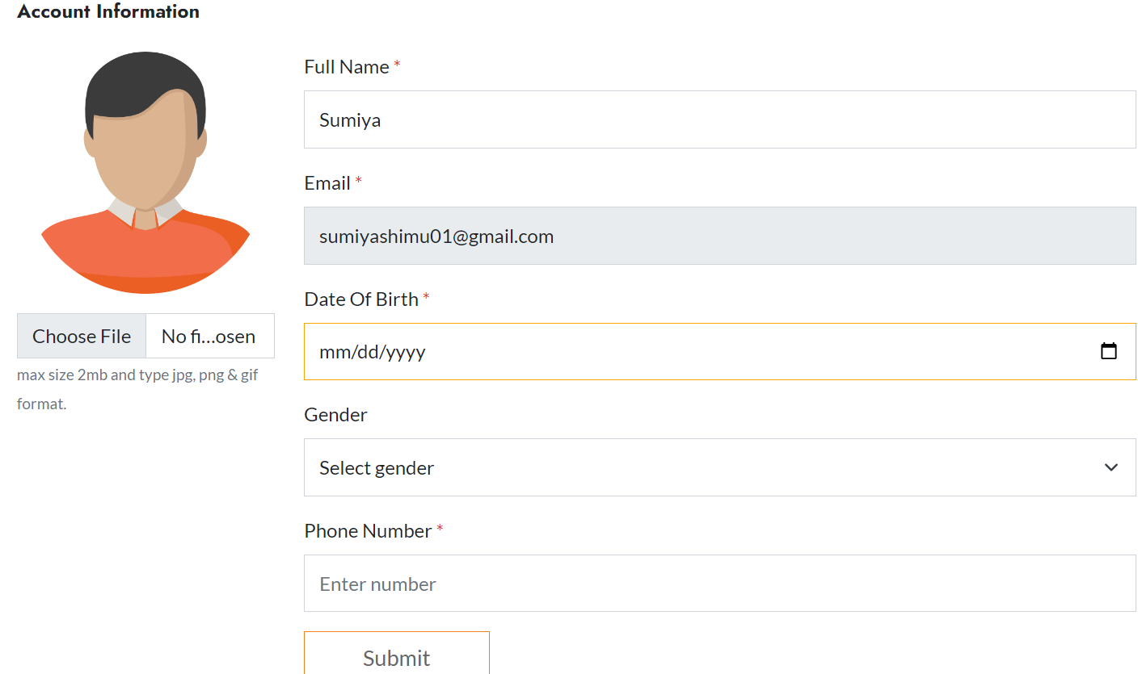
For New User
Fill up this form

Slide 7
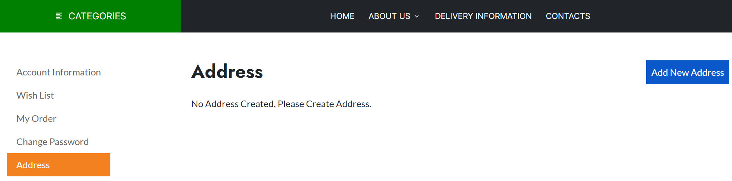
For New User
Then click Add New Address

Slide 8
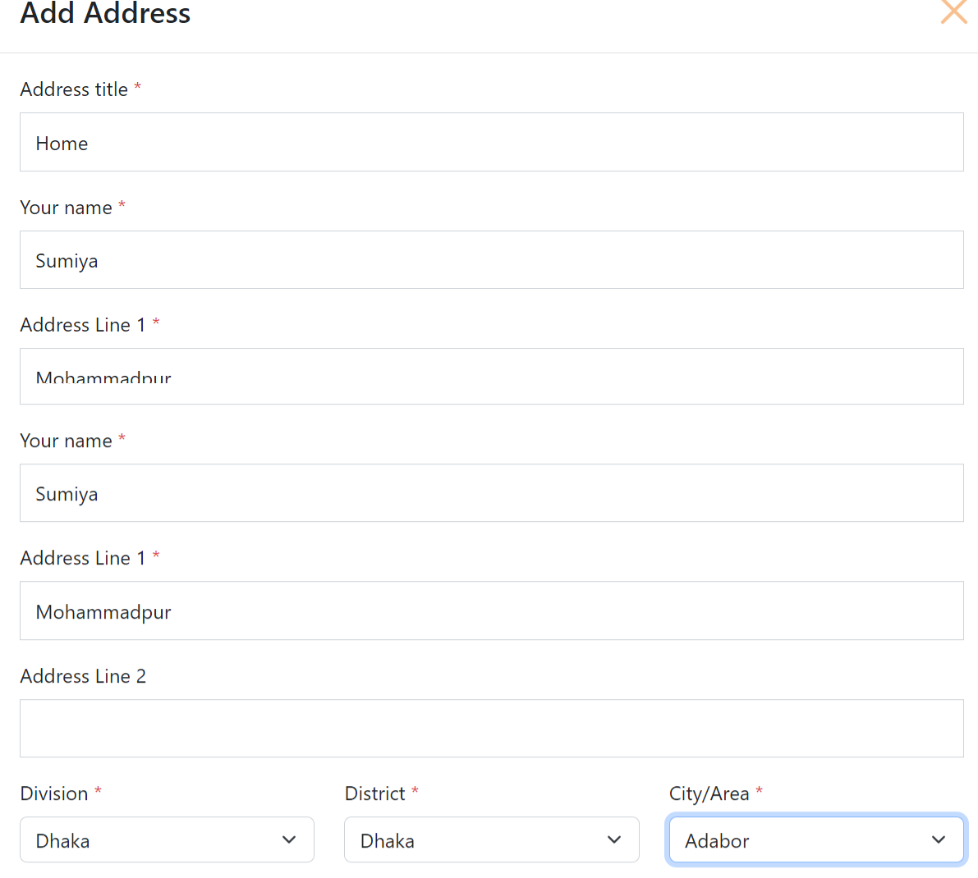
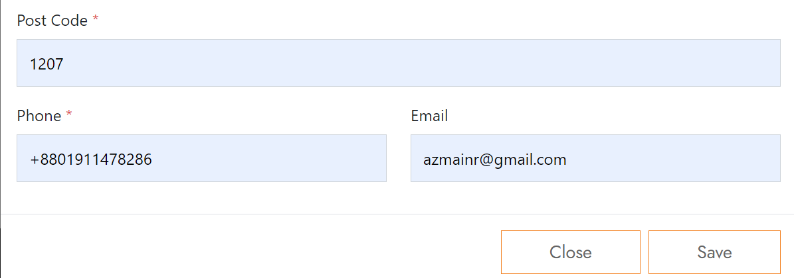
For New User
Fill up the Add Address form properly
Then Click Save

Slide 9
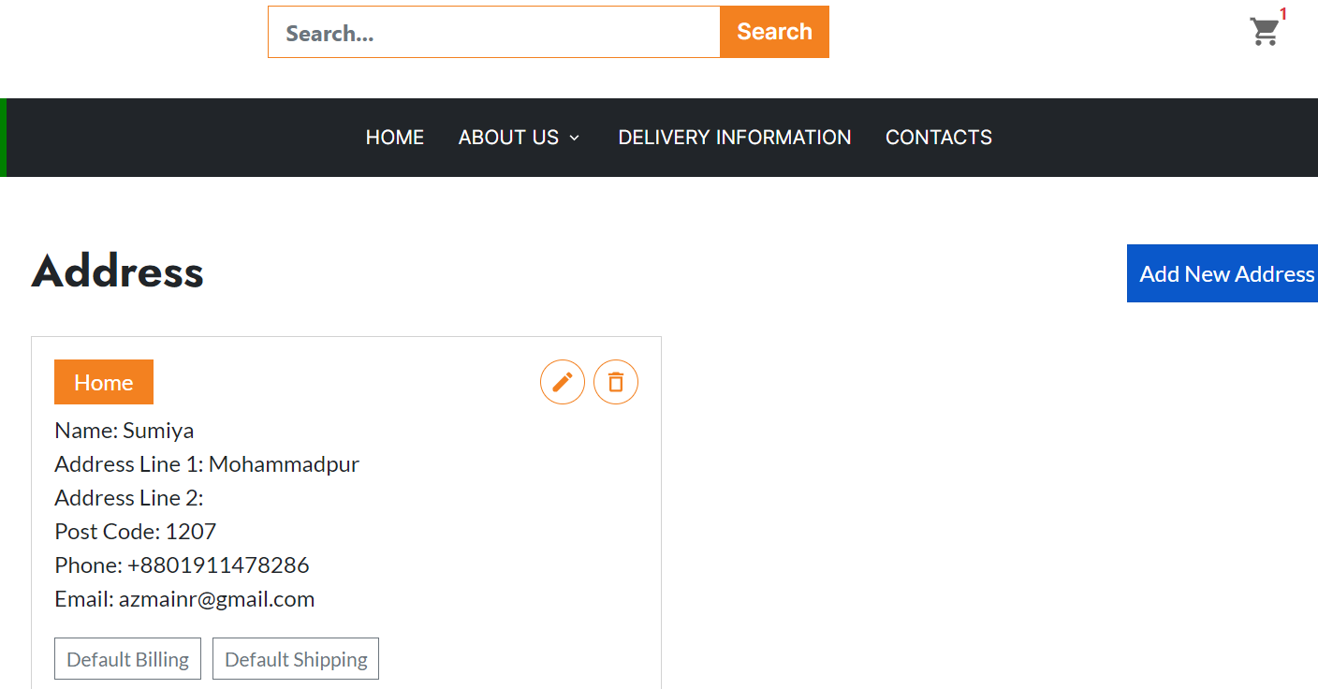
For New User
Click Default Shipping
Then Click CART

Slide 10
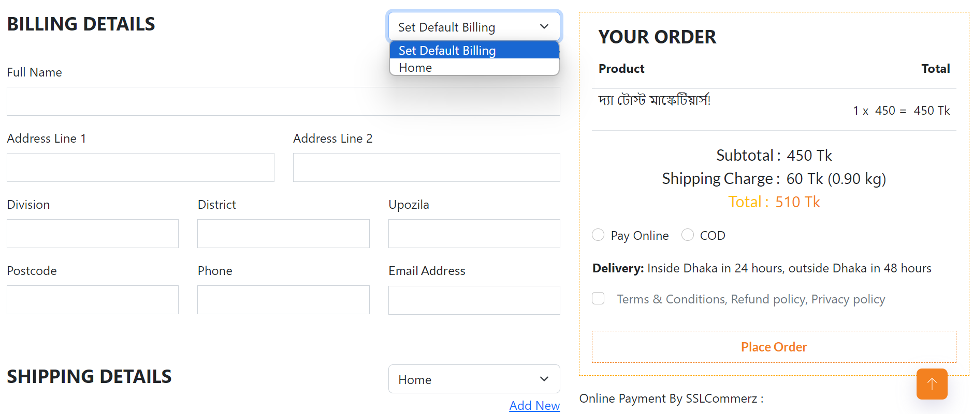
Click Home
Then Check Billing & Shipping Address is already fill-up properly
Then right side click Online or COD and Place Order

Slide 11
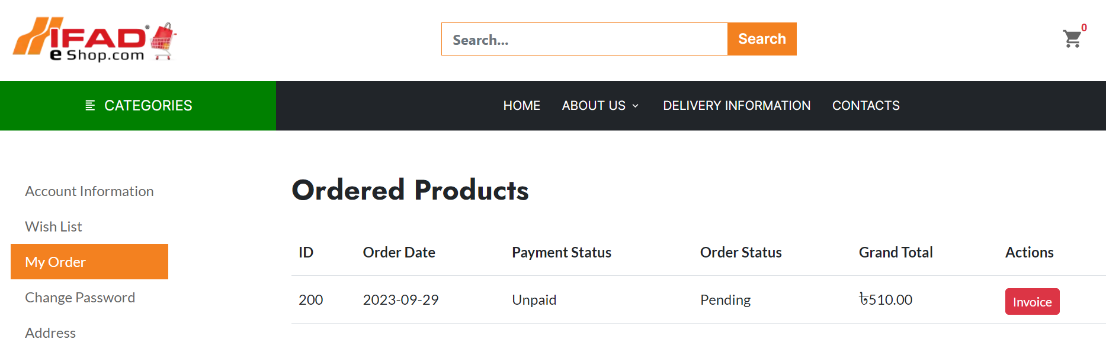
Order confirmation message
Customer will see this Invoice

Slide 12
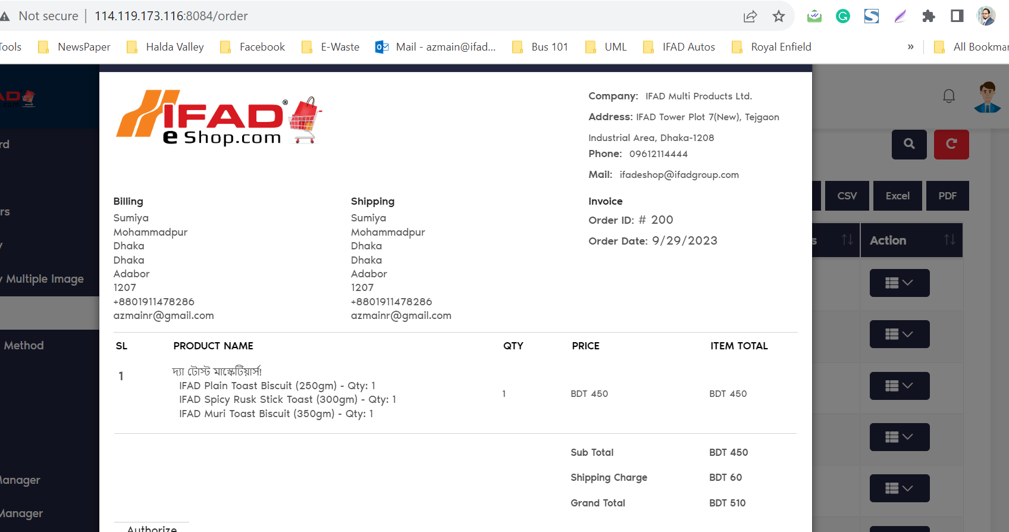
Admin will see this Invoive

Slide 13
Thank You

