Slide 1
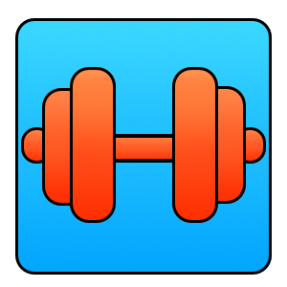
GET SWOLE
Cameron Price, Andrew Pillsbury, Patricia Neckowicz
Purpose
Easy-to-use app that allows you create your own workouts, manage your workout schedule, and track your progress.
Functions
Create Custom Workouts
Keep Workout Logs
See Calendar w/ Workouts Scheduled
Notifications on Daily Workouts
Set Goals and Track Progress
Share workouts with others

