Slide 1





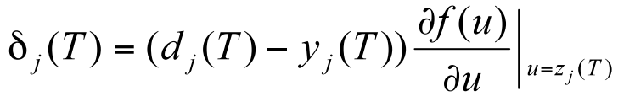
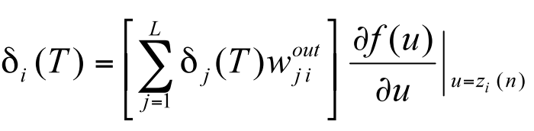
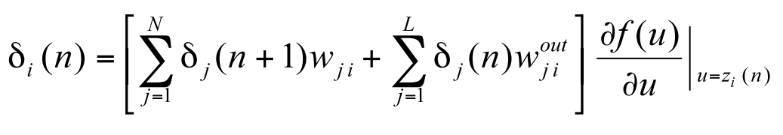
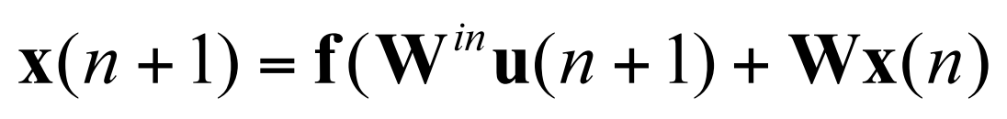
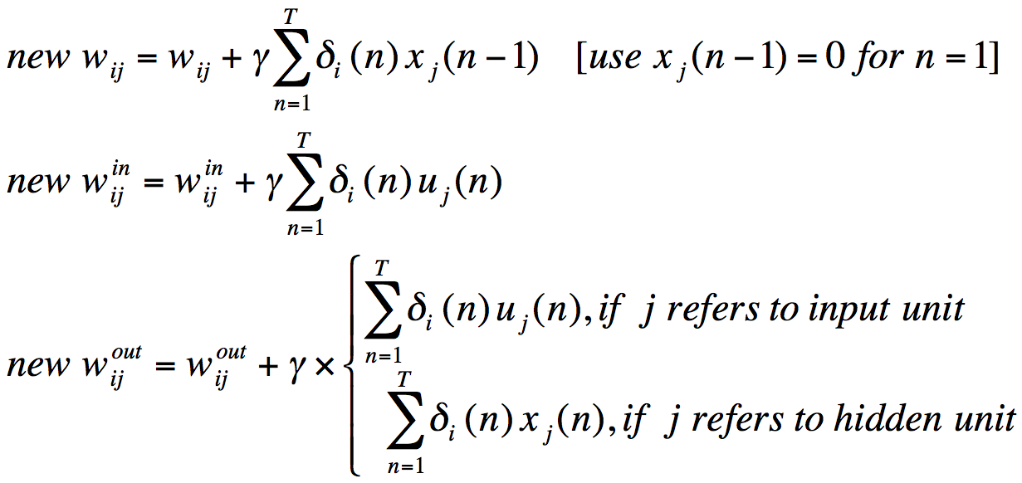
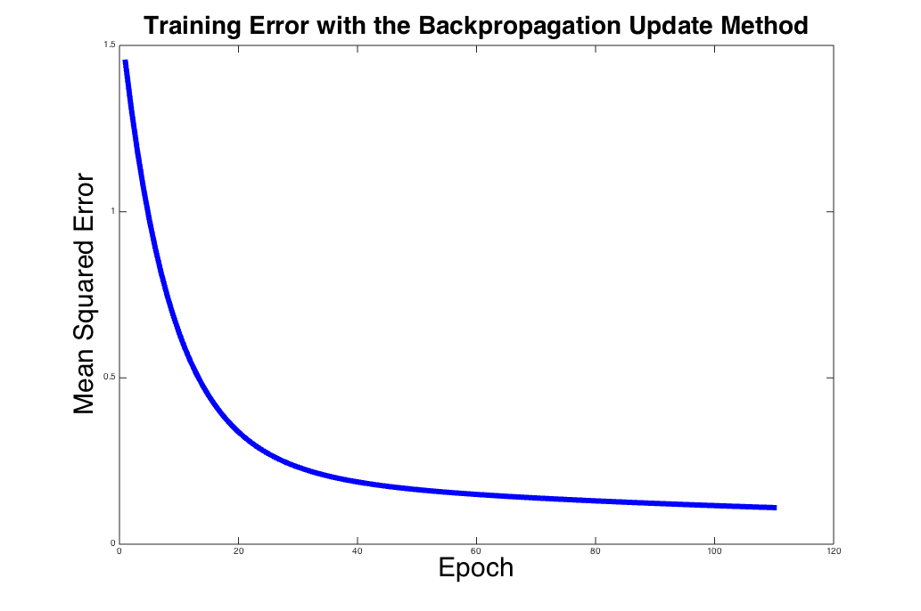
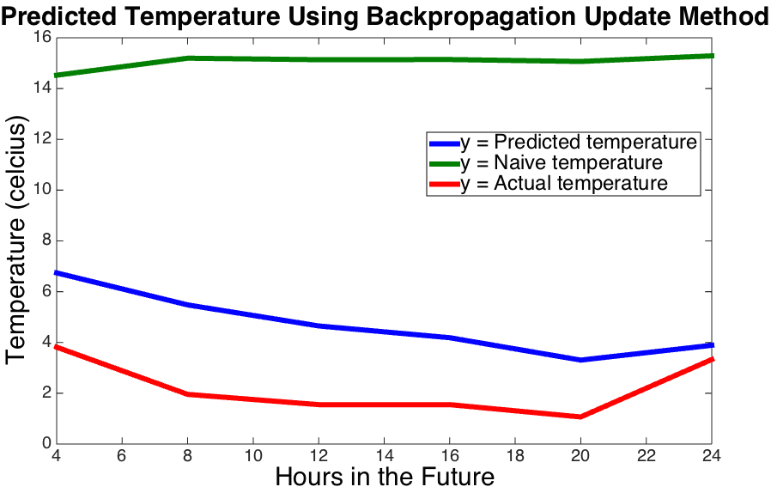
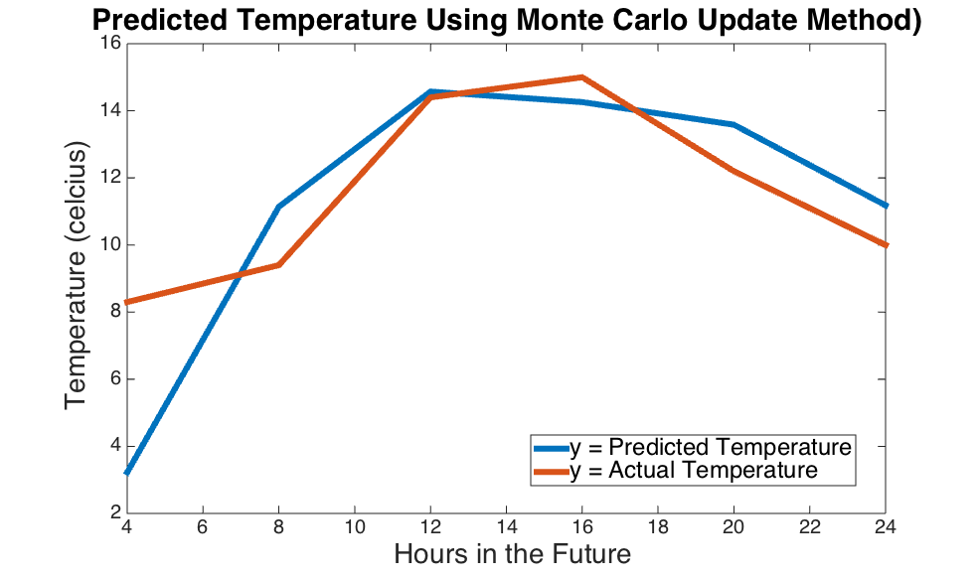
Location–Independent Weather Forecasting
Andrew Pillsbury and Rebecca Leong
CS 74 Machine Learning
Introduction
Weather forecasting has traditionally been treated as a well-studied physics-based phenomenon for a specific location. Even so, weather still exhibits data patterns that can potentially be utilized as a basis for future prediction. By gathering data from a variety of different locations in the continental United States, we are to train a dynamic neural network for location-neutral weather forecaster.
Dynamic Neural Network
Weather(t)
…
Y
Weather(t+1)
Backpropagation Update Method:
Calculate deltas-
Update weights-
Weather(t-4)
Weather(t-8)
Hidden Layer 1
Hidden Layer 2
Feed Forward:
, where
Objective
Input: The past three days of weather data samples recorded every four hours. Each sample includes readings of temperature, visibility, wind speed, wind direction, pressure, and dew point.
Output: The weather for the next day in 4 hour data samples.
Monte Carlo Update Method:
For each weight matrix, update that matrix with a randomly generated matrix and check the error. If the error has gone down after the update, save the new matrix, otherwise discard it and try again.
Results
Future Work
Run more tests to refine the three hyperparameters used in the network (number of neurons per layer, number of hidden layers, number of input samples).
Expand the network to allow for an arbitrary number of hidden layers.
Optimize for speed, potentially implementing a stochastic gradient descent.
Sources: H. Jaeger (2002, revised 2013): Tutorial on training recurrent neural networks, covering BPPT, RTRL, EKF and the “echo state network” approach. GMD Report 159, German National Research Center for Information Technology, 2002 (48 pp.)
Data Source: Quality Controlled Local Climatological Data from the National Climatic Data Center

