Slide 1


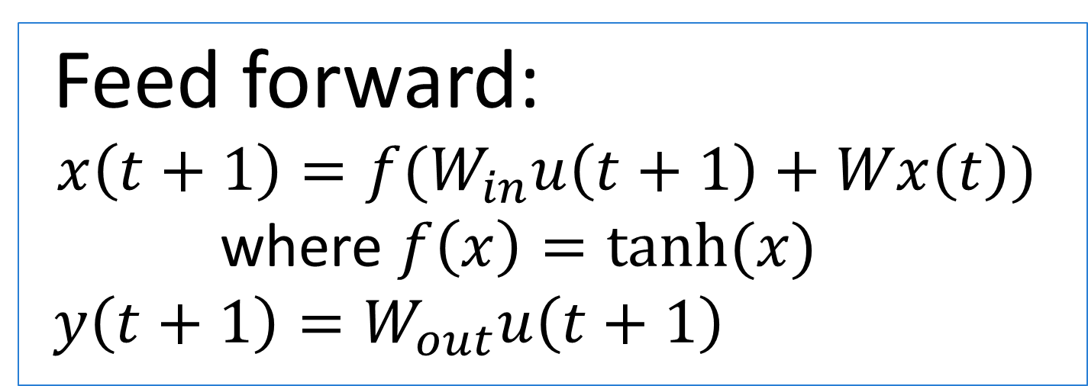



Location–Independent Weather Forecasting
Andrew Pillsbury and Rebecca Leong
CS 74 Machine Learning
Introduction
Weather forecasting has traditionally been treated as a well-studied physics-based phenomenon for a specific location. Even so, weather still exhibits data patterns that can potentially be utilized as a basis for future prediction. By gathering data from a variety of different locations in the continental United States, we are to train a dynamic neural network for location-neutral weather forecaster.
Dynamic Neural Networks
$$X_{1}^{}$$
$$X_{1}$$
Feed forward:
$$x\left(t+1\right)=f(W_{in}u\left(t+1\right)+Wx\left(t\right))$$
where $f\left(x\right)=tanh⁡(x)$
$$y\left(t+1\right)=W_{out}u\left(t+1\right)$$
Weather(t)
$$X_{2}$$
…
Y
Weather(t+1)
$${ X}_{n}$$
Weather(t-4)
Backpropagation:
Weather(t-8)
Objective
Input: Three days of 4 hour data samples
Temperature, Rain, Wind Speed, Wind direction, Pressue, Dew Point
Output: One day of 4 hour data samples
Hidden Layer 1
Hidden Layer 2
Data
Future Work
Acknowledgements:

