Slide 1
Location Independent Weather Forecasting
Rebecca Leong and Andrew Pillsbury

Slide 2
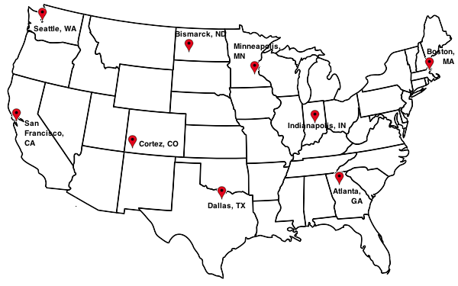
Data
9 Cities: One from each climatological region in the continental United States
8760 Readings per City: one every hour in 2013
6 Features per Reading: temperature, dew point, visibility, wind speed, wind direction, pressure
All data are Quality Controlled Local Climatological Data from the National Climatic Data Center

Slide 3
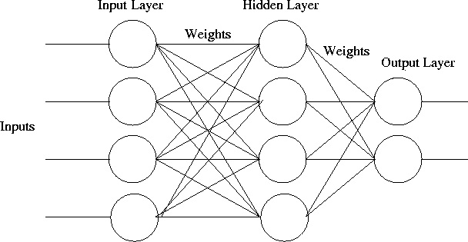
Neural Network
Weather(t)
Weather(t-1)
Weather(t+1)
. . .
Weather(t-2)
Weather(t+24)
. . .
Weather(t-71)

Slide 4
Results
www.cs.dartmouth.edu/~leongr/WeatherForecasting/

Slide 5
To Do
Determine optimal number of hidden layers
Determine optimal number of nodes per layer
Determine optimal number of input hours
Make the network dynamic?

