Slide 1



BLOCKCHAIN-BASED PATIENT RECORD ACCESS AND AUDIT LAYER
Project name:afyatrust
NAME:ATANASI PATRICK KAFUKA

Slide 2
THE PROBLEM
Patient records stop at the hospital door
Opaque
At risk
FRAGMENTED
It is difficult to see who
opened a record and when,
and access histories are
hard to keep consistent
across facilities.
Medical data is highly
sensitive. Unauthorized
access is a real privacy risk
when controls and audit trails
are weak.
Each facility keeps its own
records, so a patient's history
is hard to reach elsewhere.
Treatment is delayed and
tests get repeated

Slide 3

THE SOLUTION
Conventional systems plus a blockchain audit layer
LAYER 1
LAYER 2
Web app
API
Angular interface
for patients, doctors
and admins.
Django REST checks
login and permissions
before any record is
returned.
LAYER 4
LAYER 3
Blockchain
Database
Solidity contract on
Ethereum Sepolia
records permissions
and audit events
PostgreSQL holds
clinical records
off-chain.
Blockchain supports trust and auditability. It does not replace the secure database.

Slide 4

HOW IT WORKS
A patient moves from Hospital A to Hospital B
IDENTIFY
PERMIT
RETRIEVE
AUDIT
A doctor at Hospital B
logs in and identifies the
patient by Health ID.
The backend checks the
patient's access
permission on the smart
contract.
If allowed, the record
comes from the
database or an approved
shared service.
The access event is
recorded on-chain as a
tamper-evident entry.
The blockchain does not move records between hospitals. Real data sharing needs compatible APIs, connectivity and a data-sharing agreement between facilities

Slide 5
BLOCKCHAIN LAYER
One smart contract, seven operations
  registerPatient
  addRecord
3.patientGrantAccess
  hasAccess
  recordView
  breakGlass
Logs that a record was viewed
  getAuditTrail
Registers a patient on-chain
Registers a record reference
Patient grants access to a provider
Checks whether access is permitted
Emergency access
Retrieves the audit history
Deployed on the Ethereum Sepolia test network. On-chain transactions and events give a tamper-evident history.

Slide 6
SECURITY AND PRIVACY
Clinical data stays off-chain
PostgreSQL stores
  Patient and application data
  Clinical records and metadata
  Everything needed for authorized retrieval
The blockchain stores
  Registration and record references
  Access permissions
  Transaction and audit events
Controls: JWT-authenticated API requests, backend permission checks, and AES-256-GCM encryption for custodial wallet data.
Names, NIDA numbers, phone numbers and clinical details must never go on a public chain. A full security assessment is
needed before real patient data is used.

Slide 7
WHERE WE ARE
The foundation is built, the integration is being verified
BUILT
  Angular web application
  Django REST API with JWT login
  PostgreSQL integration
  Solidity contract deployed on Sepolia
  Off-chain and on-chain data separation
BEING VERIFIED
  Django broadcasting transactions end to end
  Receipt and event handling
  Permission grants and access denial
  The full cross-hospital workflow

Slide 8
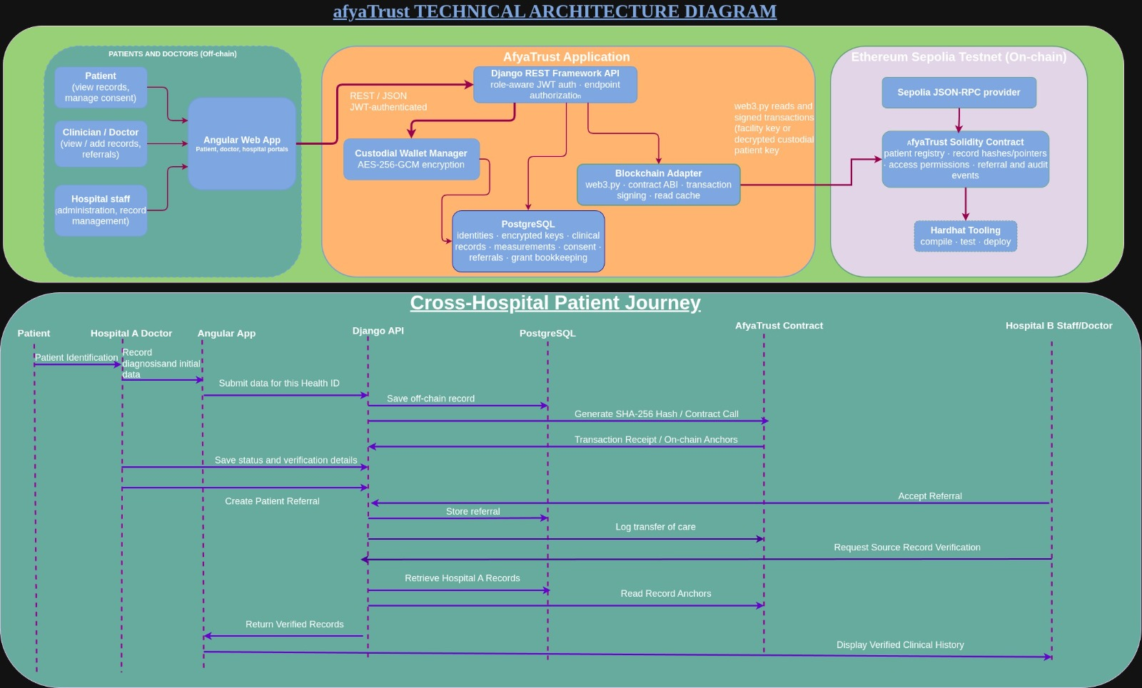
TECHNICAL ARCHITECTURE DIAGRAM

Slide 9
IMPACT
From working prototype to pilot
Close the loop
Connect hospitals
Strengthen control
Pilot safely
Verify end-to-end
transaction
broadcasting and add
automated tests.
Build hospital-to-
hospital APIs and
evaluate HL7 FHIR
Consent revocation,
emergency access, key
management and
monitoring.
Security and privacy
review, then a controlled
pilot with stakeholders.
The impact: clearer visibility and stronger accountability for who accesses patient records, on a
foundation for interoperable care

Slide 10
CONCLUSION
AfyaTrust combines Angular, Django REST API, PostgreSQL, and a Solidity smart contract on Ethereum Sepolia to support secure patient-record access and blockchain-based auditing. Clinical data remains off-chain, while supported permissions and audit events are recorded on the blockchain. Next steps include verifying end-to-end integration, connecting hospitals, and strengthening security before a pilot.
Secure records. Controlled access. Transparent auditing.

Slide 11

THANK YOU

