Slide 1


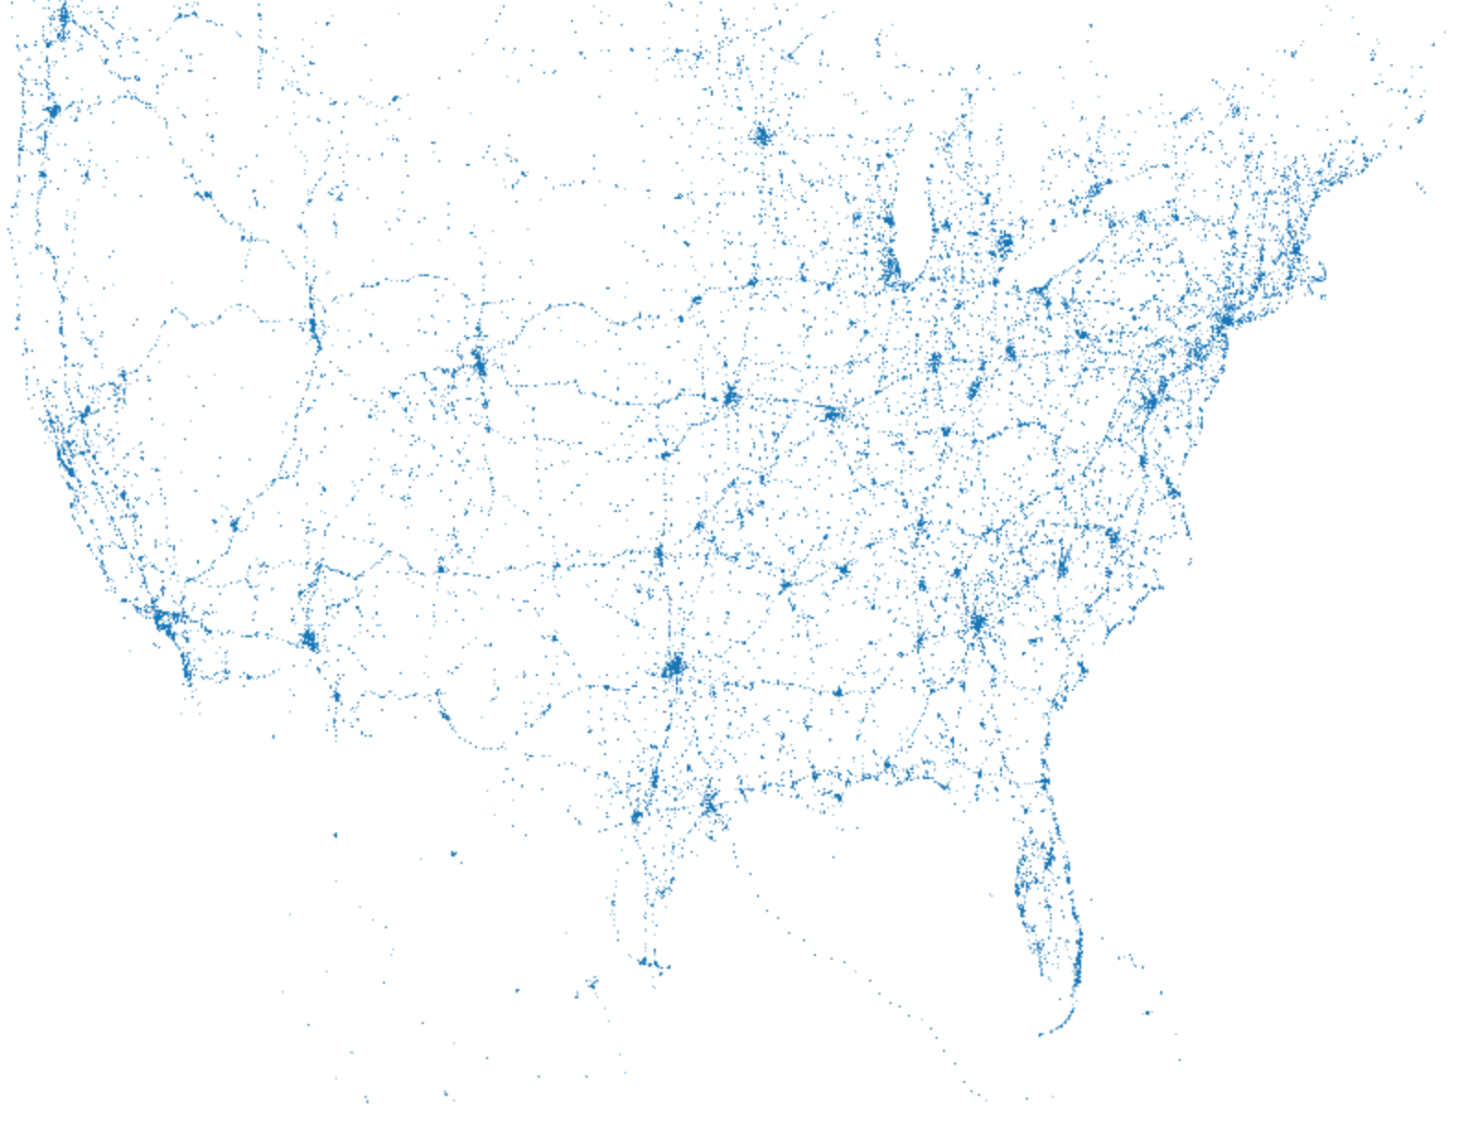
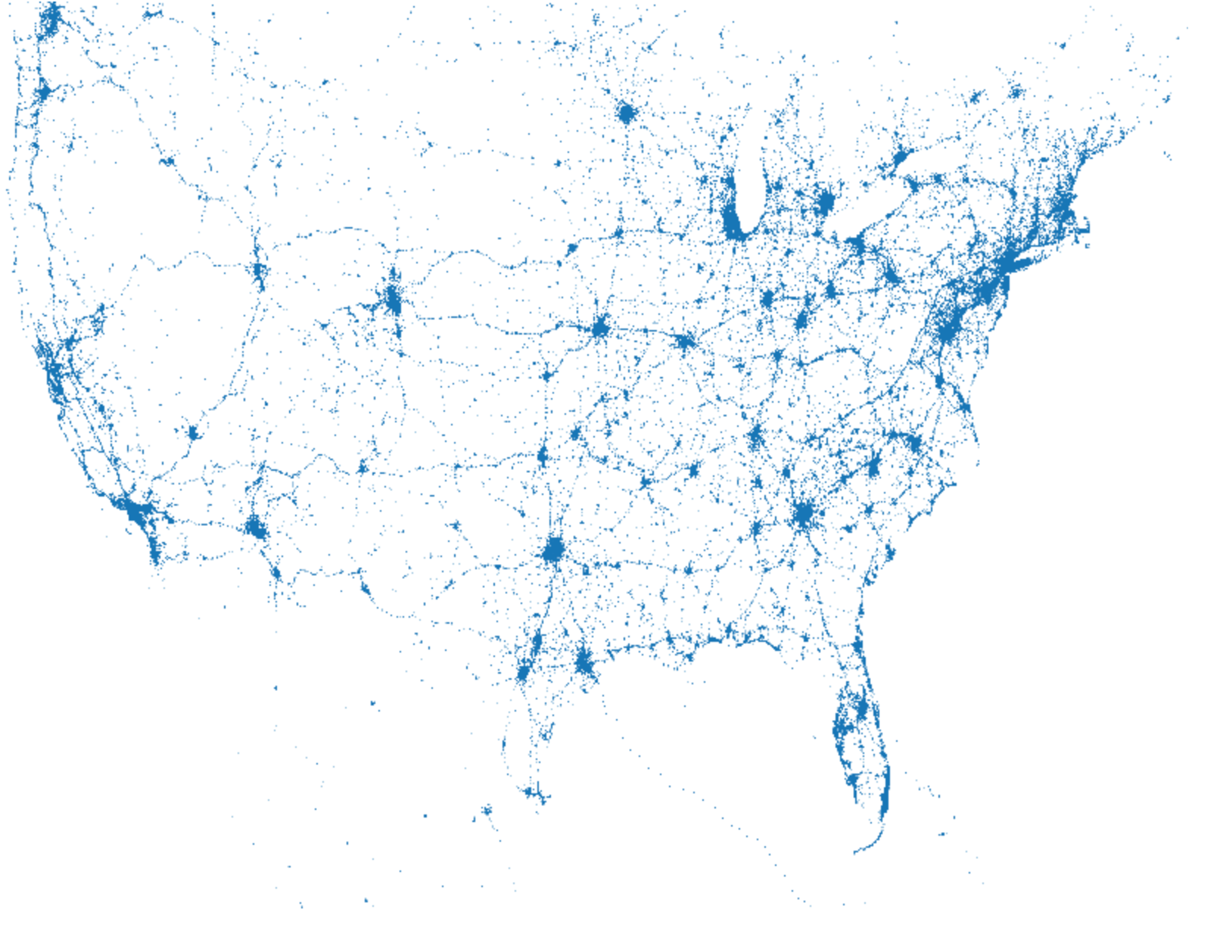
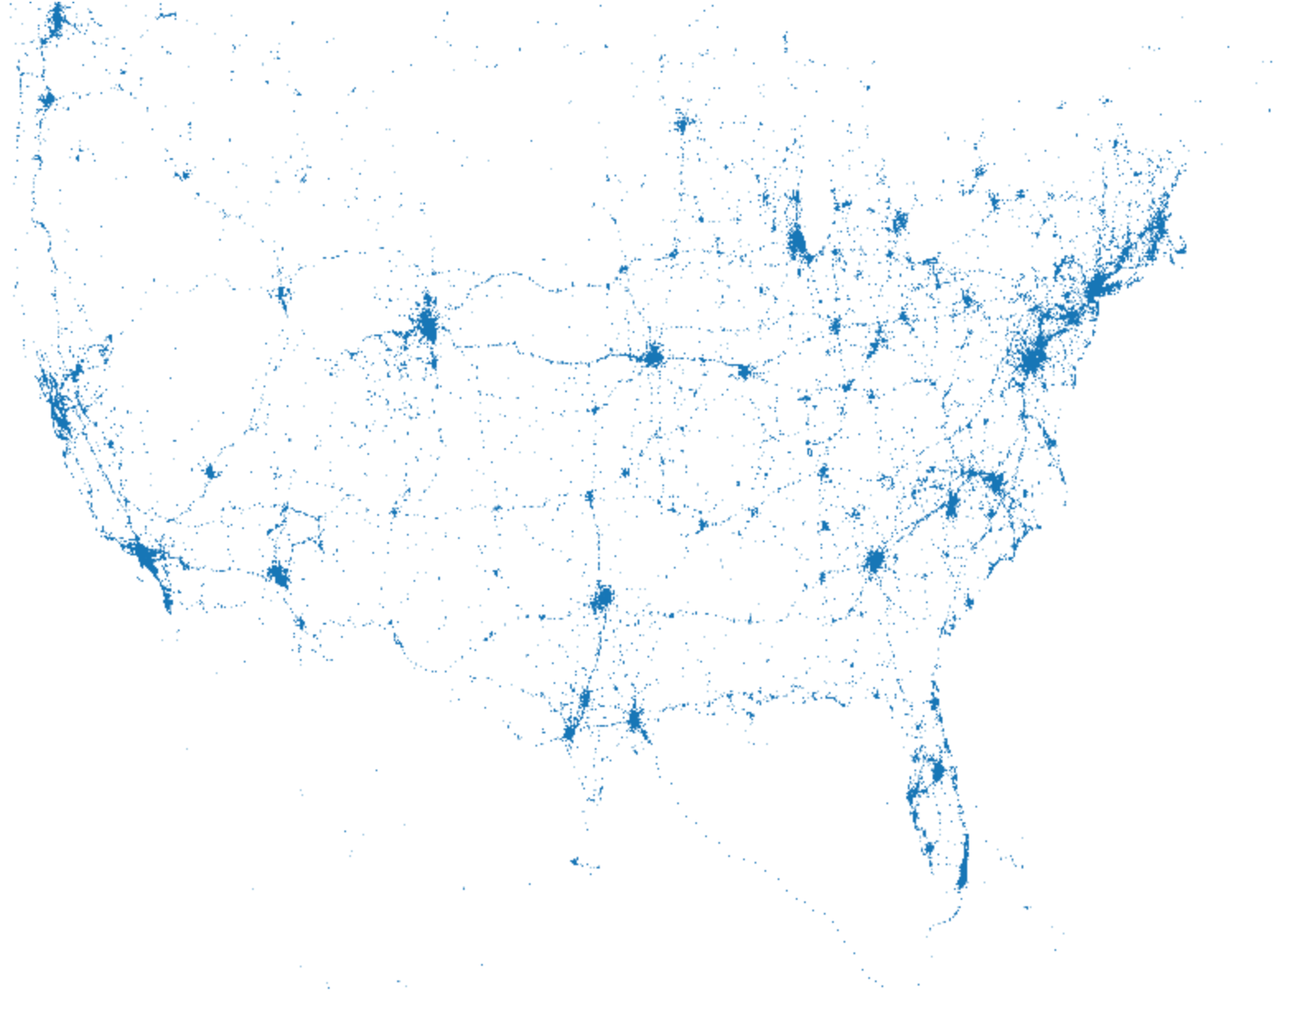
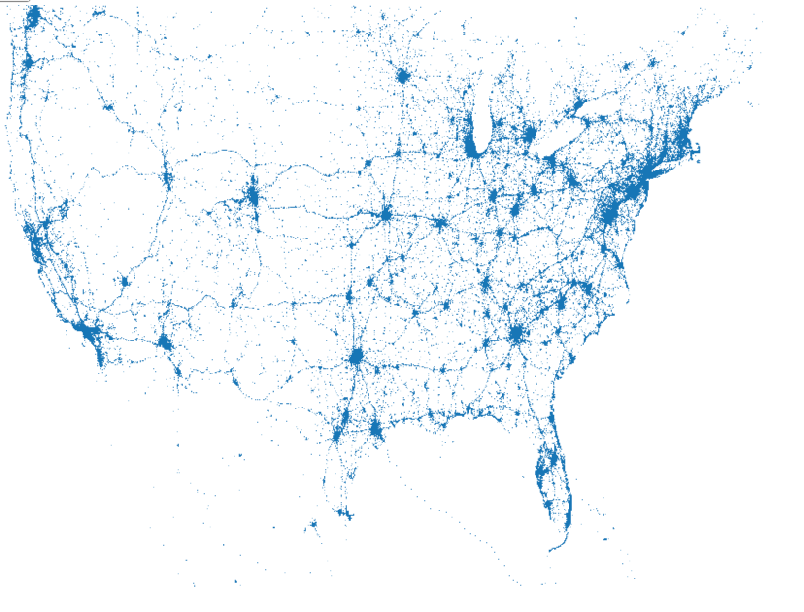
Scattr: Adaptive Sampling for Progressive Scatterplots
Andrew Lee, Biye Jiang
Department of Computer Science, UC Berkeley
Motivation
Visualization for large scale data is slow.
Small amount of data can actually show general trends
User is sensitive to the latency
Progress JPEG greatly improve user experience
Fair scheduling algorithms……
Quad Tree here
Some curves here
Objective
Apply adaptive sampling to the dataset.
Use incremental updating to show approximate result in early time
Adaptive sampling
1 data chunks
Adaptive sampling
5 data chunks
Challenge
Evaluation
Naïve sampling would lost much information
It is hard to define what is a good visualization
How maintain layout of low density areas
Use pixel difference to evaluate visualization quality
Use Time-Quality curve to measure system performance
Naïve sampling
15 data chunks
All 58 data chunks
Adaptive Sampling
Results
System Design
Our system can provide high-quality visualization with very low latency
A Quad Tree algorithm to calculate the global order.
Divide and Conquer:
First process each sub-tree
Take rounds to pickup data in subtrees
Based on the order, divide data into small chunks.
Server side:
Interface for user to upload data
Apply Quad Tree algorithm to obtain order. Store data in MySQL
Provide API for client side to fetch data
Client side:
A light-weight Javascript library for incremental data fetching
Future Work
Support zoom in/out using the global order
Extend to other visualization methods
Notes:
Add new feed options
Set the parameters
- Time out
- Number of retrials

