Slide 1
Instructions for Collaborating on GitHub Tutorial

Slide 2
Breakout 1: Connecting with your partner
Say hello and introduce yourself
Connect either on Slack (direct messaging), Zoom chat (make sure to select your partner, not send messages to everyone), phone, whatever you prefer
Decide who will be Partner 1 and who will be Partner 2
Exchange GitHub user names
Practice sharing screen (choose to share Desktop so you can share as you jump between Rstudio and your web browser)

Slide 3
Breakout 2: Create repo, clone it, and try making changes
Work through sections 9.2 – 9.7 here: http://ohi-science.org/data-science-training/collaborating.html

Slide 4
Breakout 3: Create and resolve merge conflicts
Work through sections 9.8 – 9.9 here: http://ohi-science.org/data-science-training/collaborating.html

Slide 5
Breakout 4: Set up your collaborative website
Work through sections 9.11 – 9.12 here: http://ohi-science.org/data-science-training/collaborating.html

Slide 6
Breakout 5: Explore the NYC flights data collaboratively
Partner 2 add an image to your index.Rmd (talk Partner 1 through what you’re doing or share your screen):
Search on google to find an image you like
On the image, right click and choose “Copy image address”
Add it to the .Rmd file with ![](paste_image_location_you_just_copied_here)
Pull – stage – commit – push
Check that the image shows up on your website Remember address format for website:
my github repo: https://github.com/jules32/collab-research
my website url: https://jules32.github.io/collab-research/
note that the url starts with my username.github.io

Slide 7
Breakout 5: Explore the NYC flights data collaboratively
With your partner, do the following tasks. Each of you should work on one task at a time. Since we’re working closely on the same document, talk to each other and have one person create a heading and a R chunk, and then sync; the other person can then create a heading and R chunk and sync, and then you can both work safely.
Remember to make your commit messages useful!
As you work, you may get merge conflicts. Resolve them

Slide 8
Breakout 5: Explore the NYC flights data collaboratively
Find all flights that:
Had an arrival delay of two or more hours
Flew to Houston (IAH or HOU)
Were operated by United, American, or Delta
Departed in summer (July, August, and September)
Arrived more than two hours late, but didn’t leave late
Were delayed by at least an hour, but made up over 30 minutes in flight
Departed between midnight and 6am (inclusive)
Another useful dplyr filtering helper is between(). What does it do? Can you use it to simplify the code needed to answer the previous challenges?

Slide 9
Breakout 5: Explore the NYC flights data collaboratively
If you have more time:
Add some plots: What interesting patterns can we explore in this dataset? Examples:
What is the relationship between the departure delays and arrival delays (do planes tend to catch up while underway)?
How to arrival delays compare between different airlines? Or destinations? Or days (or any combination of those)

Slide 10
Working together on a repo
Adapted from Jenny Bryan’s HappyGitwithR
https://happygitwithr.com/

Slide 11
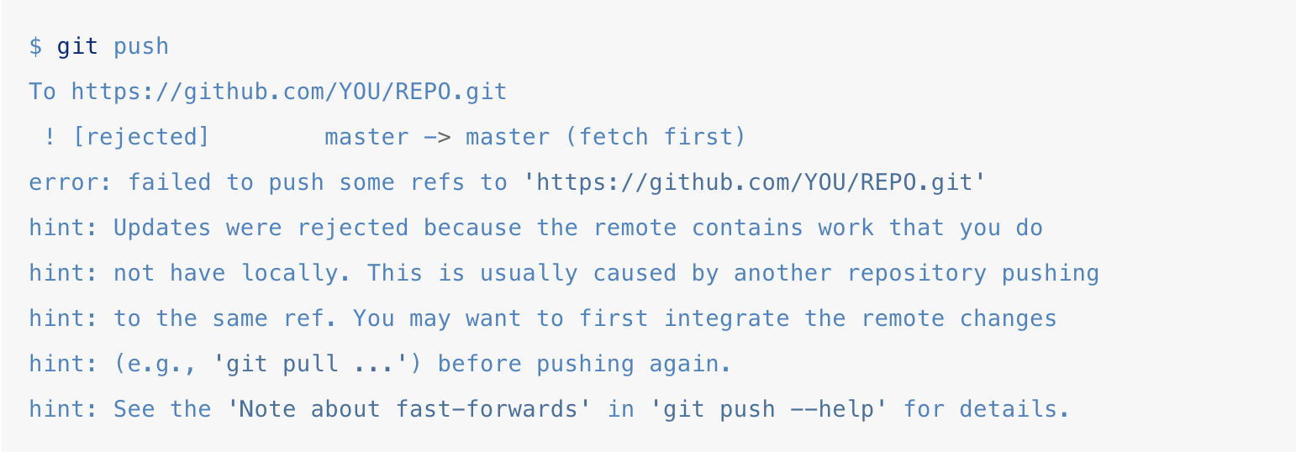
Dealing with push rejection
You want to push changes, but you are not allowed
Your local Git history and that on the GitHub remote are not compatible, i.e. they have diverged.

Slide 12
What is going on?
State of the repo on GitHub:
A – B – C
C represents changes your collaborator had made to B and then pushed while you were also still working on B
State of your local repo:
A – B – D
D represents changes you have made since you pulled B

Slide 13
What is going on?
You can’t merge C and D by pushing to GitHub
You have to pull the commit C and somehow integrate it into your D-containing history. Then you will be able to push again
State of the repo on GitHub:
A – B – C
C represents changes your collaborator had made to B and then pushed while you were also still working on B
State of your local repo:
A – B – D
D represents changes you have made since you pulled B

Slide 14
What is going on?
You can’t merge C and D by pushing to GitHub
You have to pull the commit C and somehow integrate it into your D-containing history. Then you will be able to push again
State of the repo on GitHub:
A – B – C
C represents changes your collaborator had made to B and then pushed while you were also still working on B
State of your local repo:
A – B – D
D represents changes you have made since you pulled B

Slide 15
She who pushes first wins
Push your work to master work (when it’s “ready” to share (or at least “ready enough”)
Committing, pushing, and integrating more often, not less. This does not eliminate the need to integrate different lines of work, but it makes each integration smaller, less burdensome, and less prone to error
Stay in touch with your collaborators

Slide 16
Pulling when you have local work
State of the repo on GitHub:
A – B – C
State of your local repo:
A – B – D OR
A – B – (uncommitted changes)
When working on different files, versions can be merged smoothly
Remote: A--B--C Local before 'git pull’: A--B--(uncommitted changes)
Local after 'git pull’: A--B--C--(uncommitted changes)

Slide 17
Pulling when you have local work
State of the repo on GitHub:
A – B – C
State of your local repo:
A – B – D OR
A – B – (uncommitted changes)
This also works when you have made edits to different parts of the same file
Remote: A--B--C Local before 'git pull’: A--B--(uncommitted changes)
Local after 'git pull’: A--B--C--(uncommitted changes)

Slide 18
Pulling when you have local work
State of the repo on GitHub:
A – B – C
State of your local repo:
A – B – D OR
A – B – (uncommitted changes)
When you have made changes to the same part of a file, you will need to resolve the merge conflict locally before you can push
Remote: A--B--C Local before: A--B--D
Local after: A--B--D--(merge commit) \_C_/

Slide 19
Also cover
Useful commit message (From xkcd.com) focus on the why (diff will show the content)
burn it down
The concepts of branches and pull requests

Slide 20
Examples of cool GitHub pages websites
https://twitter.github.io/
https://justanother-timetraveller.github.io/

